Slide 1
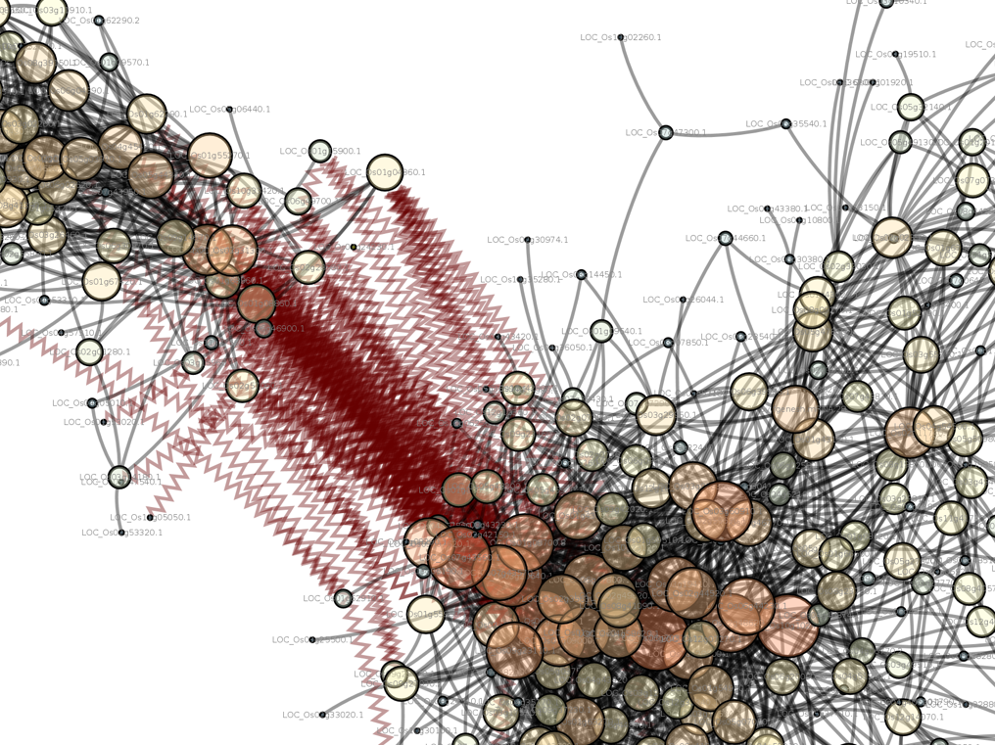
Introduction to Computing for Data Science
Day 4
01/18/2018
Hort 503-01 Spring 2018

Slide 2
Class Exercise #1: input and math
Write a program that requests 10 floating point numbers from a user.
Calculate the average of those numbers and print the average to the screen.

Slide 3
Code critique
Let’s see your code!

Slide 4
Class Exercise #2: files
Download the SRR2931278_vs_all.fpkm file from slack.
This file contains two columns of data separated by a tab character.
The first column represents a gene transcript name for Oryza sativa.
The second column represents normalized expression count data for each gene.
Your Task
Write a python script that will read in the contents of the file and save the contents into a new file. Print out the length of the contents of the file for the user to see. This seems a bit boring but we will build on it from things learned next week. Your script should:
Use the argv method to let the user provide the input file name and the output file name.
Name your script class_day03.py and when finished add it to your GitHub repository in a new folder named ‘ClassExercises’
Take a look at the file sizes of your input and output files… notice anything different? If so, why?

Slide 5
Code critique
Let’s see your code!

Slide 6
Class Exercise #3: git forking
As you become more comfortable with Python and using other people’s code you may want to start making fixes or contributing.
If you find something wrong try to contribute!!
Forking is how to do this.
A fork is a copy of someone else’s project which you can edit as you want!
Read this page and follow the instructions to learn how to fork and contribute back to a project using Git.
https://help.github.com/articles/fork-a-repo/

Slide 7
Exercise #4: debugging
Download the file ex17_bad.py from slack.
This program is a copy of exercise 17 in the book. It can copy one file into another. To make it work you give the name of the original file followed by the new file name when you run it on the command-line for example:
python .\ex17_bad.py .\SRR2931278_vs_all.fpkm .\SRR2931278_vs_all.out
However, 3 things have changed in this program such that it will not work. Can you figure them out?
Try not to look in the book for the answer unless you get absolutely stuck. But before looking ask for help thinking through what might be wrong.

