Slide 1
Sprint 3 Presentation
Team 03: Agile Elite

Slide 2

Team Members
Edmund Amankwah Jr
Michael Yopp
Liam Cespedes
Preston Hudson
Abdul Ojelade

Slide 3
Presentation Overview
Project Description
Sprint Overview
Estimated and Actual effort points
Demo
Testing
Challenges and Successes
Future Sprint

Slide 4
Project Description
A website for the Radford Child Development Inc centered around their Radford early learning center. The site should contain information, tools, and services that relate to the organization’s goals - to make available a high-quality learning experience for kids in the Radford area.

Slide 5
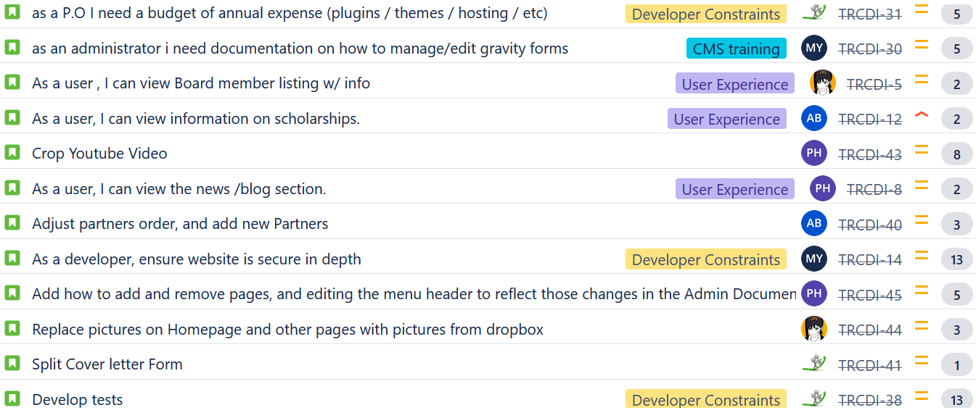
Sprint 3
Notes:
Sprint 3 overview and Effort points are the crux of your slides. Just make mention of the fact that pretty much every user story we wanted to complete was completed, the little that was moved over to sprint 4 were always to be done at towards the end of the project, but we attempted to at least begin anyway
Pick 1 or 2 user stories with differing expected and actual effort points and touch on the reason why

Slide 6
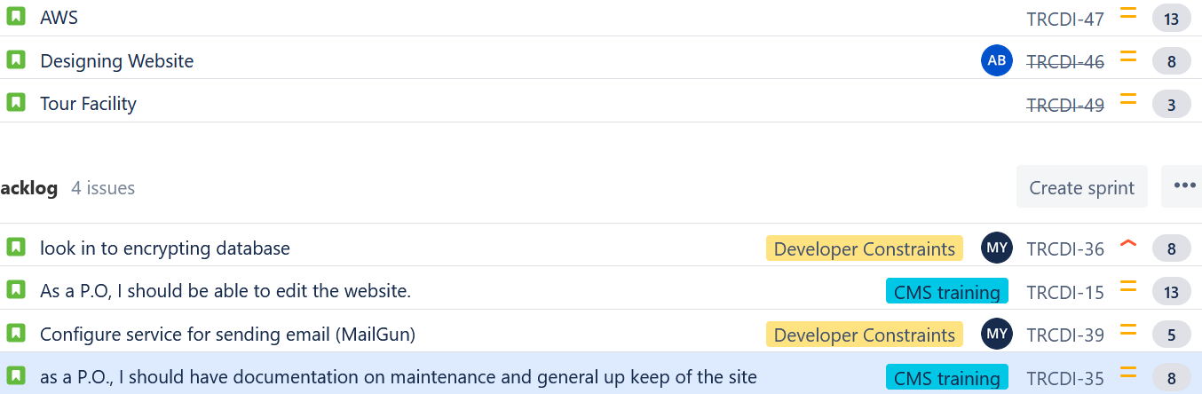
Sprint 3

Slide 7
Effort Points
User Story | Expected Points | Actual Points
TRCDI 40: Adjust partners order and add new partners. | 3 | 3
TRCDI 14: Secure website | 13 | 13
TRCDI 44: Replace images with images from drop box | 3 | 3
TRCDI 41: Split cover letter form | 1 | 2
TRCDI 8: View blog page | 2 | 1
TRCDI 38: Develop tests | 13 | 13

Slide 8
Sprint 3 cont…
TRCDI 43: Edit youtube video | 8 | 5
TRCDI 12: View info on scholarships | 2 | 2
TRCDI 49: Tour Facility | 1 | 5
TRCDI 45: Update Admin Documentation | 5 | 3
TRCDI 46: Website Design | 8 | 8
TRCDI 47: AWS | 13 | 15

Slide 9
DEMO!
rcd.michaelyopp.com
Notes:
Breez through the DEMO touching on EVERY user story completed

Slide 10
Testing
Codeception still used
Every web page + form in the site has tests for it
Used a tool called UseTrace to test the donation and contact us forms (but will need to find another tool)
Compatibility with mobile devices and different browsers
Notes:
Just make mention of the splitting up of the 1 big testing file to separate files for each page, and the verification and validation testings that we were carrying out and documenting in our Test Plan document.
No need to demo running the test, you might have 1 or 2 already run with the ‘passed’ result showing at the bottom

Slide 11
Successes and Challenges
Challenges
AWS configuration and troubleshooting
Testing tools: Selenium, UseTrace
Successes
Successful SCRUM master transition
Touring client facility
Deployment of AWS EC2 instance
Notes:
Touch on the challenged of AWS transition and Ed’s successful run as SCRUM master

Slide 12
Sprint 4
In addition to the user stories moved over from the initial sprint3 scope, we have the following;
Improve and Polish Design
Refactor (as a result of moving over to AWS)
Google Analytics
More rigorous testing
Publish Website
Notes:
Breez through this smooth and clear, touching on at least 2 points

