Slide 1


M.Tech/MCA Program
Advanced Industry Integrated Programs
Jointly offered by University and LTIMindTree
Review II
Intelligent Supply Chain Management Platform for
Electric Vehicle Manufacturing
Team Member
Radha Gohil [T10002]
Knowledge partner | Implementation partner

Slide 2
Project Title - Calibri body 18
Introduction….
Existing Challenges: EV manufacturing supply chains involve multiple components, suppliers, warehouses, and procurement activities, which are often managed through separate systems and processes.
Current Limitations: Component shortages, excess inventory, supplier delays, supply risks, and inefficient supplier selection can affect production continuity and increase procurement costs.
Proposed Solution: An integrated intelligent supply-chain platform that connects BOM-based material planning, inventory management, supplier evaluation, risk analysis, procurement decisions, and purchase-order tracking.
Intelligent Decision Support: The system identifies component shortages, evaluates supplier performance and risk, ranks suitable suppliers, and recommends procurement quantities for better purchasing decisions.
Real-Time Operational Support: Purchase orders can be tracked from creation to material receipt, with inventory and supplier availability updated as procurement activities progress.
Overall Benefit: The proposed system improves supply-chain visibility, reduces shortage and supplier risks, supports faster procurement decisions, and helps maintain continuous EV manufacturing operations.

Slide 3
Project Title - Calibri body 18
Objective….
Develop an AI-driven supply-chain management platform for EV manufacturing.
Optimize component planning using vehicle BOM, inventory, safety stock, and shortage analysis.
Evaluate supplier performance using reliability, quality, capacity, availability, and lead time.
Predict supplier risk using XGBoost for proactive risk management.
Provide multi-criteria supplier ranking and intelligent procurement recommendations.
Automate purchase-order generation, tracking, material receipt, and inventory updates.
Enable connected supply-chain intelligence using Neo4j, Graph-RAG, LLMs, and AI Agents.

Slide 4
Project Title - Calibri body 18
Modules to cover….
Module 1: Inventory Management — Intelligent Inventory Planning
Vehicle BOM [Bill of Materials] -based component requirements
Stock, safety stock, incoming stock & shortage analysis
Multi-warehouse inventory and transaction management
Procurement quantity & urgency identification
Module 2: Supplier Intelligence — Supplier Performance & Risk Analysis
Supplier quality, reliability & historical performance analysis
XGBoost-based supplier risk prediction
Supplier capacity, availability & lead-time analysis
Supplier performance monitoring

Slide 5
Project Title - Calibri body 18
Modules to cover….
Module 3: Intelligent Procurement — AI-Based Procurement Decision
Multi-criteria supplier ranking
Best supplier & procurement quantity recommendation
Cost, capacity, MOQ, availability & lead-time evaluation
Risk-aware procurement decision support
Module 4: Purchase Order Management — Procurement Execution & Tracking
Automated purchase order generation
Confirmation, dispatch, transit & delivery tracking
Partial/full material receipt
Inventory & supplier availability updates

Slide 6
Project Title - Calibri body 18
Modules to cover….
Module 5: Supply Chain Knowledge Intelligence — Knowledge Graph & Graph-RAG
Vehicle–BOM–component–supplier–inventory–PO relationship mapping
Neo4j-based supply-chain Knowledge Graph
Graph-RAG + LLM-based intelligent querying
Context-aware supply-chain knowledge retrieval
Module 6: Agentic AI Decision Support — Autonomous Supply Chain Intelligence
Inventory, Supplier, Procurement & Risk AI agents
Multi-agent coordination and reasoning
Intelligent alerts & recommendations
Explainable, context-aware decision support

Slide 7
Project Title - Calibri body 18
Methodology/Modeling Plan….
1. Data Integration & Preprocessing
PostgreSQL-based integration of vehicle, BOM, inventory, supplier, PO, and transaction data.
2. BOM & Inventory Analysis
Calculate component requirements from production plans and identify shortages using available inventory, safety stock, and incoming orders.
3. Supplier Risk Prediction — XGBoost
Predict supplier risk using historical supplier performance and operational features.
4. Multi-Criteria Supplier Ranking
Rank eligible suppliers using availability, reliability, fulfilment, quality, AI risk, price, and lead time.

Slide 8
Project Title - Calibri body 18
Methodology/Modeling Plan….
5. Intelligent Procurement Recommendation
Recommend the appropriate component quantity and supplier for identified shortages.
6. Purchase Order & Inventory Management
Track purchase orders through delivery and update warehouse inventory after material receipt.
7. Knowledge Graph & Graph-RAG
Model supply-chain relationships in Neo4j and retrieve connected supply-chain information through Graph-RAG.

Slide 9
Project Title - Calibri body 18
Data preprocessing & EDA….
Data Source: The project uses a synthetic EV manufacturing supply-chain dataset, designed to simulate realistic industry operations.
Dataset Coverage: It contains data for vehicles, components, BOM, suppliers, supplier-component relationships, warehouse inventory, purchase orders, inventory transactions, and supplier performance.
Why Synthetic Data: Synthetic data enables development and testing of the complete procurement workflow without requiring confidential or proprietary industrial supply-chain data.
Project Usefulness: The dataset supports BOM-based material requirement calculation, inventory and shortage analysis, supplier evaluation, XGBoost risk prediction, supplier ranking, procurement recommendations, and purchase-order management.

Slide 10
Project Title - Calibri body 18
Data preprocessing & EDA….
Preprocessing: Missing values, duplicates, invalid values, data types, and relationships between datasets are checked and cleaned before analysis.
EDA: Inventory patterns, supplier performance, reliability, quality, fulfillment, lead time, pricing, and risk-class distributions are analyzed.
Data Integration: Cleaned datasets are stored in PostgreSQL and relevant relationships are also represented in Neo4j for Knowledge Graph and Graph-RAG functionality.

Slide 11
Project Title - Calibri body 18
Approach/Algorithms/Tools….
BOM-Based Requirement Analysis: Calculates component requirements based on the vehicle production plan and Bill of Materials.
Inventory & Shortage Analysis: Compares required quantity with available stock, safety stock, and incoming purchase orders.
XGBoost Classification: Predicts supplier risk levels using supplier performance and operational features.
Multi-Criteria Weighted Ranking: Ranks suppliers based on reliability, fulfillment, availability, quality, AI risk, price, and lead time.
Procurement Decision Logic: Recommends the procurement quantity and suitable supplier for component shortages.
Knowledge Graph & Graph-RAG: Uses Neo4j to represent Vehicle–Component–Supplier–Warehouse–PO relationships and retrieve connected information.

Slide 12
Project Title - Calibri body 18
Approach/Algorithms/Tools….
Tools & Technologies:
Python
Pandas
NumPy
Scikit-learn
XGBoost
Fast API
PostgreSQL
SQL Alchemy
Neo4j
React.js
Material UI |
Graph-RAG

Slide 13
Project Title - Calibri body 18
Project plan/Milestone Progress
Milestone | Key Work | Progress
1. Data Preparation | Synthetic EV supply-chain dataset, preprocessing & EDA | ✅ Completed
2. Database Development | PostgreSQL database integration and validation | ✅ Completed
3. Inventory & BOM Analysis | Material requirements, stock analysis & shortage detection | ✅ Completed
4. Supplier Risk Model | XGBoost-based supplier risk prediction | ✅ Completed
5. Supplier Ranking | Multi-criteria supplier evaluation and ranking | ✅ Completed

Slide 14
Project Title - Calibri body 18
Project plan/Milestone Progress
6. Procurement Module | Procurement quantity & supplier recommendations | ✅ Completed
7. Purchase Order Management | PO creation, tracking, receipt & inventory updates | ✅ Completed
8. Knowledge Graph | Neo4j-based supply-chain relationship modelling | ✅ Completed
9. Graph-RAG Integration | Graph-based querying & decision-support interface | 🟡 In Progress
10. Testing & Validation | End-to-end testing, model evaluation & system optimization | ⏳ Pending

Slide 15
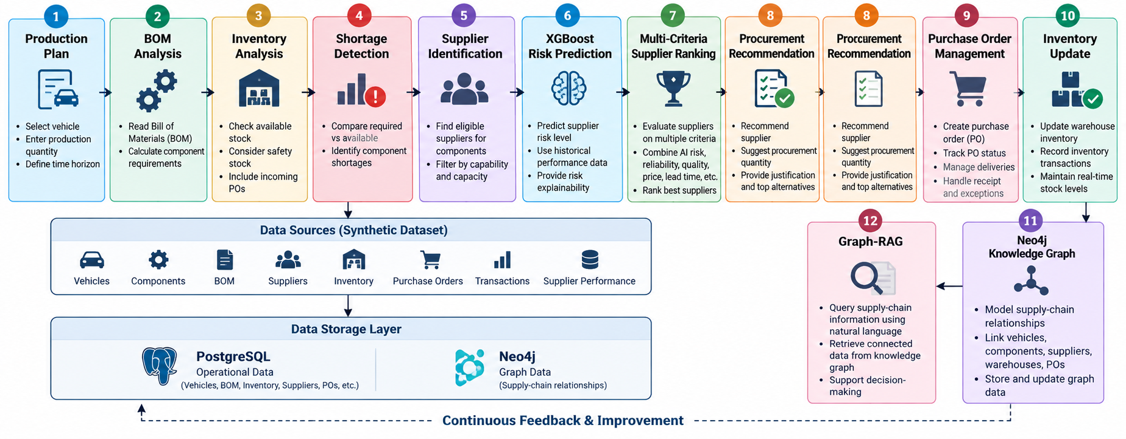
Project Title - Calibri body 18
Pipeline structure

