Slide 1
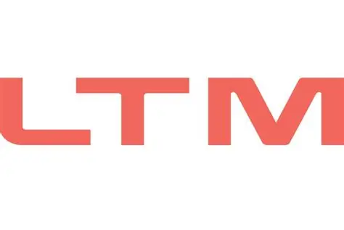

M.Tech Program
Advanced Industry Integrated Programs
Jointly offered by University and LTIMindTree
Project Title
Intelligent Supply Chain Management Platform for
Electric Vehicle Manufacturing
NAME: RADHA GOHIL
T10002
Knowledge partner | Implementation partner

Slide 2
Intelligent Supply Chain Management Platform for Electric Vehicle Manufacturing
Introduction….
Problem: EV manufacturing supply chains involve numerous components, suppliers, warehouses, and procurement activities, making efficient coordination difficult.
Key Challenges: Component shortages, excess inventory, supplier risks, procurement delays, and difficulty selecting the most suitable supplier.
Process: Vehicle BOM[Bill of Materials] → Inventory Analysis → Supplier Evaluation → Risk Prediction → Supplier Ranking → Procurement Recommendation → Purchase Order → Tracking & Inventory Update.
Proposed Solution: An AI-driven supply chain platform integrating inventory, supplier intelligence, procurement, and purchase order management.
AI Intelligence: Uses XGBoost for supplier risk prediction and multi-criteria analysis for supplier ranking and procurement recommendations.
Advanced Intelligence: Uses Neo4j Knowledge Graph, Graph-RAG, and AI Agents for connected supply-chain analysis and intelligent decision support.

Slide 3
Intelligent Supply Chain Management Platform for Electric Vehicle Manufacturing
Objective….
Develop an AI-driven supply chain management platform for EV manufacturing.
Optimize inventory planning using vehicle BOM[Bill of Materials], stock levels, safety stock, and component requirements.
Analyse supplier performance, reliability, quality, capacity, and availability.
Predict supplier risk using XGBoost to support proactive risk management.
Provide intelligent supplier ranking and procurement recommendations based on multiple decision factors.
Automate and track purchase orders from creation to material receipt and inventory update.
Build a Neo4j Knowledge Graph and Graph-RAG for connected supply-chain knowledge and context-aware querying.
Implement AI agents for coordinated inventory, supplier, procurement, and risk decision support.

Slide 4
Intelligent Supply Chain Management Platform for Electric Vehicle Manufacturing
Scope….
Manage EV component inventory and BOM[Bill of Materials]-based requirements.
Analyse supplier performance, availability, and risk.
Provide AI-based supplier ranking and procurement recommendations.
Manage and track purchase orders and inventory updates.
Use Knowledge Graph and Graph-RAG for connected supply-chain intelligence.
Use AI agents for automated analysis and decision support.

Slide 5
Intelligent Supply Chain Management Platform for Electric Vehicle Manufacturing
Literature Review…
Study | Approach | Key Contribution | Limitation / Research Gap
EV Supply Chain Management – Systematic Review | Systematic literature review | Identified major EV supply-chain challenges including sustainability, sourcing, cost and supply risks | Limited focus on integrated AI-based decision-making
EV Battery Supply Chain & Critical Materials | Battery and critical-material supply-chain analysis | Identified material dependency, sourcing risks and battery supply challenges | Focused mainly on batteries/materials rather than the complete manufacturing supply chain
AI for Supply Chain Resilience | Machine Learning and AI-based supply-chain analysis | Demonstrated the potential of AI for prediction, disruption detection and resilient supply chains | AI solutions are mostly applied to individual supply-chain problems

Slide 6
Intelligent Supply Chain Management Platform for Electric Vehicle Manufacturing
Literature Review…
Study | Approach | Key Contribution | Limitation / Research Gap
ML-Based Backorder Prediction | Machine Learning-based inventory/backorder prediction | Improved early identification of potential stock shortages and replenishment requirements | Focused on inventory prediction without supplier and procurement intelligence
Knowledge Graphs & LLMs for Supply Chain Visibility | Knowledge Graph + Large Language Model | Improved supply-chain visibility, relationship discovery and dependency analysis | Limited integration with operational inventory and procurement decisions
Supplier Evaluation & Risk Prediction for EV Industry | Multi-criteria supplier evaluation + XGBoost | Enables supplier evaluation and data-driven supplier risk prediction | Primarily supplier-focused; lacks complete end-to-end EV supply-chain intelligence
Proposed System | ML + XGBoost + Optimization + Knowledge Graph + Graph-RAG + Agentic AI | Integrates demand forecasting, BOM planning, inventory, supplier risk, procurement, tracking and intelligent decision support | Aims to bridge the gap between isolated AI solutions and an integrated end-to-end EV supply-chain platform

Slide 7
Intelligent Supply Chain Management Platform for Electric Vehicle Manufacturing
Summary of Literature….
Existing studies usually address individual problems such as EV battery supply risk, supplier evaluation, demand/backorder prediction, resilience, or Knowledge Graph-based visibility. There is limited work combining these capabilities into a single end-to-end EV manufacturing supply-chain platform.
Proposed Solution:
BOM[Bill of Materials] Planning → Inventory Optimization → Supplier Risk Prediction → Intelligent Procurement → Purchase Order Tracking → Knowledge Graph → Graph-RAG → Agentic AI Decision Support.

Slide 8
Intelligent Supply Chain Management Platform for Electric Vehicle Manufacturing
Additional Information….
Tech Stack: React.js, Fast-API, PostgreSQL, Python, XGBoost, Neo4j, Graph-RAG, LLMs, and Agentic AI.
Core Modules: BOM [Bill of Materials] planning, inventory management, supplier intelligence, procurement, risk analysis, and purchase order tracking.
AI Intelligence: XGBoost-based supplier risk prediction, multi-criteria supplier ranking, and intelligent procurement recommendations.
Knowledge Intelligence: Neo4j Knowledge Graph and Graph-RAG for connected supply-chain analysis and natural-language querying.
Agentic AI: Specialized AI agents for inventory, supplier, procurement, and risk analysis with automated decision support.

Slide 9
Intelligent Supply Chain Management Platform for Electric Vehicle Manufacturing
Modules to cover….
Module 1: Inventory Management — Intelligent Inventory Planning
Vehicle BOM [Bill of Materials] -based component requirements
Stock, safety stock, incoming stock & shortage analysis
Multi-warehouse inventory and transaction management
Procurement quantity & urgency identification
Module 2: Supplier Intelligence — Supplier Performance & Risk Analysis
Supplier quality, reliability & historical performance analysis
XGBoost-based supplier risk prediction
Supplier capacity, availability & lead-time analysis
Supplier performance monitoring

Slide 10
Intelligent Supply Chain Management Platform for Electric Vehicle Manufacturing
Module name
Module 3: Intelligent Procurement — AI-Based Procurement Decision
Multi-criteria supplier ranking
Best supplier & procurement quantity recommendation
Cost, capacity, MOQ, availability & lead-time evaluation
Risk-aware procurement decision support
Module 4: Purchase Order Management — Procurement Execution & Tracking
Automated purchase order generation
Confirmation, dispatch, transit & delivery tracking
Partial/full material receipt
Inventory & supplier availability updates

Slide 11
Intelligent Supply Chain Management Platform for Electric Vehicle Manufacturing
Module name
Module 5: Supply Chain Knowledge Intelligence — Knowledge Graph & Graph-RAG
Vehicle–BOM–component–supplier–inventory–PO relationship mapping
Neo4j-based supply-chain Knowledge Graph
Graph-RAG + LLM-based intelligent querying
Context-aware supply-chain knowledge retrieval
Module 6: Agentic AI Decision Support — Autonomous Supply Chain Intelligence
Inventory, Supplier, Procurement & Risk AI agents
Multi-agent coordination and reasoning
Intelligent alerts & recommendations
Explainable, context-aware decision support

Slide 12
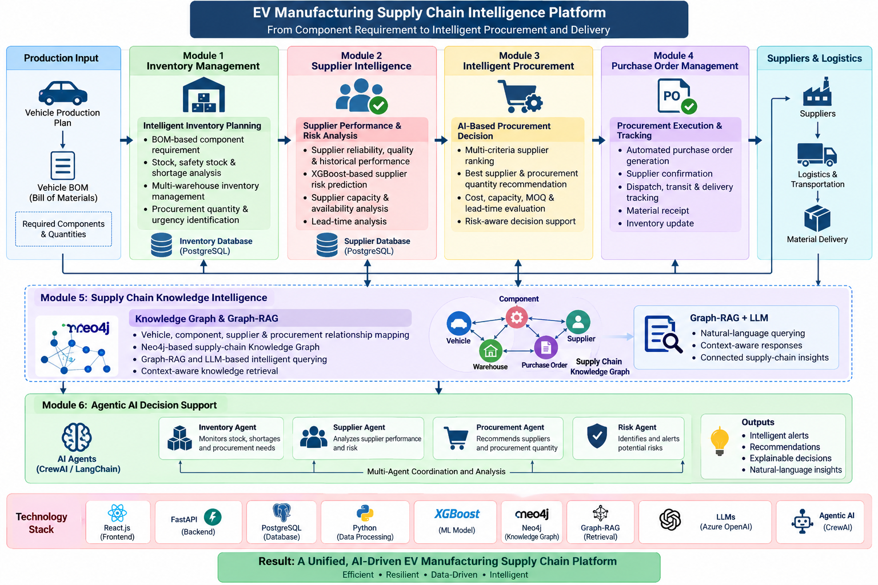
Intelligent Supply Chain Management Platform for Electric Vehicle Manufacturing

