Slide 1


M.Tech/MCA Program
Advanced Industry Integrated Programs
Jointly offered by University and LTIMindTree
Review II
Autonomous Multi-Agent Cybersecurity Defense and
Incident Intelligence Tool
Team Member
Radha Gohil [T10002]
Knowledge partner | Implementation partner

Slide 2
Project Title - Calibri body 18
Introduction….
Existing Challenges: Windows endpoints face malware, ransomware, suspicious processes, malicious network activity, and persistence attacks.
Current Limitations: Isolated security alerts make threat correlation, attack understanding, and fast response difficult.
Proposed Solution: SENTINEL-X integrates endpoint monitoring, multi-engine threat detection, event correlation, AI-based investigation, and controlled response.
Intelligent Decision Support: AI agents support triage, investigation, risk assessment, and response recommendations using correlated threat data.
Overall Benefit: The platform improves threat detection, attack visibility, response speed, and explainable endpoint protection.

Slide 3
Project Title - Calibri body 18
Objective….
Monitor file, process, network, and registry activity in real time.
Detect malware, ransomware, suspicious behaviour, and network threats.
Use ML, anomaly detection, and behavioural analysis for threat detection.
Correlate events and generate a unified threat score.
Use AI agents for investigation, risk assessment, and response recommendations.
Provide explainable and controlled threat response.
Build an installable Windows endpoint security application.

Slide 4
Project Title - Calibri body 18
Modules to cover….
Module 1: Endpoint Telemetry Collection - Real-Time System Monitoring
• Process start/stop and parent-child monitoring
• File create, modify, rename and delete monitoring
• Network connection monitoring
• Registry and startup activity monitoring
Module 2: Malware & Threat Detection- Multi-Engine Security Detection
• Static PE malware analysis using hashes, entropy, sections, imports and exports
• ML-based malware and network attack detection
• Behavioural, anomaly and ransomware detection
• Threat type, confidence, severity and risk prediction

Slide 5
Project Title - Calibri body 18
Modules to cover….
Module 3: Detection Fusion & Correlation - Unified Threat Analysis
• Combine outputs from multiple detection engines
• Generate a unified threat score
• Correlate file, process, network and registry events
• Identify related suspicious activities and attack patterns
Module 4: Threat Investigation - Attack Intelligence & Analysis
• IOC and event-history analysis
• MITRE ATT&CK mapping
• CVE and vulnerability context where applicable
• Attack timeline and attack-graph generation

Slide 6
Project Title - Calibri body 18
Modules to cover….
Module 5: AI Agent Intelligence - Autonomous Security Analysis
• Triage Agent for alert prioritization
• Correlation Agent for linking related events
• Investigation Agent for attack analysis
• Risk Agent for severity and impact assessment
• Response Agent for remediation recommendations
Module 6: Response & Remediation - Controlled Threat Response
• File quarantine and restoration
• Suspicious process termination
• Network/IP blocking
• Persistence cleanup and rescan actions
• Policy/user-controlled approval before sensitive actions

Slide 7
Project Title - Calibri body 18
Methodology/Modeling Plan….
Hybrid Detection Architecture: Combines machine learning, behavioural rules, statistical anomaly detection, and event correlation instead of relying on a single detection method.
Multi-Source Monitoring: Processes endpoint, network, authentication, file, registry, email, and exfiltration-related security activity.
Threat Detection Engines: Uses specialized modules for malware, phishing, brute-force behaviour, ransomware-like activity, network anomalies, exfiltration, and unknown behavioural anomalies.
Event Correlation: Links related security events using common entities such as process IDs, file paths, hashes, remote IPs, event categories, and time proximity.
Incident Creation: Correlated suspicious activities are grouped into a single incident for deeper investigation instead of treating every alert independently.

Slide 8
Project Title - Calibri body 18
Methodology/Modeling Plan….
Multi-Agent Investigation: Triage, investigation, risk, and response agents analyze the same incident context and generate coordinated security decisions.
Risk Assessment: Calculates incident severity and risk using evidence, correlation strength, event diversity, and agent findings.
Digital Twin Simulation: Evaluates multiple response plans virtually before recommending any action to the real endpoint.
Human-in-the-Loop Response: High-impact actions require analyst approval, allowing the SOC analyst to approve or reject the recommended response.
Mitigation Verification: Compares the modelled security state before and after the simulated response to determine whether risk has been reduced.
Explainable SOC Workflow: Evidence, attack timeline, agent reasoning, response plans, tickets, and verification results are displayed through the SENTINEL-X dashboard.

Slide 9
Project Title - Calibri body 18
Data preprocessing & EDA….
Security Telemetry: Collects and organizes process, file, network, authentication, registry, email, and outbound-activity events.
Event Normalization: Converts different security logs into a common SecurityEvent structure for consistent analysis across detection modules.
Threat Feature Extraction: Extracts indicators such as process ID, destination IP, connection count, failed logins, transferred bytes, file paths, hashes, and event severity.
Behavioural Profiling: Builds short-term behaviour patterns for processes and devices to identify unusual activity such as connection bursts, repeated failures, or abnormal transfers.
Suspicious Pattern Analysis: Examines repeated authentication failures, unusual network destinations, suspicious process-file relationships, beaconing patterns, and high-volume outbound activity.

Slide 10
Project Title - Calibri body 18
Data preprocessing & EDA….
Event Correlation Analysis: Studies relationships between process, file, network, registry, and authentication events to identify multi-stage attack behaviour.
Severity & Risk Analysis: Analyses the distribution of INFO, LOW, MEDIUM, HIGH, and CRITICAL events to prioritize incidents.
Anomaly Analysis: Uses statistical deviation from historical behaviour to detect unknown or previously unseen suspicious activity.
Incident-Level EDA: Examines event count, attack categories, related entities, correlation scores, evidence density, and incident risk levels.
SOC Intelligence Preparation: Pre-processed and correlated data is passed to the multi-agent investigation, risk-assessment, Digital Twin, and response-planning modules.

Slide 11
Project Title - Calibri body 18
Approach/Algorithms/Tools….
Approach: Hybrid cybersecurity architecture combining ML-based detection, behavioural analysis, statistical anomaly detection, event correlation, multi-agent investigation, and Digital Twin-based response planning.
Detection Algorithms: Uses XGBoost/Random Forest for malware classification, rule-based behavioural detection for suspicious process/network/authentication activity, and statistical anomaly detection for unknown behaviour.
Correlation Logic: Applies deterministic correlation rules using process IDs, file paths, hashes, remote IPs, event categories, severity, and time-window relationships.
Risk Assessment: Uses heuristic risk scoring based on incident severity, evidence strength, correlated activity, and agent findings.
Multi-Agent System: Includes Triage, Investigation, Risk Assessment, Correlation, and Response agents working on shared incident context.

Slide 12
Project Title - Calibri body 18
Approach/Algorithms/Tools….
Digital Twin Algorithm: Compares candidate response plans using modeled residual risk, risk reduction, operational impact, and plan score.
Mitigation Verification: Uses weighted before/after comparison of risk score, suspicious events, active indicators, and exposure score.
Backend Tools: Python, Fast API, SQLite/PostgreSQL, REST APIs.
Frontend Tools: React, Vite, CSS, and SOC dashboard components.
ML / Data Tools: Pandas, NumPy, scikit-learn, XGBoost, LIEF, and joblib/pickle for model persistence.
System Monitoring Tools: psutil and custom endpoint collectors for process, file, network, authentication, and registry telemetry.
Development Tools: Git, GitHub, VS Code, Postman/Swagger for API testing.

Slide 13
Project Title - Calibri body 18
Project plan/Milestone Progress
Milestone | Key Work | Progress
1. Telemetry & Data Preparation | Process, file, network, authentication, registry, email and security-event preprocessing | ✅ Completed
2. Detection Engine Development | Malware ML, phishing, brute-force, ransomware-like behavior, network, exfiltration and anomaly detection | ✅ Completed
3. Event Correlation & Incident Creation | Correlation of related security events and automatic incident generation | ✅ Completed
4. Multi-Agent SOC Workflow | Triage, Correlation, Investigation, Risk Assessment and Response agents | ✅ Completed
5. Digital Twin Response Planning | Candidate response-plan simulation, residual-risk estimation and operational-impact analysis | ✅ Completed

Slide 14
Project Title - Calibri body 18
Project plan/Milestone Progress
6. SOC Persistence & Backend APIs | Persistent incidents, evidence, tickets, response actions, timelines and FastAPI integration | ✅ Completed
7. Mitigation Verification | Before/after simulated security-state comparison and mitigation-effectiveness verification | ✅ Completed
8. SOC Dashboard Development | React dashboard for incidents, agents, Digital Twin, tickets, evidence and response actions | 🟡 In Progress
9. End-to-End System Integration | Detection → Correlation → Incident → Agents → Digital Twin → Approval → Simulated Response → Verification | 🟡 In Progress
10. Extended ML Models & Evaluation | Additional ML-based cybersecurity detection models and final performance evaluation | 🔴 Planned

Slide 15
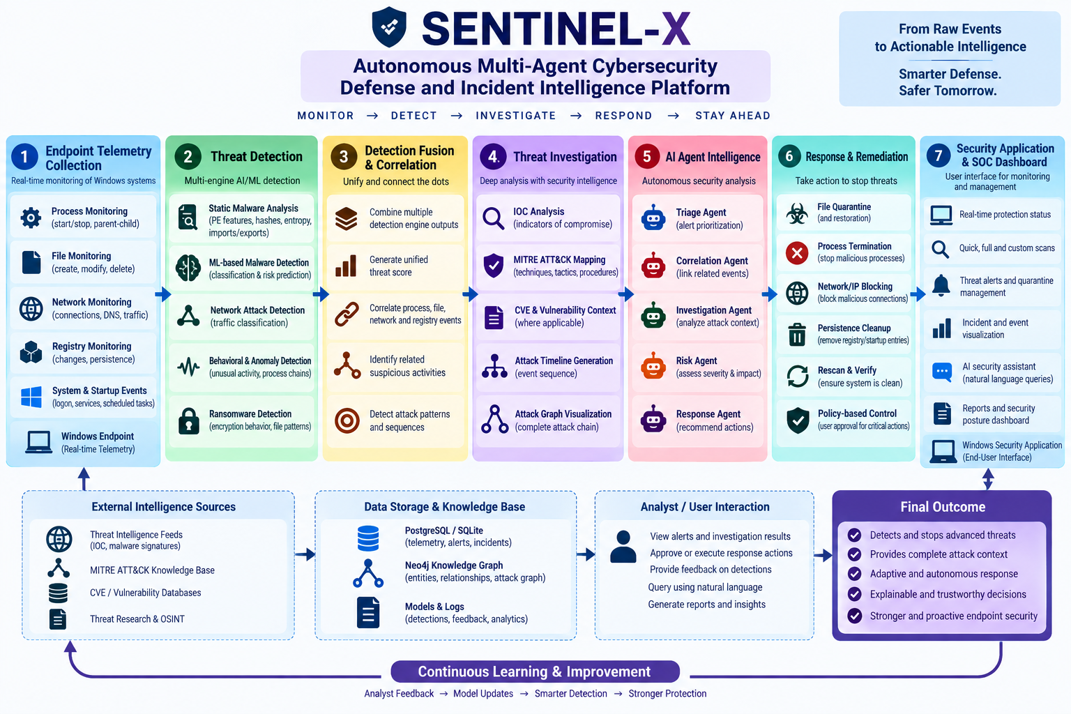
Project Title - Calibri body 18
Pipeline structure

