Slide 1

ST FRANCIS COLLEGE
Department Of BCA
“CUSTOMER CHURN PREDICTION”
MACHINE LEARNING PROJECT
Presentation on
Under the guidance of :
PRINSTON SMART ENGINEERS
Presented by:
KEERTHANA S
-U18IW22S0036

Slide 2
CONTENTS
Abstract
Introduction
Company Profile
Problem Statement
Objective
Dataset
Libraries Used
Implementation (Code)
Snapshots of the Project
Conclusion

Slide 3
ABSTRACT
Customer churn prediction is a critical task for businesses aiming to retain their customers and maintain steady revenue. This project leverages machine learning techniques to identify patterns and indicators that signal the likelihood of customer attrition. By analyzing historical customer data—including usage behavior, demographics, and transaction history—the model predicts customers who are at risk of leaving. The insights derived enable proactive retention strategies, such as personalized offers or targeted communication, ultimately reducing churn rates and enhancing customer loyalty. This presentation outlines the methodology, data preprocessing, model selection, performance metrics, and actionable insights generated from the predictive model.

Slide 4
INTRODUCTION
In today’s competitive market, retaining existing customers is often more cost-effective than acquiring new ones. Customer churn refers to the phenomenon where customers stop using a company’s products or services over a given period. High churn rates can significantly impact a company’s profitability and growth.
Predicting customers allows businesses to understand which customers are likely to leave and why. By applying machine learning algorithms to customer data, organizations can detect patterns and take proactive steps to improve customer satisfaction and loyalty. This project focuses on building a predictive model to forecast churn and support strategic decision-making for customer retention.

Slide 5

COMPANY PROFILE
Name : PRINSTON SMART ENGINEERS
Main office : Vishnuvardhan Statue Rd, Vishwa Priya Nagar, Begur, Bengaluru, Karnataka, 560068
Phone : 9513106196
Email : Prinston.Smart@gmail.com
Contact Person: Mrs. Farheen Farhath (Managing Director)
Year stand up : 2004
Company category : IT Software/ Embedded

Slide 6
PROBLEM STATEMENT
Customer churn is a major concern for businesses, as it directly impacts revenue and increases the cost of acquiring new customers. Identifying potential churners in advance is challenging due to the complexity and variety of customer behavior. Traditional methods often fall short in detecting subtle patterns that lead to churn. This project aims to develop a machine learning-based solution to accurately predict which customers are likely to leave, using historical and behavioral data. Early prediction enables businesses to implement targeted retention strategies, reduce churn rates, and enhance overall customer satisfaction.

Slide 7
OBJECTIVES
To analyze the customer data and identify the key factors contributing to them.
To build a predictive model using machine learning algorithms.
To evaluate the performance of different models and select the most accurate ones

Slide 8
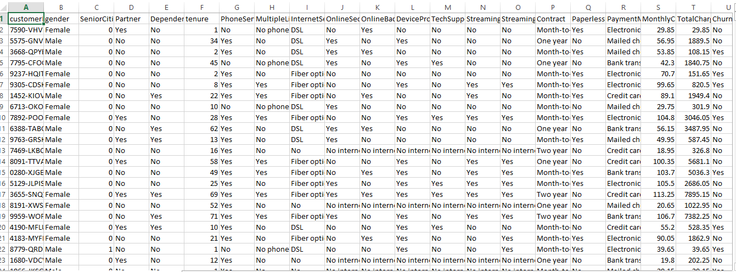
DATASET

Slide 9
LIBRARIES
Pandas: Pandas is a powerful library for data manipulation and analysis. Pandas can be used to load mutual fund data from CSV files and preprocess the data for machine learning models.
Scikit-learn: Scikit-learn is a popular library for machine learning in Python. Scikit-learn also includes tools for data preprocessing, model selection, and model evaluation. Scikit-learn can be used to train machine learning models for mutual fund classification and regression.
sklearn.model_selection: to split our data into train and test sets where feature variables are given as input in the method.
sklearn.linear_model :performing machine learning with linear models.
sklearn.metrics: implements several loss, score, and utility functions to measure classification
Seaborn: Seaborn is a visualization library that builds on top of Matplotlib. Seaborn can be used to create more advanced visualizations of mutual fund data to identify patterns and relationships in the data.

Slide 10
IMPLEMENTATION
# Importing necessary libraries
import pandas as pd
import matplotlib.pyplot as plt
import seaborn as sns
# Reading the dataset
df = pd.read_csv("WA_Fn-UseC_-Telco-Customer-Churn.csv")
# Display first few rows
df.head()
# Shape of the dataset
df.shape
# Columns in the dataset
df.columns
# Data types of the columns
df.dtypes
# Dataset information
df.info()

Slide 11
# Statistical summary
df.describe()
# Checking for null values
df.isnull().sum()
# Checking nulls in 'TotalCharges'
df["TotalCharges"].isnull().sum()
# Viewing records with null 'TotalCharges'
df[df["TotalCharges"].isnull()]
# Removing rows with null 'TotalCharges'
df = df[df["TotalCharges"].notnull()]
df = df.reset_index()[df.columns]
# Converting 'TotalCharges' to float
df["TotalCharges"] = df["TotalCharges"].astype(float)
# Churn value counts
df["Churn"].value_counts()
# Count plot for Churn
sns.countplot(data=df, x="Churn")
# Identifying numerical and categorical features
numerical_features = df.select_dtypes(include=["int64", "float64"]).columns
categorical_features = df.select_dtypes(include=["object"]).columns

Slide 12
# Displaying numerical and categorical features
numerical_features
categorical_features
# Converting 'SeniorCitizen' to categorical
df["SeniorCitizen"] = df["SeniorCitizen"].astype("object")
# Histograms for numerical features
fig, axs = plt.subplots(3, 3, figsize=(15, 15))
axs = axs.flatten()
for i, column in enumerate(numerical_features):
sns.histplot(data=df, x=column, kde=True, ax=axs[i])
plt.tight_layout()
plt.show()
# Dropping 'customerID'
df = df.drop("customerID", axis=1)
# Encoding categorical variables
df = pd.get_dummies(df, drop_first=True)

Slide 13
# Splitting data into features and target
from sklearn.model_selection import train_test_split
from sklearn.preprocessing import StandardScaler
X = df.drop("Churn_Yes", axis=1)
y = df["Churn_Yes"]
X_train, X_test, y_train, y_test = train_test_split(X, y, test_size=0.2, random_state=42)
# Feature scaling
scaler = StandardScaler()
X_train_scaled = scaler.fit_transform(X_train)
X_test_scaled = scaler.transform(X_test)
# Training Logistic Regression model
from sklearn.linear_model import LogisticRegression
from sklearn.metrics import classification_report, confusion_matrix
model = LogisticRegression()
model.fit(X_train_scaled, y_train)
# Making predictions
y_pred = model.predict(X_test_scaled)
# Evaluation metrics
print(confusion_matrix(y_test, y_pred))
print(classification_report(y_test, y_pred))

Slide 14
CONCLUSION
The customer churn prediction model helps identify telecom users likely to leave the service.
Logistic Regression was used for classification after data cleaning and preprocessing.
Key factors influencing churn include contract type, tenure, and monthly charges.
The model achieved reasonable accuracy and provided actionable insights.
It enables the company to take proactive steps to retain high-risk customers.
This can reduce churn, improve customer satisfaction, and boost revenue.
Future work can involve more advanced models and real-time data integration.

Slide 15
THANK YOU

