Slide 1
COMPONENT SHARING IN NETXINVESTOR
By Radha Lakshmi Venkata Subramanian(117015106)
Under the guidance of
Mareeswaran Paulraj Muthuraj
iNautix Technologies Pvt. Ltd.,

Slide 2
AGENDA
Introduction
NetXInvestor
Component Sharing
Component
Existing System
Proposed Method
Technologies Used
Snapshots
Conclusion
References

Slide 3
INTRODUCTION- NETXINVESTOR
NetXInvestor is a product developed by iNautix to serve BNY Mellon clients.
Similar to ICICI direct
Helps Clients to
Access account information
View statements and trade confirmations
Access quotes and news from leading sources
Research on stocks, options and mutual funds

Slide 4
INTRODUCTION-COMPONENT SHARING
Component Sharing is the process through which technological components and platforms are transferred and shared between projects.
Product-based strategy
Families of similar products have similar components
To be specific, Component Sharing is a technique that allows client to take components from NXI and embed them directly in their own website

Slide 5
INTRODUCTION-COMPONENT
What is a Component?
Any portlet in a website
Group of portlets in some case.
What is not a Component?
An Entire page
NavBar widgets
Full Contents of the main container div

Slide 6
EXISTING SYSTEM
Component Sharing in NetXInvestor was done using HTML iframes
iframe is used to display a web page within a web page
Drawbacks of the existing system
Styles and Scripts
Does not scale well(Scroll bar appears if content exceeds)
Not supported in some browser
Cross domain restrictions

Slide 7
PROPOSED METHOD
Drawbacks of the existing system which used iframes are overcome by using OpenF2 framework
OpenF2 provides tighter integration
Cross domain restrictions are overcome by the usage of JSONP in OpenF2.

Slide 8
TECHNOLOGIES USED
The following were the major technologies used.
OpenF2
Dojo
Liferay

Slide 9
OPENF2
Open and free web integration framework
Helps financial industry participants to develop custom solutions.
Combines the best tools and content from multiple providers into one
Maintained by Markit On Demand.

Slide 10
DOJO
Powerful open source JavaScript toolkit
Provides uniform access to Browser APIs
Encapsulates JavaScript implementation
Provides pluggable widgets UI(Dijit)

Slide 11
LIFERAY PORTAL
Free and open source enterprise portal software product
Web platform with features required for the development of websites and portals
Includes a built-in web content management system
Supports plugins for PHP , JSP, Servlets and Ruby

Slide 12
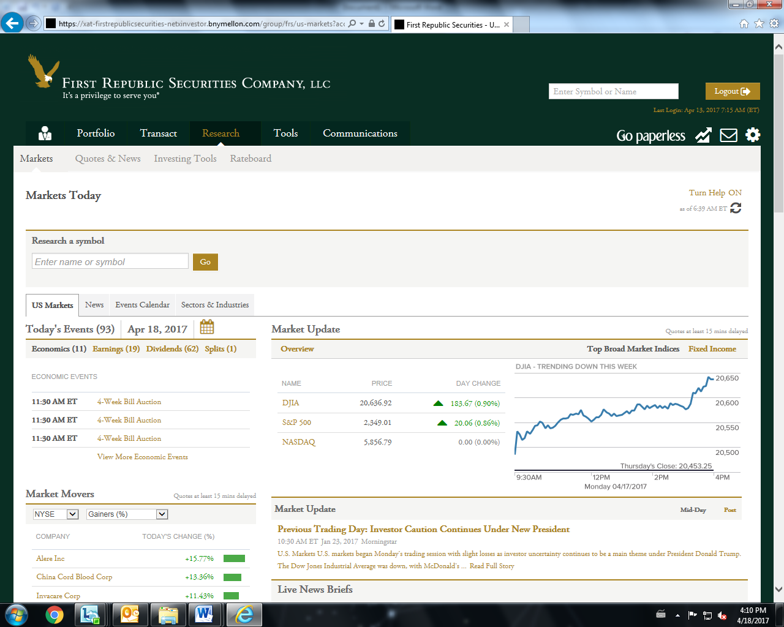
SNAPSHOTS
The entire Research tab is built using Component Sharing.
Others are data from the client’s site.

Slide 13
COMPONENTS IN RESEARCH TAB

Slide 14
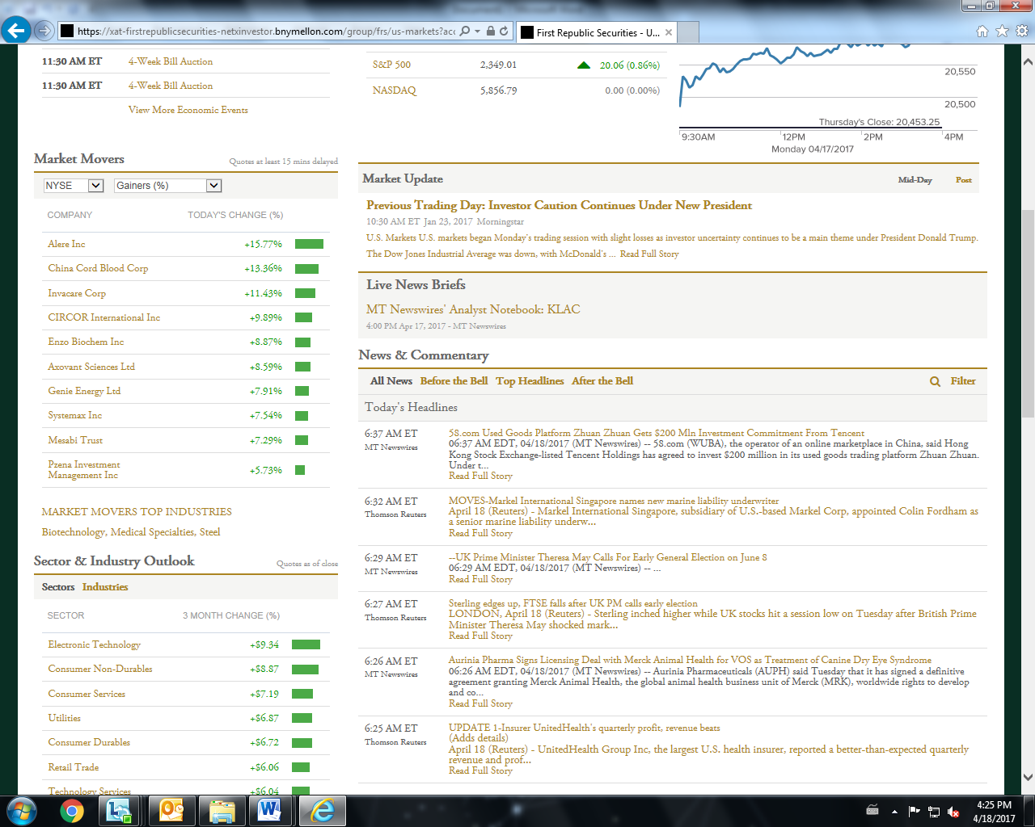

Slide 16
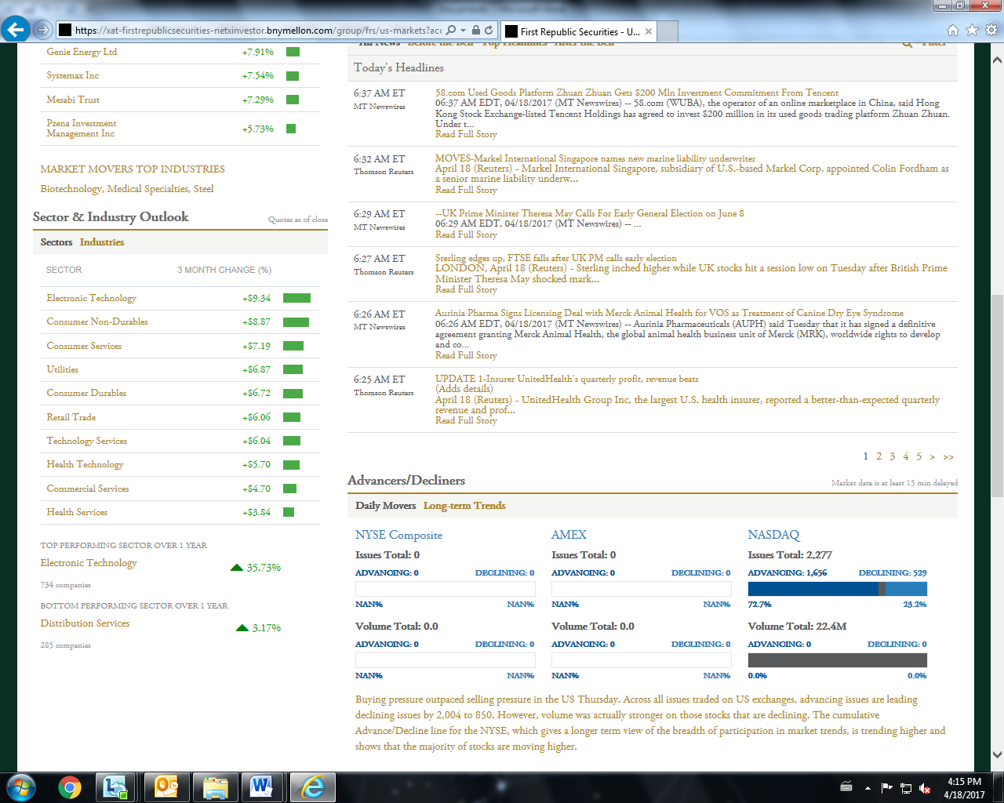

Slide 18
CONCLUSION
The proposed method proves to be more efficient as it provides tighter integration.
Usage of OpenF2 and Dojo overcomes the drawback of Cross Domain Restriction.
OpenF2 also gives better user interface since the styling complies with the existing styling.

Slide 19
REFERENCES
https://inautixonline.inautix.com/
https://dojotoolkit.org
http://openf2.org
www.netxinvestor.com
https://dev.liferay.com/develop/tutorials

