Slide 1
PRIME BROKER MANAGEMENT SYSTEM
PROJECT DONE BY,
J.SRUTHI
REG NO : 117015140
TEAM NO :85
GUIDED BY,
MURALI MUNIYANDI
iNAUTIX TECHNOLOGIES Pvt.Ltd
\

Slide 2
AGENDA
Introduction
Existing System-Challenges
Proposed Method
Technologies Used
Diagrams
Snapshots
Conclusion
References

Slide 3
INTRODUCTION
Prime Broker
One who facilitates and coordinates complex trading services
Hedge fund clients.
He will affirm the trade if the trade is within the credit limits
Various other parameters established for the customer’s account
A centralized system is essential to maintain all information pertaining to the trade.
Prime brokers are usually units of large, global investment banks

Slide 4
EXISTING SYSTEM
CHALLENGES :
Reactive and slow
Capacity constrained
Cumbersome

Slide 5
PROPOSED SYSTEM
To implement the automated system in prime brokerage in order to reduce the human resource and enhance re-usability.
PBMS primarily deals with the following modules – storing and managing account information, user management and audit registry, which provides a comprehensive history of the changes made in the system.
To convert the static application into interactive dynamic application with better user interface.

Slide 6
TECHNOLOGIES USED
DOTNET
•Virtual machine that turns intermediate language (IL) into machine code
•Four primary principles:
-Integrated Environment.
-Consistent Object Oriented.
-Supports Software Lifecycle.
-It executes with high performance.

Slide 7
TECHNOLOGIES USED
ASP .NET
used to create web pages and web technologies
Better Performance:
Just-In-Time compilation
Early binding
Caching services
Source code(ASP code) and HTML generates dynamic web pages

Slide 8
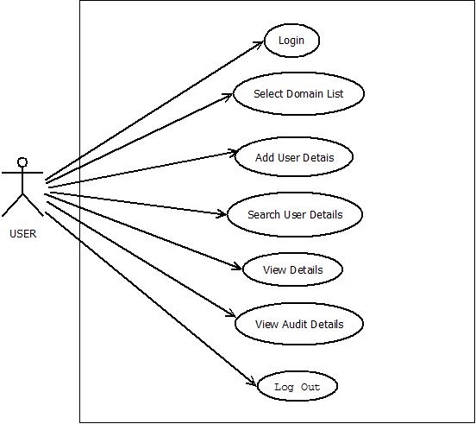
DIAGRAMS – USE CASE DIAGRAM

Slide 9
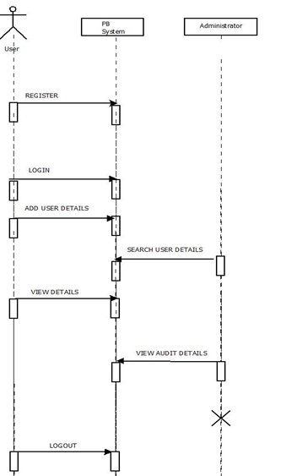
DIAGRAMS – SEQUENCE DIAGRAM

Slide 10
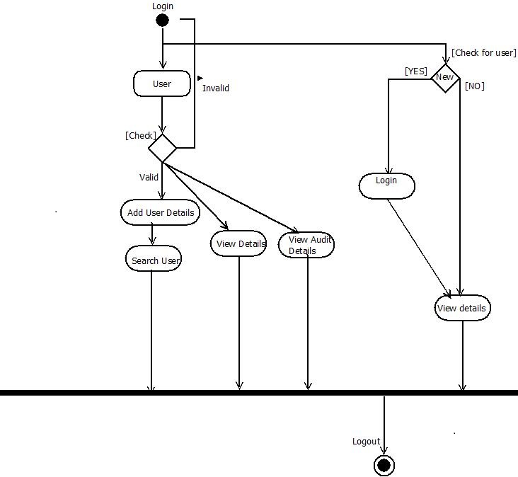
DIAGRAMS - ACTIVITY DIAGRAM

Slide 11
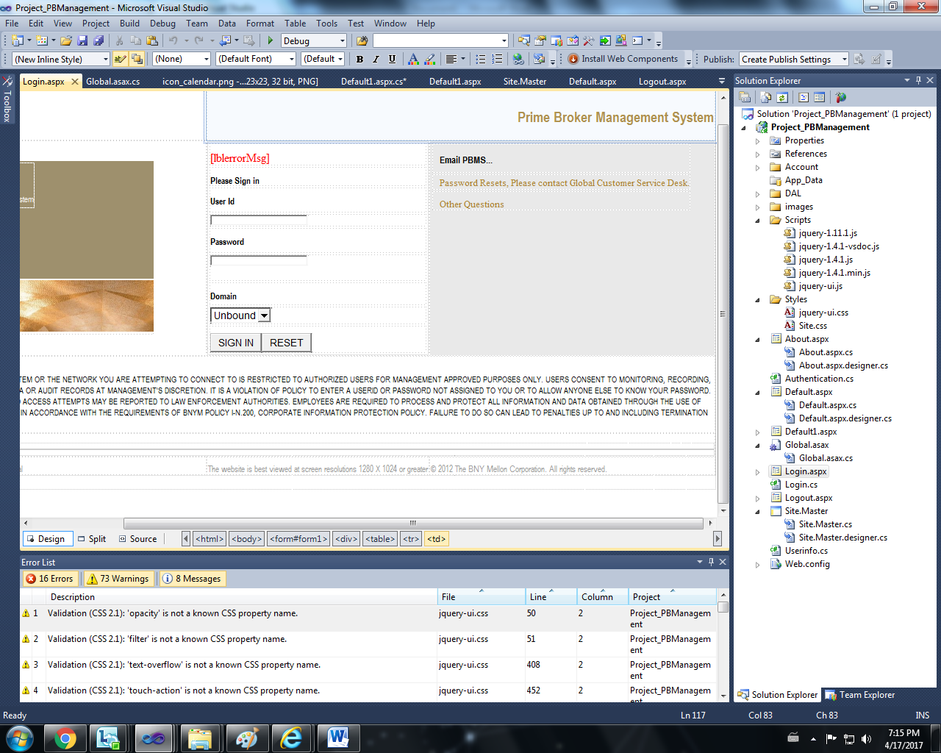
OUTPUT SNAPSHOTS - LOGIN PAGE

Slide 12
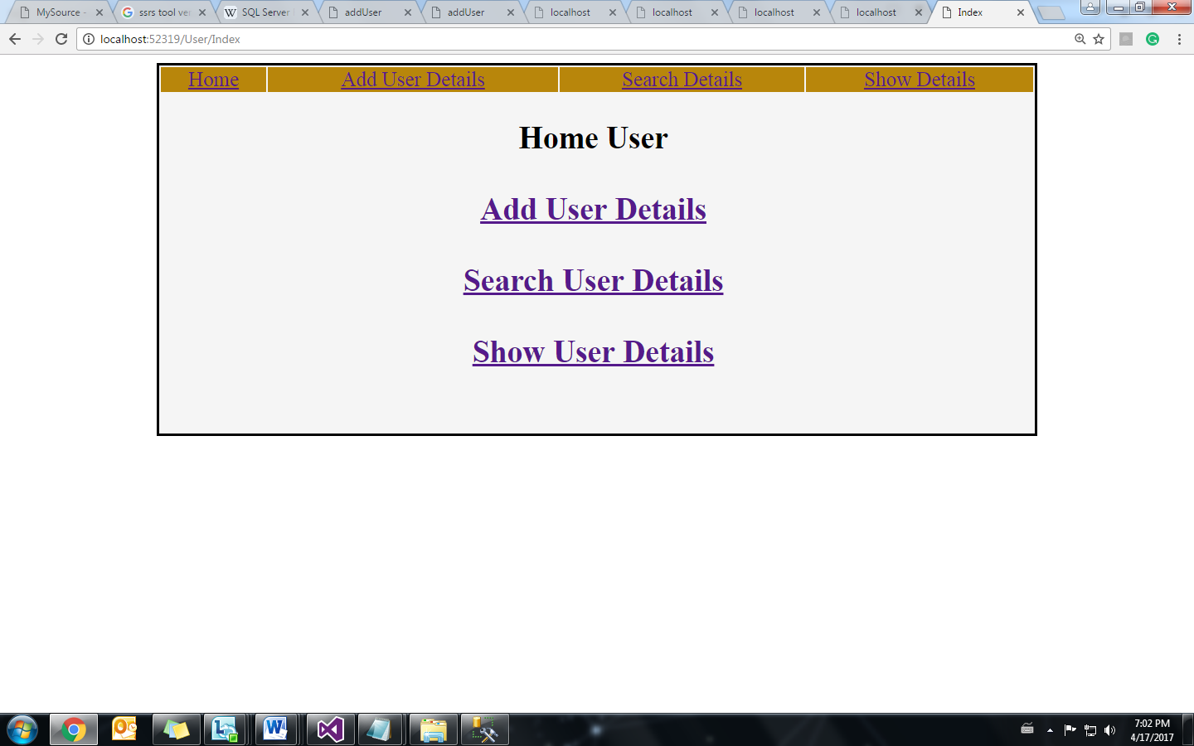
OUTPUT SNAPSHOTS – HOME PAGE

Slide 13
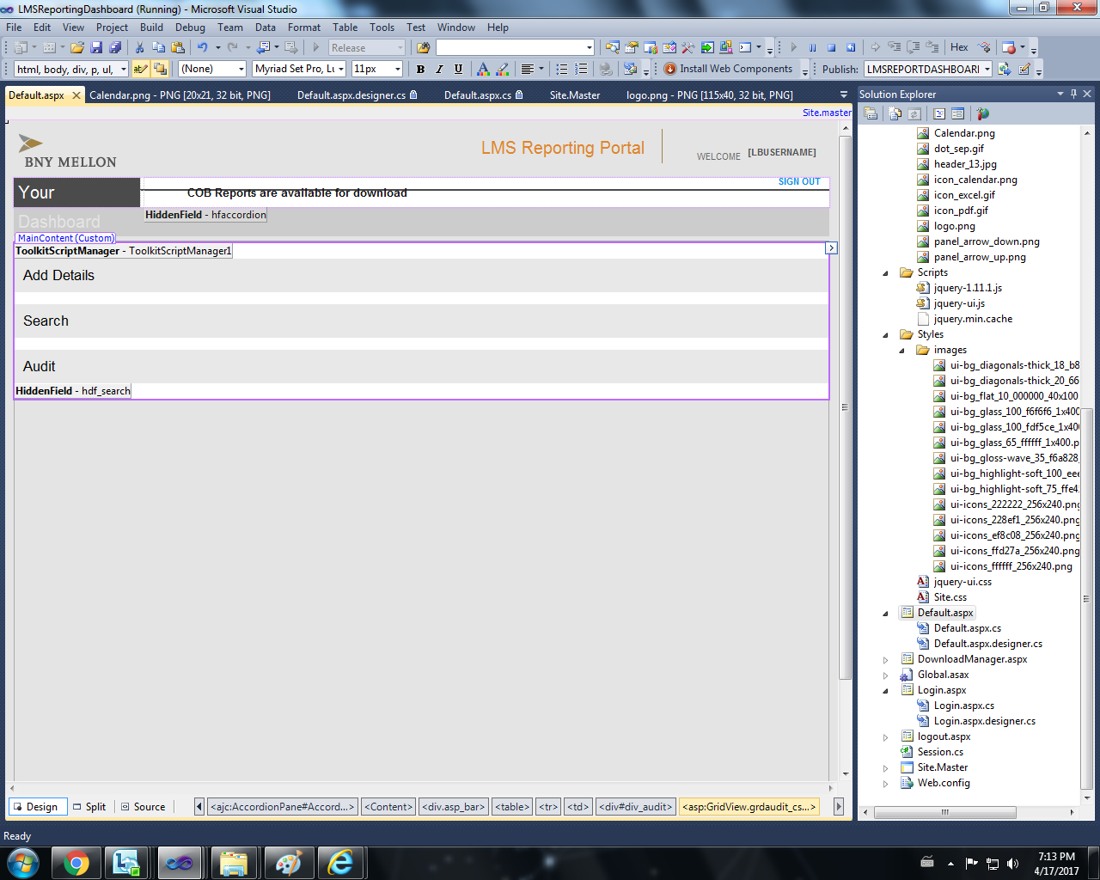
OUTPUT SNAPSHOTS - HOME PAGE FOR PB

Slide 14
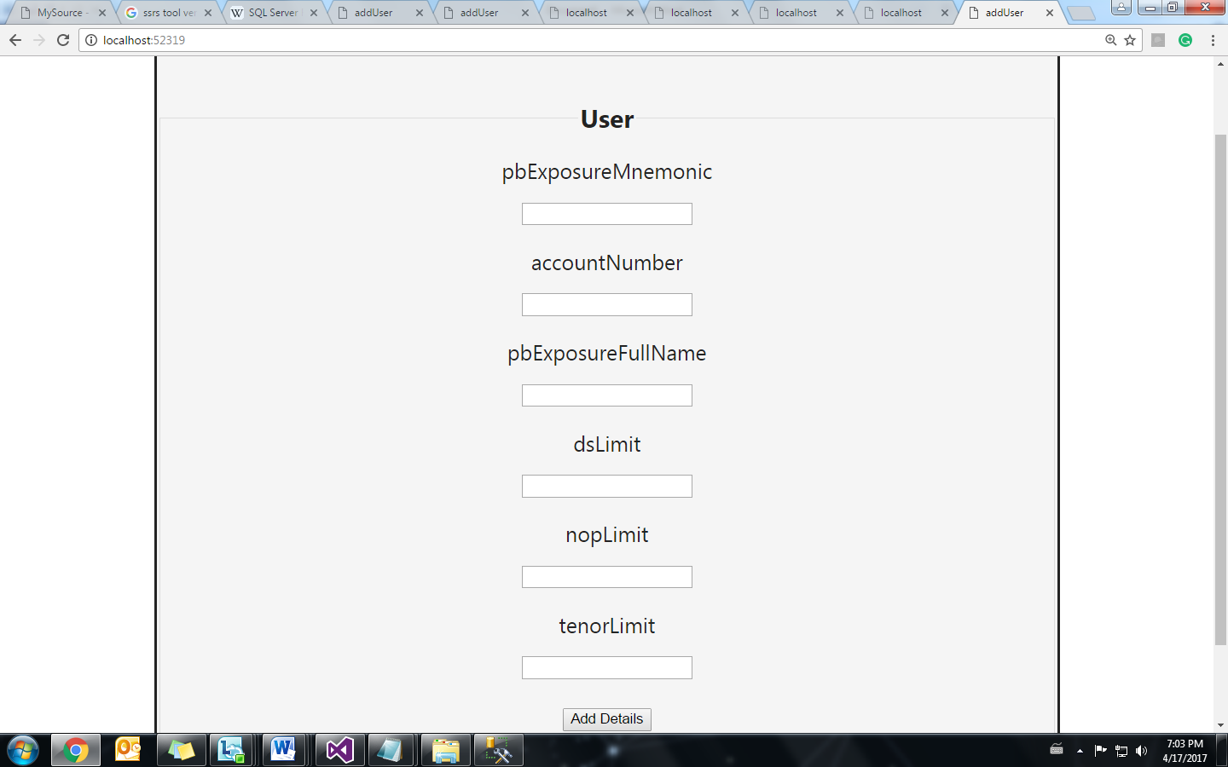
OUTPUT SNAPSHOTS – USER INFORMATION

Slide 15
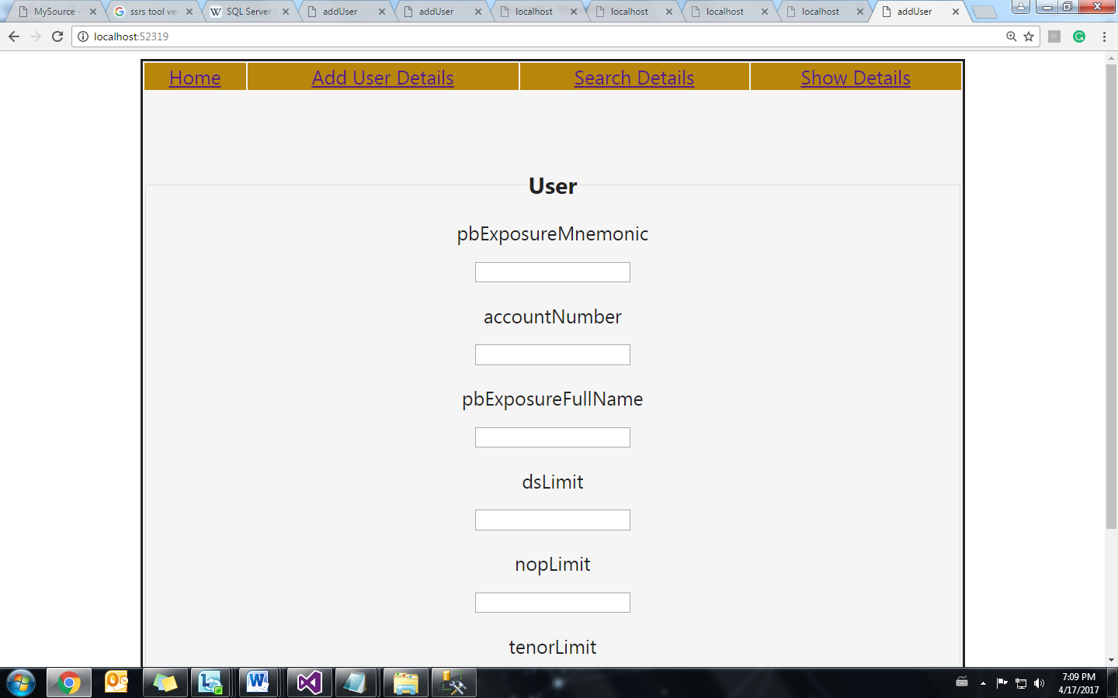
OUTPUT SNAPSHOTS - VIEW USER INFORMATION

Slide 16
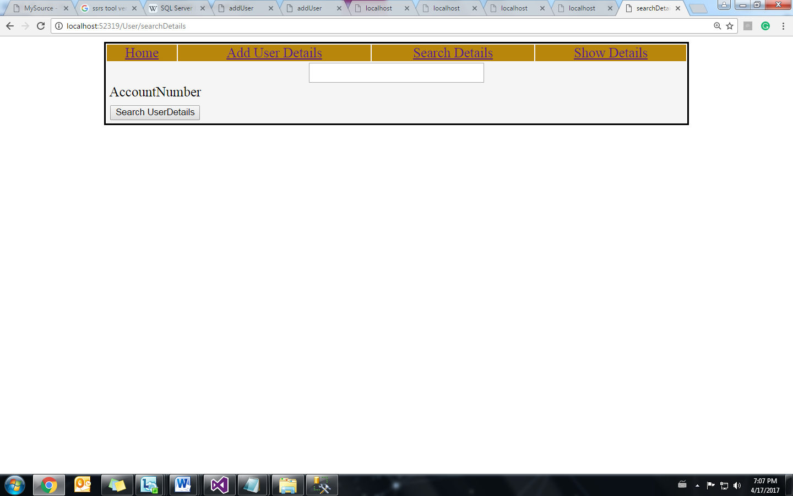
OUTPUT SNAPSHOTS – SEARCH USER INFORMATION

Slide 17
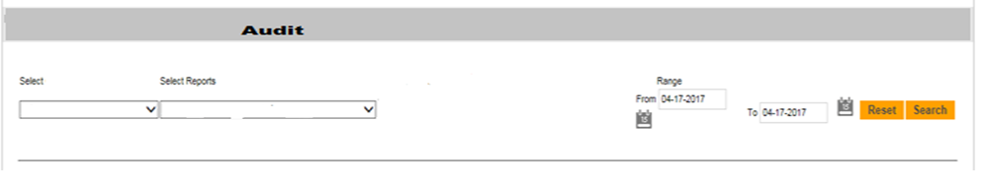
OUTPUT SNAPSHOTS – AUDIT RECORDS

Slide 18
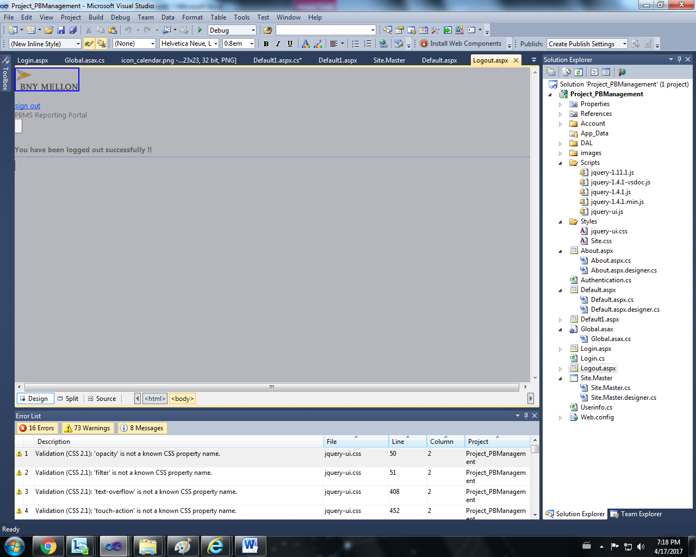
OUTPUT SNAPSHOTS – LOGOUT PAGE

Slide 19
CONCLUSION
The proposed model can be used for
Storing and managing account information,
User management and
Audit registry
This system proves to provide customer satisfaction and product efficiency.

Slide 20
REFERENCES
https://inautixonline.inautix.com/
https://www.coursera.org/learn/html-css-javascript
http://www.tutorialspoint.com/bootstrap/
http://www.tutorialspoint.com/angularjs/
http://www.tutorialspoint.com/jsp/
http://www.tutorialspoint.com/jquery/
http://www.tutorialspoint.com/ssrs/

Slide 21
Thank You

