Slide 2
Introduction to Problem solving

Slide 3
Vertices 1,2,34,5,6
Edges{(1,2).
(2,3) (3,4)
...}
1
2
6
5
3
4

Slide 4
Edges are number of vertices minus 1
Spanning tree is not closed.

Slide 5
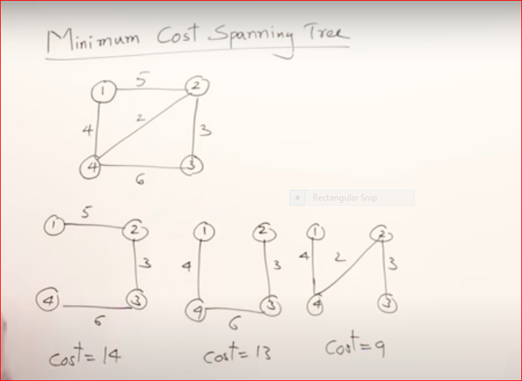

Slide 6
