Slide 1
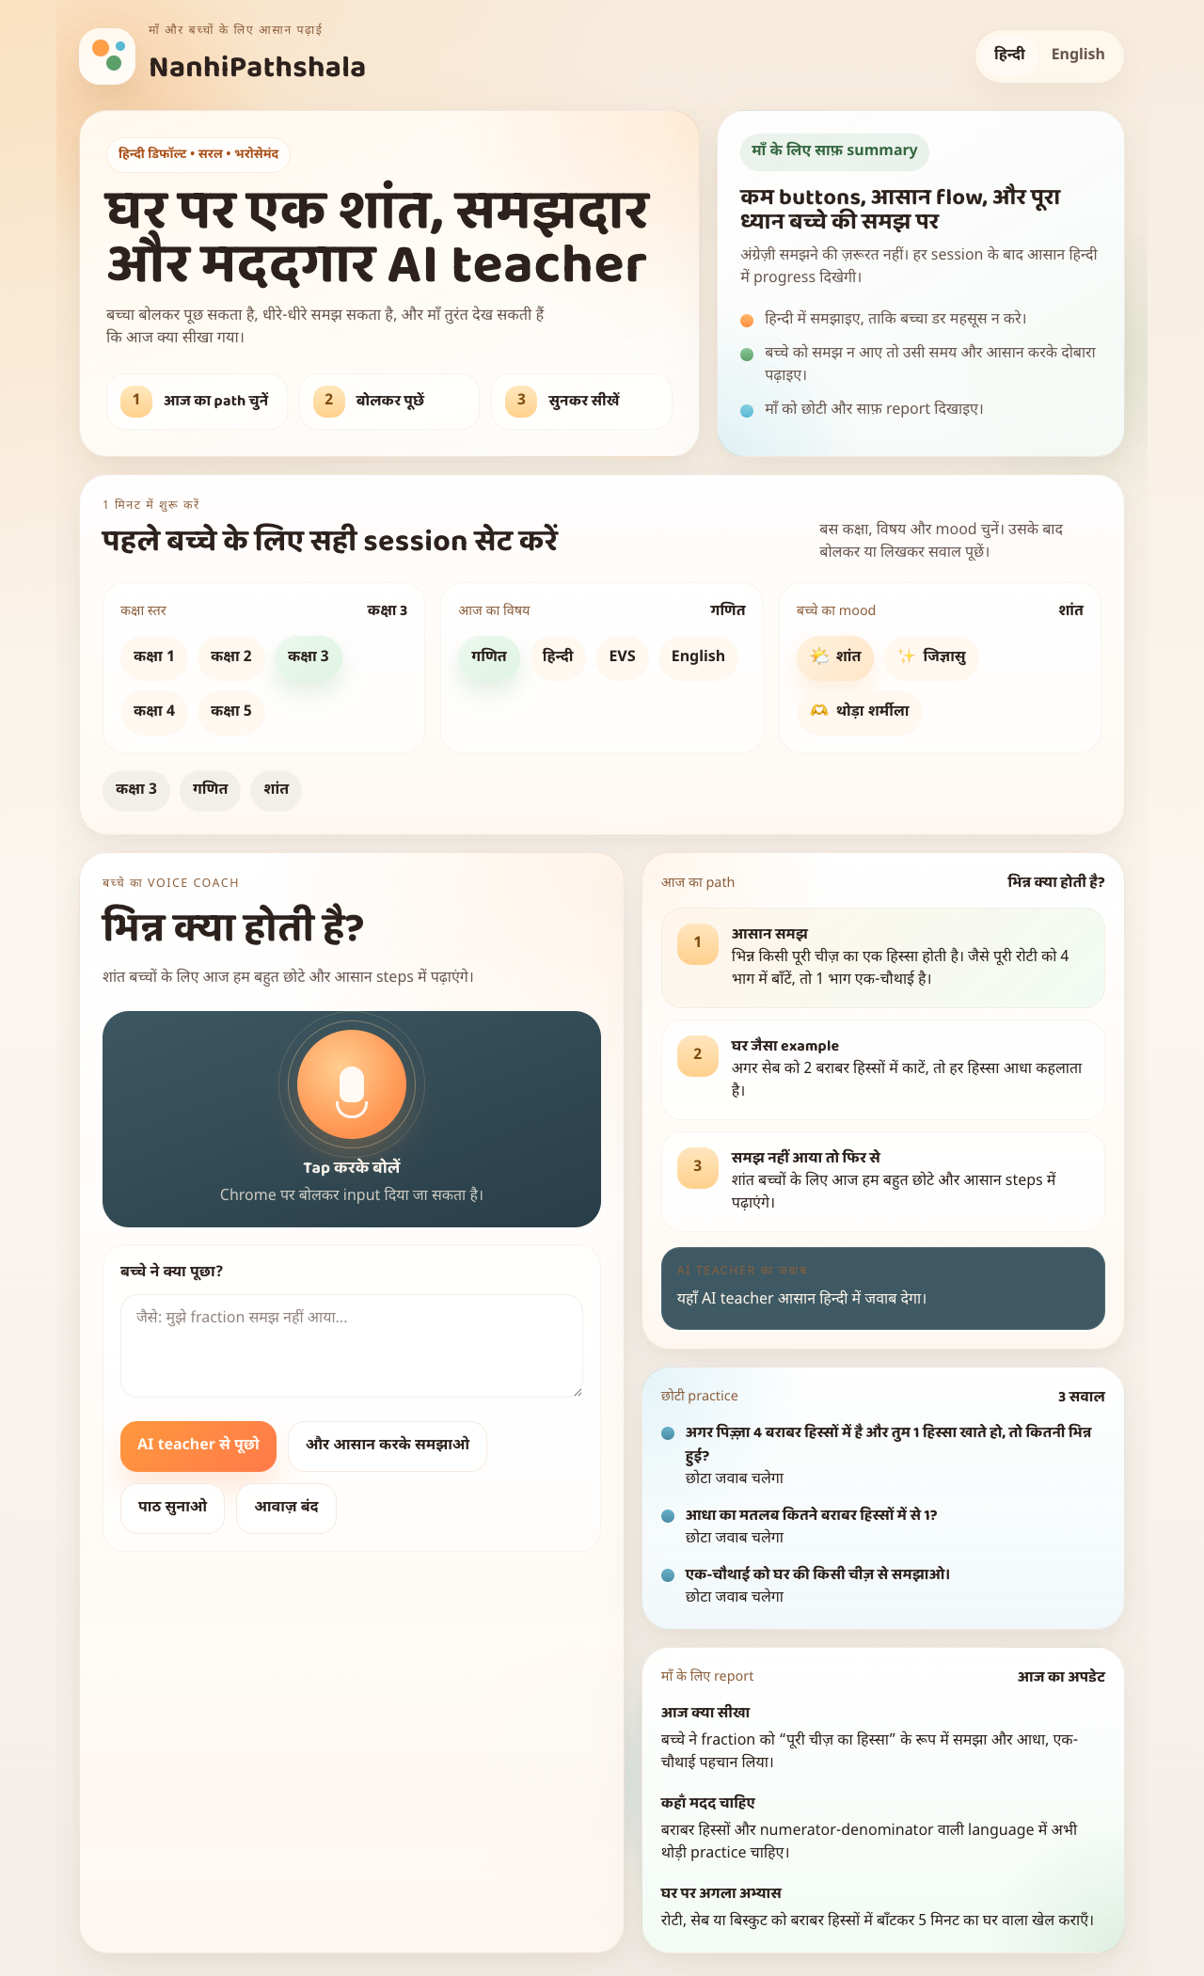
Track 1
Google ADK
Cloud Run
NanhiPathshala
Hindi-first AI tutoring agent for Indian mothers and children
A mobile-first learning companion that teaches in simple Hindi, adapts when a child is confused, speaks calmly, and gives mothers a clear progress summary.
Problem
Solution
Build
English-first and stressful tools
Hindi tutor with gentle reteaching
ADK + Gemini + Cloud Run
Live app screenshot

Slide 2
PROBLEM AND USER
Why this matters for Indian families
Mothers want to help children study at home, but most tools are not made for Hindi-first, low-pressure, early learning.
Core pain points
Target users
What success looks like
Most edtech and AI tools are English-first and intimidating for young learners.
Children need short explanations, real-life examples, and repetition without shame.
Mothers want clarity, not a complex dashboard or long English reports.
Affordable home learning support is still a gap for many families.
Classes 1 to 5
Hindi-comfortable children
Mothers guiding study at home
Low-cost side-project friendly deployment
The child feels safe to ask questions in Hindi.
The tutor reteaches patiently when the child says “samajh nahi aaya”.
The mother can see learned topic, weak area, and next home practice in one view.

Slide 3
PRODUCT
What we built in the MVP
A simple mobile web experience with one clear flow: choose the child context, ask by voice or text, get a calm Hindi explanation, then view practice and parent summary.
1
Set the child context
MVP features
Why the UI is different
Choose class, subject, and child mood in one simple setup area.
Hindi-first tutoring
Browser audio input and spoken response
Class, subject, and mood selection
Quiz prompts for quick practice
Parent summary card
Not a generic transcript-style chatbot.
Large buttons and mobile-friendly spacing.
Warm Indian visual language with Hindi default.
Designed for low-tech confidence, not power-user complexity.
2
Tap to talk
The child can use a large voice button or type a simple question.
3
Learn and retry
The agent explains in Hindi and can reteach more simply when needed.

Slide 4
ARCHITECTURE
Built as a real Google ADK agent
NanhiPathshala is a genuine agent implementation for Track 1. It has a root agent, tools, session-aware execution, Gemini on Vertex AI, and Cloud Run deployment.
Mobile Web App
Cloud Run Frontend
Cloud Run ADK API
Gemini on Vertex AI
Hindi-first UI for child and mother
Public web service
Session-based tutor runtime
gemini-2.5-flash model
ADK agent proof
Current tools
Cloud alignment
Defined root agent
Tool-backed workflows
Stateful session execution
generate_quiz
reteach_topic
generate_parent_summary
Cloud Build for deploys
Cloud Run services live
Track 1 stack matched directly

Slide 5
IMPACT AND ROADMAP
Why this MVP is strong now and expandable later
The current version is intentionally small, affordable, and demo-ready. It solves a real problem first, then leaves room for deeper native audio and broader language support.
Immediate value
Affordable build
Hackathon fit
Scale path
Hindi support, calm teaching, and mother-friendly summary from day one.
Cloud Run + Gemini Flash keeps the MVP cost low and practical.
Clear problem, simple demo, and direct Google Cloud alignment.
Native audio and progress tracking later.
What is already live
Next product upgrades
Judge takeaway
Deployed frontend
Deployed ADK backend
Real Gemini responses through Vertex AI
Gemini Live native audio
Progress history across sessions
More class-wise topic packs
Useful now
Low-friction demo
Clearly deployable

Slide 6
DEMO AND LINKS
How to present NanhiPathshala in under 2 minutes
Open the live app, choose class and subject, ask a Hindi question, show the reteach flow, then end on the parent summary and architecture story.
Demo flow
Live links
Closing line
Show Hindi-first mobile UI.
Pick a class, subject, and child mood.
Ask a simple topic question.
Say “samajh nahi aaya” and show reteach behavior.
Show practice prompts and mother summary.
Web app: nanhipathshala-web-766923141169.us-central1.run.app
Agent API: nanhipathshala-agent-766923141169.us-central1.run.app
Docs: architecture, track fit, demo script, submission copy
NanhiPathshala gives Indian families a low-cost Hindi AI tutor that is patient, practical, and deployable today on Google Cloud.
Thank you

