Slide 1




SMART INDIA HACKATHON 2026
TITLE PAGE
  Problem Statement ID – 26075
  Problem Statement Title-
  Theme- Smart Education
  PS Category- Software
  Team ID-
  Team Name- Sankalp
CAPACITY
CONNECT – A Digital Capacity Building
and Learning Management Portal

Slide 2

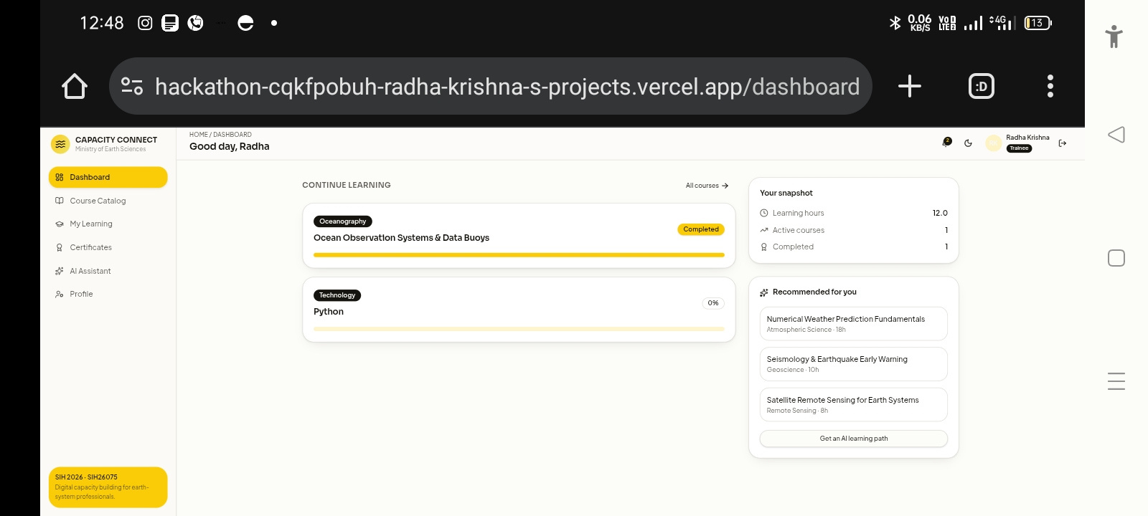
CAPACITY CONNECT
Sankalp
Problem
Our Solution
Innovation
• AI Skill Gap Analysis
• Semantic Search
• Knowledge Graph
• AI Recommendations
• Predictive Analytics
• Fragmented training records
• Manual competency tracking
• Lack of personalized learning
• No analytics
• Poor knowledge sharing
• Unified AI-powered LMS
• Competency Mapping
• Personalized Learning Paths
• Knowledge Repository
• AI Chatbot
• Smart Analytics
Capacity Connect
2
Notes:
2

Slide 3
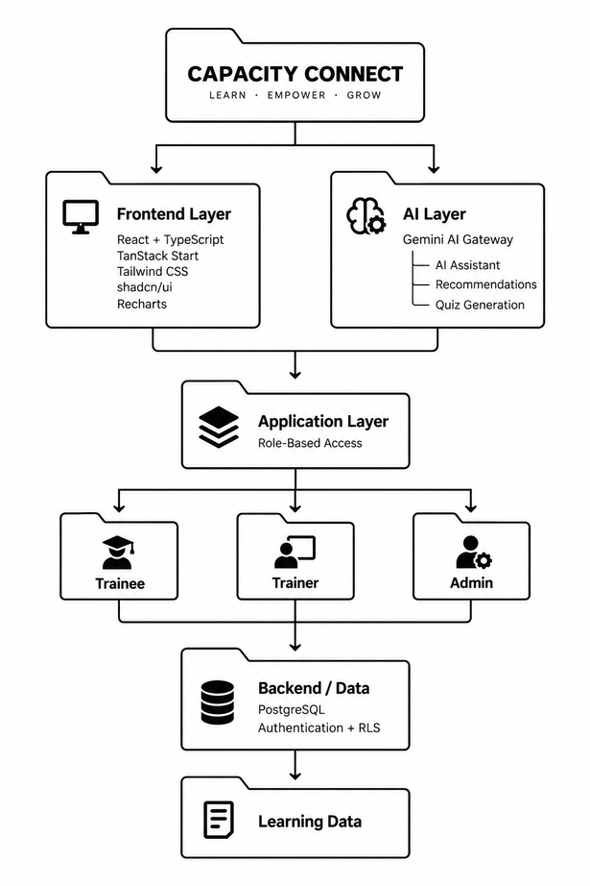
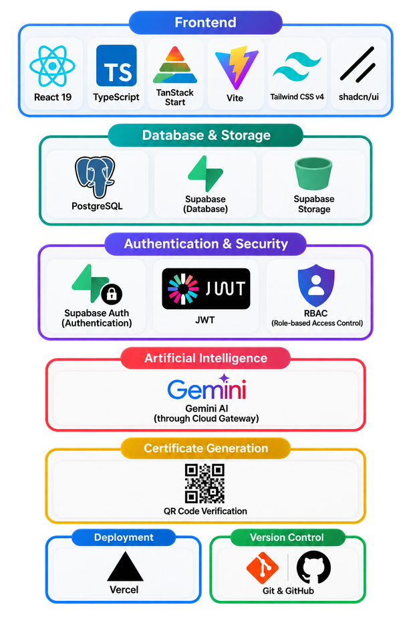
TECHNICAL APPROACH
Sankalp
  Frontend: Built with React 19, TypeScript, TanStack Start, Vite, Tailwind CSS v4, and shadcn/ui.
  Database & Storage: Supabase (PostgreSQL + Supabase Storage) for scalable database management, secure file storage, real-time data synchronization, and built-in authentication support.
  Authentication & Security: Supabase Auth, JWT, RBAC
  Artificial Intelligence: Integrated with Gemini through the
cloud Gateway.
  Certificate Generation: QR Code Verification
  Deployment : Vercel
  Version Control: Git & GitHub
Capacity Connect
3
Notes:
3

Slide 4
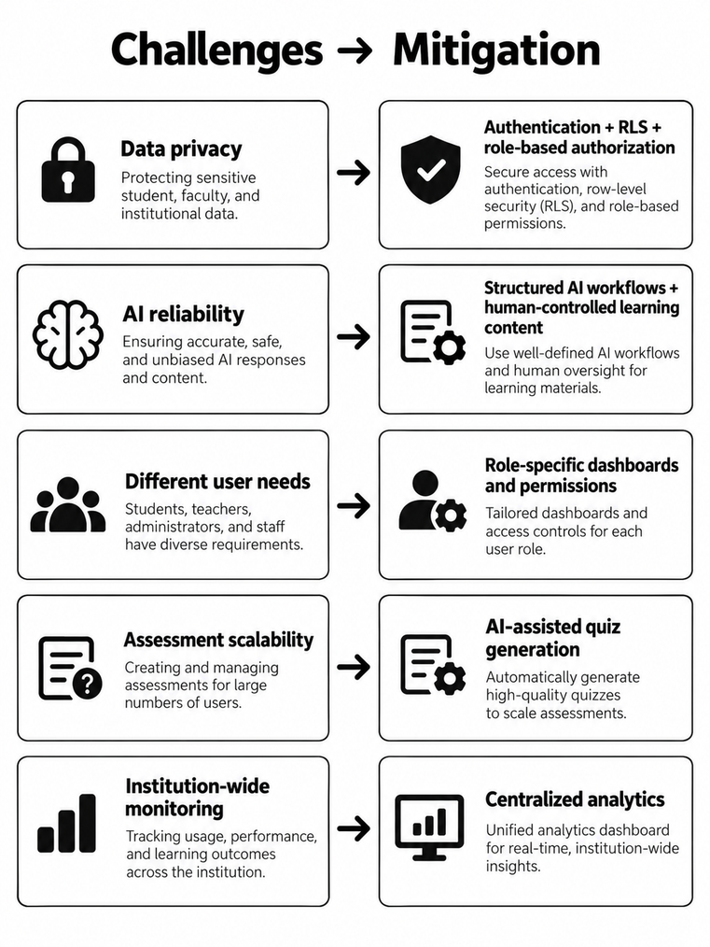

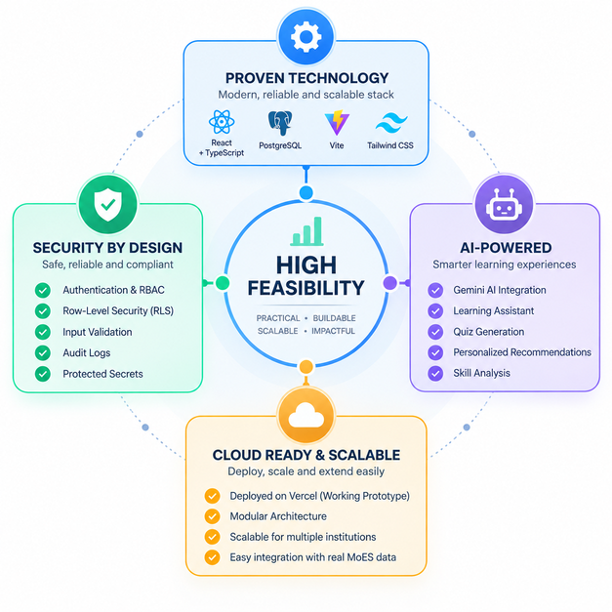

FEASIBILITY AND VIABILITY
Sankalp
Technologies
Security
  Modern web architecture
  Cloud-hosted PostgreSQL
  Modular React architecture
  API-based AI integration
  Responsive web application
  JWT-based sessions
  Row-Level Security
  Dedicated role table
  has_role()` security function
  Audit logging
  Protected routes
Operational
  Three clearly defined user roles
  Trainers can manage courses
  Administrators can manage users and institutional data
  Learners have self-service learning
Capacity Connect
4
Notes:
4

Slide 5
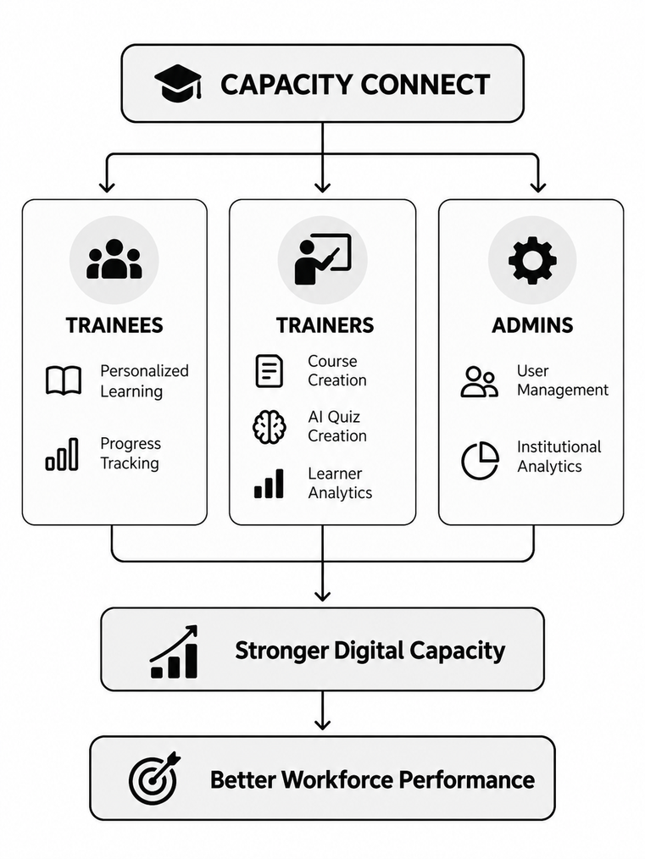
IMPACT AND BENEFITS
Sankalp
For Trainees:
For Trainers:
  Personalized learning
  Self-paced courses
  Timed assessments
  Progress tracking
  Certificates
  AI assistant
  Course creation and management
  AI-generated quizzes
  Learner progress monitoring
  Course analytics
One platform → Every learner → Personalized growth → Measurable institutional capacity
For Admin:
  User management
  Role assignment
  Institutional analytics
  Centralized oversight
Capacity Connect
5
Notes:
5

Slide 6

RESEARCH AND REFERENCES
Sankalp
GitHub repository:
github.com/radhakrishna131/Hackathon
Prototype Live Demo:
https://sankalp-sih.vercel.app
Reference Taken:
https://www.techsnap.in
Research:
For Features reference
  Perplexity
  Google
  Gemini
  Reddit
  youtube
  Swayam
  Scaler
  nptel
  FreeCodeCamp
  coursera
Capacity Connect
6
Notes:
6

