Slide 1
19CS2109
COMPUTER NETWORKS AND SECURITY

Slide 2
Introduction
Session-2
© 2020-21 KL University – The contents of this presentation are an intellectual and copyrighted property of KL University. ALL RIGHTS RESERVED

Slide 3
1.0 Technology Revolution
18th Century Mechanical systems
19th Century Steam Engine
20th Century Information
- gathering
- distribution
- processing
- creating

Slide 4
What is a Computer Network
◆ A set of communication elements connected by
communication links
➭ Communication elements
● Computers, printers, mobile phones, …
● Routers, switches, ...
➭ Communication links
● optic fiber
● coaxial cable
● twisted pair
● wireless (radio, microwave, satellite)
➭ Topologies
● Ring, Star, Bus, Tree, Mesh
router
workstation
server
mobile
local ISP
regional ISP
company
network

Slide 5
What is a Computer Network
◆ A software/hardware infrastructure
➭ Share resources
● data, files, computing power, video,…
➭ Information highway
● communication between geographically dispersed users
➭ Electronic Society
● Cyberspace
● Virtual global nation

Slide 6
Introduction
Computer Network
an interconnected collection of autonomous computers
Internet: “network of networks”
loosely hierarchical
public Internet versus private intranet
WWW a distributed systems run on the top of Internet
Distributed System
High degree of cohesiveness and transparency
A software system built on top of a network

Slide 7
1.1 Uses of Computer Networks
Business Applications
Home Applications
Mobile Users
Social Issues

Slide 8
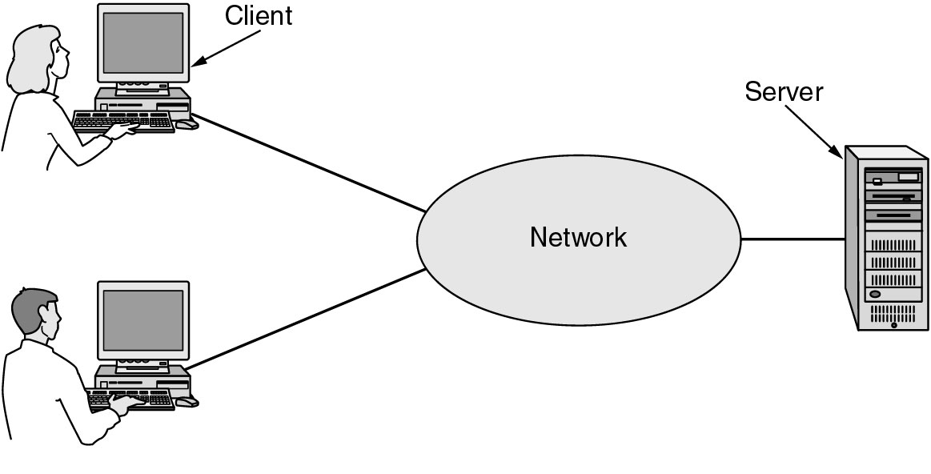
Business Applications of Networks
Resource sharing (hardware, software, information, …)
b. Providing communication medium (e-mail, videoconferenceing)
c. Doing business electronically (B2B, B2C, e-commerce)
A network with two clients and one server.

Slide 9
Goals of Networks for Companies
Resource sharing: equipment, programs, data
high reliability
replicated data
hardware
Saving money
mainframe: 10 times faster, but 1000 times more expensive than PC
client-server model
Scalability
mainframe: replace a larger one
client-server model: add more servers
Communication medium for separated employees

Slide 10
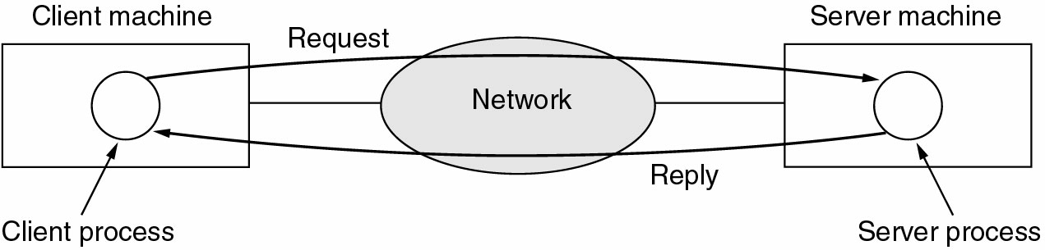
Business Applications of Networks (2)
a. Two processes are involved
b. A communication network is needed
The client-server model involves requests and replies.

