Slide 1
19CS2109
COMPUTER NETWORKS AND SECURITY

Slide 2
Introduction
Session-3
© 2020-21 KL University – The contents of this presentation are an intellectual and copyrighted property of KL University. ALL RIGHTS RESERVED

Slide 3
Home Network Applications
Access to remote information
Person-to-person communication
Interactive entertainment
Electronic commerce

Slide 4
Networks for People
Access to remote information
e.g.: financial, shopping, customized newspapers, on-line digital library, WWW
Person-to-person communication
email, video conference, newsgroup
Interactive entertainment
VOD, interactive movies or TVs, game playing

Slide 5
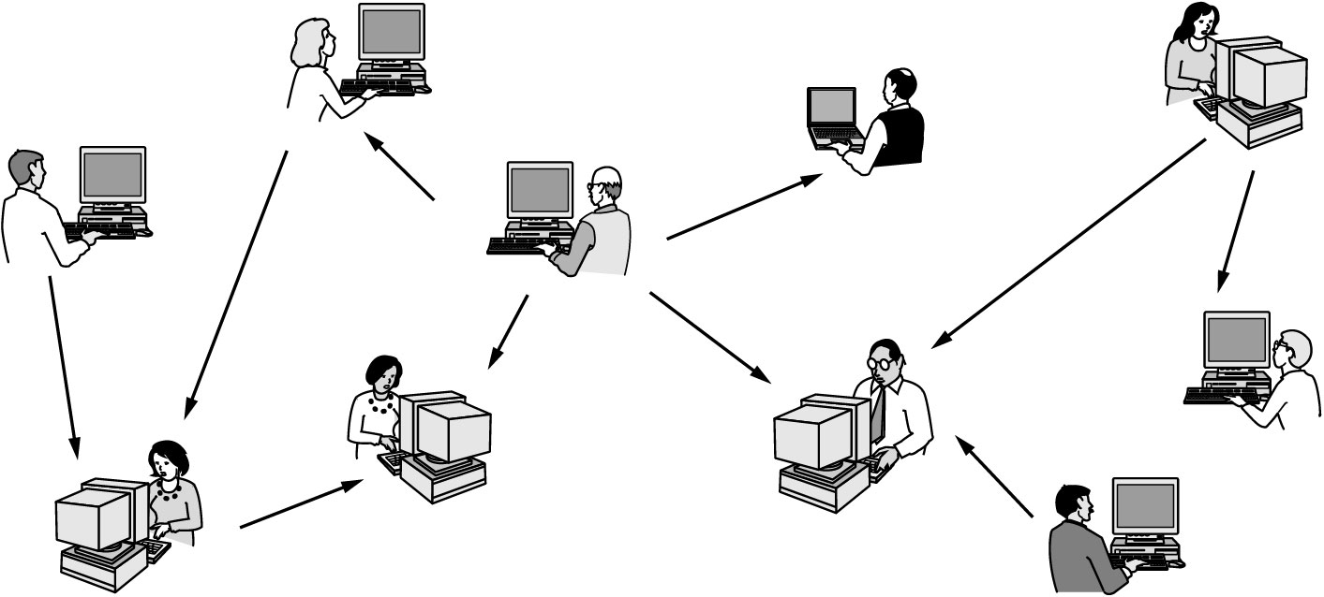
Home Network Applications (2)
In peer-to-peer system there are no fixed clients and servers.

Slide 6
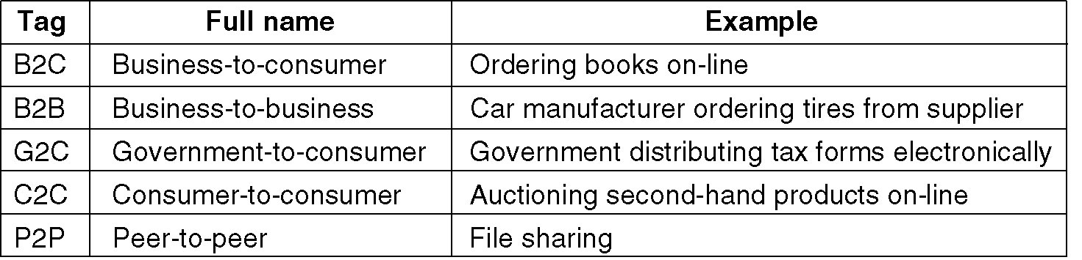
Home Network Applications (3)
Some forms of e-commerce.

Slide 7
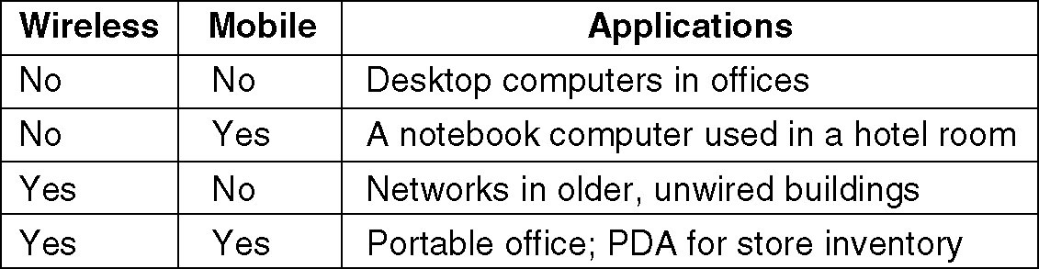
Mobile Network Users
Combinations of wireless networks and mobile computing.
mobile-commerce

Slide 8
Social Issues
Politics
Religion
Sex
Privacy
Crime
junk mail, ill-information
Each country has different laws.
Debate rages!

