Slide 1
19CS2109
COMPUTER NETWORKS AND SECURITY
© 2020-21 KL University – The contents of this presentation are an intellectual and copyrighted property of KL University. ALL RIGHTS RESERVED

Slide 2
Introduction
Session-4
© 2020-21 KL University – The contents of this presentation are an intellectual and copyrighted property of KL University. ALL RIGHTS RESERVED

Slide 3
Network Hardware
Local Area Networks
Metropolitan Area Networks
Wide Area Networks
Wireless Networks
Home Networks
Internetworks

Slide 4
Network Hardware
Types of transmission technology
Broadcast links
Point-to-point links

Slide 5
Network Hardware
Broadcast networks
single communication channel shared by all machines
broadcasting or multicasting (via packets)
broadcasting: a special code in address field
multicasting: reserve one bit to indicate multicasting, the remaining n-1address bits can hold a group number. Each machine can subscribe to any groups
used by localized networks (or satellites)
point-to-point networks
many hops
routing algorithms: multiple routs are possible
used by large networks

Slide 6
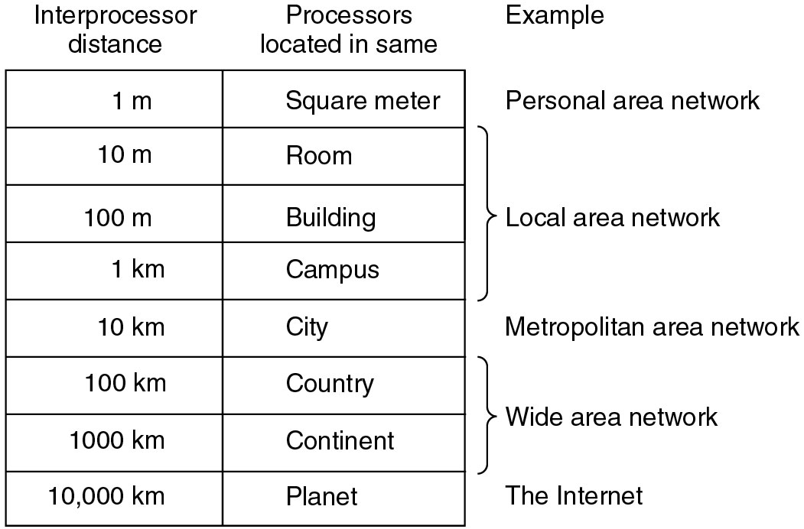
Classification of interconnected processors by scale

Slide 7
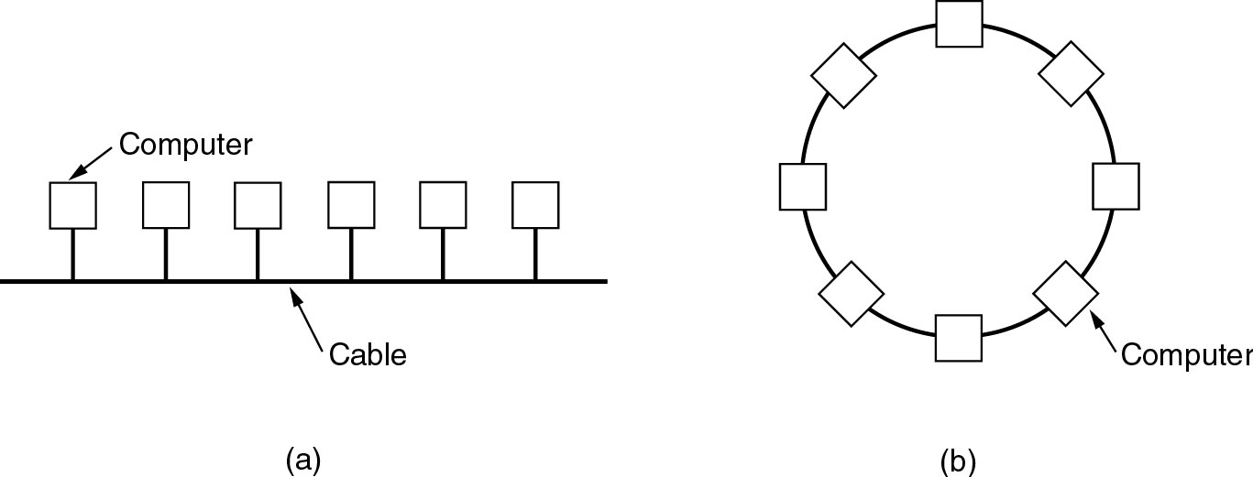
Local Area Networks (LANs)
· Characterics of LANs: (a) privated-owned, (b) small size,
(c) transmission technology, (d) topology
· Ethernets are most popular (up to 10 Gb/s)
Two broadcast networks
(a) Bus
(b) Ring

Slide 8
Local Area Networks
Characteristics
small size
transmission technology
single cable
10Mbps ~ 10Gb/s
10Gb/s : 10,000,000.000 bps
topology:
bus
Ethernet (IEEE 802.3): 10 or 100 Mbps (10Gb/s)
ring
IBM token ring (IEEE 802.5): 4 or 16 Mbps
Channel allocation of broadcast networks
static: each machine has an allocated time slot
dynamic

Slide 9
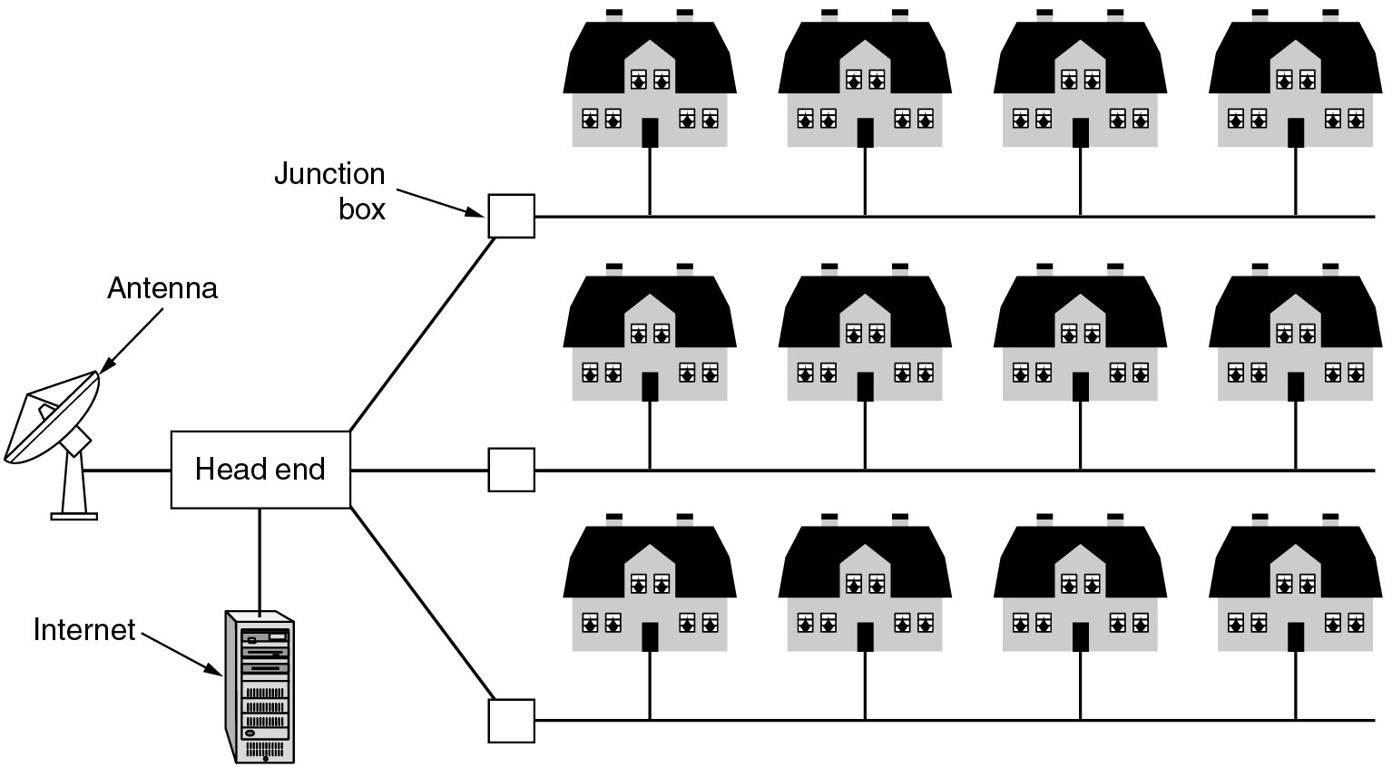
Metropolitan Area Networks
A metropolitan area network based on cable TV.

Slide 10
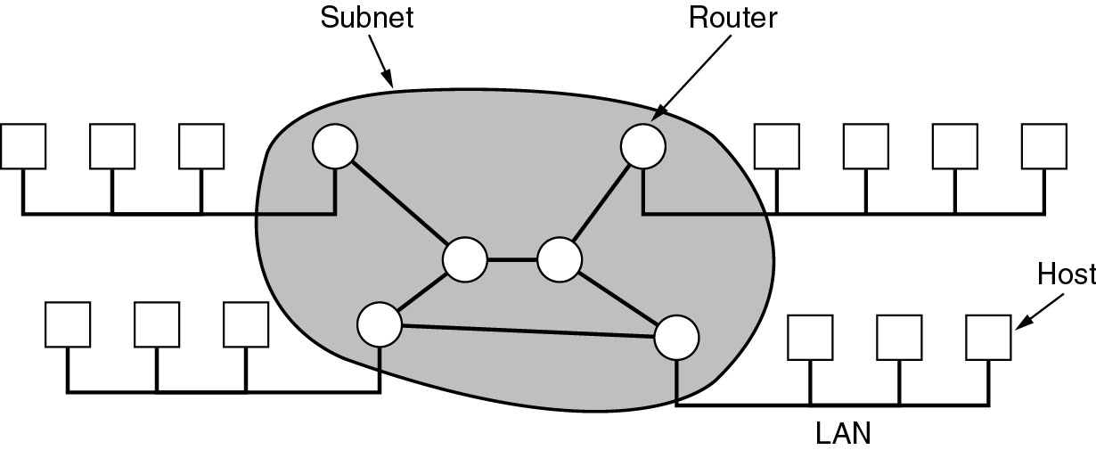
Wide Area Networks (WANs)
·WANs are point-to-point networks
·WANs consist of two distinct components:
transmission lines (copper, fiber, microwave) and switches (electronics, optics)
⇨ Store-and-forward or packet-switched subnet
Relation between hosts on LANs and the subnet.

Slide 11
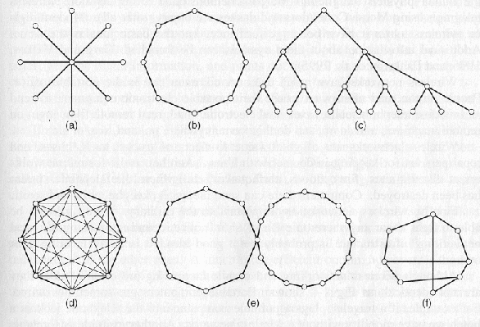
Network Topology

Slide 12
Subnet (WANs)
Subnet (WANs) is consists of two components:
transmission lines (circuits, channels, trunks)
move bits between machines
switching elements
connect transmission lines
Router: also called packet switching nodes, intermediate systems, and data switching exchanges
Operate in store-and-forward, or packet-switched mode.

Slide 13
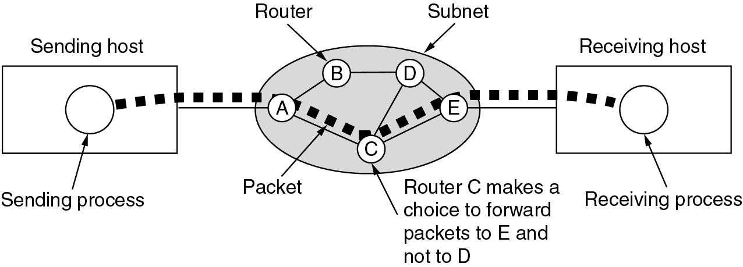
Wide Area Networks (2)
A stream of packets from sender to receiver. (virtual- circuit)
Routing decisions are made locally·
How A makes that decision is called the routing algorithm.
⇨ Will be studied in detail in Chapter 5.
9/17 End

Slide 14
Wireless Networks
Categories of wireless networks:
System interconnection
(short-range radio, e.g. Bluetooth)
Wireless LANs
(802.11a, 802.11b, 802.11g)
Wireless WANs
(802.16, Cellular telephones, Satellites)
Wireless sensor networks

Slide 15
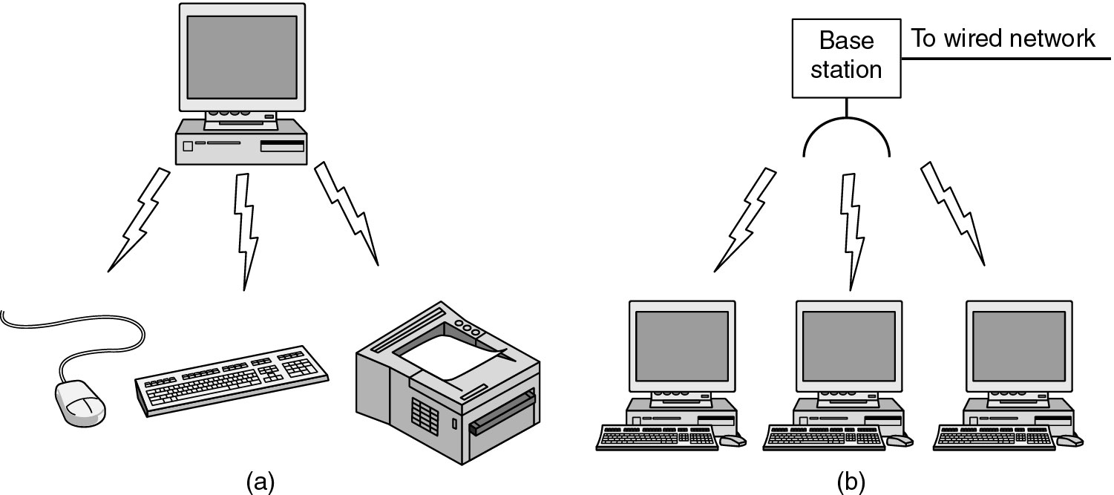
Wireless Networks (2)
(a) Bluetooth configuration
(b) Wireless LAN

Slide 16
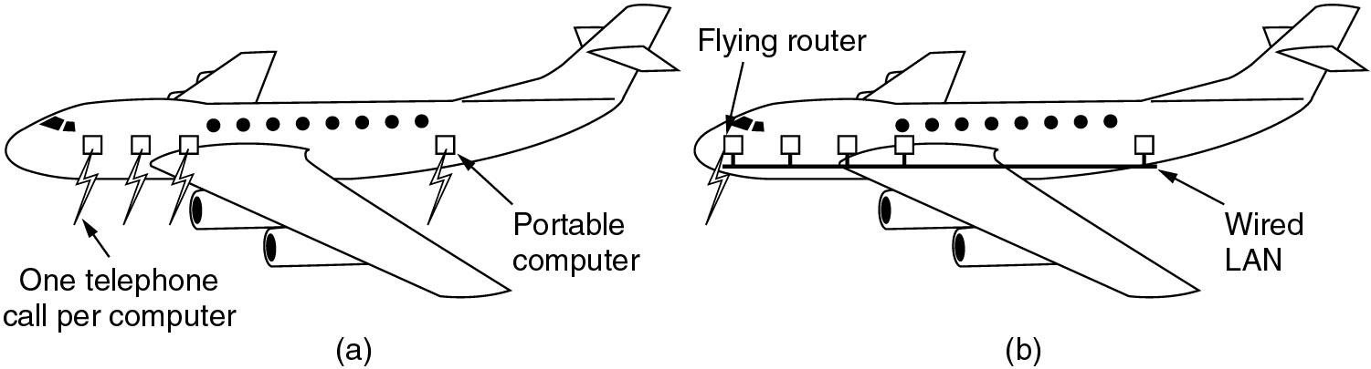
Wireless Networks (3)
(a) Individual mobile computers
(b) A flying LAN

Slide 17
Home Network Categories
Computers (desktop PC, PDA, shared peripherals)
Entertainment (TV, DVD, VCR, camera, stereo, MP3)
Telecomm (telephone, cell phone, intercom, fax)
Appliances (microwave, fridge, clock, furnace, airco., light)
Telemetry (utility meter, smoke/burglar alarm, babycam).

Slide 18
Fundamentally different properties
1. Devices have to be easy to install
2. The network and devices have to be foolproof in
operation
3. Low price is essential
4. The network needs sufficient capacity ( for multimedia
application)
5. The network interface and wiring have to be stable for
many years
6. Security and reliability will be very important
(minimize false alarm or misalarm)
Home networks may be wired or wireless

Slide 19
Internetworks
Internetworks connect networks with different hardware
and software
A collection of interconnected networks is called
an internetwork or internet
Internet is one specific internet
Gateways are used to make the connection and to
provide the necessary translation (protocol convertion)

Slide 20
Network Software
Protocol Hierarchies (Layer structure)
Design Issues for the Layers
Connection-Oriented and Connectionless Services
Service Primitives
The Relationship of Services to Protocols

Slide 21
Network Software
Protocol Hierarchies
a series of layers (levels)
lower layer provides service to higher layers
protocol:
an agreement between the communication parties on how communication is to proceed
Peers:
the corresponding layers on different machines.
Network architecture: a set of layers and protocols
Protocol stack:
a list of protocols used by a certain system, one protocol per layer

Slide 22
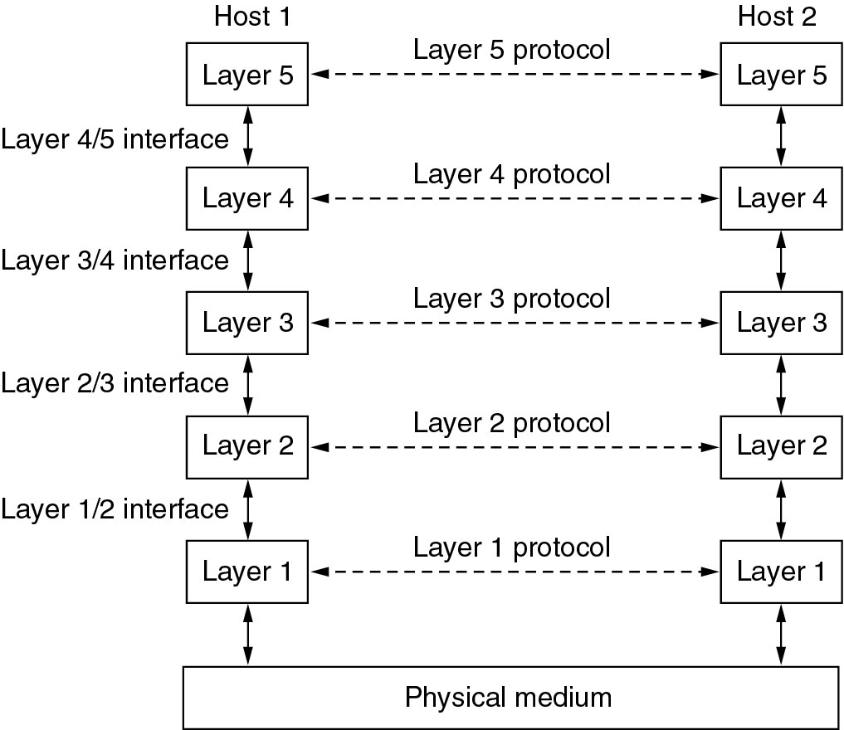
Network Software Protocol Hierarchies
Virtual
Communication
→ Peer
Physical
Communication
Layers, protocols, and interfaces.
Network Architecture: A set of layers and protocols
Protocol Stack: A list of protocols used by a certain system, one protocol per layer.

Slide 23
Network Software
◆ Layering
➭ To make things simple: modularization
➭ Different layer has different functions
➭ Create layer boundary such that
● description of services can be small
● number of interactions across boundary are minimized
● potential for interface standardized
➭ Different level of abstraction in the handling of data (e.g.,
syntax, semantics)
➭ Provide appropriate services to upper layer
➭ Use service primitives of lower layer

Slide 24
Protocol Hierarchies (2)
The philosopher-translator-secretary architecture.

Slide 25
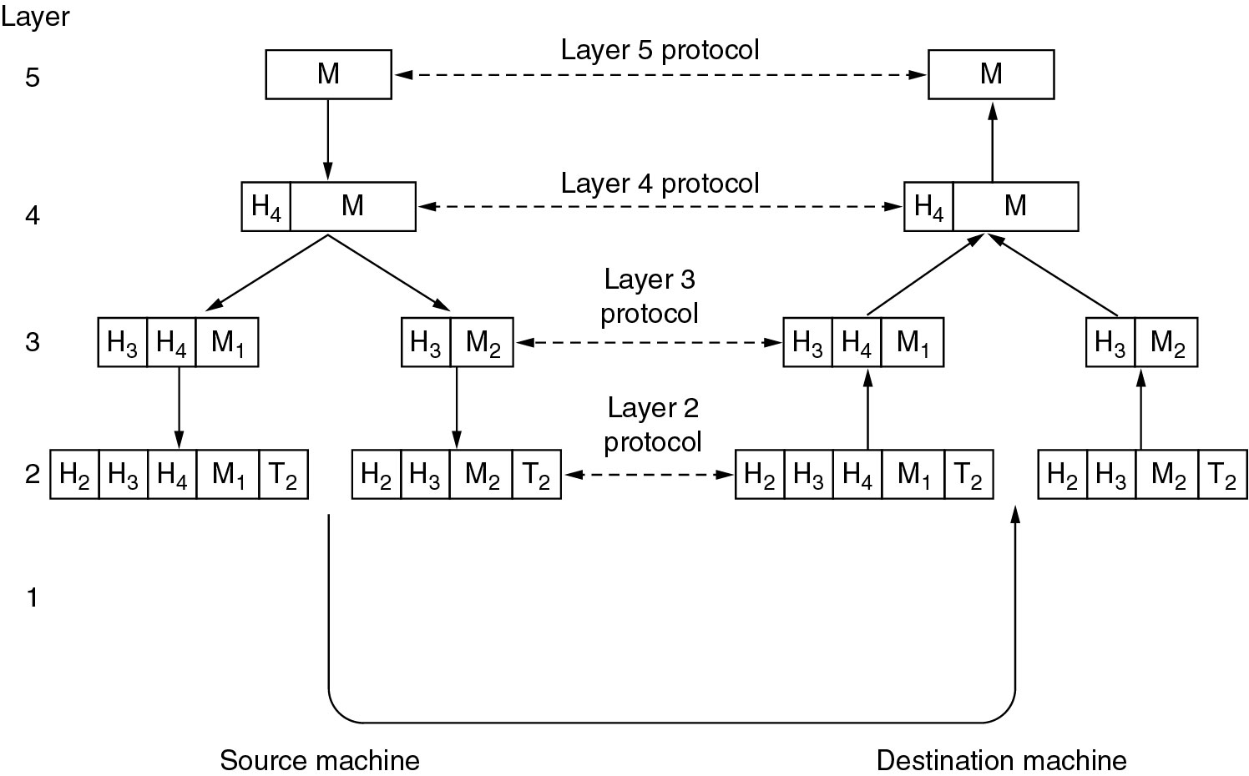
Protocol Hierarchies (3)
Message segmentation
Encapsulation
Example information flow supporting virtual communication in layer 5.

Slide 26
Design Issues for the Layers
Addressing (telephone number, e-mail address, IP address,…)
Error Control (error correction codes, ARQ, HARQ,…)
Flow Control (feedback-based, rate-based)
Multiplexing (gathering several small messages with the same destination into a single large message or vice versa → Demultiplexing)
Routing (directing traffic to the destination)

Slide 27
Design Issues for Layers
Identify senders and receivers
multiple computers and processes: addressing
Data transfer
simplex, half-duplex, full-duplex communication
# of logical channels per connections, priorities
Error control
error detection
error correction
Sequencing of pieces

Slide 28
Design Issues for Layers
Flow control
feedback from the receiver
agreed upon transmission rate
Length of messages
long messages: disassemble, transmit, and reassmeble messages
short messages: gather several small messages
Multiplexing and Demultiplexing
when expensive to set up a separate connection
needed in physical layer
Routing: split over two or more layers
High level: London -> France or Germany -> Rome
Low level: many available circuits

Slide 29
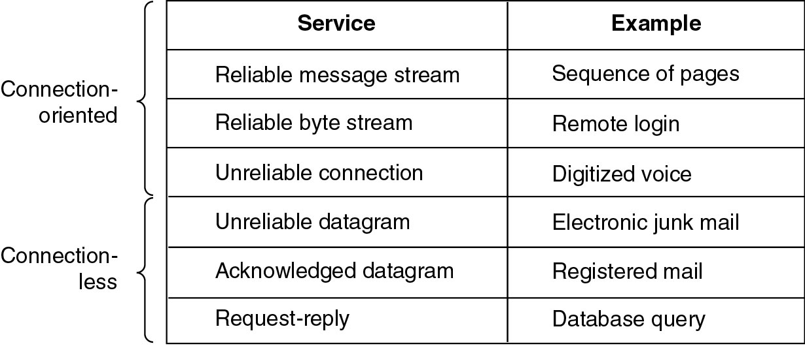
Connection-Oriented and Connectionless Services
Six different types of service.

Slide 30
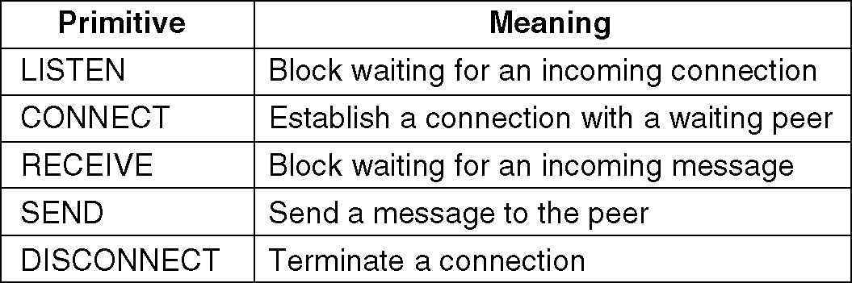
Service Primitives (Operations)
A service is formally defined by a set of primitives (operations) available to a user process to access the services.
Five service primitives for implementing a simple connection-oriented service.

Slide 31
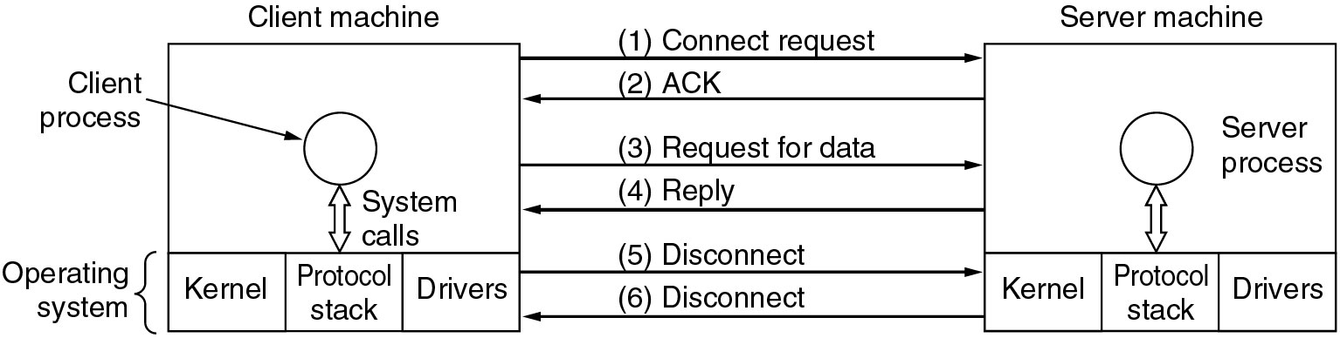
Service Primitives (2)
If the protocol stack is located in the operating system,
the primitives are normally system calls.
Packets sent in a simple client-server interaction on a connection-oriented network.

Slide 32
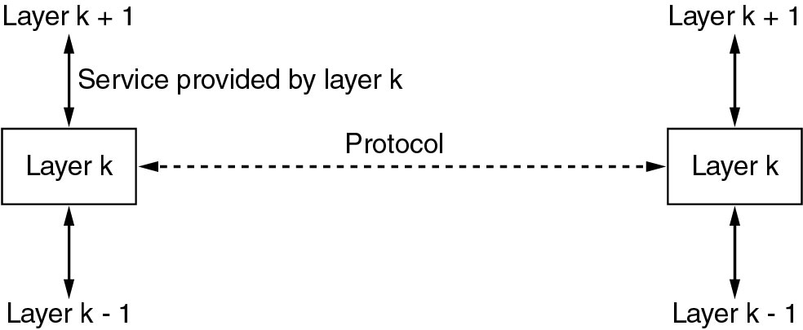
Services to Protocols Relationship
·The service defines what operations the layer is prepared to perform on behalf of its users
·A service is a set of primitives that a layer provides to the layer above it.
·A protocol is a set of rules governing the format and meaning of the packets which are
exchanged by the peer entities in the same layer.
Services related to the interfaces between layers;
Protocols related to the packets sent between peer entities on different machine.
Service Users
Service Providers
The relationship between a service and a protocol.

