Slide 1
19CS2109
COMPUTER NETWORKS AND SECURITY

Slide 2
Introduction
Session-5-6

Slide 3
Reference Models
The OSI Reference Model
The TCP/IP Reference Model
A Comparison of OSI and TCP/IP
A Critique of the OSI Model and Protocols
A Critique of the TCP/IP Reference Model

Slide 4
The Design Principle of the OSI reference model
A layer should be created where a different abstraction is needed
Each layer should perform a well defined function
The function of each layer can be chosen as an international standard
The layer boundaries should be chosen to minimize the information flow across the interfaces
The number of layers should be not be too large or not too small

Slide 5
OSI REFERENCE MODEL
Established in 1947
ISO is a multinational body dedicated to worldwide agreement on international standards.
Almost three-fourths of countries in the world are represented in the ISO.
An ISO standard that covers all aspects of network communications is the Open Systems Interconnection (OSI) model.
It was first introduced in the late 1970s
An open system is a set of protocols that allows any two different systems to communicate regardless of their underlying architecture

Slide 6
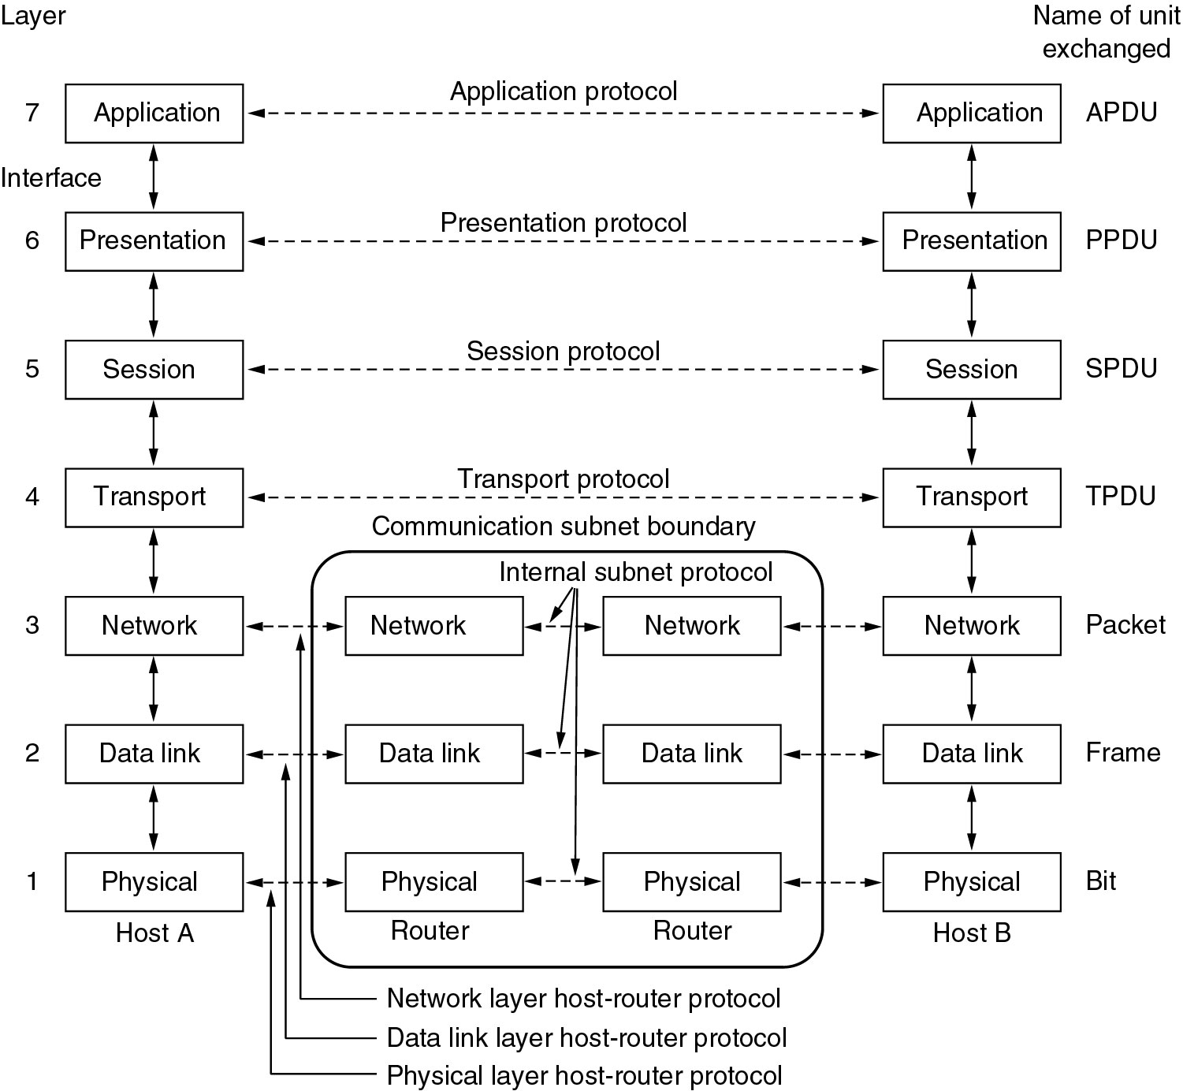
Reference Models (The OSI Reference Model)

Slide 7
PHYSICAL LAYER
Physical characteristics of interfaces and media.
Representation of bits.
Data rate.
Synchronization of bits
Line configuration.
Physical topology.
Transmission mode.

Slide 8
Data Link Layer
Framing.
Physical addressing
Flow control
Error control.
Access control.

Slide 9
Network Layer
The network layer is responsible for the source-to-destination delivery of a packet, possibly across multiple networks (links). Whereas the data link layer oversees the delivery of the packet between two systems on the same network (link).
Logical addressing
Routing

Slide 10
Transport layer
The transport layer is responsible for process-to-process delivery of the entire message. A process is an application program running on the host
Service-point addressing
Segmentation and reassembly
Connection control
Flow control
Error control

Slide 11
Session Layer
The session layer is the network dialog controller.
It establishes, maintains, and synchronizes the interaction between communicating systems.
Dialog control: The session layer allows two systems to enter into a dialog. It allows the communication between two processes to take place in either half-duplex (one way at a time) or full-duplex (two ways at a time) mode.
Synchronization: CHECK POINTS

Slide 12
Presentation Layer
Translation.
Encryption.
Compression

Slide 13
Application Layer
File transfer, access, and management (FTAM): This application allows a user to access files in a remote host (to make changes or read data), to retrieve files from a remote computer for use in the local computer, and to manage or control files in a remote computer locally.
E-mail services: This application provides the basis for e-mail forwarding and storage.
Directory services: This application provides distributed database sources and access for global information about various objects and services

Slide 14
The functions of the seven layers
The physical layer is concerned with transmitting raw bits over a communication channel
The data link layer performs flow control and also transforms a raw transmission facility into a line that appears error free (ARQ)
The network layer controls the operation of the subnet, e.g. routing, flow control, internetworking,…
The transport layer performs assembling and disassembling, isolates the upper layers from the changes in the network hardware, and determines the type of services
The session layer establishes sessions (dialog control, …)
The presentation layer is concerned with the syntax and semantics
The application layer contains a variety of commonly used protocols (e.g. Hyper Text Transfer Protocol for WWW, file transfer, e-mail, network news,…)

Slide 15
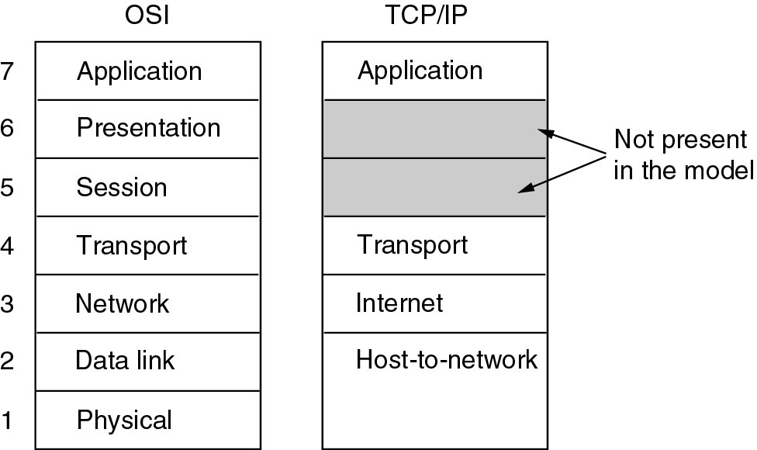
Reference Models (2)
The TCP/IP reference model.

Slide 16
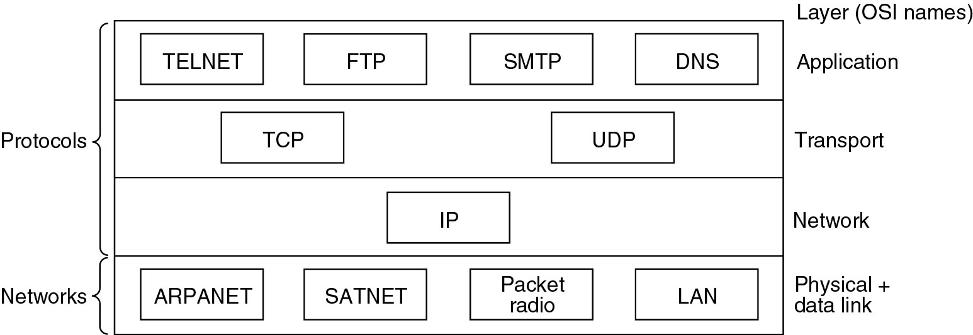
Reference Models (3)
Protocols and networks in the TCP/IP model initially.

Slide 17
Comparing OSI and TCP/IP Models
Concepts central to the OSI model
Services: defines layer’s semantics
Interfaces: tells the processes above it how to access it.
Protocols
Probably the biggest contribution of the OSI model is to make the
distinction between these three concepts explicit.

Slide 18
A Critique of the OSI Model and Protocols
Why OSI did not take over the world
Bad timing
Bad technology
Bad implementations
Bad politics

Slide 19
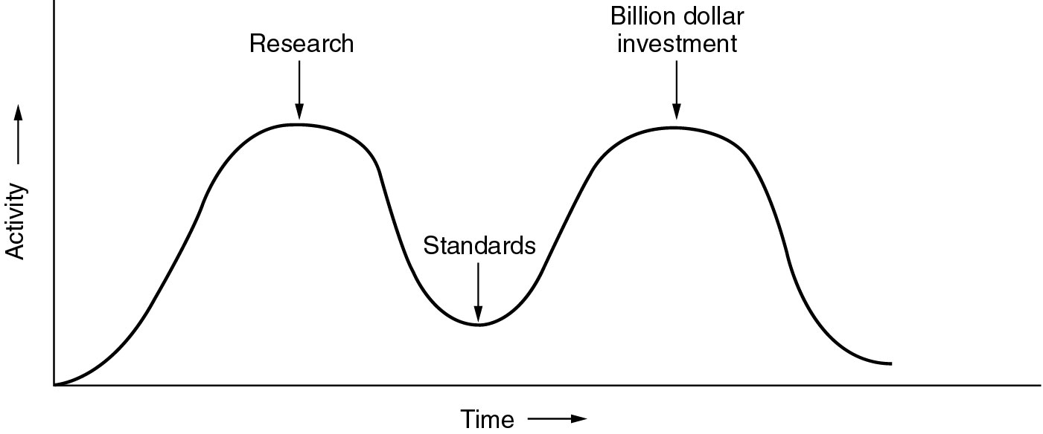
Bad Timing
The apocalypse of the two elephants.
investment opportunity
right time to make
new discovery

Slide 20
Bad Technology
The choice of seven layers was political
- session and presentation layers are nearly empty
- Data and network layers are overfull
The OSI model is extraordinarily complex
Some functions e.g. addressing, flow control, error control reappear again and again

Slide 21
Bad Implementations
Huge, Unwieldy, and Slow
Bad Politics
Bureaucrats involved too much (European telecommunication ministries, community, us government)

Slide 22
A Critique of the TCP/IP Reference Model
Problems:
Service, interface, and protocol not distinguished
Not a general model
Host-to-network “layer” not really a layer (is an interface)
No mention of physical and data link layers
Minor protocols deeply entrenched, hard to replace
(The virtual terminal protocol, TELNET, was designed for mechanical teletype terminal)

Slide 23
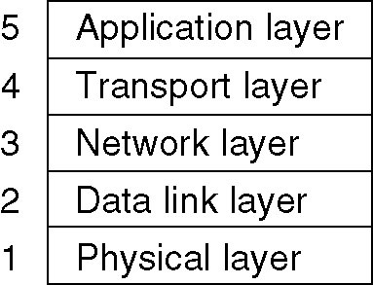
Hybrid Model
The hybrid reference model to be used in this book.

