Slide 1
18 CS 2204
COMPUTER NETWORKS AND SECURITY

Slide 2
Introduction
Session-7&8

Slide 3
Data Link Layer Design Issues
Services Provided to the Network Layer
Framing
Error Control
Flow Control
Access Control

Slide 4
Functions of the Data Link Layer
Provide service interface to the network layer
Dealing with transmission errors
Regulating data flow
  Slow receivers not swamped by fast senders
  Frame management forms the heart of what data link layer does

Slide 5
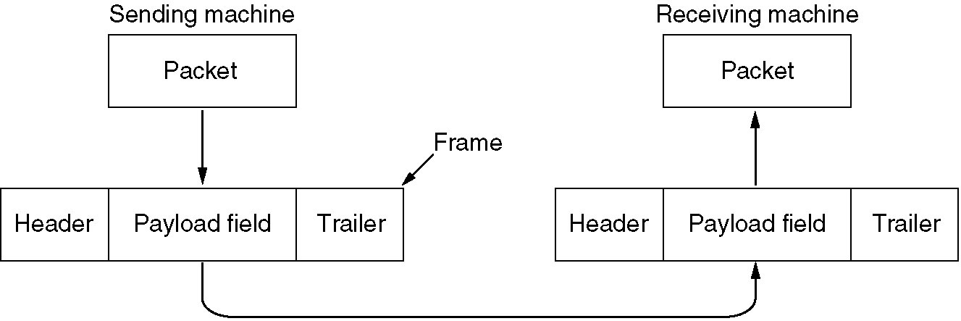
Functions of the Data Link Layer (2)
Relationship between packets and frames.

Slide 6
Services Provided to Network Layer
The function of the data link layer is to provide services to the network layer.
The principal service is transferring data from the network layer on the source machine to the network layer on the destination machine.
The data link layer can be designed to offer various services. The actual services offered can vary from system to system. Three reasonable possibilities that are commonly provided are
1. Unacknowledged connectionless service.
2. Acknowledged connectionless service.
3. Acknowledged connection-oriented service.

Slide 7
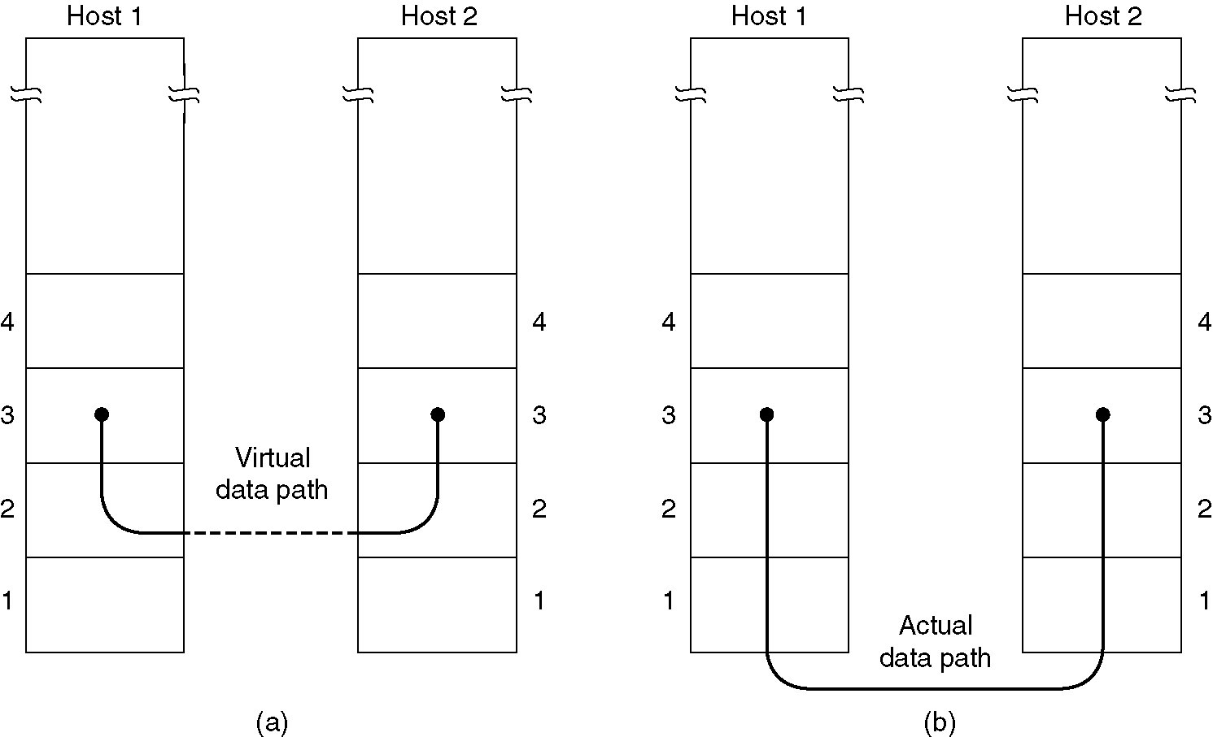
Services Provided to Network Layer
(a) Virtual communication.
(b) Actual communication.

Slide 8
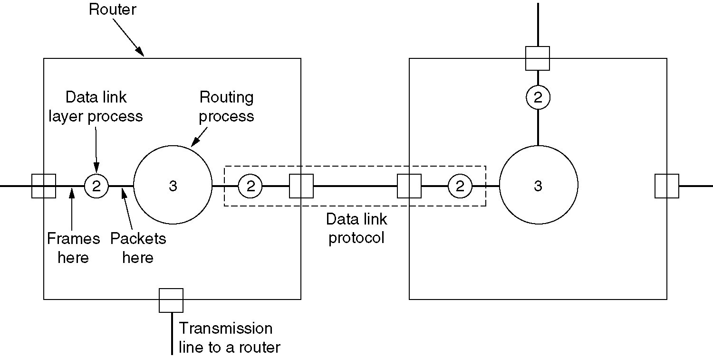
Services Provided to Network Layer (2)
Placement of the data link protocol.

Slide 9
Framing:
To provide service to the network layer, the data link layer must use the service provided to it by the physical layer.
What the physical layer does is accept a raw bit stream and attempt to deliver it to the destination. This bit stream is not guaranteed to be error free.
The usual approach is for the data link layer to break the bit stream up into discrete frames and compute the checksum for each frame.
Breaking the bit stream up into frames is more difficult than it at first appears. One way to achieve this framing is to insert time gaps between frames, much like the spaces between words in ordinary text.
Since it is too risky to count on timing to mark the start and end of each frame, other methods have been devised. Now we will look at three methods:
1. Character count.
2. Flag bytes with byte stuffing.
3. Starting and ending flags, with bit stuffing.

Slide 10
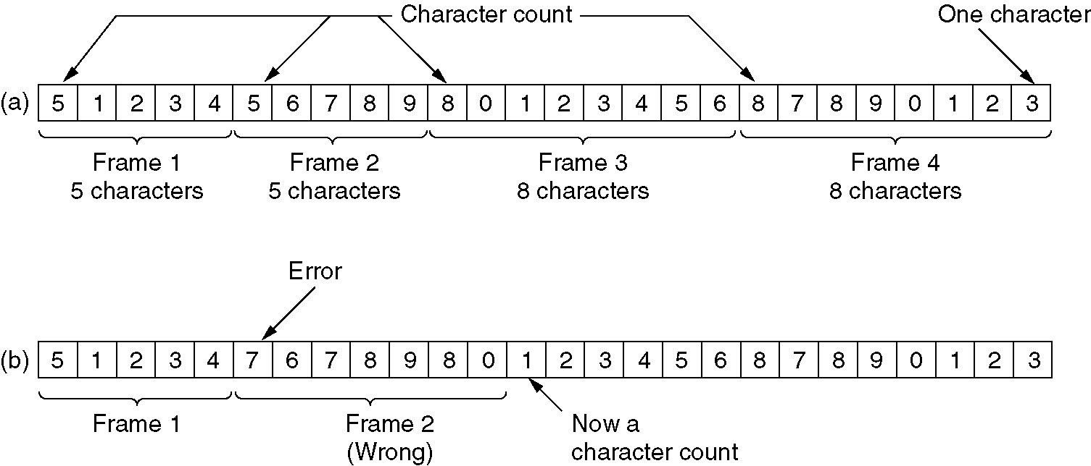
Framing
A character stream. (a) Without errors. (b) With one error.

Slide 11
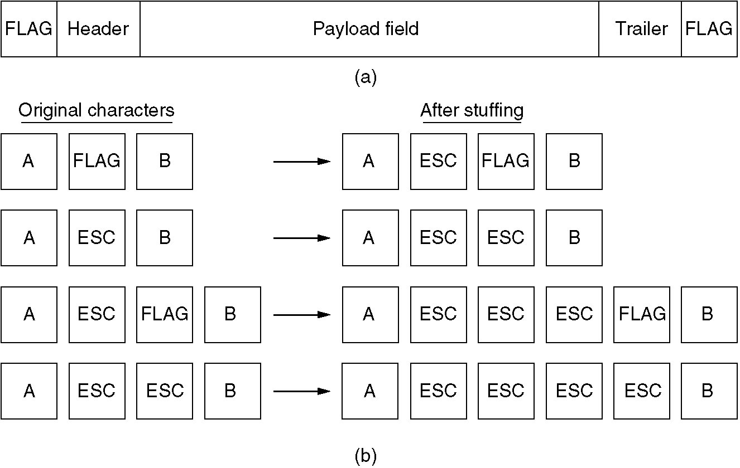
Framing (2)
(a) A frame delimited by flag bytes.
(b) Four examples of byte sequences before and after stuffing.

Slide 12
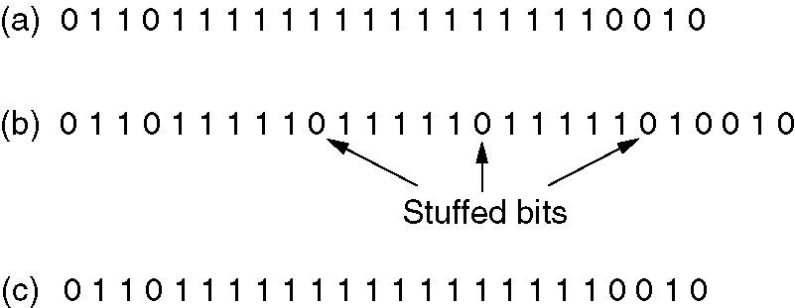
Framing (3)
Bit stuffing
(a) The original data.
(b) The data as they appear on the line.
(c) The data as they are stored in receiver’s memory after destuffing.

Slide 13
Error Detection and Correction
Error-Correcting Codes
Error-Detecting Codes

Slide 14
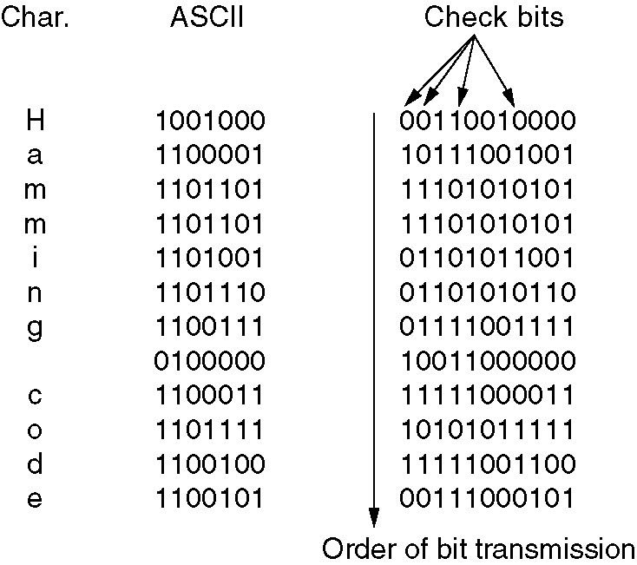
Error-Correcting Codes
Use of a Hamming code to correct burst errors.

Slide 15
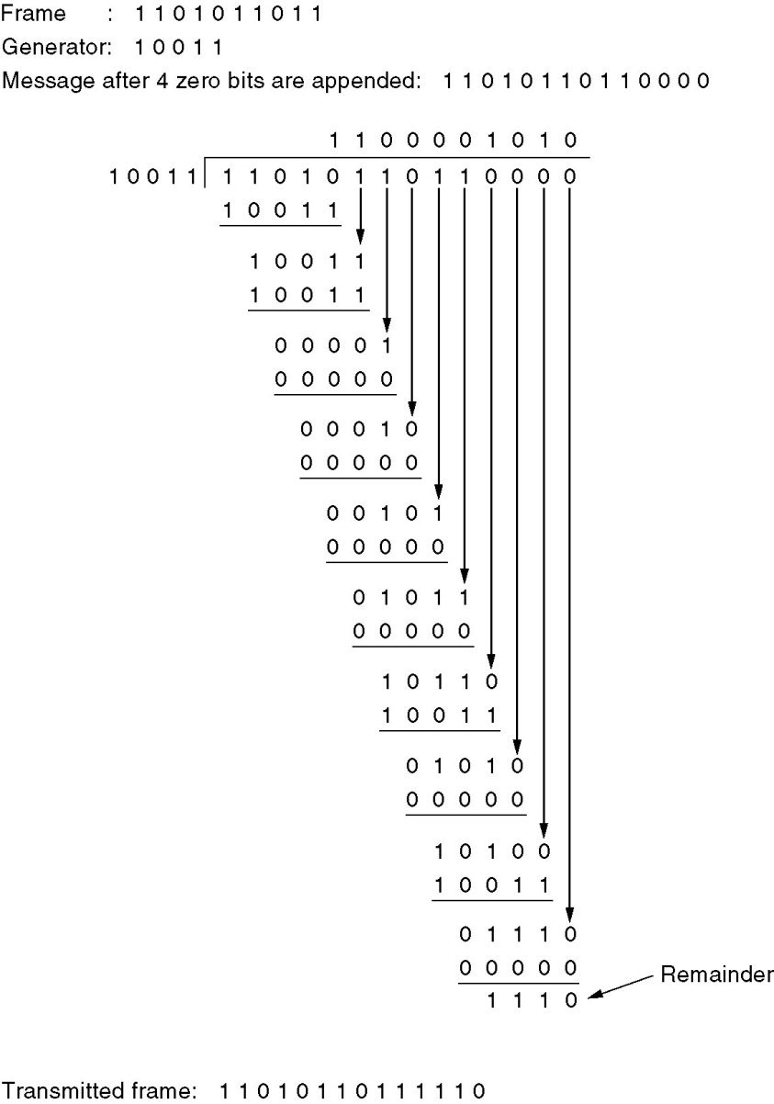
Error-Detecting Codes
Calculation of the polynomial code checksum.

