Slide 1
Session 7
LOCAL SEARCH ALGORITHMS

Slide 2
Session outcomes
Students will be able to learn about Local Search and types of local search algorithms

Slide 3
The search algorithms that we have seen so far designed to explore search spaces systematically.
This systematicity is achieved by keeping one or more paths in memory and by recording which alternatives have been explored at each point along the path.
When a goal is found, the path to that goal also constitutes a solution to the problem.
In many problems, how-ever, the path to the goal is irrelevant. For example, in the 8-queens problem . what matters is the final configuration of queens, not the order in which they are added.
The same general property holds for many important applications such as integrated-circuit design, factory-flour layout, job-shop scheduling, automatic programming, telecommunications network optimization, vehicle routing. and portfolio management.

Slide 4
LOCAL SEARCH ALGORITHMS
If the path to the goal does not matter, a different class of algorithms like Local Search Algorithms can be considered.
Local search algorithms operate using a single current node (rather than multiple paths) and generally move only to neighbors of that node.
Typically, the paths followed by the search are not retained.
Although local search algorithms are not systematic, they have two key advantages:
They use very little memory—usually a constant amount; and
They can often find reasonable solutions in large or infinite(continuous) state spaces for which systematic algorithms are unsuitable.

Slide 5
In addition to finding goals, local search algorithms are useful for solving pure optimization problems, in which the aim is to find the best state according to an objective function.
A complete local search algorithm always finds a goal if one exists.
An optimal algorithm always finds a global minimum/maximum.

Slide 6
HILL CLIMIBING
Hill climbing is a simple local optimization method that “climbs” up the hill until a local optimum is found (assuming a maximization goal).
The method works by iteratively searching for new solutions within the neighborhood of current solution, adopting new solutions if they are better.
There are several hill climbing variants:
Simple Hill Climbing: Which selects one next state in the neighborhood and adopts that.
Steepest Ascent Hill Climbing: which searches for up to N solutions in the neighborhood of S and then adopts the best one. It is time consuming but gives an optimum result.

Slide 7
Hill Climbing(continued…)
Algorithm: Simple Hill Climbing
Evaluate the initial state. If it is also goal state, then return it and quit. Otherwise continue with the initial state as the current state.
Loop until a solution is found or until there are no new operators left to be applied in the current state:
Select an operator that has not yet been applied to the current state and apply it to produce a new state
Evaluate the new state
If it is the goal state, then return it and quit.
If it is not a goal state but it is better than the current state, then make it the current state.
If it is not better than the current state, then continue in the loop.

Slide 8

Hill Climbing(continued…) – Blocks World Problem

Slide 9
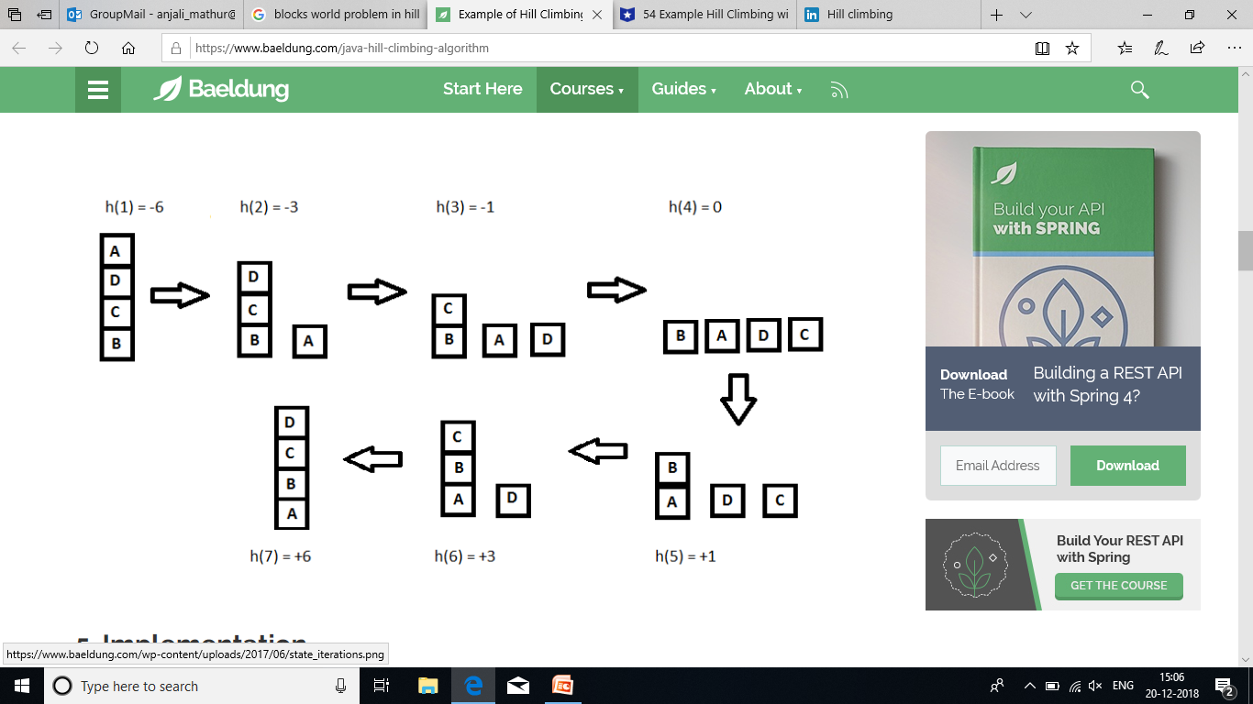

Slide 10
Steepest-Ascent Hill Climbing
This is a variation of simple hill climbing which considers all the moves from the current state and selects the best one as the next state. Also known as Gradient search
Algorithm: Steepest-Ascent Hill Climbing
1.Evaluate the initial state. If it is also a goal state, then return it and quit. Otherwise, continue with the initial state as the current state.
2. Loop until a solution is found or until a complete iteration produces no change to current state:
Let SUCC be a state such that any possible successor of the current state will be better than SUCC
For each operator that applies to the current state do:
Apply the operator and generate a new state
Evaluate the new state. If is is a goal state, then return it and quit. If not, compare it to SUCC. If it is better, then set SUCC to this state. If it is not better, leave SUCC alone.
If the SUCC is better than the current state, then set current state to SUCC.

Slide 11
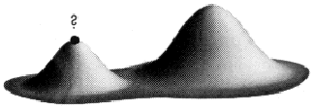
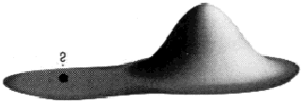
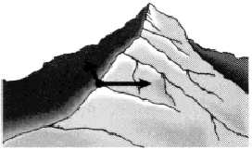
Hill-climbing (continued…) - Limitations
Both simple Hill climbing and Steepest-Ascent Hill climbing may have following limitations:
Local Maxima: a local maximum as opposed to global maximum.
Way Out: Backtrack to some earlier node and try going in a different direction
2. Plateaus: An area of the search space where evaluation function is flat, thus requiring random walk.
Way out: Make a big jump to try to get in a new section
3. Ridge: Where there are steep slopes and the search direction is not towards the top but towards the side.
Way out: Apply two or more rules before doing the test.

Slide 12
Simulated Annealing
A Hill-Climbing algorithm which cannot make moves towards with lower value is guaranteed to be incomplete, because it can get stuck on a local maximum.
In contrast, a purely random walk i.e., moving to a successor chosen uniformly at random from the set of successors is complete but extremely inefficient.
Therefore, it is reasonable to try to combine hill climbing with a random walk in some way that yields both efficiency and completeness.
Simulated Annealing is such an algorithm.

Slide 13
In metallurgy, annealing is the process used to temper or harden metals and glass by heating them to a high temperature and then gradually cooling them, thus allowing the material to reach a low energy crystalline state.
This property of physical annealing can be used to define an analogous process of simulated annealing.
Simulated annealing uses the objective function of an optimization problem instead of the energy of a material.
Implementation of SA is surprisingly simple.
The algorithm is basically hill-climbing except instead of picking the best move, it picks a random move.

Slide 14
If the selected move improves the solution, then it is always accepted.
Otherwise, the algorithm makes the move anyway with some probability less than 1.
The probability decreases exponentially with the “badness” of the move, which is the amount ∆E by which the solution is worsened (i.e., energy is increased.)

Slide 15
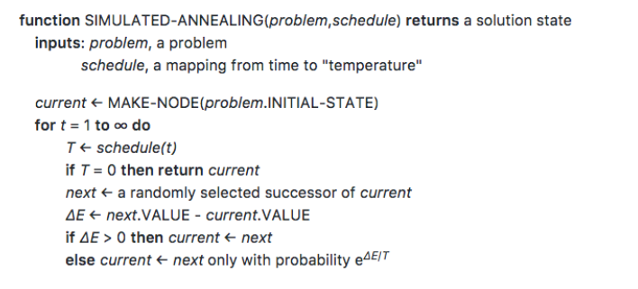
Simulated Annealing - Algorithm

Slide 16
Local Beam Search
In this algorithm, it holds k number of states at any given time.
At the start, these states are generated randomly.
The successors of these k states are computed with the help of objective function.
If any of these successors is the maximum value of the objective function, then the algorithm stops.
Otherwise the (initial k states and k number of successors of the states = 2k) states are placed in a pool.
The pool is then sorted numerically.
The highest k states are selected as new initial states.
This process continues until a maximum value is reached.

Slide 17
Local Beam Search - Algorithm
function BeamSearch( problem, k), returns a solution stat
start with k randomly generated states
loop
generate all successors of all k states
if any of the states = solution, then return the state
else select the k best successors
end

