Slide 1
Session 8
Adversarial Search

Slide 2
Session Outcomes
Students will learn applicability of AI in game playing
Students will learn Optimal decisions in games

Slide 3
Adversarial Search
Here we examine the problems that arise when we try to plan ahead in a world where other agents are planning against us.
We cover competitive environments where agents goals are in conflict which leads adversarial search problem, also known as games.
In AI, these games are considered as deterministic, turn-taking, two-player, zero-sum games of perfect information. For eg: Chess.

Slide 4
Typical AI assumptions
Two agents whose actions alternate
Utility values for each agent are equal and opposite of the other creates the adversarial situation
Fully observable and deterministic environments
Egs:
 | deterministic | Chance moves
Perfect information | Chess, checkers, go, othello | Backgammon, monopoly
Imperfect information (Initial Chance Moves) | Bridge, Skat | Poker, scrabble, blackjack

Slide 5
Search versus Games
Search – no adversary
  Solution is (heuristic) method for finding goal
  Heuristic techniques can find optimal solution
  Evaluation function: estimate of cost from start to goal through given node
  Examples: path planning, scheduling activities
Games – adversary
  Solution is strategy (strategy specifies move for every possible opponent reply).
  Optimality depends on opponent.
  Time limits force an approximate solution
  Evaluation function: evaluate “goodness” of game position
  Examples: chess, checkers, Othello, backgammon

Slide 6
Games with two players
We consider games with two players:
Two players: MAX and MIN
MAX moves first and they take turns until the game is over Winner gets award, loser gets penalty.
Game can be defined as search with following elements:
  S₀ : The initial state, which specifies how the game is set up at the start.
  PLAYER(s): Defines which player has the move in a state.
  ACTIONS(s): Returns the set of legal moves in a state.
  RESULT(s,a): The transition model, which defines the result of a move.
Notes:
Explain these conventions carefully. Maybe contrast with general game trees.

Slide 7
  TERMINAL-TEST(s): A terminal test, which is true when the game is over and false otherwise. States where the game has ended are called terminal states.
  UTILITY(s,p): A utility function (also called an objective function or payoff function), defines the final numeric value for a game that ends in terminal state s for a player p.
The initial state, ACTIONS function, and RESULT function define the game tree for the game
Game tree is a tree where the nodes are game states and the edges are moves.
The figure in next slide shows part of the game tree for tic-tac-toe game.

Slide 8
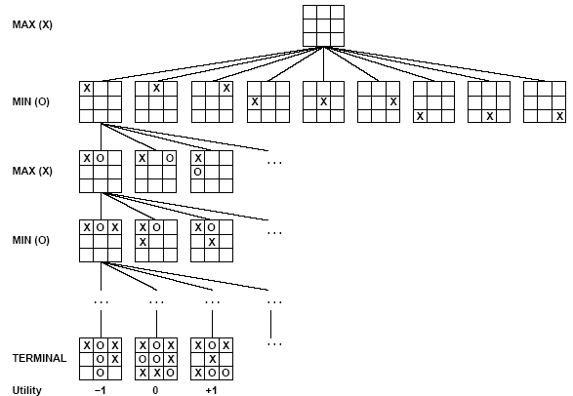
Partial Game Tree for Tic-Tac-Toe

Slide 9
From the initial state, MAX has nine possible moves.
Play alternates between MAX 's placing an X and MIN's placing an 0.
This is continued until we reach leaf nodes corresponding to terminal states such that one player has three in a row or all the squares arc filled.
The number on each leaf node indicates the utility value of the terminal state from the point of view of MAX;
High values are assumed to be good for MAX and bad for MIN (which is how the players get their names).
For tic-tac-toe the game tree is relatively small—fewer than 9! = 362, 880 terminal nodes.

Slide 10
For chess terminal nodes are over 10⁴⁰ nodes.
so the game tree is best thought of as a theoretical construct that we cannot realize in the physical world.
But regardless of the size SEARCH TREE of the game tree, it is MAX's job to search for a good move
We use the term search tree for a tree that is superimposed on the full game tree, and examines enough nodes to allow a player to determine what move to make.

Slide 11
OPTIMAL DECISIONS IN GAMES
In adversarial search, MAX must find a contingent strategy, which specifies MAX's move in the initial state.
Then MAX's moves in the states resulting from every possible response by MIN to those moves and so on.
. We consider the following example:

Slide 12
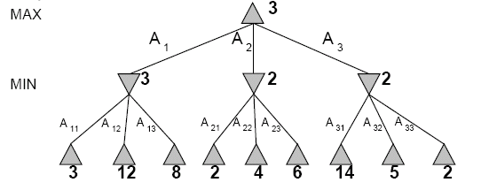
Two-Ply Game Tree

Slide 13


In the above two-ply game tree:
The nodes are MAX nodes, in which it is MAX's turn to move.
The nodes are MIN nodes.
The terminal nodes show the utility values for MAX.
The other nodes are labeled with their minimax values.
MAX 's best move at the root is A1 ,because it leads to the state with the highest minimax value,
and MIN 's best reply is A11, because it leads to the state with the lowest minimax value.
We can identify the minimax decision at the root.

Slide 14
Definition of optimal play for MAX assumes MIN plays optimally: maximizes worst-case outcome for MAX.
But if MIN does not play optimally, MAX will do even better.

Slide 15
The minimax algorithm
function MINIMAX-DECISION(state) returns an action
inputs: state, current state in game
v←MAX-VALUE(state)
return the action in SUCCESSORS(state) with value v
function MAX-VALUE(state) returns a utility value
if TERMINAL-TEST(state) then return UTILITY(state)
v ← -∞
for a,s in SUCCESSORS(state) do
v ← MAX(v,MIN-VALUE(s))
return v
function MIN-VALUE(state) returns a utility value
if TERMINAL-TEST(state) then return UTILITY(state)
^{v ← ∞}
for a,s in SUCCESSORS(state) do
^{v ← MIN(v,MAX-VALUE(s))}
^{return v}

Slide 16
The minimax algorithm in the above example computes the minimax decision from the current state.
It uses a simple recursive computation of the minimax values of each successor state, directly implementing the defining equations.
The recursion proceeds all the way down to the leaves of the tree, and then the minimax values are backed up through the tree as the recursion unwinds.
For example, in above figure, the algorithm first recurses down to the three bottom left nodes and uses the UTILITY function on them to discover that their values are 3, 12, and 8, respectively.
Then it takes the minimum of these values, 3, and returns it as the backed up value of node B.

Slide 17
A similar process gives the backed-up values of 2 for C and 2 for D.
Finally, we take the maximum of 3, 2, and 2 to get the backed-up value of 3 for the root node.
The minimax algorithm performs a complete depth-first exploration of the game tree.
Time and Space complexities:
If the maximum depth of the tree is m and there are b legal moves at each point, then the
  Time complexity of the minimax algorithm is 0(b^{m}).
  The space complexity is 0(bm.)

Slide 18
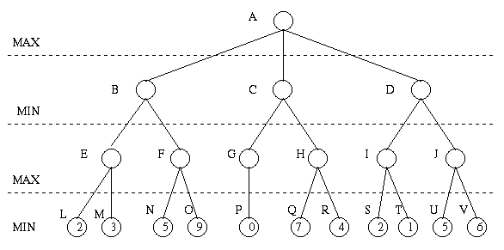
Minimax Algorithm
Payoff for Max

Slide 19
Minimax Algorithm (cont’d)
3
9
0
7
2
6
Payoff for Max

Slide 20
Minimax Algorithm (cont’d)
3
0
2
3
9
0
7
2
6
Payoff for Max

Slide 21
Minimax Algorithm
(DFS left to right)
3
3
0
2
3
9
0
7
2
6
Payoff for Max
End of Session

