Slide 1
SESSION 9
Alpha Beta Pruning

Slide 2
Session outcomes
Students will be able to learn how to prune branches of minimax game tree using Alpha Beta Pruning

Slide 3
INTRODUCTION
The Problem with minimax search is that the number of games states it has to examine is exponential in the depth of the tree.
To avoid this, we can compute the correct minimax decision without looking at every node in the game tree.
This particular technique we examine is called alpha-beta pruning.
When this technique is applied to a standard minimax tree, it returns same move as minimax would, but prunes away braches that cannot possibly influence the final decision.
Alpha-beta pruning can be applied to trees of any depth.
It is often possible to prune entire sub trees rather than just leaves.

Slide 4
Alpha-beta pruning gets its name from two parameters.
They describe bounds on the values that appear anywhere along the path under consideration:
α = the value of the best (i.e., highest value) choice found so far along the path for MAX.
β = the value of the best (i.e., lowest value) choice found so far along the path for MIN.
Alpha-beta search updates the values of α an β as it goes along and prunes the remaining braches at a node as soon as the value of the current node is known to be worse than the current α an β value for MAX or MIN, respectively.

Slide 5
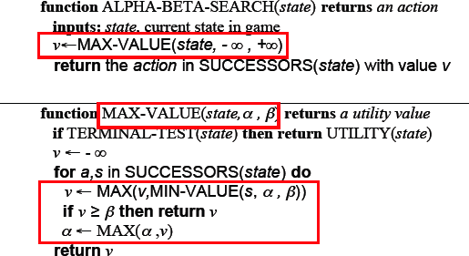
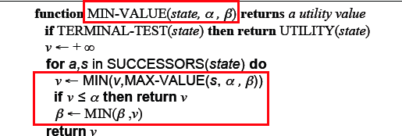
Algorithm: Alpha Beta Search

Slide 6
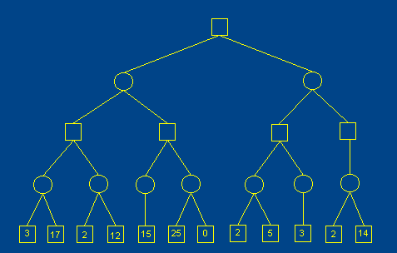
Example

Slide 7

Initial Assumption for Alpha and Beta
At the start of the problem, you see only the current state (i.e. the current position of pieces on the game board). As for upper and lower bounds, all you know is that it's a number less than infinity and greater than negative infinity. Thus, here's what the initial situation looks like:

Slide 8
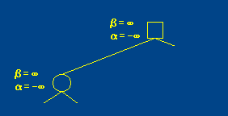
Example
Since the bounds still contain a valid range, we start the problem by generating the first child state, and passing along the current set of bounds. At this point our search looks like this:

Slide 9
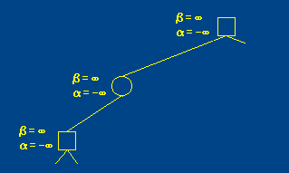
Example
We're still not down to depth 4, so once again we generate the first child node and pass along our current alpha and beta values:

Slide 10
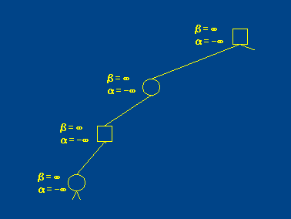
Example
And one more time

Slide 11
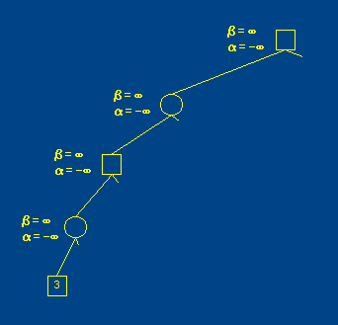
Example
When we get to the first node at depth 4, we run our evaluation function on the state, and get the value 3. Thus we have this:

Slide 12
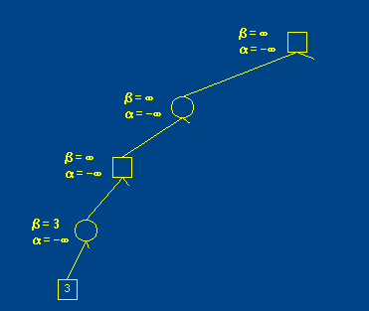
Example
We pass this node back to the min node above. Since this is a min node, we now know that the minimax value of this node must be less than or equal to 3. In other words, we change beta to 3.

Slide 13
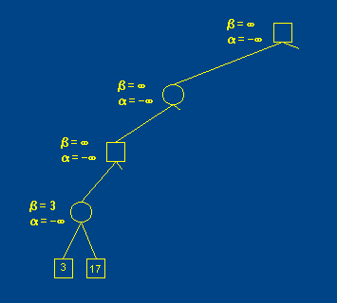
Example
Next we generate the next child at depth 4, run our evaluation function, and return a value of 17 to the min node above:

Slide 14
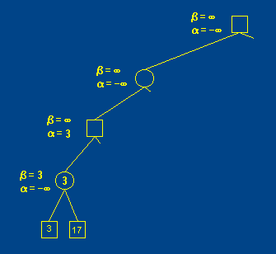
Example
Since this is a min node and 17 is greater than 3, this child is ignored. Now we've seen all of the children of this min node, so we return the beta value to the max node above. Since it is a max node, we now know that it's value will be greater than or equal to 3, so we change alpha to 3:

Slide 15
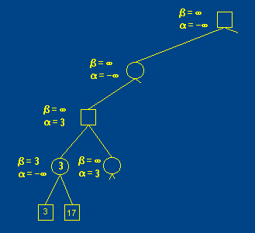
Example
We generate the next child and pass the bounds along

Slide 16
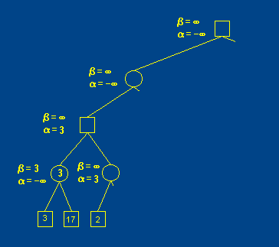
Example
Since this node is not at the target depth, we generate its first child, run the evaluation function on that node, and return it's value

Slide 17
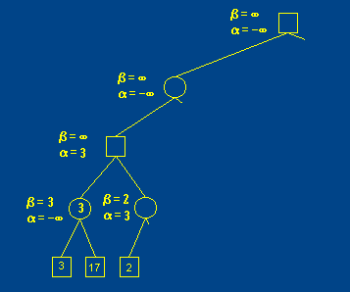
Example
Since this is a min node, we now know that the value of this node will be less than or equal to 2, so we change beta to 2:

Slide 18
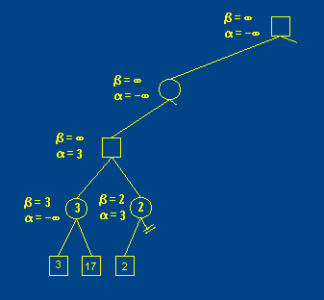
Example
Admittedly, we don't know the actual value of the node. There could be a 1 or 0 or - 100 somewhere in the other children of this node. But even if there was such a value, searching for it won't help us find the optimal solution in the search tree. The 2 alone is enough to make this subtree fruitless, so we can prune any other children and return it.

Slide 19
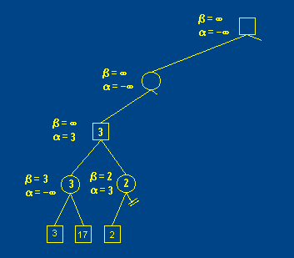
Example
Back at the parent max node, our alpha value is already 3, which is more restrictive than 2, so we don't change it. At this point we've seen all the children of this max node, so we can set its value to the final alpha value:

Slide 20
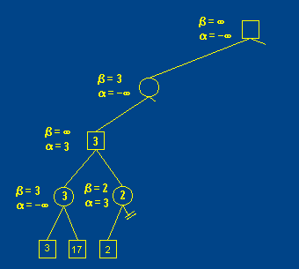
Example
Now we move on to the parent min node. With the 3 for the first child value, we know that the value of the min node must be less than or equal to 3, thus we set beta to 3:

Slide 21
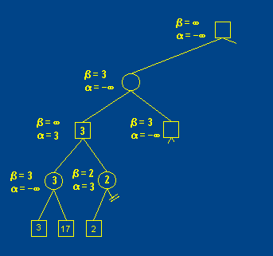
Example
Since we still have a valid range, we go on to explore the next child. We generate the max node...

Slide 22
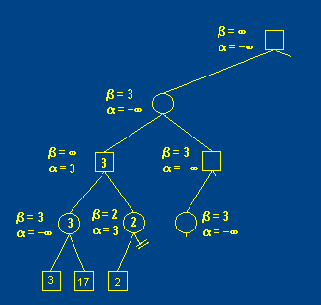
Example
... it's first child min node

Slide 23
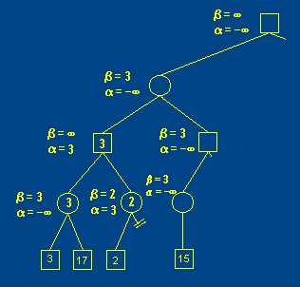
Example
... and finally the max node at the target depth. All along this path, we merely pass the alpha and beta bounds along.

Slide 24
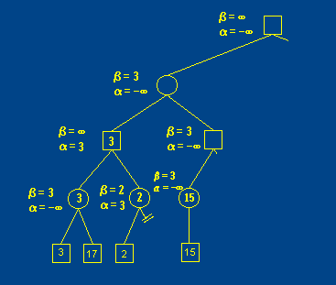
Example
At this point, we've seen all of the children of the min node, and we haven't changed the beta bound. Since we haven't exceeded the bound, we should return the actual min value for the node. Notice that this is different than the case where we pruned, in which case you returned the beta value. The reason for this will become apparent shortly.

Slide 25
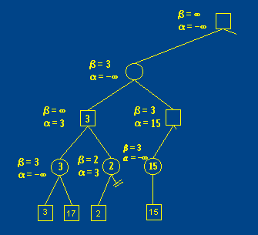
Example
Now we return the value to the parent max node. Based on this value, we know that this max node will have a value of 15 or greater, so we set alpha to 15:

Slide 26
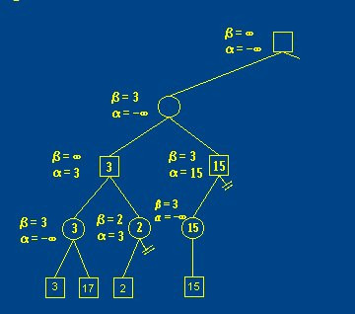
Example
Once again the alpha and beta bounds have crossed, so we can prune the rest of this node's children and return the value that exceeded the bound (i.e. 15). Notice that if we had returned the beta value of the child min node (3) instead of the actual value (15), we wouldn't have been able to prune here.

Slide 27
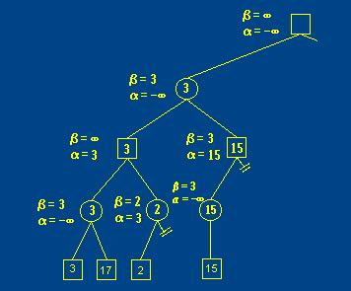
Example
Now the parent min node has seen all of it's children, so it can select the minimum value of it's children (3) and return.

Slide 28
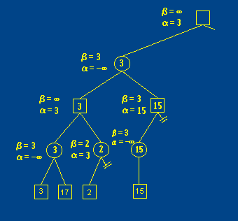
Example
Finally we've finished with the first child of the root max node. We now know our solution will be at least 3, so we set the alpha value to 3 and go on to the second child.

Slide 29
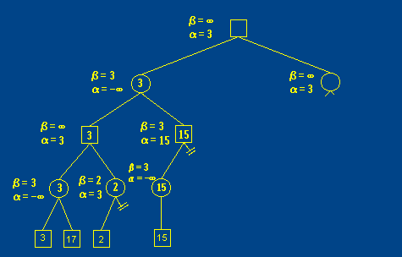
Example
Passing the alpha and beta values along as we go, we generate the second child of the root node...

Slide 30
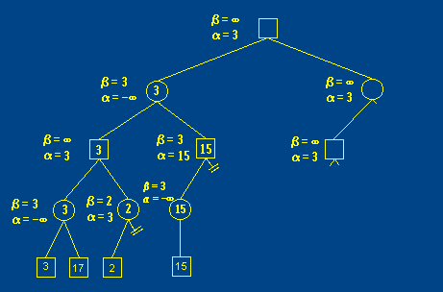
Example
... and its first child ...

Slide 31
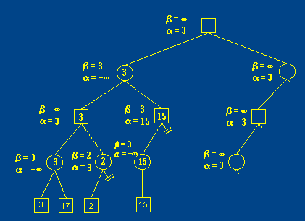
Example

Slide 32
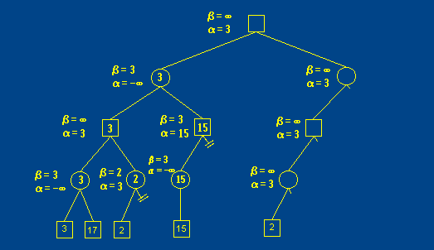
Examplee

Slide 33
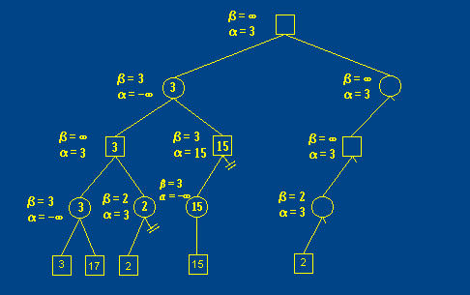
Example
The min node parent uses this value to set it's beta value to 2:

Slide 34
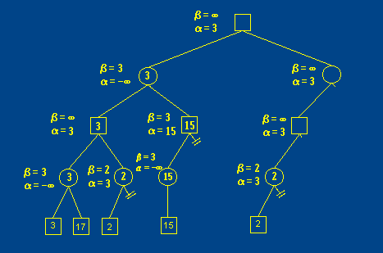
Example
Once again we are able to prune the other children of this node and return the value that exceeded the bound. Since this value isn't greater than the alpha bound of the parent max node, we don't change the bounds.

Slide 35
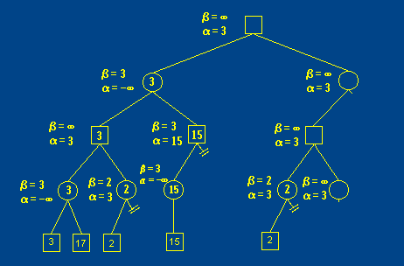
Example
From here, we generate the next child of the max node:

Slide 36
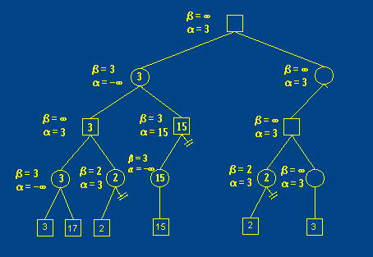
Example
Then we generate its child, which is at the target depth. We call the
evaluation function and get its value of 3.

Slide 37
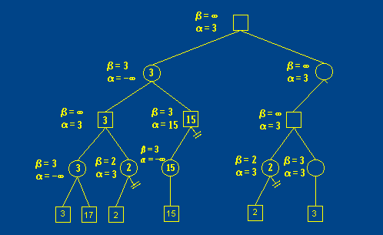
Example
The parent min node uses this value to set its upper bound (beta) to 3:

Slide 38
Example
In other words, at this point alpha = beta. Should we prune here? We haven't actuallyexceeded the bounds, but since alpha and beta are equal, we know we can't really do better in this subtree.
The answer is yes, we should prune. The reason is that even though we can't do better, we might be able to do worse. Remember, the task of minimax is to find the best move to make at the state represented by the top level max node. As it happens we've finished with this node's children anyway, so we return the min value 3.

Slide 39
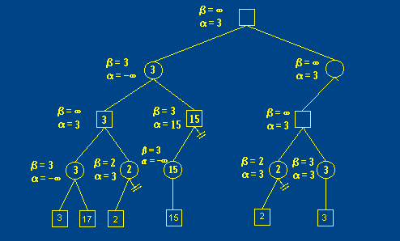
Examplee

Slide 40
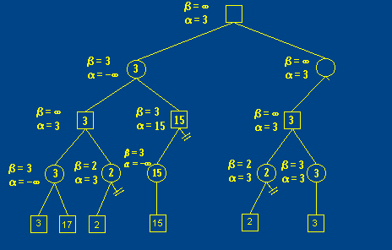
Example
The max node above has now seen all of its children, so it returns the maximum value of those it has seen, which is 3.

Slide 41
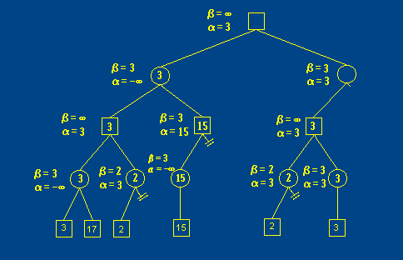
Example
This value is returned to its parent min node, which then has a new upperbound of 3, so it sets beta to 3.

Slide 42
Once again, we're at a point where alpha and beta are tied, so we prune. Note that a real solution doesn't just indicate a number, but what move led to that number.
If you were to run minimax on the list version presented at the start of the example, your minimax would return a value of 3 and 6 terminal nodes would have been examined.

Slide 43
Conclusion
Pruning does not affect final results.
Entire subtrees can be pruned, not just leaves.
Good move ordering improves effectiveness of pruning.
With perfect ordering, time complexity is O(b^{m/2}).
Effective branching factor of sqrt(b).
Consequence: alpha-beta pruning can look twice as deep as minimax in the same amount of time.

