Slide 1
Session 11 Constraint satisfaction problem

Slide 2
Constraint satisfaction problems (CSPs)
A problem is solved when each variable has a value that satisfies all the constraints on the variable.
A problem described this way is called a constraint satisfaction problem, or CSP.
A constraint satisfaction problem consists of three components X, D, and C:
X is a set of variables, {X_{i}, ., X_{n},}.
D is a set of domains, {D_{i}, , D_{n}}one for each variable.
C is a set of constraints that specify allowable combinations of values.
Each domain Di consists of a set of allowable values,{v1,v2,…vn} for variable X.
Each constraint C_{i} consists of a pair scope rely, where scope is a tuple of variables that participate in the constraint.
And is a relation that defines the values that those variables can take on.

Slide 3
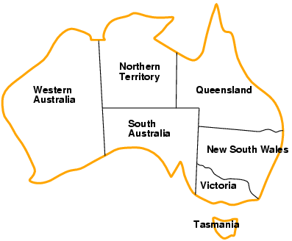
Example: Map-Coloring
Variables WA, NT, Q, NSW, V, SA, T
Domains D_{i} = {red,green,blue}
Constraints: adjacent regions must have different colors e.g., WA ≠ NT, or (WA,NT) in {(red,green),(red,blue),(green,red), (green,blue),(blue,red),(blue,green)}.

Slide 4
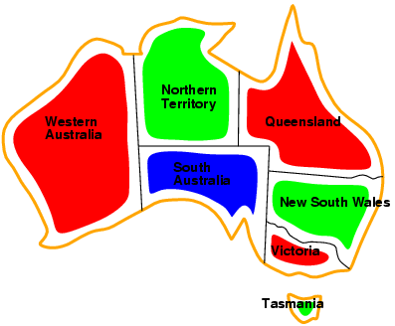
Example: Map-Coloring
Solutions are complete and consistent assignments
e.g., WA = red, NT = green, Q = red, NSW = green, V = red, SA = blue, T = green.

Slide 5
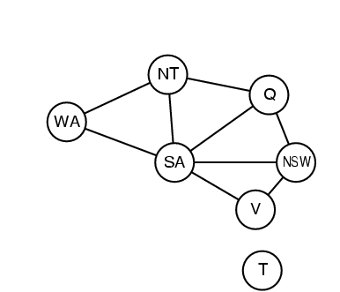
Constraint graph
Constraint graph: nodes are variables, arcs are constraints

Slide 6
Variations on the CSP formalism
Discrete variables
finite domains:
n variables, domain size d → O(d^{n}) complete assignments
e.g., Boolean CSPs, incl. Boolean satisfiability (NP-complete)
infinite domains:
integers, strings, etc.
e.g., job scheduling, variables are start/end days for each job
need a constraint language, e.g., StartJob₁ + 5 ≤ StartJob₃
Continuous variables
e.g., start/end times for Hubble Space Telescope observations
linear constraints solvable in polynomial time by LP

Slide 7
Types of constraints
Unary constraints involve a single variable,
e.g., SA ≠ green
Binary constraints involve pairs of variables,
e.g., SA ≠ WA
Higher-order constraints involve 3 or more variables,
e.g., crypt arithmetic column constraints

Slide 8
Real-world CSPs
Assignment problems
e.g., who teaches what class
Timetabling problems
e.g., which class is offered when and where?
Transportation scheduling
Factory scheduling

Slide 9
Standard search formulation (incremental)
Let's start with the straightforward approach, then fix it.
States are defined by the values assigned so far
Initial state: the empty assignment { }
Successor function: assign a value to an unassigned variable that does not conflict with current assignment
fail if no legal assignments Goal test: the current assignment is complete
This is the same for all CSPs
Every solution appears at depth n with n variables→ use depth-first search
Path is irrelevant, so can also use complete-state formulation
b = (n - l )d at depth l, hence n! · d^{n} leaves

Slide 10
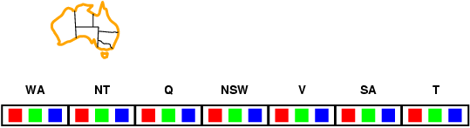
Forward checking
Idea:
Keep track of remaining legal values for unassigned variables
Terminate search when any variable has no legal values

Slide 11
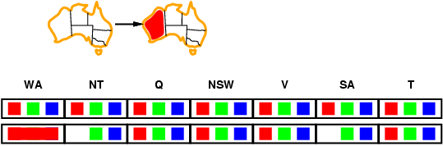
Forward checking
Idea:
Keep track of remaining legal values for unassigned variables
Terminate search when any variable has no legal values

Slide 12
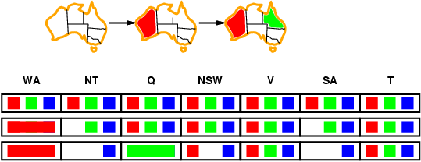
Forward checking
Idea:
Keep track of remaining legal values for unassigned variables
Terminate search when any variable has no legal values

Slide 13
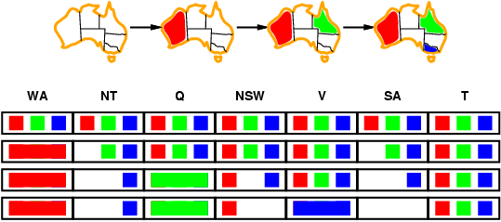
Forward checking
Idea:
Keep track of remaining legal values for unassigned variables
Terminate search when any variable has no legal values

Slide 14
Forward checking
Forward checking propagates information from assigned to unassigned variables, but doesn't provide early detection for all failures:
NT and SA cannot both be blue!
Constraint propagation algorithms repeatedly enforce constraints locally…

Slide 15
Constraint propagation: Inferences in CSPs
In regular state-space search, an algorithm can do only one thing: search.
In CSPs there is a choice: an algorithm can search (choose a new variable assignment from several possibilities) or do a specific type of inference called constraint propagation.
Constraint Propagation is nothing but using the constraints to reduce the number of legal values for a variable, which in turn can reduce the legal values for another variable, and so on.
Constraint propagation may be intertwined with search, or it may he done as a preprocessing step, before search starts_ Sometimes this preprocessing can solve the whole problem, so no search is required at all.

Slide 16
The key idea is local consistency.
If we treat each variable as a node in a and each binary constraint as an arc, then the process of enforcing local consistency in each pan of the graph causes inconsistent values to be eliminated throughout the graph.
There are different types of local consistency.
Node consistency
Arc consistency
Path consistency
K-consistency

