Slide 1
Backtracking search
The term backtracking search is used for a depth-first search that chooses values for one variable at a time and backtracks when a variable has no legal values left to assign.
It repeatedly chooses an unassigned variable, and then tries all values in the domain of that variable in turn, trying to find a solution.
If an inconsistency is detected, then BACKTRACK returns failure, causing the previous call to try another value
Only need to consider assignments to a single variable at each node
Depth-first search for CSPs with single-variable assignments is called backtracking search

Slide 2
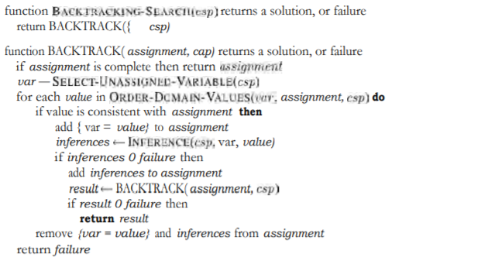
Backtracking search - Algorithm

Slide 3

Backtracking example

Slide 4
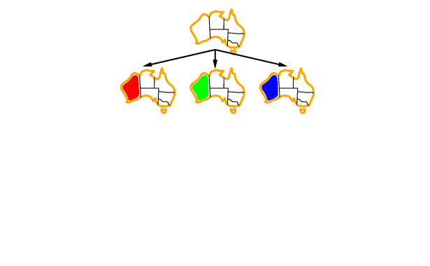
Backtracking example

Slide 5
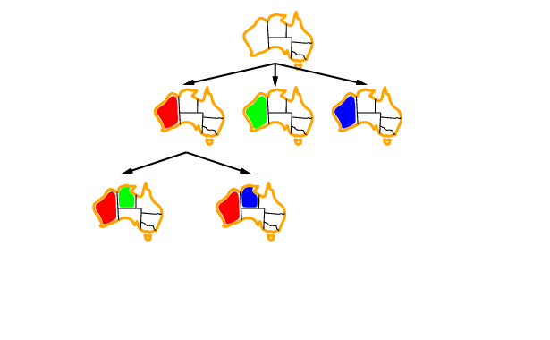
Backtracking example

Slide 6
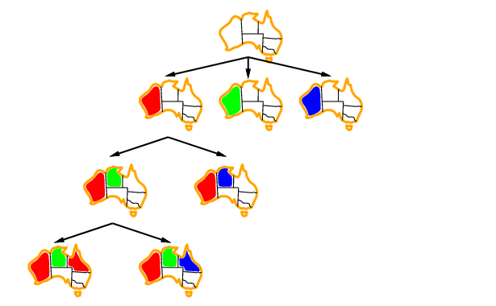
Backtracking example

Slide 7
Improving backtracking efficiency
General-purpose methods can give huge gains in speed:
Which variable should be assigned next?
In what order should its values be tried?
Can we detect inevitable failure early?

Slide 8
Summary
CSPs are a special kind of problem:
states defined by values of a fixed set of variables
goal test defined by constraints on variable values
Backtracking = depth-first search with one variable assigned per node
Variable ordering and value selection heuristics help significantly
Forward checking prevents assignments that guarantee later failure
Constraint propagation (e.g., arc consistency) does additional work to constrain values and detect inconsistencies
Iterative min-conflicts is usually effective in practice
End of Session

Slide 9
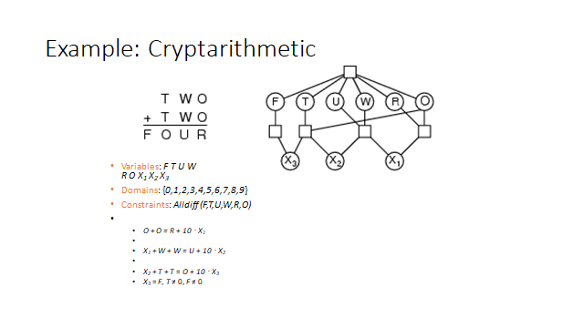

Slide 10
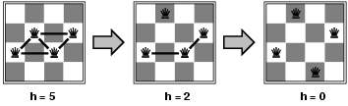
Example: 4-Queens(Self learning)
States: 4 queens in 4 columns (4⁴ = 256 states)
Actions: move queen in column
Goal test: no attacks
Evaluation: h(n) = number of attacks
Given random initial state, can solve n-queens in almost constant time for arbitrary n with high probability (e.g., n = 10,000,000)

Slide 11
Local search for CSPs(Self Learning)
Hill-climbing, simulated annealing typically work with "complete" states, i.e., all variables assigned To apply to CSPs: allow states with unsatisfied constraints operators reassign variable values Variable selection: randomly select any conflicted variable Value selection by min-conflicts heuristic: choose value that violates the fewest constraints
i.e., hill-climb with h(n) = total number of violated constraints

