Slide 1
ARTIFICIAL INTELLIGENCE LAB-3

Slide 2
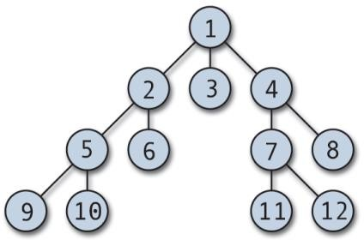
PRE-LAB
Trace out the path using BFS, DFS and IDDFS for the following tree.

Slide 3
BFS
Breadth-first search is a simple strategy in which the root node is expanded first, then all the successors of the root node are expanded next, then their successors, and so on.
In general, all the nodes are expanded at a given depth in the search tree before any nodes at the next level are expanded.
Breadth-first search is an instance of the general graph-search algorithm in which the shallowest unexpanded node is chosen for expansion. This is achieved very simply by using a FIFO queue data structure

Slide 4
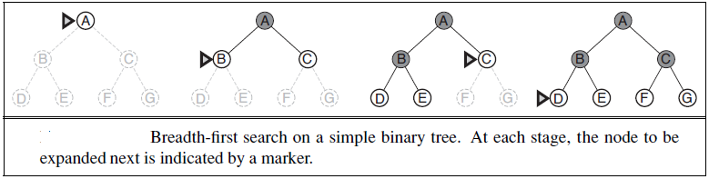
Starting node: A
Goal node: D

Slide 5
DFS
Depth-first search always expands the deepest node.
The search proceeds immediately to the deepest level of the search tree, where the nodes have no successors.
Depth-first search uses a LIFO stack data structure.

Slide 6
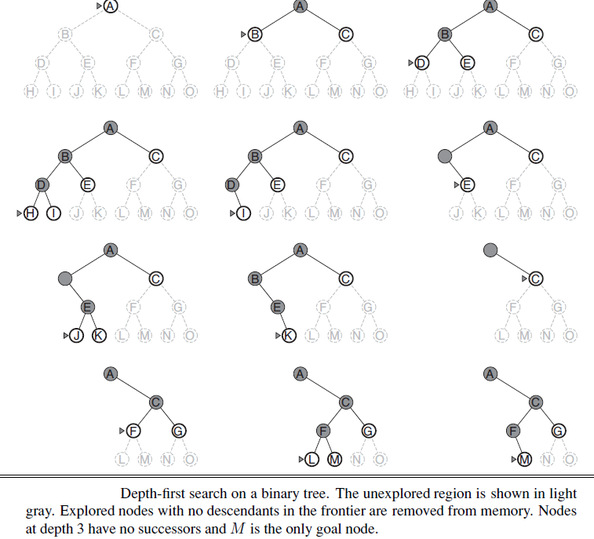

Slide 7
IDDFS
Iterative deepening search (or iterative deepening depth-first search) is a general strategy, often used in combination with depth-first tree search, that finds the best depth limit.
It does this by gradually increasing the limit—first 0, then 1, then 2, and so on—until a goal is found.

Slide 8
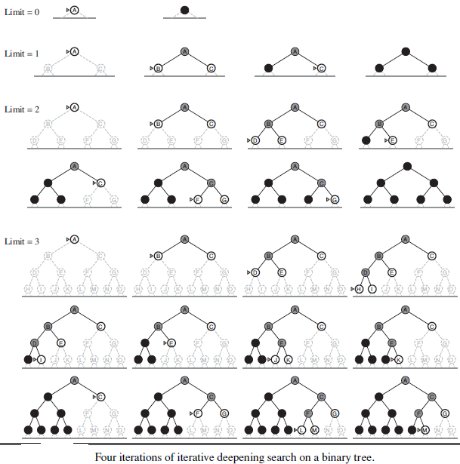

Slide 9
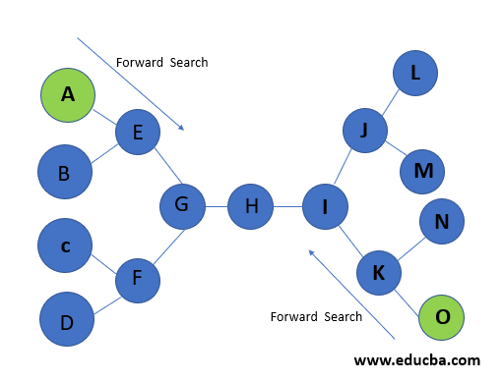
2. Trace out the path using bidirectional search for the following graph with the given starting node and the goal node.

Slide 10
The idea behind bidirectional search is to run two simultaneous searches—one forward from the initial state and the other backward from the goal—hoping that the two searches meet in the middle.
The algorithm terminates at node H where two searches meet as in the graph.

Slide 11
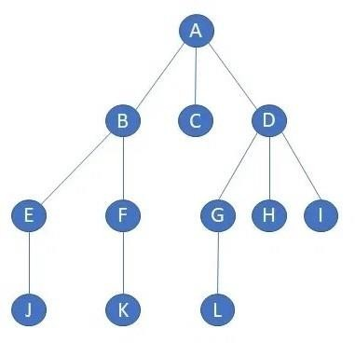
IN-LAB
1. Write an efficient python program to implement breadth-First Search by considering the following tree.

Slide 12
BFS Algorithm
Define:
i. Graph using dictionary
ii. closed and opened empty list
2. Apply BFS algorithm:
bfs(graph, node):
add node to opened
do until opened not empty
n = delete and keep 1st element from opened
add n to closed
for each neighbour of n in graph
if neighbour not in closed and opened
add neighbour to end of opened
4. Call bfs with graph and starting node
5. Display closed which contains visited order of nodes.

Slide 13
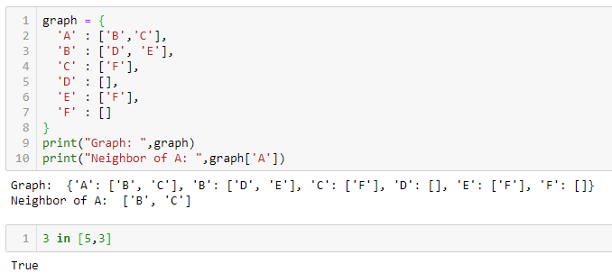
Creating and Accessing Graph

Slide 14
Input & Output
Input: Create a dictionary for given graph
Output:
A B C D E F G H I J K L

Slide 15
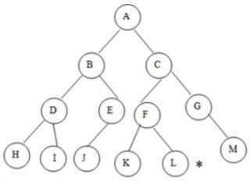
2. Write a python code to implement Depth-First Search by considering the following tree. Your code must satisfy the tree to find the best and shortest path.

Slide 16
DFS Algorithm
Define:
i. Graph using dictionary
ii. closed and opened empty list
2. Apply DFS algorithm:
dfs(graph, node):
add node to opened
do until opened not empty
n = delete and keep last element from opened
add n to closed
for each neighbour of n in graph
if neighbour not in closed and opened
add neighbour to end of opened
4. Call dfs with graph and starting node
5. Display closed which contains visited order of nodes.

Slide 17
Input: create a dictionary for given graph
Output:
A
B
D
H
I
J
C
F
K
L
G
M

Slide 18
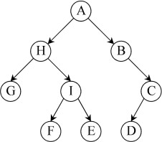
POST-LAB
1. Write an efficient python program to implement iterative deepening search by considering following tree.

Slide 19
PROCEDURE
Create given graph using Dictionary data structure.
Apply the DFS algorithm on the graph repeatedly by increasing depth 1,2,..n until we find goal node or all nodes in the graph are visited.

Slide 20
IDFS Algorithm
Define:
i. Graph using dictionary
ii. closed and opened empty list
iii. Root and goal
2. Apply DFS algorithm:
dfs(graph, node, level)
clear opened and closed for each call
if level = 0 and node = goal
display node and return True
add node to opened
do until opened not empty and level >= 0
s = delete and keep last element from opened
if s == goal:
return True
level = level-1
add s to closed
for each neighbour of s in graph
if neighbour not in closed and opened
add neighbour to end of opened
return False

Slide 21
4.Apply IDDFS
def IDDFS(root,level):
for each depth 0 to level-1
found = dfs(graph, root, depth)
if found then
print nodes in closed and exit.
5. Call IDDFS with root and level and print success or fail

Slide 22
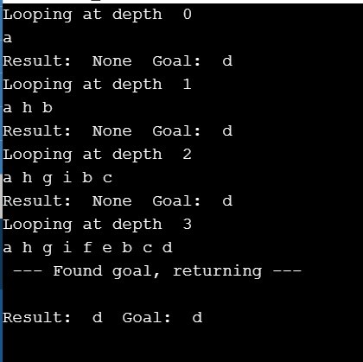
OUTPUT

Slide 23
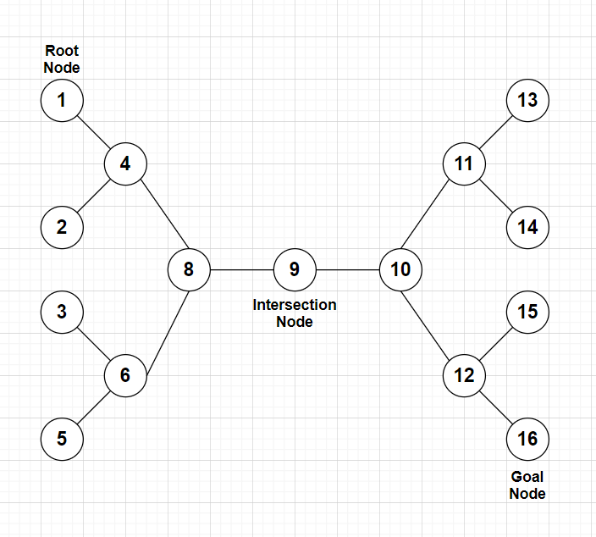
2. Write an efficient python program to implement bidirectional search by considering following graph and print the path.

Slide 24
PROCEDURE
Create given graph using Dictionary data structure.
Apply a search algorithm from start node and a goal node.
The algorithm success if both the searches intersects at a node otherwise fails.
Combine and display visited nodes of both the searches(backward search need to display in reverse order).

Slide 25
BiDirectional Algorithm
Define:
i. Graph using dictionary
ii. s_closed and s_opened empty list
iii. d_closed and d_opened empty list
2. Apply BFS algorithm:
bfs(graph, opened, closed):
add node to opened
if opened not empty
n = delete and keep 1st element from opened
add n to closed
for each neighbour of n in graph
if neighbour not in closed and opened
add neighbour to end of opened

Slide 26
3. Apply BiDirSearch:
BiDirSearch(graph, s, d):
add s to s_opened
add d to d_opened
do until s_opened and d_opened empty:
bfs(graph, s_opened, s_closed)
bfs(graph, d_opened, d_closed)
if there is intersection node in s_closed and d_closed
create a new list path that contains nodes of s_closed and reverse order of d_closed
return 1
return 0
4. Call BiDirSearch with graph, source node and destination node
5. If result is 0 then display fail i.e; no path from source to destination.

Slide 27
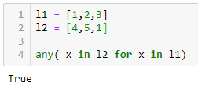
Finding Common element in lists

Slide 28
Input: Create a dictionary for given graph
Output:
[1, 4, 8, 9, 10, 12, 16]

