Slide 1

Mathematical Programming
© 2020 KL University – The contents of this presentation are an intellectual and copyrighted property of KL University. ALL RIGHTS RESERVED

Slide 2
Management science is characterized by a scientiﬁc approach to managerial decision making.
Management science has been known by a variety of other names
operations research in US
operational research in Great Britan
To identify the scientiﬁc approach to managerial problem solving under such other names as systems analysis, cost–beneﬁt analysis, and cost-effectiveness analysis
© 2020 KL University – The contents of this presentation are an intellectual and copyrighted property of KL University. ALL RIGHTS RESERVED

Slide 3
Management science
Management science is characterized by the use of mathematical models in providing guidelines to managers for making effective decisions within the state of the current information, or in seeking further information if current knowledge is insufﬁcient to reach a proper decision
© 2020 KL University – The contents of this presentation are an intellectual and copyrighted property of KL University. ALL RIGHTS RESERVED

Slide 4
There are several elements of this statement that are deserving of emphasis
First, the essence of management science is the model-building approach— that is, an attempt to capture the most signiﬁcant features of the decision under consideration by means of a mathematical abstraction.
Second, through this model-design effort, management science tries to provide guidelines to managers or, in other words, to increase managers’ understanding of the consequences of their actions. The aim is to support the managers.
© 2020 KL University – The contents of this presentation are an intellectual and copyrighted property of KL University. ALL RIGHTS RESERVED

Slide 5
Finally, it is the complexity of the decision under study, and not the tool being used to investigate the decision-making process, that should determine the amount of information needed to handle that decision effectively.
© 2020 KL University – The contents of this presentation are an intellectual and copyrighted property of KL University. ALL RIGHTS RESERVED

Slide 6
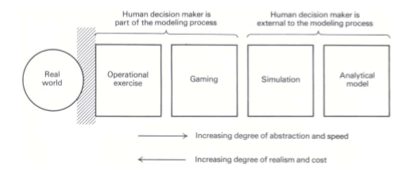
MODEL CLASSIFICATION
The management-science literature includes several approaches to classifying models.
Types of model representation
© 2020 KL University – The contents of this presentation are an intellectual and copyrighted property of KL University. ALL RIGHTS RESERVED

Slide 7
This approach to operate successfully, it is mandatory to
design experiments to be conducted carefully
To evaluate the experimental results in light of errors that can be introduced by measurement inaccuracies,
To draw inferences about the decisions reached, based upon the limited number of observations performed
The ﬁrst model type is an operational exercise
© 2020 KL University – The contents of this presentation are an intellectual and copyrighted property of KL University. ALL RIGHTS RESERVED

Slide 8
Gaming
The second type of model in this classiﬁcation is gaming
In this case, a model is constructed that is an abstract and simpliﬁed representation of the real environment.
This model provides a responsive mechanism to evaluate the effectiveness of proposed alternatives, which the decision-maker must supply in an organized and sequential fashion.
© 2020 KL University – The contents of this presentation are an intellectual and copyrighted property of KL University. ALL RIGHTS RESERVED

Slide 9
Gaming
The model is simply a device that allows the decision-maker to test the performance of the various alternatives that seem worthwhile to pursue.
In addition, in a gaming situation, all the human interactions that affect the decision environment are allowed to participate actively by providing the inputs they usually are responsible for in the actual realization of their activities.
The model should reﬂect, with an acceptable degree of accuracy, the relationships between the inputs and outputs of the reﬁnery process.
© 2020 KL University – The contents of this presentation are an intellectual and copyrighted property of KL University. ALL RIGHTS RESERVED

Slide 10
Subsequently, all the personnel who participate in structuring the decision process in the management of the reﬁnery would be allowed to interact with the model.
The production manager would establish production plans
The marketing manager would secure contracts and develop marketing strategies
The purchasing manager would identify prices and sources of crude oil and develop acquisition programs, and so forth.
© 2020 KL University – The contents of this presentation are an intellectual and copyrighted property of KL University. ALL RIGHTS RESERVED

Slide 11
The cost of processing each alternative has been reduced, and the speed of measuring the performance of each alternative has been increased.
Gaming is used mostly as a learning device for developing some appreciation for those complexities inherent in a decision-making process.
Several management games have been designed to illustrate how marketing, production, and ﬁnancial decisions interact in a competitive economy.
© 2020 KL University – The contents of this presentation are an intellectual and copyrighted property of KL University. ALL RIGHTS RESERVED

Slide 12
Simulation
Simulation models are similar to gaming models except that all human decision-makers are removed from the modeling process.
The model provides the means to evaluate the performance of a number of alternatives, supplied externally to the model by the decision-maker, without allowing for human interactions at intermediate stages of the model computation.
© 2020 KL University – The contents of this presentation are an intellectual and copyrighted property of KL University. ALL RIGHTS RESERVED

Slide 13
Like operational exercises and gaming, simulation models neither generate alternatives nor produce an optimum answer to the decision under study.
These types of models are inductive and empirical in nature; they are useful only to assess the performance of alternatives identiﬁed previously by the decision-maker.
Many simulation models take the form of computer programs, where logical arithmetic operations are performed in a prearranged sequence.
© 2020 KL University – The contents of this presentation are an intellectual and copyrighted property of KL University. ALL RIGHTS RESERVED

Slide 14
Analytical Model
Finally, the fourth model category proposed in this framework is the analytical model
In this type of model, the problem is represented completely in mathematical terms
Normally by means of a criterion or objective, which we seek to maximize or minimize
Subject to a set of mathematical constraints that portray the conditions under which the decisions have to be made.
© 2020 KL University – The contents of this presentation are an intellectual and copyrighted property of KL University. ALL RIGHTS RESERVED

Slide 15
The model computes an optimal solution, that is, one that satisﬁes all the constraints and gives the best possible value of the objective function.
Most of the work undertaken by management scientists has been oriented toward the development and implementation of analytical models.
© 2020 KL University – The contents of this presentation are an intellectual and copyrighted property of KL University. ALL RIGHTS RESERVED

Slide 16
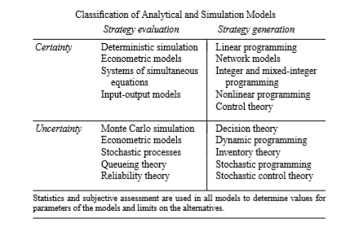
The classiﬁcation presented in Table is not rigid, since strategy evaluation models are used for improving decisions by trying different alternatives until one is determined that appears‘‘best.’
© 2020 KL University – The contents of this presentation are an intellectual and copyrighted property of KL University. ALL RIGHTS RESERVED

