Slide 1
Session-3 Finding the optimal solution using Graphical Method for a given Linear Programming Problem(LPP)

Slide 2
Topic delivery on Graphical Method
Any optimization problem with two variables can be solved
It is visual in nature
For solving the problems graphically, we need the following
Inequality Constraints
Objective Functions

Slide 3
Outlines of Graphical Method
The linear programming problems of two decision variables can be easily solved by graphical method.
The outlines of the graphical procedure as follows:
Step: 1 Identify the problem-the decision variables, the objective function and the restrictions.
Step: 2 set up the mathematical formulation of the problem.
Step: 3 consider each inequality –constraint as an equation

Slide 4
Step: 4 Plot each equation on the graph, as each one will geometrically represent a straight line.
Step: 5 Shade the feasible region. Every point on the line will satisfy the equation of the line. If the inequality constraint corresponding to that line is ‘≤’, then the region below the line lying in the first quadrant (due to non-negativity of variables) is shaded. For the inequality-constraint with ‘≥’ sign, the region above the line in the first quadrant is shaded. The points lying in the common region will satisfy all the constraints simultaneously. The common region thus obtained is called the feasible region.

Slide 5
Step: 6: Choose the convenient value of z(say-0) and plot the objective function line.
Step: 7 pull the objective function line until the extreme points of the feasible region. In the maximization case, this line will stop farthest from the origin and passing through at least one corner of the feasible region. In the minimization case, this line will stop nearest to the origin and passing through at least one corner of the feasible region.
Step: 8 Read the coordinates of the extreme point(s) selected in step6, and find the maximum or minimum value of z.

Slide 6
Students doubts with poll/pop questions.
Questions
1. why do we use the graphical method?
2. why graphical method is so popular?
3. what is the constraint in graphical method?

Slide 7
Problem
Using the graphical method, solve the following problem
Max Z=3x+2y
subject to the constraints
2x+y≤18, 2x+3y≤42, 3x+y≤24 and y≥0
Solution:
First, we draw the lines of all the given equations and shade the common region according to the signs.

Slide 8
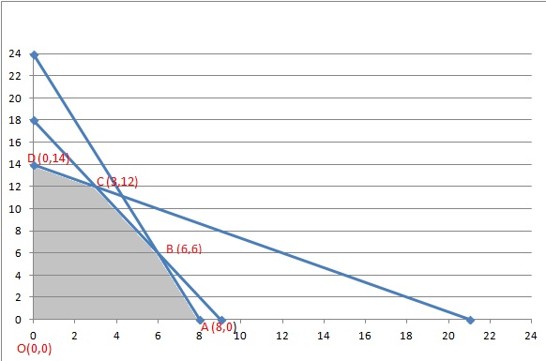

Slide 9
The feasible region is the intersection of the regions defined by the set of constraints and the coordinate axis (conditions of non-negativity of variables). This feasible region is represented by the O-A-B-C-D-O
As a feasible region exists, extreme values (or polygon vertices) are calculated. These vertices are the point’s candidate as optimal solutions. In the example, these points are O, A, B, C, and D, as shown in the figure.

Slide 10
Finally, the objective function is evaluated in each of these points (results are shown in the tableau below). Since C-point provides the greatest value to the Z-function and the objective is to maximize, this point is the optimal solution: Z = 33 with x = 3 and y = 12

Slide 11
Points | Coordinates | Value of Objective function
O | (0,0) | 0
A | (8,0) | 24
B | (6,6) | 30
C | (3,12) | 33
D | (0,14) | 28

Slide 12
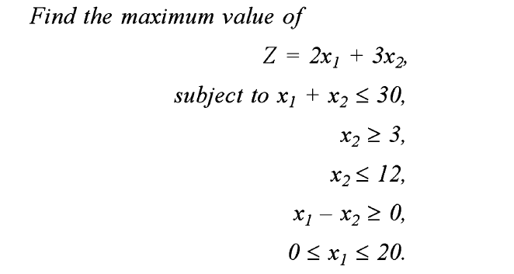

Slide 13
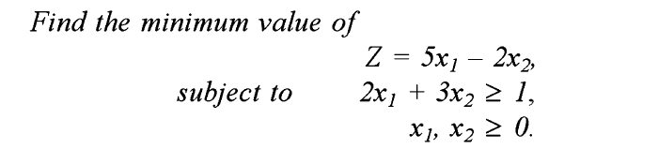

Slide 14
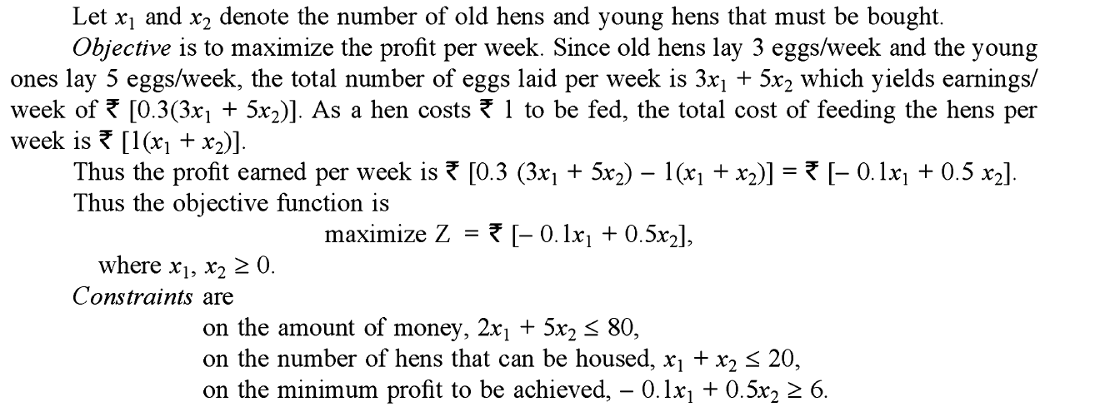
Formulation of an LPP and finding optimal solution using Graphical method

Slide 15
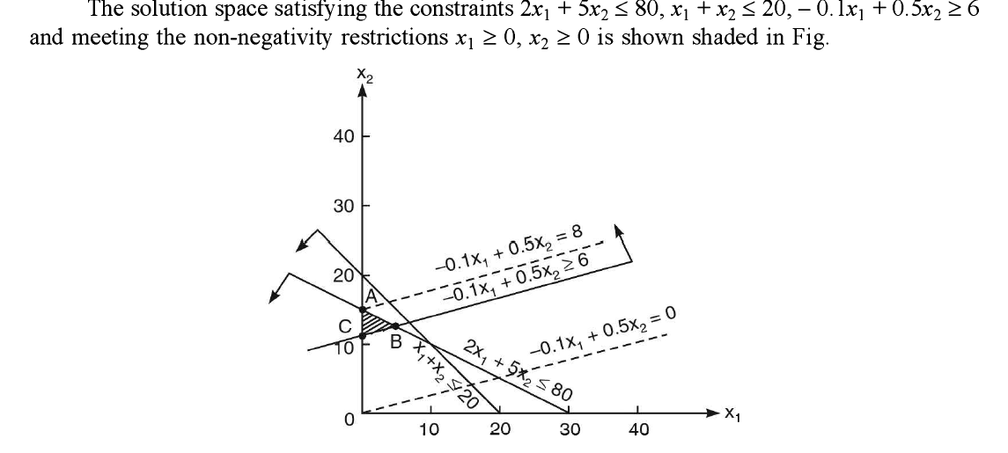

Slide 16
