Slide 1

Session-2 Mathematical Modeling of Linear Programming Problem
© 2020 KL University – The contents of this presentation are an intellectual and copyrighted property of KL University. ALL RIGHTS RESERVED

Slide 2
Example Problem
A small cooperative craft workshop makes two types of table: a standard rectangular table and a de luxe circular table. The market can absorb as many of either type of table as the workshop can produce, and so we can assume unlimited demand.
Each type of table is made from the same wood and, once the wood has been cut, each table has to go through three processes: joinery, pre ﬁnishing and ﬁnal ﬁnishing (in that order). Suﬃcient cut wood is always available. Each rectangular table takes 2 hours for joinery, 40 minutes for pre ﬁnishing and 5 hours 20 minutes for ﬁnal ﬁnishing.
© 2020 KL University – The contents of this presentation are an intellectual and copyrighted property of KL University. ALL RIGHTS RESERVED

Slide 3
Cont…
Each circular table requires 3 hours for joinery, 2 hours for pre-ﬁnishing and 4 hours for ﬁnal ﬁnishing. The workshop employs ﬁve joiners, two sanders and eight polishers.
The joiners each work a ﬁxed six-hour day, while the sanders and polishers each work a ﬁxed eight-hour day on the pre ﬁnishing and ﬁnal ﬁnishing respectively.
No overtime is worked, and full six-hour or eight-hour days are worked by each employee irrespective of whether there is work for that employee to do. All running costs, including wages, are ﬁxed.
The cooperative sells each rectangular table for £120 and each circular table for £150. How many of each type of table should it produce each day in order to maximize its proﬁt?
© 2020 KL University – The contents of this presentation are an intellectual and copyrighted property of KL University. ALL RIGHTS RESERVED

Slide 4
Formulating the problem
This example is obviously simpliﬁed, but it includes features common to many mathematical programming problems:
There is a quantity (the proﬁt) to be maximized and there are constraints (the available person-hours) on each process involved in making the tables.
We want to formulate a mathematical model of the problem, where the purpose of the model is to decide how many of each type of table should be produced each day in order to maximize proﬁt.
© 2020 KL University – The contents of this presentation are an intellectual and copyrighted property of KL University. ALL RIGHTS RESERVED

Slide 5
Having speciﬁed the purpose of the model, the mathematical modelling process now suggests that we should state the assumptions.
For the example, we can identify the following assumptions from the given description.
© 2020 KL University – The contents of this presentation are an intellectual and copyrighted property of KL University. ALL RIGHTS RESERVED

Slide 6
There is unlimited demand for both types of table.
Each table is made from the same type of wood.
Suﬃcient cut wood is always available.
No overtime is worked.
Full days are worked irrespective of whether there is work to do.
All running costs, including wages, are ﬁxed.
© 2020 KL University – The contents of this presentation are an intellectual and copyrighted property of KL University. ALL RIGHTS RESERVED

Slide 7
Objective Function
The quantity to be optimized in a mathematical programming problem is known as the objective function, and the objective is to optimize this function.
© 2020 KL University – The contents of this presentation are an intellectual and copyrighted property of KL University. ALL RIGHTS RESERVED

Slide 8
The ﬁrst step in formulating a linear programming model is to identify the objective and it’s objective function.
In this example, we want to maximize the daily proﬁt, so we could take maximizing the daily proﬁt as the objective and the daily proﬁt as the objective function.
However, the daily proﬁt is equal to the daily income from selling tables less the ﬁxed daily running costs (including the cost of wood and wages). So, since the running costs are ﬁxed, maximizing daily proﬁt is equivalent to maximizing daily income.
© 2020 KL University – The contents of this presentation are an intellectual and copyrighted property of KL University. ALL RIGHTS RESERVED

Slide 9
As omitting the ﬁxed running costs will simplify the model, we shall therefore take the objective to be to maximize daily income and the objective function to the daily income.
The second step is to identify the variables, other than the objective function, and to specify their units of measurement.
In this example, the only variables are the numbers of tables of each type made per day
© 2020 KL University – The contents of this presentation are an intellectual and copyrighted property of KL University. ALL RIGHTS RESERVED

Slide 10
The third step is to identify the constraints and parameters. In this example the only constraints are the numbers of person-hours available for joinery, pre ﬁnishing and ﬁnal ﬁnishing each day. The parameters are the time it takes for each process for each type of table, the hours available for each process each day, and the selling prices of the tables
© 2020 KL University – The contents of this presentation are an intellectual and copyrighted property of KL University. ALL RIGHTS RESERVED

Slide 11
The fourth step is to assign algebraic symbols to the objective function, the variables and, if necessary, the parameters. It is usual in linear programming to use z for the objective function and x1, x2, ... for the variables. So, in this case, we have:
z the daily income, in pounds
x1 the number of rectangular tables made per day
x2 the number of circular tables made per day.
© 2020 KL University – The contents of this presentation are an intellectual and copyrighted property of KL University. ALL RIGHTS RESERVED

Slide 12
We shall therefore adopt this approach here, so that, usually, instead of assigning symbols to the parameters, we shall state their numerical values in a table that relates them to the variables, the objective function and the constraints, as in Table
 | Rectangle Table | Circular Table | upper limit(Per Day)
income (£) | 120 | 150 | -
joinery (hours) | 2 | 3 | 30
Pre ﬁnishing (hours) | 2/3 | 2 | 16
ﬁnal ﬁnishing (hours) | 5 1/3 | 4 | 64
© 2020 KL University – The contents of this presentation are an intellectual and copyrighted property of KL University. ALL RIGHTS RESERVED

Slide 13
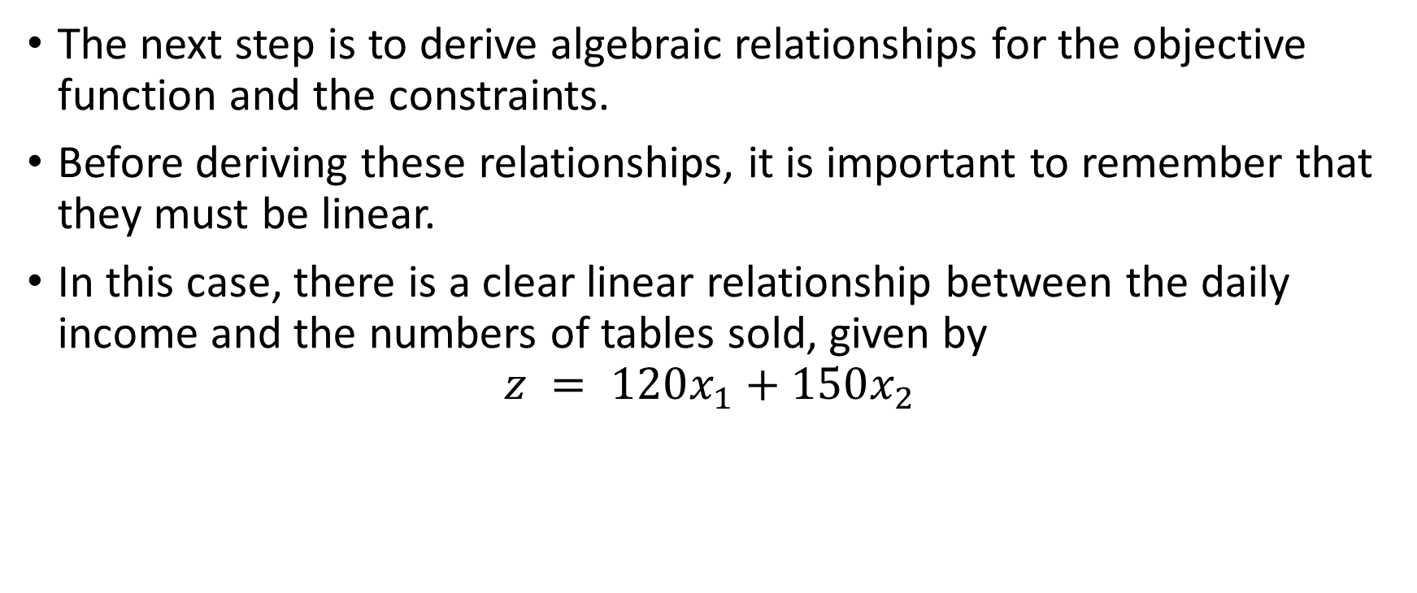
© 2020 KL University – The contents of this presentation are an intellectual and copyrighted property of KL University. ALL RIGHTS RESERVED

Slide 14
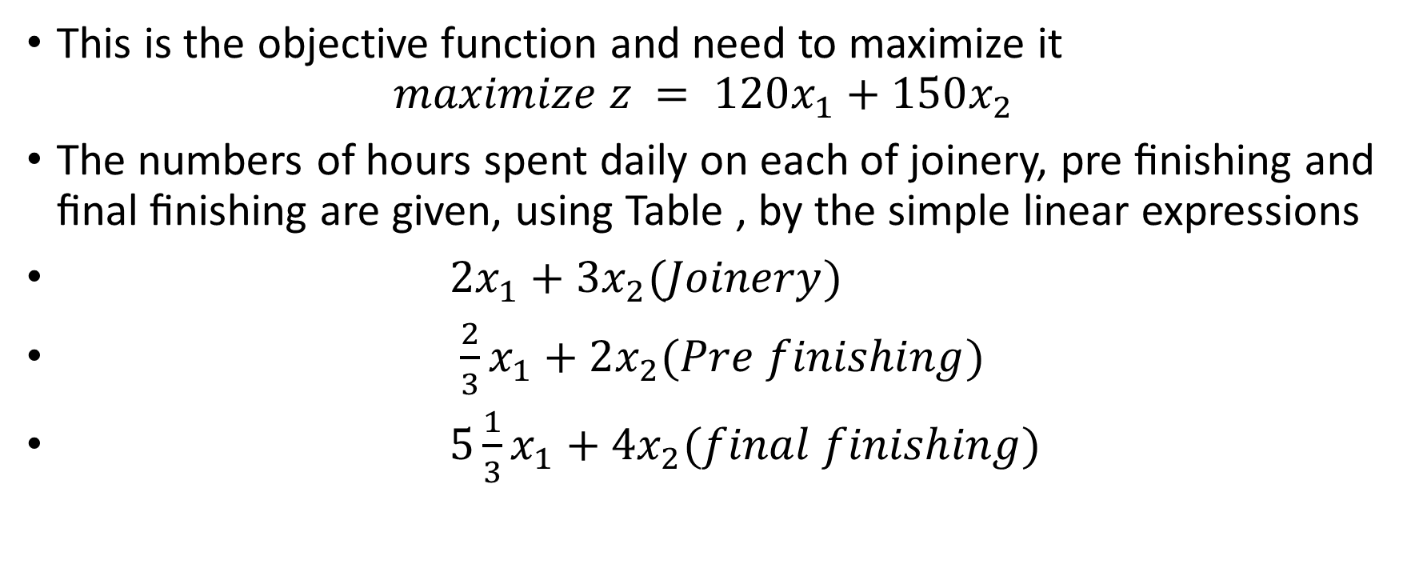
This is the objective function and need to maximize it
$$maximize z = 120x_{1}+150x_{2}$$
The numbers of hours spent daily on each of joinery, pre ﬁnishing and ﬁnal ﬁnishing are given, using Table , by the simple linear expressions
$2x_{1}+3x_{2}(Joinery)$
$\frac{2}{3}x_{1}+2x_{2}(Pre finishing)$
$5\frac{1}{3}x_{1}+4x_{2}(final finishing)$
© 2020 KL University – The contents of this presentation are an intellectual and copyrighted property of KL University. ALL RIGHTS RESERVED

Slide 15
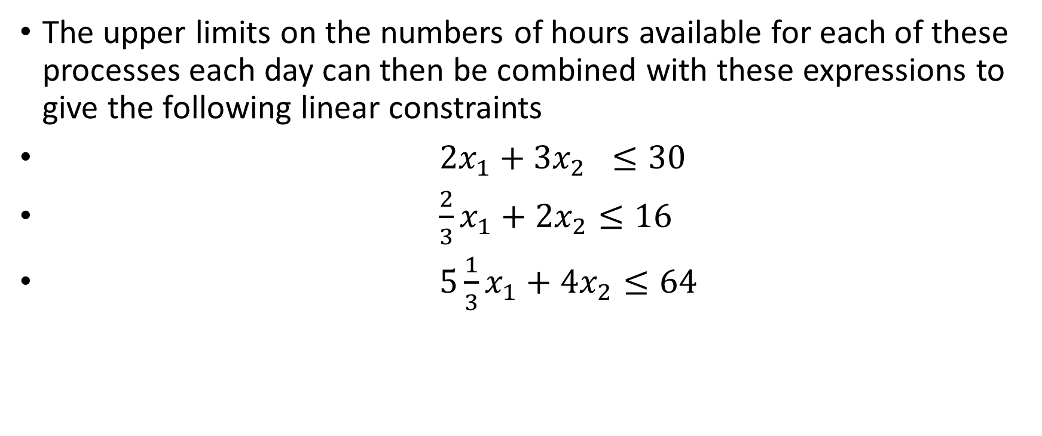
The upper limits on the numbers of hours available for each of these processes each day can then be combined with these expressions to give the following linear constraints
$2x_{1}+3x_{2} ≤30$
$\frac{2}{3}x_{1}+2x_{2}≤16$
$5\frac{1}{3}x_{1}+4x_{2}≤64$
© 2020 KL University – The contents of this presentation are an intellectual and copyrighted property of KL University. ALL RIGHTS RESERVED

Slide 16
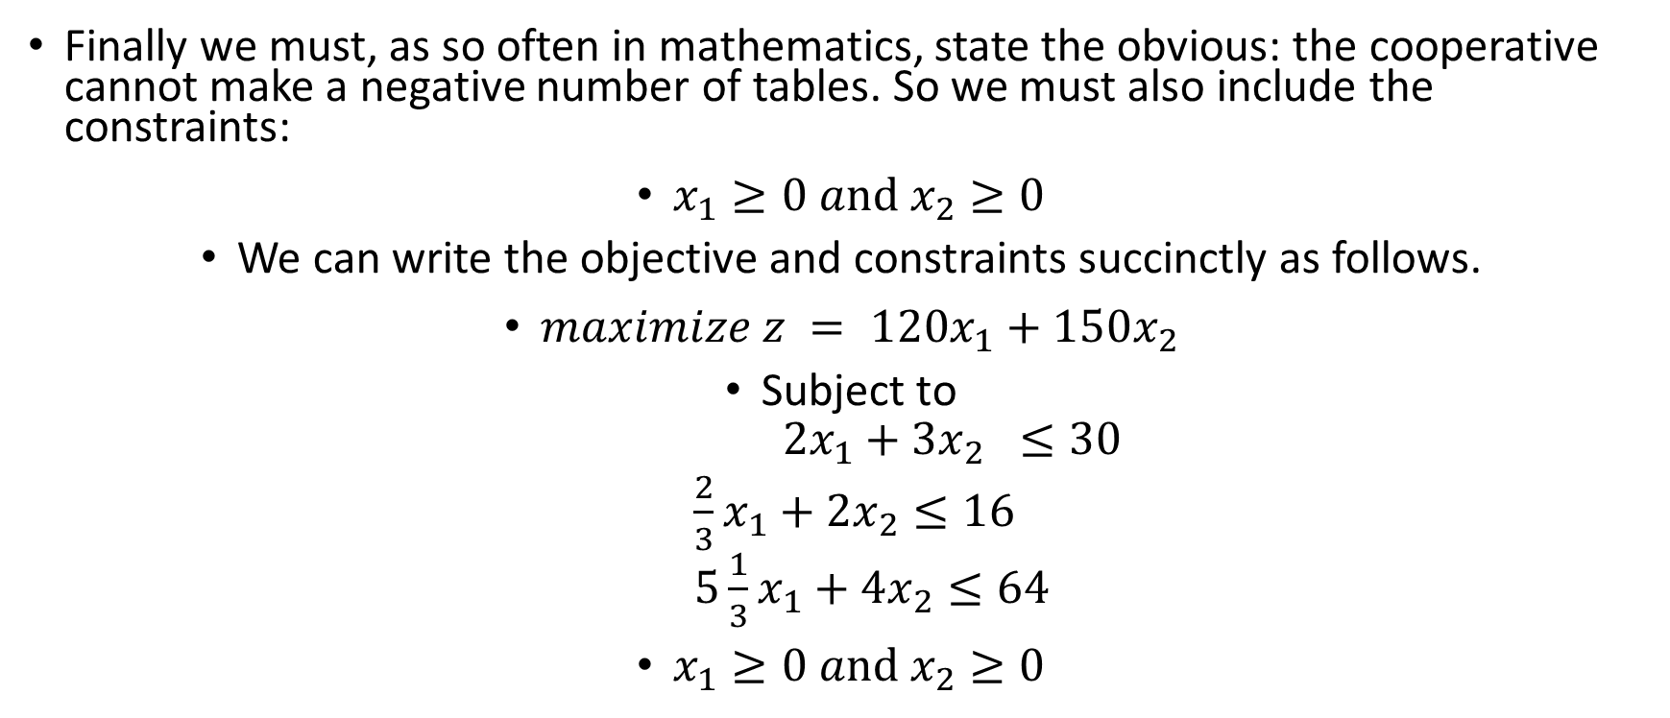
Finally we must, as so often in mathematics, state the obvious: the cooperative cannot make a negative number of tables. So we must also include the constraints:
$x_{1}≥0 and x_{2}≥0$
We can write the objective and constraints succinctly as follows.
$maximize z = 120x_{1}+150x_{2}$
Subject to
$$2x_{1}+3x_{2} ≤30$$
$$\frac{2}{3}x_{1}+2x_{2}≤16$$
$$5\frac{1}{3}x_{1}+4x_{2}≤64$$
$x_{1}≥0 and x_{2}≥0$
© 2020 KL University – The contents of this presentation are an intellectual and copyrighted property of KL University. ALL RIGHTS RESERVED

Slide 17


Formulating linear programming models
Given a precise statement of a linear programming problem, including a speciﬁed purpose and any appropriate data and assumptions, the problem may be formulated as a linear programming model as follows.
(a) Identify the objective of the model (for example maximizing proﬁt or minimizing cost) and decide on the units in which the objective function is to be measured (for example units of currency).
(b) Identify the variables and decide on the units in which each is to be measured.
(c) Identify the constraints and parameters for the problem.
(d) Assign algebraic symbols to the objective function (usually z) and to the variables (usually $x_{1}{,x}_{2}{,……..x}_{n}$), and write down precise deﬁnitions, including units of measurement, for all of these. If necessary, assign algebraic symbols to the parameters as well.
(e) Using a table of parameter values or otherwise, identify the linear relationships between the objective function and the variables and between the constraints and the variables, being careful to use consistent units when identifying these relationships
© 2020 KL University – The contents of this presentation are an intellectual and copyrighted property of KL University. ALL RIGHTS RESERVED

Slide 18

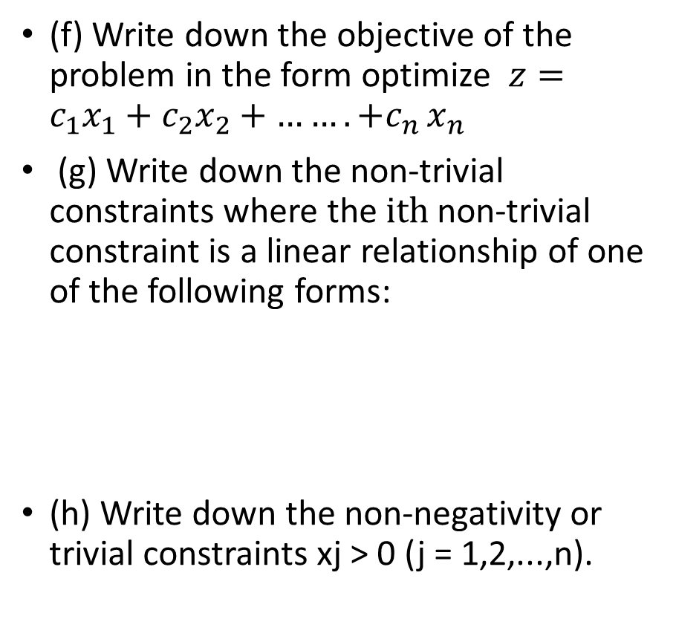
Formulating linear programming models
(f) Write down the objective of the problem in the form optimize $z=c_{1}x_{1}+c_{2}x_{2}+{…….+c}_{n}x_{n}$
(g) Write down the non-trivial constraints where the $ⅈth$ non-trivial constraint is a linear relationship of one of the following forms:
(h) Write down the non-negativity or trivial constraints xj> 0 (j = 1,2,...,n).
© 2020 KL University – The contents of this presentation are an intellectual and copyrighted property of KL University. ALL RIGHTS RESERVED

Slide 19
Example
A food manufacturer buys edible oils in their raw state, and refines and blends them to produce margarine. The raw oils can be vegetable or non-vegetable. The vegetable oils are ground-nut, soya-bean and palm. The non-vegetable oils are lard and fish. The margarine sells at £2400 a tonne, and the manufacturer can sell as much margarine as can be made. The prices of the raw oils are shown in Table . Sufficient quantities of all five oils can be assumed to be readily available.
© 2020 KL University – The contents of this presentation are an intellectual and copyrighted property of KL University. ALL RIGHTS RESERVED

Slide 20
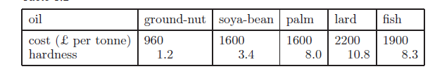
© 2020 KL University – The contents of this presentation are an intellectual and copyrighted property of KL University. ALL RIGHTS RESERVED

Slide 21
To avoid contamination, vegetable and non-vegetable oils are refined separately, using different equipment. It is possible to refine up to 1000 tones of vegetable oil and up to 800 tones of non-vegetable oil in a month. When refined, some or all of the oils are blended to produce the margarine.
The quantities of oil lost during the refining and blending processes are negligible.
© 2020 KL University – The contents of this presentation are an intellectual and copyrighted property of KL University. ALL RIGHTS RESERVED

Slide 22
The hardnesses of the refined oils, given in Table , are assumed to combine linearly to give the hardness of the margarine. To ensure that the margarine spreads easily but is not runny, the hardness of the margarine must be between 5.6 and 7.4, measured in the same units as the hardnesses of the oils in Table . All running costs can be taken to be fixed. The manufacturer wants to know how much of each type of oil to use in order to maximize profit while maintaining the quality of the margarine.
© 2020 KL University – The contents of this presentation are an intellectual and copyrighted property of KL University. ALL RIGHTS RESERVED

Slide 23
Formulation
We follow the steps of Procedure
(a) The purpose of the model is to maximize profit, subject to constraints on resources, while maintaining quality. Since the refining capacities are given per month, it is sensible to work on a monthly basis. We could therefore take maximizing monthly profit as the objective. However, since the running costs are fixed, maximizing monthly profit is equivalent to maximizing monthly income. Therefore, as omitting the fixed running cost will simplify the model, we shall take the objective as maximizing monthly income. This monthly income could be measured in pounds. However, looking at the quantities involved, it would seem more sensible to work in units of £10 000.
© 2020 KL University – The contents of this presentation are an intellectual and copyrighted property of KL University. ALL RIGHTS RESERVED

Slide 24
(b) The variables are the quantities of each oil used per month in blending the margarine. Also, as it will be useful to know the total quantity of margarine manufactured per month, we shall regard this as a variable.
(c)identify the parameters
© 2020 KL University – The contents of this presentation are an intellectual and copyrighted property of KL University. ALL RIGHTS RESERVED

Slide 25
(d) We now assign algebraic symbols to the objective function and the variables, giving precise definitions, including units of measurement:
z the monthly profit, in tens of thousands of pounds;
x1 the quantity, in hundreds of tones, of ground-nut oil used per month;
x2 the quantity, in hundreds of tones, of soya-bean oil used per month;
x3 the quantity, in hundreds of tones, of palm oil used per month;
x4 the quantity, in hundreds of tones, of lard used per month;
x5 the quantity, in hundreds of tones, of fish oil used per month;
x6 the quantity, in hundreds of tones, of margarine manufactured per month.
© 2020 KL University – The contents of this presentation are an intellectual and copyrighted property of KL University. ALL RIGHTS RESERVED

Slide 26
(e) We next identify the linear relationships for the objective function and the constraints. We can do this by extending Table , and making
suitable adjustments to the numerical values to take into account the
units of measurement decided on in (a) and (b), and listed in (d). This
results in the following Table
© 2020 KL University – The contents of this presentation are an intellectual and copyrighted property of KL University. ALL RIGHTS RESERVED

Slide 27
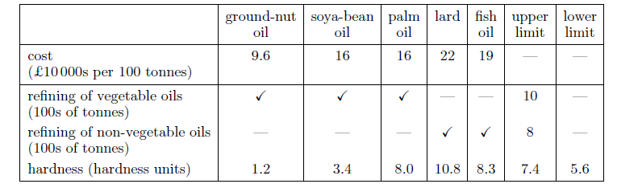
© 2020 KL University – The contents of this presentation are an intellectual and copyrighted property of KL University. ALL RIGHTS RESERVED

Slide 28
(f) Determine the objective function and objective of the problem in terms of x1, . . . , x6
(g) We now want to express the constraints algebraically in terms of the variables.
The hardness constraints require some thought.
Remember that the hardnesses of the components combine linearly to give the hardness of the margarine, which must be at least 5.6.
© 2020 KL University – The contents of this presentation are an intellectual and copyrighted property of KL University. ALL RIGHTS RESERVED

Slide 29

Using Table this means that we must have
If, for consistency, we keep all variables to the left-hand side of inequality or equality signs, this becomes
© 2020 KL University – The contents of this presentation are an intellectual and copyrighted property of KL University. ALL RIGHTS RESERVED

Slide 30

We must also remember the quantity constraint, which can be written as
or, in the format of the other constraints, as
© 2020 KL University – The contents of this presentation are an intellectual and copyrighted property of KL University. ALL RIGHTS RESERVED

Slide 31
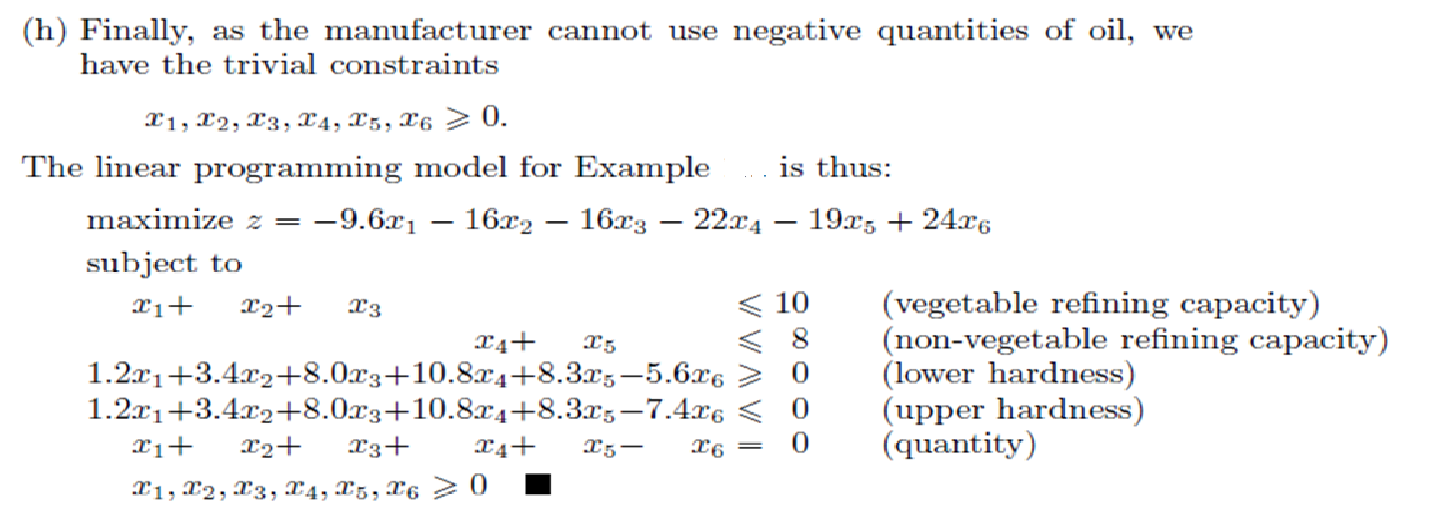
© 2020 KL University – The contents of this presentation are an intellectual and copyrighted property of KL University. ALL RIGHTS RESERVED

