Slide 1

LAB NO:8
Operating System Design
@KL University, 2020

Slide 2
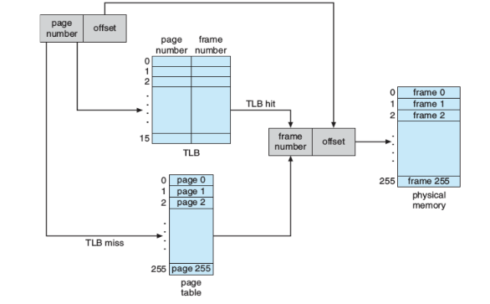
Paging - linear translates
Translating logical to physical addresses for a virtual address space of size 65,536 bytes.
Here we need to read from a file containing logical address and using a TLB as well as a page table, translates each logical address to its corresponding physical address and output the value of the byte stored at the translated physical address

Slide 3
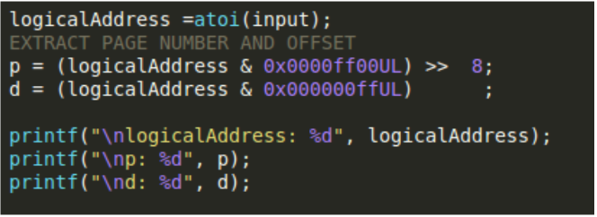
Extracting Page Number and Offset from Logical Address

Slide 4
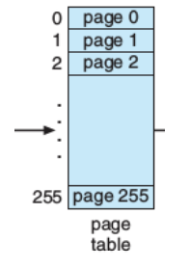
Page Table
The page Table has 256 entries.
Every page number is assigned a frame number as physical memory also has 256 frames.
you get an address, fetch p and d
use p as an index into a page table to fetch f , table[p] = f
physical_address = (f * 256) + d

Slide 5
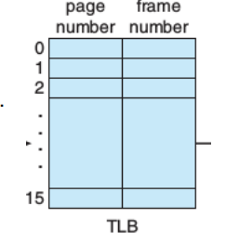
Translation Lookaside Buffer
The TLB has 16 entries. Every entry is page#, frame# pair cached.
you get an address, fetch p and d
page-number compared with all keys (p)
if matched, return frame-number (f)
physical_address = (f * 256) + d else, search pagetable
use p as an index into a page table to fetch f , table[p] = f
physical_address = (f * 256) + d
update p,f to TLB using FIFO page replacement algorithm

Slide 6
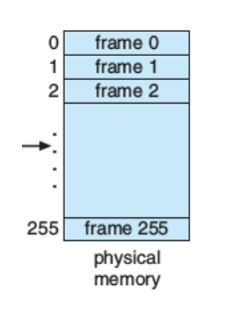
PAGE FAULTS
locate free frame in physical memory (frames[ ])
read desired page from disk into allocated frame
update page table + TLB
resume program execution

Slide 7
Compile and executing
Compile with: gcc filename.c -o filename.o -std=c99 –lm
Run with: ./filename.o addresses.txt output.txt BACKING_STORE.bin

Slide 8



