Slide 1
Session – 14
Scrum Cont..

Slide 2
The Scrum Meeting: Details
The Scrum Meeting—or scrum—is the heartbeat of Scrum and the project. Each workday at the same time and place, hold a meeting with the team members standing in a circle, at which time the same special questions are answered by each member:
1. What have you done since the last Scrum?
2. What will you do between now and the next Scrum?
3. What is getting in the way (blocks) of meeting the iteration goals?
4. Any tasks to add to the Sprint Backlog
5. The last question provides an efficient forum for a continuously improving and learning group

Slide 3
Some key practices
self-directed and self-organizing team
no external addition of work to an iteration, once chosen
daily stand-up meeting with special questions
usually 30-calendar day iterations
demo to external stakeholders at end of each iteration
each iteration, client-driven adaptive planning

Slide 4
Other Practices and Values
Other Practices:
Workers daily update the Sprint Backlog
No PERT charts allowed
Scrum Master reinforces vision
Replace ineffective Scrum Master
Scrum Values:
Commitment: Team members personally commit to achieving team goals
Courage: Team members do the right thing and work on tough problems.
Focus: Concentrate on the work identified for the sprint and the goals of the team.
Openness: Team members and stakeholders are open about all the work and the challenges the team encounters.
Respect: Team members respect each other to be capable and independent.

Slide 5
Common Mistakes and Misunderstandings
Not a self-directed team; managers or Scrum Master direct or organize the team
No daily update of the Sprint Backlog by members or daily tracker
New work added to iteration or individual
Product Owner isn't involved or doesn't decide
No Sprint Review
Many masters
Documentation is bad
Design or diagramming is bad
Full team (including customers and management) not briefed in Scrum and its values
Scrum Meeting too long or unfocused
Predictive planning; PERT chart planning

Slide 6
Adoption Strategies
12 Must do’s for successful adoption of Agile Scrum methodology:
Assess Project for readiness & suitability
Identify a ‘Go-Get-It’ team
Pilot when maximum teams are ready to fly
Convince the party poopers
Be Patient while transformation
Set a high bar and low expectations
Handhold to smoothen friction
Be open to Experts’ help
Make Good Information More Accessible
Find Your Evangelists
Measure the Results Early and Often
Be sure what’s Scrum and what’s Not

Slide 7
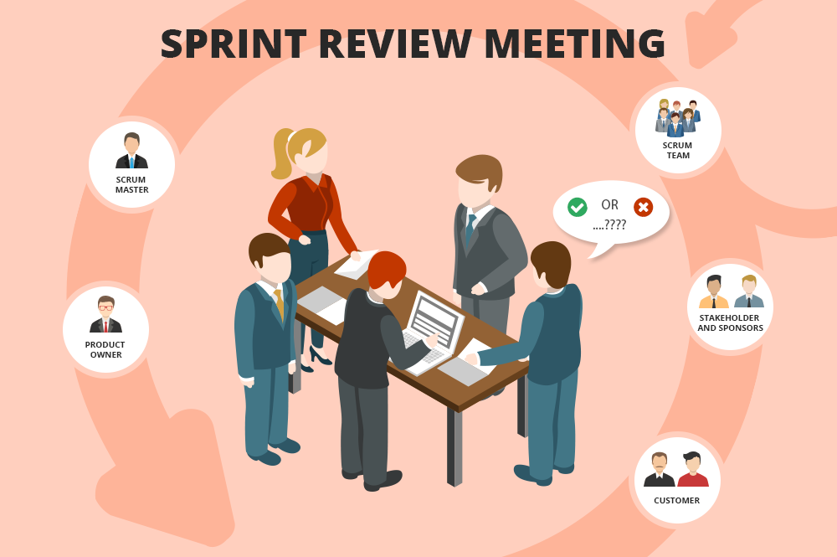
The Sprint Review
Team presents what it accomplished during the sprint
Typically takes the form of a demo of new features or underlying architecture
Informal
2-hour prep time rule
No slides
Whole team participates
Invite the world

Slide 8
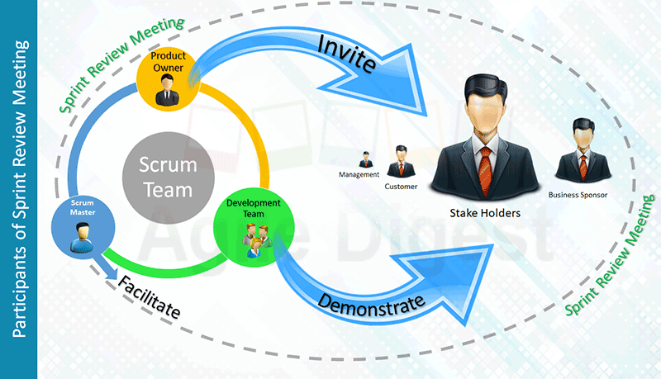
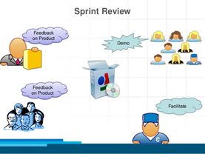
Sprint Review Cont:-

Slide 9
Scalability
Typical individual team is 7 ± 2 people
Scalability comes from teams of teams
Factors in scaling
Type of application
Team size
Team dispersion
Project duration
Scrum has been used on multiple 500+ person projects

Slide 10











Scaling: Scrum of Scrums

Slide 11
Scrum of Scrums
Scale Scrum up to large groups
Consisting of dividing the groups into Agile teams of 5-10
Each daily scrum within a sub-team ends by designating one member as “ambassador”
“Ambassador” participate in a daily meeting with ambassadors from other teams
Purpose
Scale the daily stand-up meeting when multiple teams are involved.
Its purpose is to support agile teams in collaborating and coordinating their work with other teams.

Slide 12
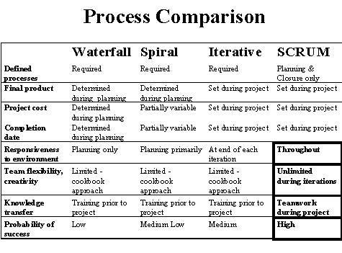
Scrum vs. Other Models

Slide 13
Fact versus Fantasy
First, a standard disclaimer: Process is only a second-order effect. The unique people, their feelings and qualities, are more influential.
Scrum practitioners do not report significant variation from the ideals of Scrum compared to its concrete use, presumably due to the relatively small and unambiguous set of practices. The most commonly reported reality checks are the encroachment of non-iteration work on to team members, and attempts by management to direct or organize the team, or solve—unasked—its problems. Scrum iterations have also failed when the Scrum Master does not regularly reinforce the project vision and Sprint goals, and the team drifts.

Slide 14
Strengths versus "Other"
Simple practices and management workproducts.
Individual and team problem solving and self-management.
Evolutionary and incremental requirements and development, and adaptive behavior.
Customer participation and steering.
Focus.
Openness and visibility.
Easily combined with other methods.
Team communication, learning, and value-building.
Team building via the daily Scrum, even if not in common project room.
Other: Could be viewed as a weakness, strength, or deliberate desirable exclusion, depending on point of view.

Slide 15
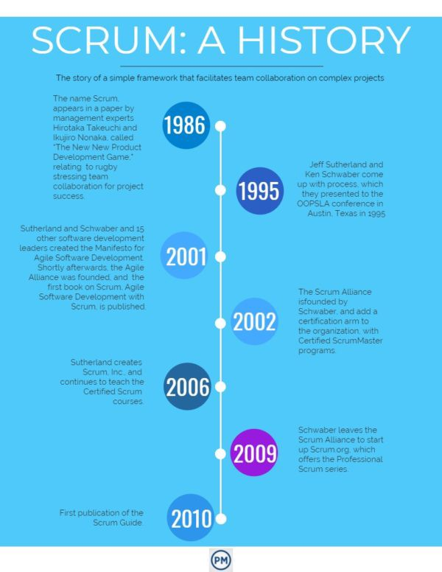
History of Scrum

Slide 16
Questions
Advantages of Scrum Meeting.
List out the values of scrum.
List out the Adoption Strategies.
Explain Process Mixtures of scrum.
List out the strengths of Scrum.
List out common mistakes and misunderstandings of scrum.

