Slide 1
Digital Platform for IoT: Development of Cloud Server for Storing Sensor Data and Hosting
Guided by: Prof. S.K Das Presented by:
Pradyumna Kumar Behera (122EC0124)
Radha Madhab Pattnaik (122EC0349)
Swayam Rana (122EC0352)
Sanskar Panda (122EC0582)
Subham Swarup Tripathy (122EC0816)

Slide 2
OBJECTIVES
1. IoT System Development: Build a complete IoT solution using ESP32 and Arduino.
2. Cloud Integration: Develop cloud server systems to store and host sensor data.
3. Visualization Platform: Implement a web dashboard for real-time data.
4. Data Analytics: Enable anomaly detection and optimization.

Slide 3
INTRODUCTION
IoT enables real-time data collection and automation.
This project builds a system using ESP32 and Arduino sensors transmitting to cloud servers.
Applications include smart homes, monitoring, and predictive maintenance.

Slide 4
LITERATURE SURVEY
1. IoT Hardware: ESP32, Arduino for data collection.
2. Communication: MQTT, HTTP protocols.
3. Cloud Platforms: Firebase, AWS IoT, Google Cloud.
4. Data Analytics: Cloud-based predictive analytics
5. Visualization: ReactJS dashboards.
6. Edge Computing: ESP32 local preprocessing to reduce cloud load.

Slide 5
COMPARISON BETWEEN EXISTING IDEA AND PROPOSED IDEA
Existing Systems:
- Focus on limited parameters.
- Heavy cloud dependency.
- Basic dashboards.
- High decision-making latency.

Slide 6
COMPARISON BETWEEN EXISTING IDEA AND PROPOSED IDEA
Proposed System:
- Multi-Sensor Integration.
- Edge Preprocessing.
- Dynamic Real-Time Dashboards.
- Predictive Analytics with ML models.

Slide 7
PROPOSED SYSTEM MODEL
System Components:
- Sensors: Temp, Humidity, Air Quality, etc.
- Microcontrollers: ESP32, Arduino.
- Cloud: Firebase / AWS IoT / Google Cloud.
- Communication: Wi-Fi (MQTT/HTTP).
- Frontend: ReactJS/HTML Dashboard.

Slide 8
PROPOSED SYSTEM MODEL: CONTINUED...
- Processing: ESP32 for local preprocessing.
- Data Transmission: Secure Wi-Fi.
- Cloud Storage: Real-time DBs (e.g., Firebase).
- User Interface: Interactive Dashboards.

Slide 9
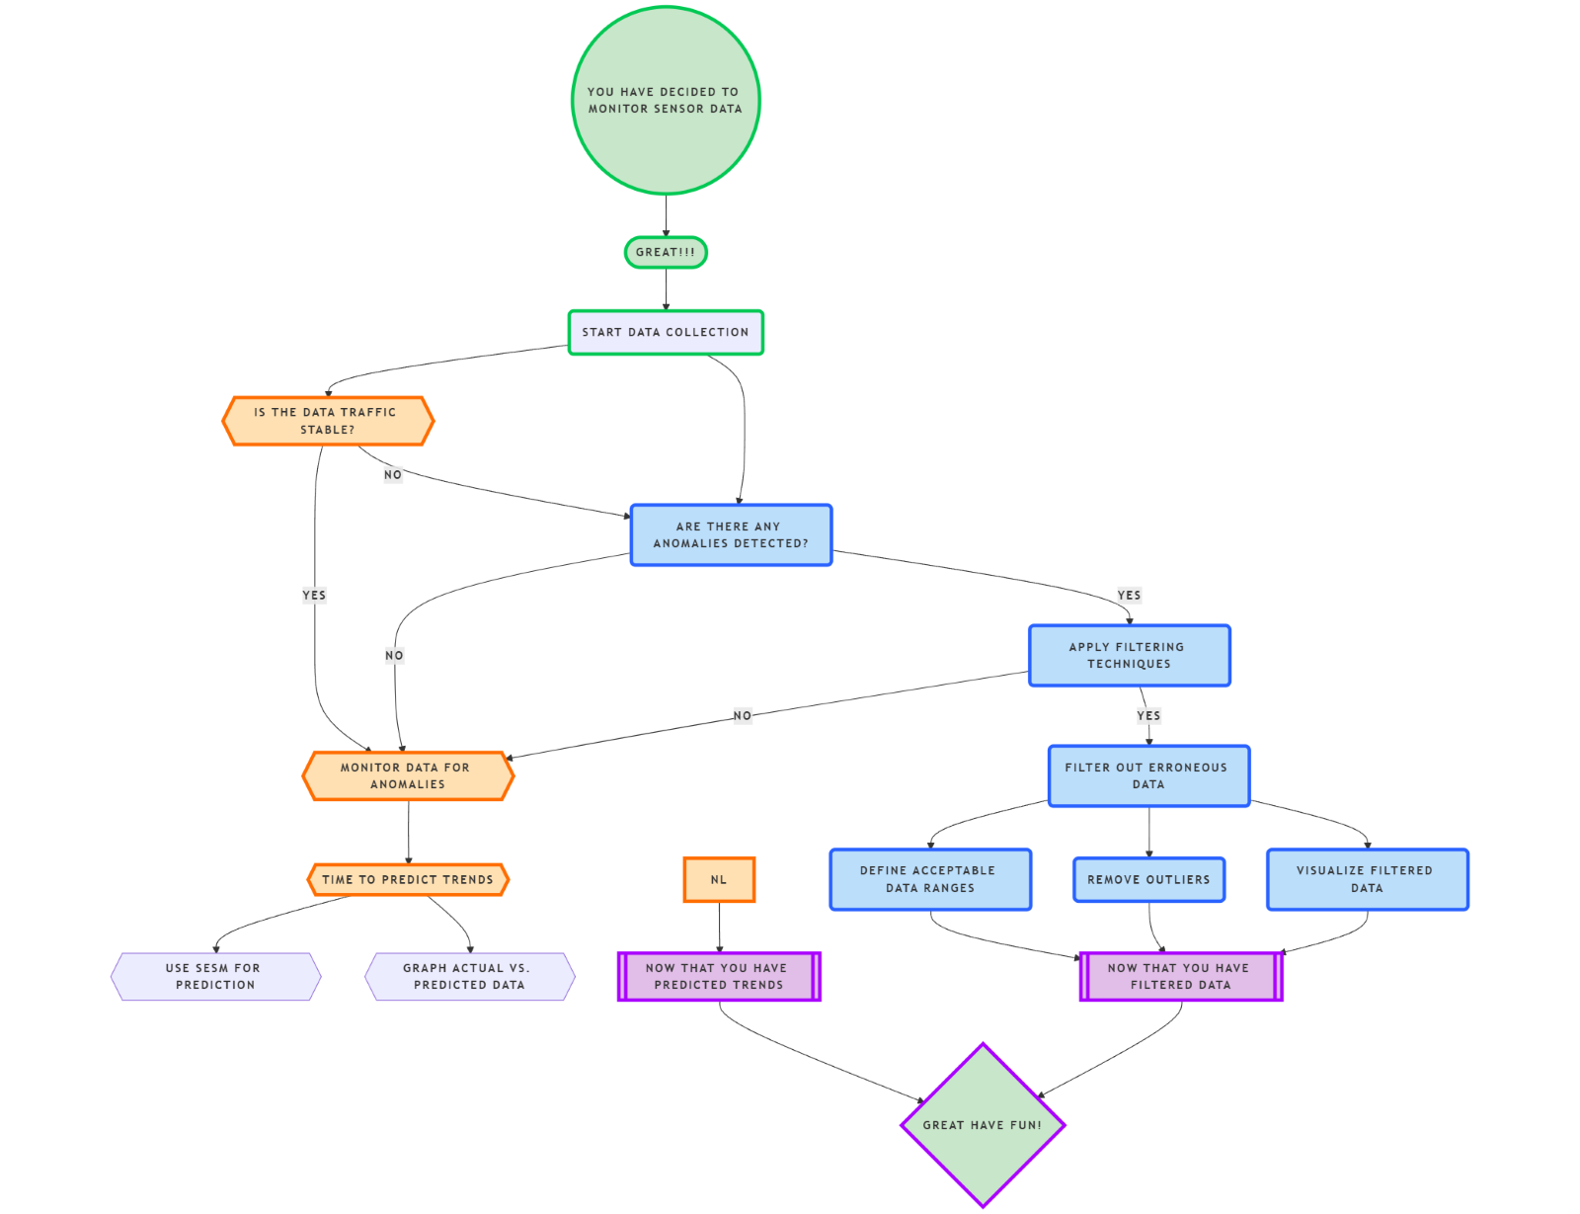
Design Diagram: Hardware & Software Flow

Slide 10
THANK YOU

