Slide 1
Introduction to Mobile Market Trends
NextHikes IT Solutions
REPRESENT BY :
KAVIRA KR. RAJU

Slide 2
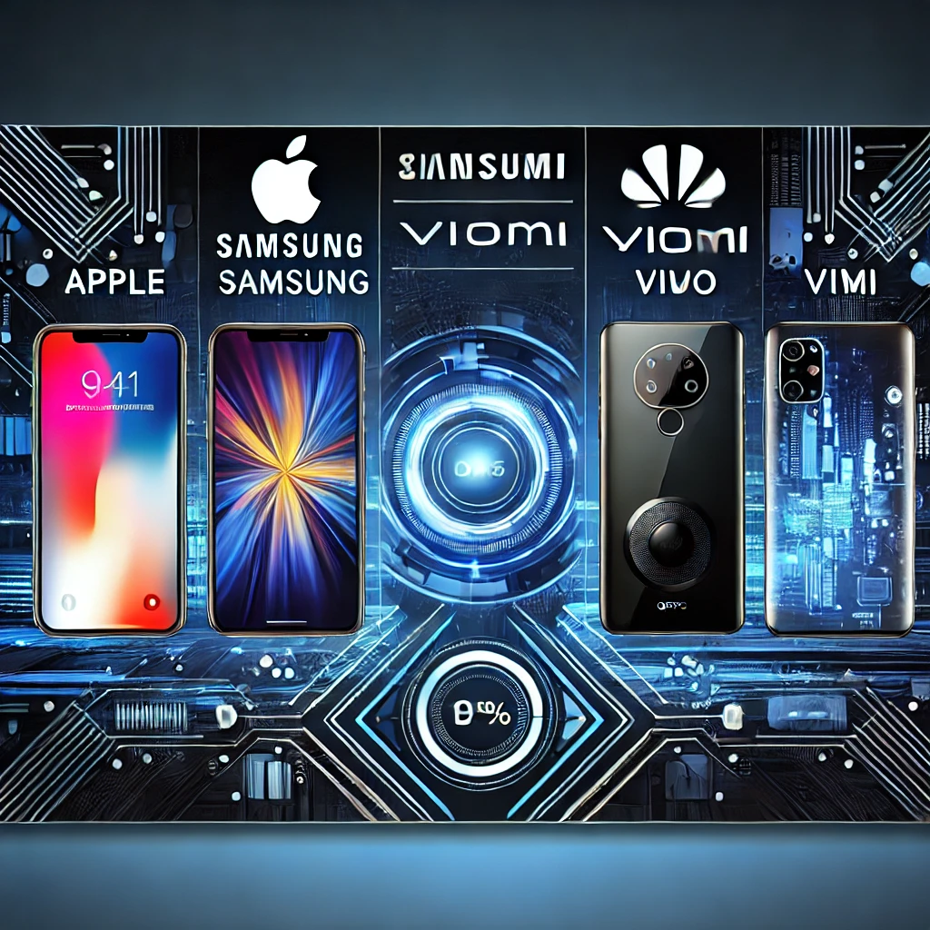
Mobile Phone Data Analysis
Project 4 - Market Trends and Insights

Slide 3
Dataset Overview
Total Records: 541
Total Features: 189
Key factors: Storage, RAM, Battery, Camera, Processor, Price
Used for market analysis and trends detection.
Popular Processors:
Qualcomm Snapdragon 680, Mediatek Helio A22, Unisoc SC9863A1

Slide 4
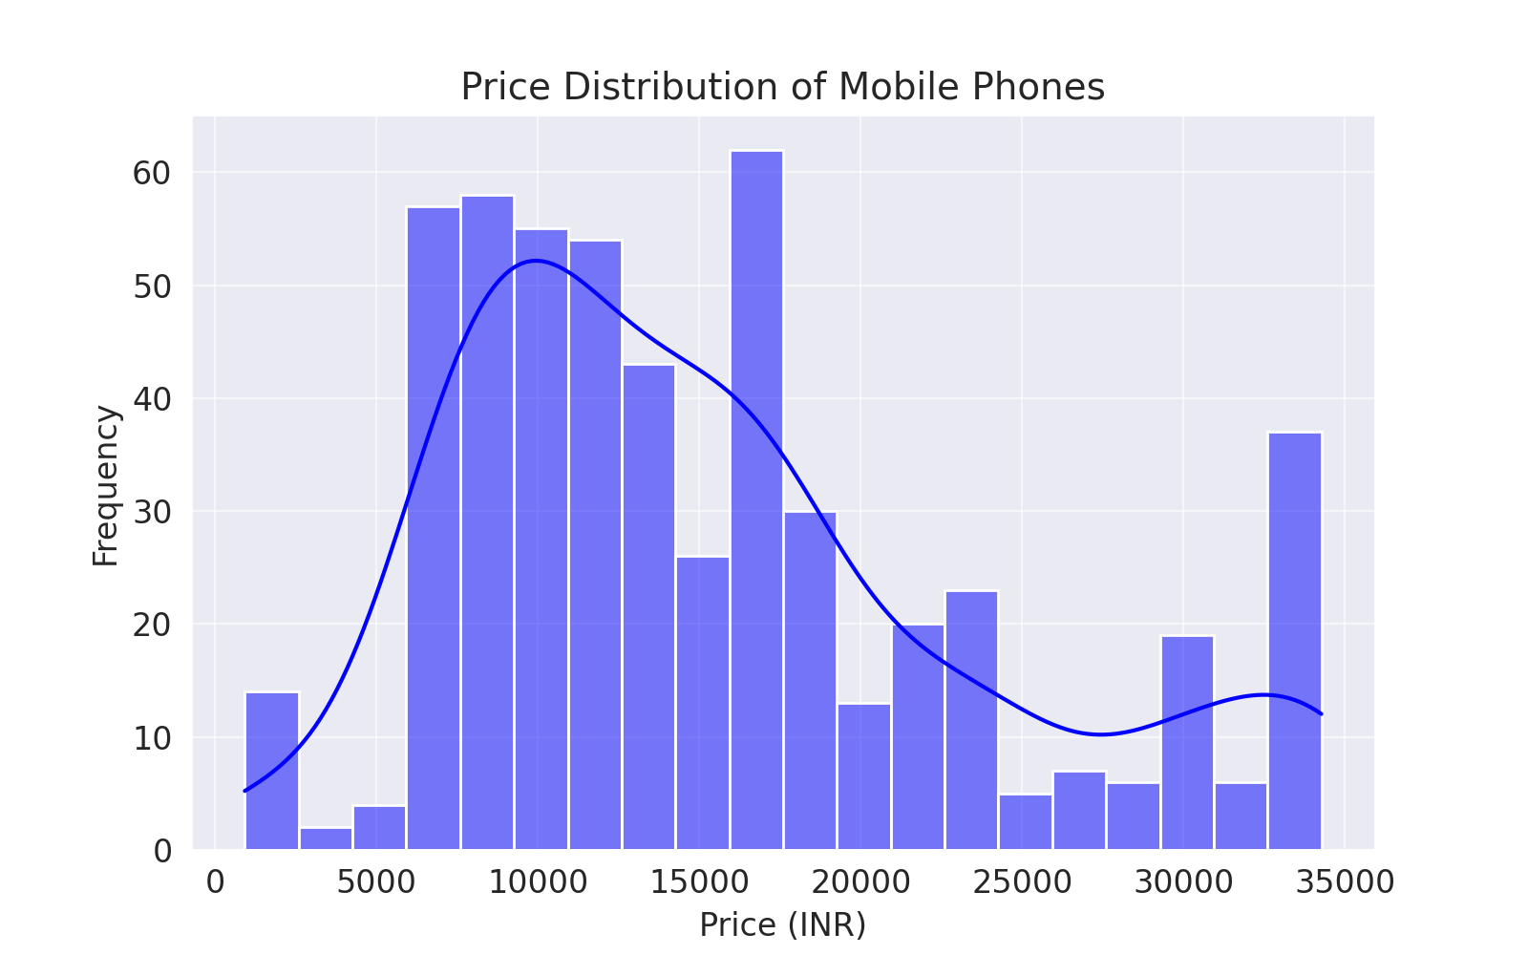
Price Distribution
Most mobile phones are priced between ₹7,000 - ₹12,000, indicating a preference for budget-friendly devices.
Premium smartphones above ₹40,000 form a smaller segment.
Visualization: Histogram of price distribution.

Slide 5
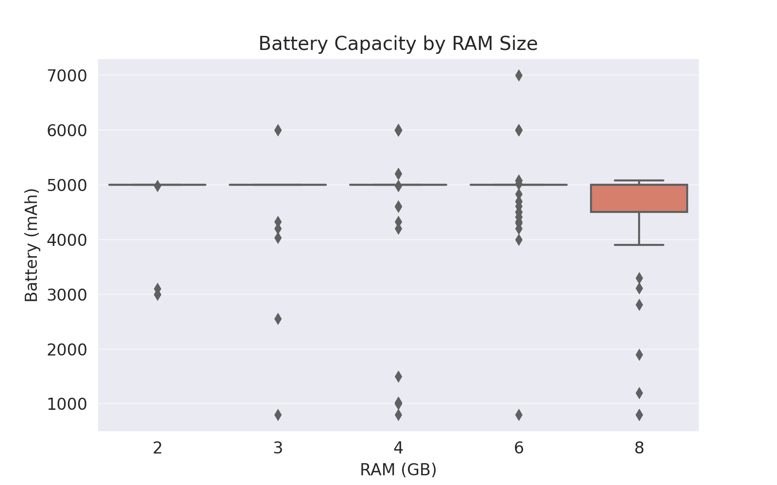
BATTERY vs RAM
Higher RAM generally correlates with larger battery capacity.
Devices with 6GB+ RAM tend to have batteries above 4500mAh.
Entry-level phones with 2GB-3GB RAM usually have smaller batteries (~3000mAh or less).
Mid-range phones (4GB-6GB RAM) have balanced battery life.
Most phones in this range have 4000-5000mAh batteries, offering a good balance between performance and longevity.
Flagship phones (8GB RAM and above) do not always have the biggest batteries.

Slide 6
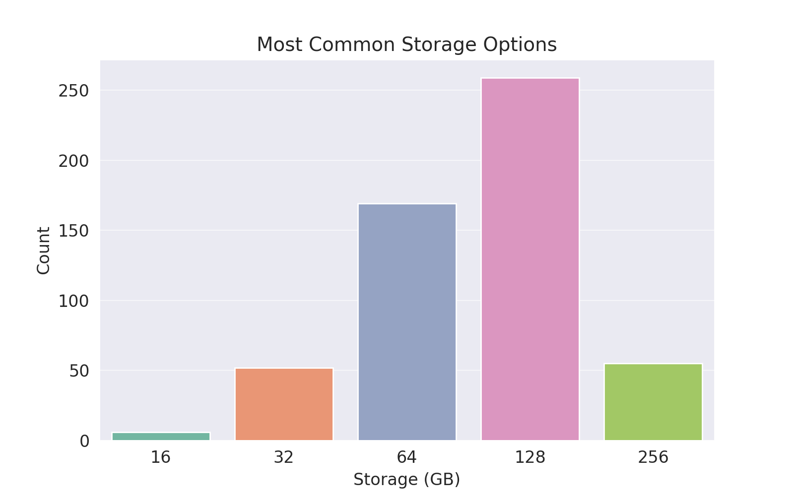
Storage
128GB is the most preferred storage option.
Followed by 64GB and 256GB models.
32GB and lower storage is becoming less common due to increasing app and media storage demands.

Slide 7
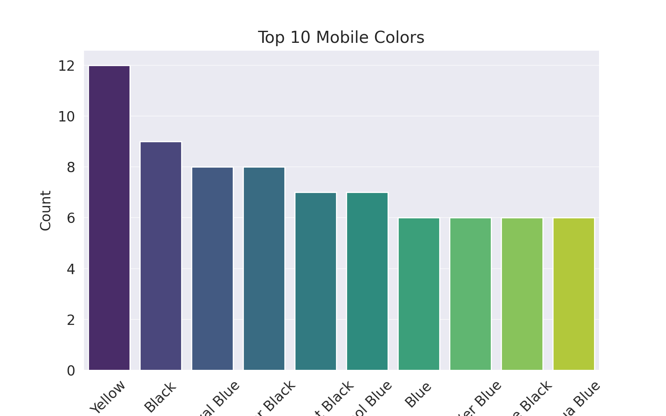
Popular Colors

Slide 8
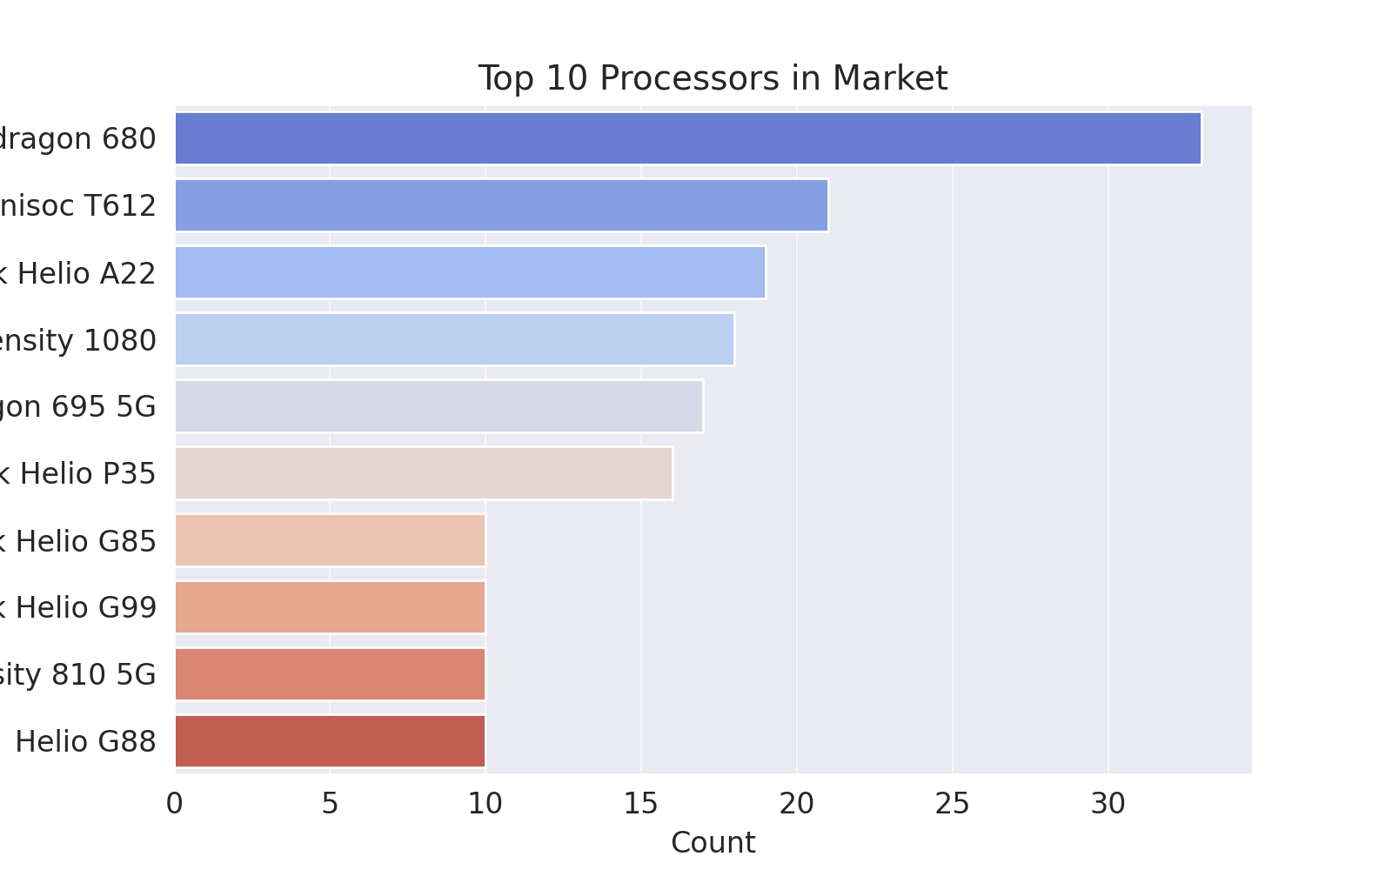
Processor Market

Slide 9
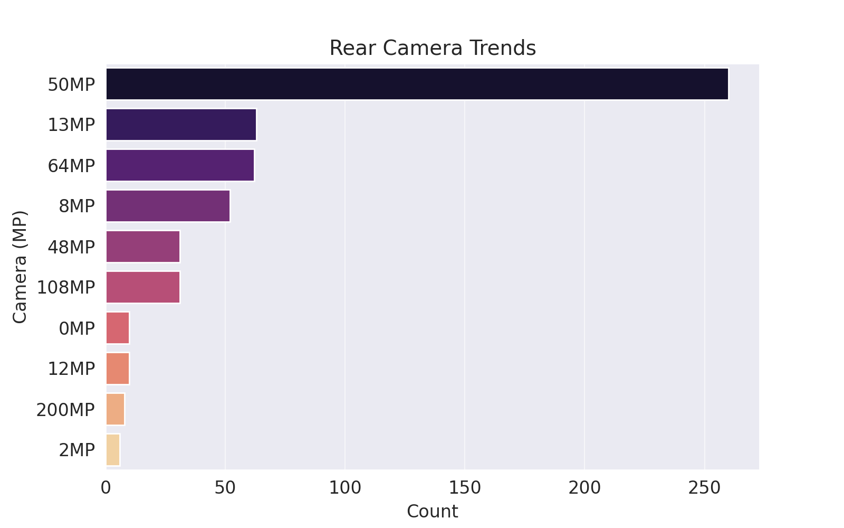
Rear Camera Trends

Slide 10
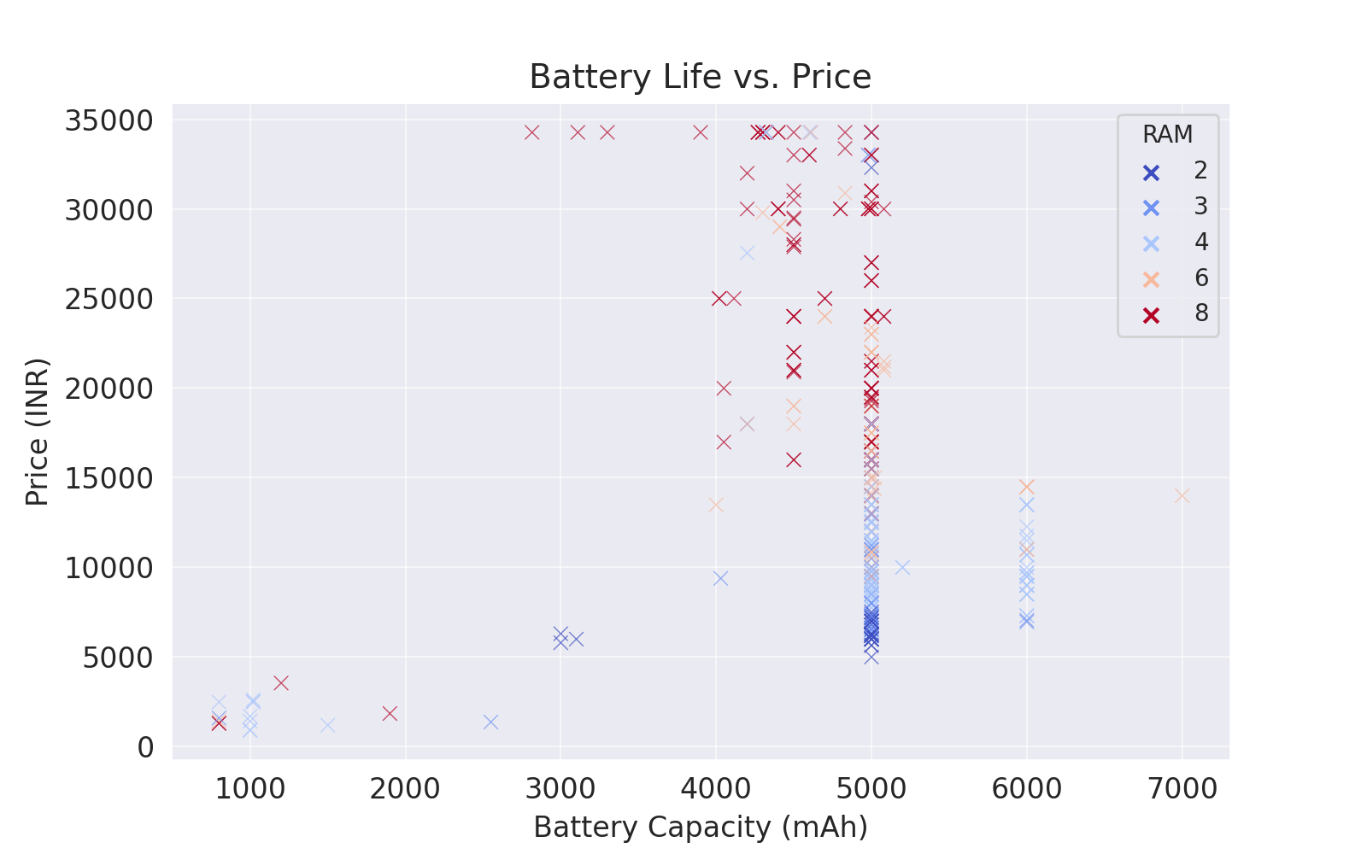
Price vs Battery

Slide 11
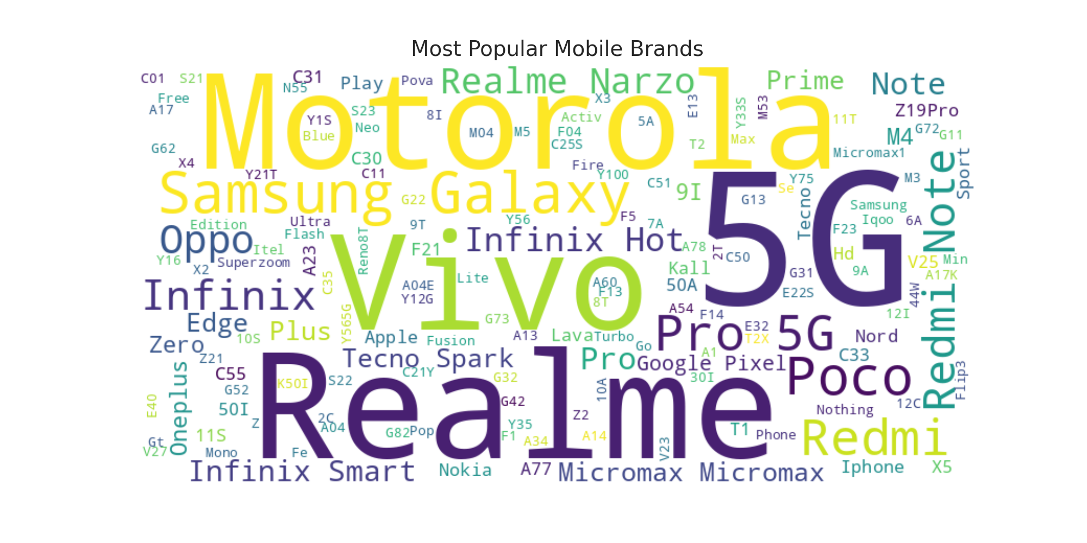
Most Popular Mobile Brands

Slide 12
Top Mobile Brands
Popular brands include Apple, Samsung, Xiaomi, Vivo, and Oppo.
Each brand focuses on different segments from budget to flagship phones.

Slide 13
Key Insights & Trends
Price distribution shows a significant market for budget-friendly phones.
Battery life tends to improve with higher RAM.
Black, Blue, and Gray are the most preferred colors.
Snapdragon processors dominate the market.

Slide 14
Conclusion
The mobile phone market offers a variety of specifications catering to different needs.
Battery, camera, and price remain major decision-making factors.
These insights help consumers and manufacturers make informed choices.
Future trends indicate a rise in higher RAM and battery efficiency.

Slide 15
THANKS FOR WATCHING

