Slide 1
COACHING MANAGEMENT SYSTEM
TS- WEB/CC/AI TRACK CAPSTONE PROJECT
Presented By:
Miss Yalla Sandhya(S170185)
2. Miss Yerragudi Himabindu(S170850)
3. Miss Gonapu Lokeswari(S170379)
Miss Jasmine Ouku(S170846)
5. Miss Mathangi Haveela(S170828)
Guided By: Mrs. Uma Maheshwari

Slide 2
OUTLINE
Abstract
Problem Statement
Aims , Objective & Proposed System/Solution
System Design
System Development Approach(Technology Used)
Algorithm & Deployment
Conclusion
References
Future Scope

Slide 3
Abstract
The "Coaching Class Management System" is a software product to automate and log on to various day-to-day activities and to provide instantaneous information required in effective management of any coaching classes. The automation part of the software would involve data capture and maintenance of details on the institute, teachers, students and tasks in the overall management of the classes. In the existing system we can stored all the record manually that required large man power and place to store the records.

Slide 4
Problem Statement
The current problem in the coaching institutes is did not have systematic data arrangement in the student management. When the staff of administrator wants to record the data of the student, they need to fill out by use the manual system, In this case data might be lost when several problem is occur. Other problem that can be happen is hard to search and update the student information and class arrangement. Teachers also have some problem to as same as administrator that using manual system including to develop the student performance example student discipline, result, attendance and so on that have no any systematic record.
Most 10 common problems in CMS :
Admission & Enrollment.
Course Management.
Teacher Evaluation .
Courses Management Strategy.
Student Monitoring.
Forecasting the academic achievement.

Slide 5
Aims and Objectives:
Managing a coaching institute, bringing together departments to achieve the mission is always a big challenge for CMS. The main objectives of our work are:
To provide a proper registration channel/system to the new students.
To maintain all the accounts of the students in digital platform from enrolment up to the end of the study.
To have a centralized control over the records of the students, teachers and monitor changes in these records.
To minimize the redundancy and loss of data.
To understand the popularity and relevance of coaching classes.

Slide 6
6. To record all of the student academic information for future reference and enhancement and to update and search student information include personal information, result and performance.
7. The manual system is not providing the security of the academic information that might be lost so we are providing this feature.

Slide 7
Proposed Solution
In purposed system everything will be monitored and stored i.e. student, teacher details, where website would contain variety of options. The options are home page, login and register that would contain address, email id, and the most important thing the phone number of the student. The admin is keep the record of student and teacher in the register, everything will be store in the database of the website. so when the data of the store in online in the database there is more security of the data and would also save the memory or space of the class which can be used for the other purpose. students and teacher can save there time and money and they can use for any other purpose.

Slide 8
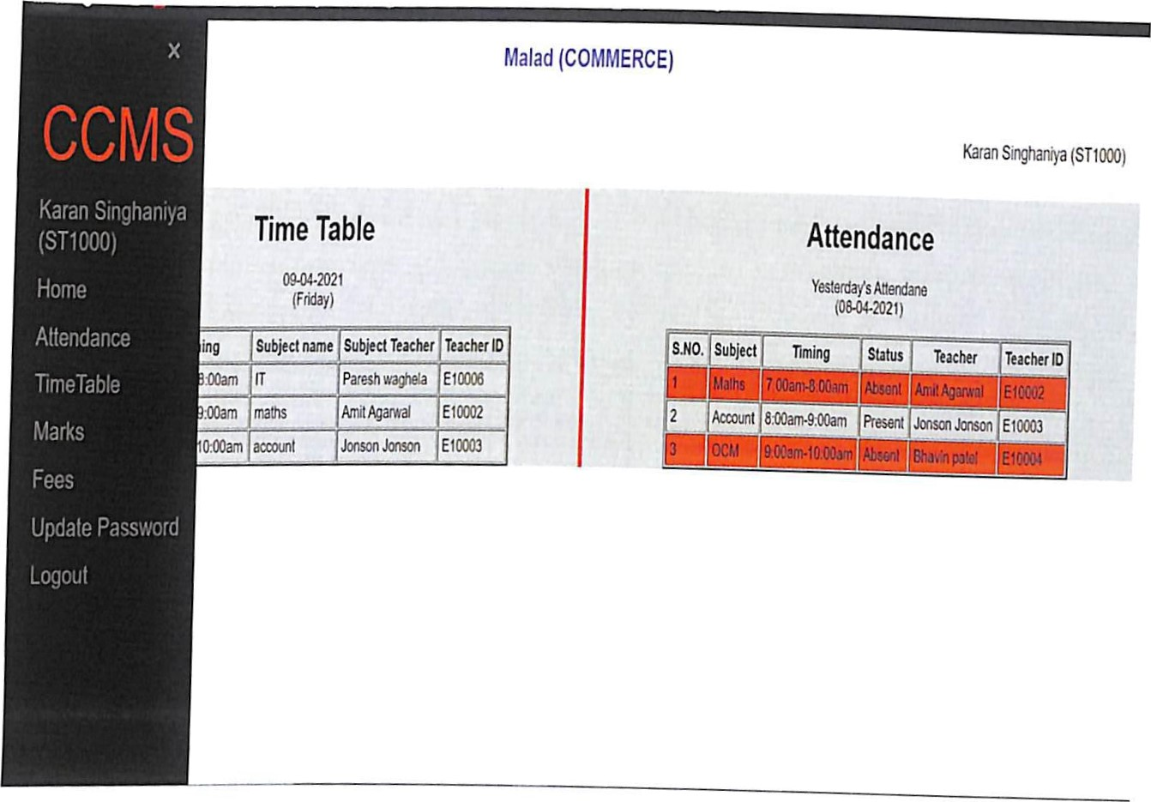
SYSTEM DESIGN

Slide 9
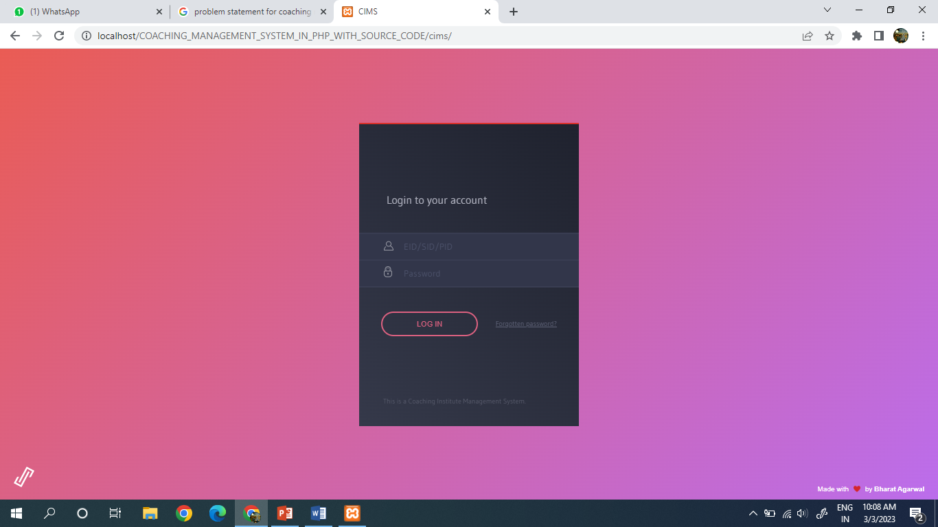
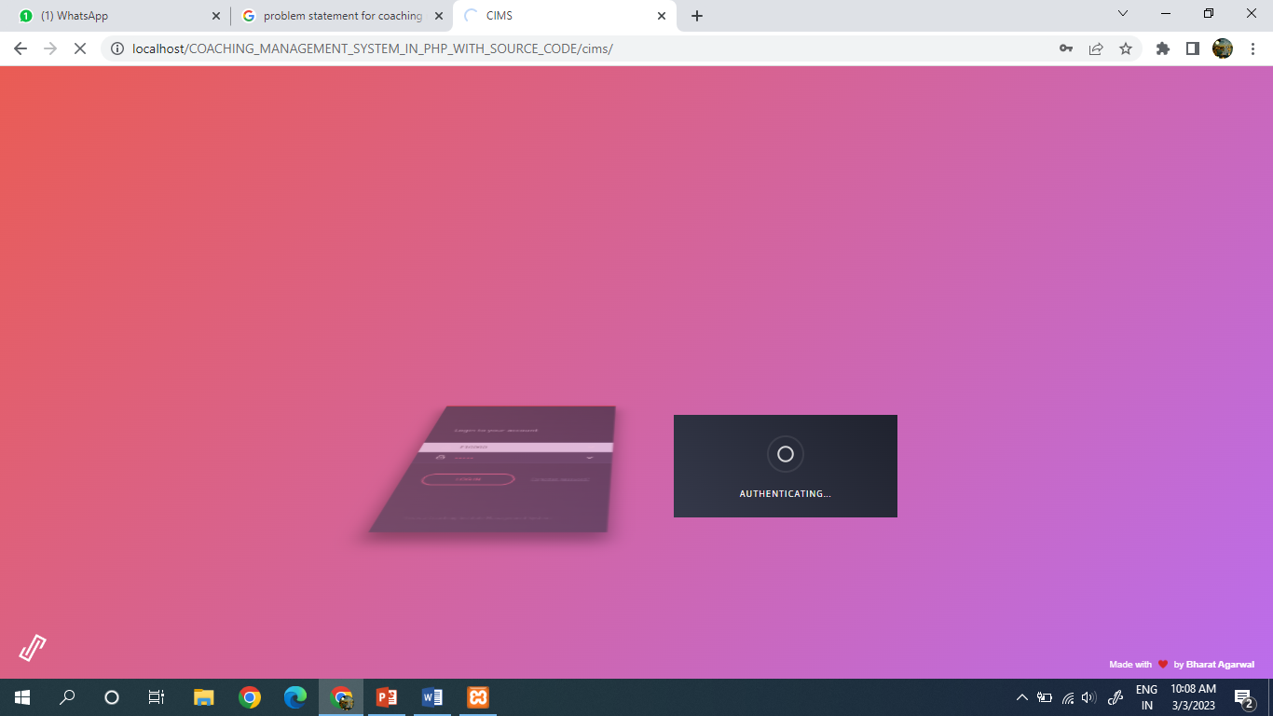
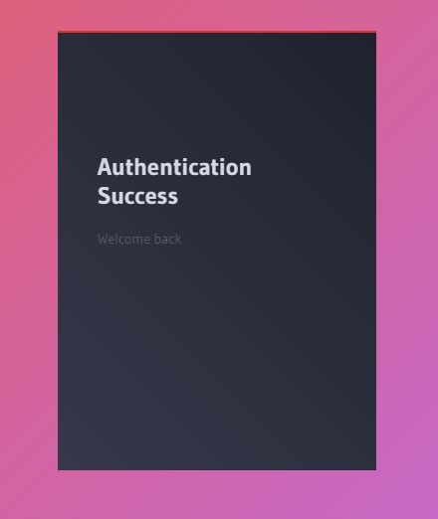
Login details

Slide 10
System Deployment Approach
This Coaching Management System is designed using PHP, JavaScript, and CSS. About the features of this system, it contains the admin sections and other various user sections. The design of this system is simple so that the user won’t get any difficulties while working on it and XAMPP is a free and open-source cross-platform web server solution stack package, it makes transitioning from a local test server to a live server possible. The project contains six modules:
Super Admin (Admin of main/Head center)
Admin (Each Center has its own “Center Admin”)
HOD (Each Center has subject wise HOD’s)
Mentor (Each Batch in each center has their own mentors)
Teacher (Each center has their own teachers and their accounts)
Student (Each student of each center has different accounts)

Slide 11
CONCLUSION:
In this website super admin can see the all admin, center, change admin and center information. The admin can add the new students, teachers details and displays the teacher and student details in home page section. Super admin, Admin, Teachers and students can view the details and they can change the password.

Slide 12
REFERENCES:
https://www.w3schools.com/
https://stackoverflow.com
www.tutuorialspoint.com

Slide 13
Future Scope of the Project:
The future scope of this project is very broad Few of them are:
It can be add the online fees payment for the student convenience.
We can add the parents module for the student activity.
It can be add the quiz for students.
Email Verification for Security.
This can be accessed anytime anywhere, since it is a website provided only an internet connection.

Slide 14
THANK YOU

