Slide 1
Docker

Slide 2
What is Docker?
Docker is an open platform for developing, shipping, and running applications. Docker enables you to separate your applications from your infrastructure so you can deliver software quickly. With Docker, you can manage your infrastructure in the same ways you manage your applications. By taking advantage of Docker’s methodologies for shipping, testing, and deploying code quickly, you can significantly reduce the delay between writing code and running it in production.

Slide 3
DOCKER PLATFORM
Docker provides the ability to package and run an application in a loosely isolated environment called a container. The isolation and security allow you to run many containers simultaneously on a given host. Containers are lightweight and contain everything needed to run the application, so you do not need to rely on what is currently installed on the host. You can easily share containers while you work, and be sure that everyone you share with gets the same container that works in the same way.

Slide 4























































Slide 5






























Slide 6
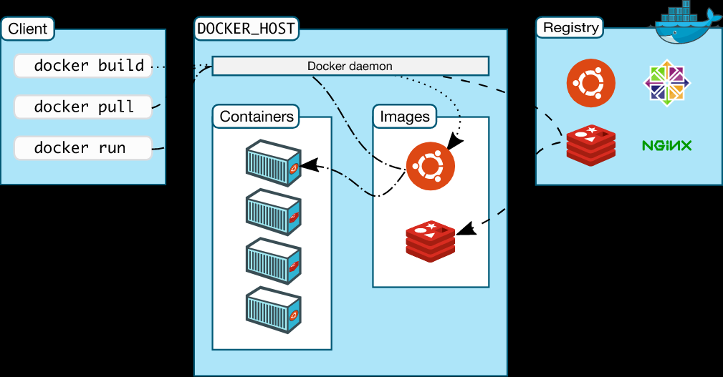


Docker Ecosystem

Slide 7
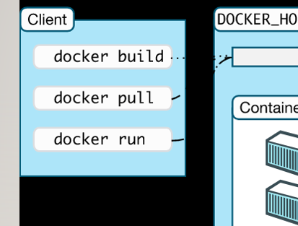
The Docker client
The Docker client (docker) is the primary way that many Docker users interact with Docker. When you use commands such as docker run, the client sends these commands to dockerd, which carries them out. The docker command uses the Docker API. The Docker client can communicate with more than one daemon.

Slide 8
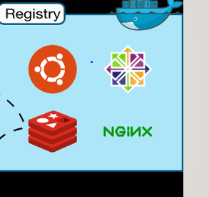
Docker registries
A Docker registry stores Docker images. Docker Hub is a public registry that anyone can use, and Docker is configured to look for images on Docker Hub by default. You can even run your own private registry.
When you use the docker pull or docker run commands, the required images are pulled from your configured registry. When you use the docker push command, your image is pushed to your configured registry.

Slide 9
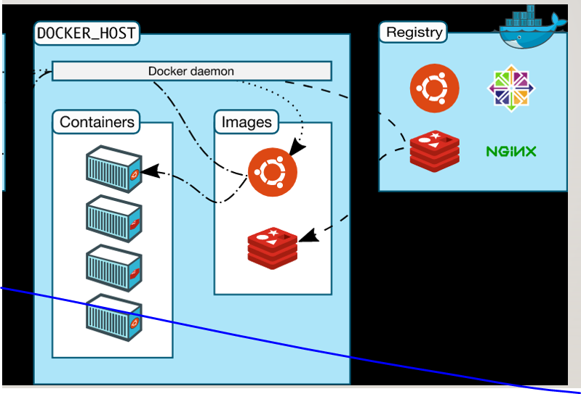
An image is a read-only template with instructions for creating a Docker container.
A container is a runnable instance of an image. You can create, start, stop, move, or delete a container using the Docker API or CLI. You can connect a container to one or more networks, attach storage to it, or even create a new image based on its current state.
container is relatively well isolated from other containers and its host machine.

