Slide 2
CQRS
Command Query Responsibility Segregation

Slide 3
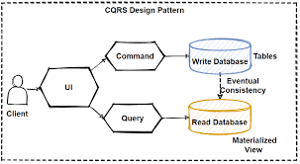
CQRS is one of the important pattern when querying between microservices. We can use CQRS design pattern in order to avoid complex queries to get rid of inefficient joins. CQRS stands for Command and Query Responsibility Segregation. Basically this pattern separates read and update operations for a database.

Slide 4
Understanding the CQRS pattern
The Command Query Responsibility Segregation (CQRS) pattern separates a service’s write tasks from its read tasks. While reading and writing to the same database is acceptable for small applications, distributed applications operating at web-scale require a segmented approach. Typically there’s more read activity than write activity. Also, read activity is immutable. Thus, replicas dedicated to reading data can be spread out over a variety of geolocations. This approach allows users to get the data that closest to them. The result is a more efficient enterprise application.

Slide 5
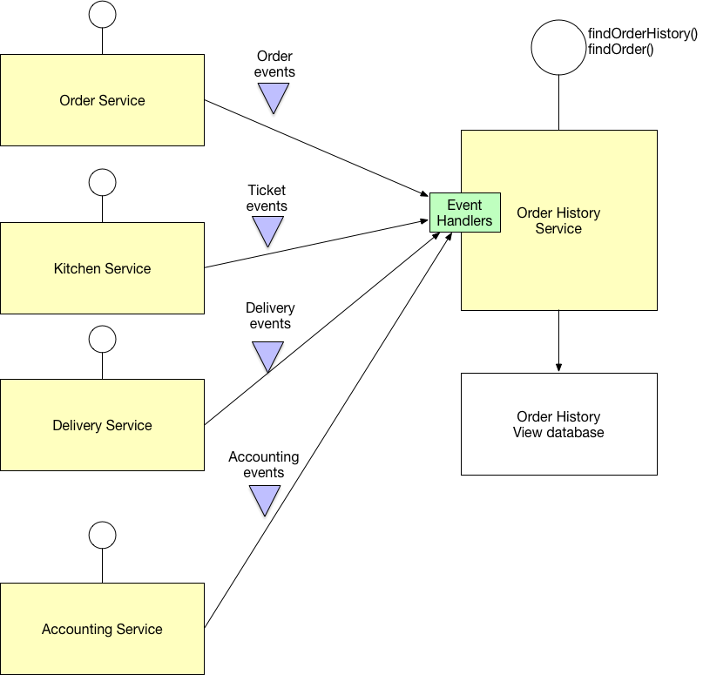

Slide 6
Event Sourcing
Event Sourcing is a pattern for data storage, where instead of storing the current state of any entity, all past changes to that state are stored. With Axon Framework, you can implement Event Sourcing with minimal boilerplate code, giving you the benefits of Event Sourcing, without the hassle.

Slide 7
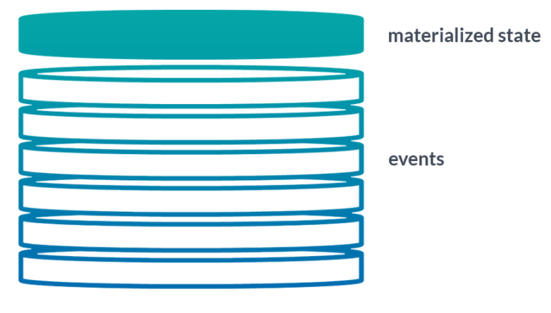
Event Sourcing is a way of storing an application’s state through the history of events that have happened in the past. The current state is reconstructed based on the full history of events, where each event represents a change or fact in our application. Events give us a single source of truth about what happened in our application. It is especially beneficial in applications that need to provide a full audit log to external reviewers. The current state is called Materialized state in some resources. The following figure represents the reconstruction of materialized state based on the history of events.

Slide 8
Pros
Separating write activity from ready activities allows you to use the best database technology for the task at hand, for example, a SQL database for writing and a non-SQL database for reading.
Read activity tends to be more frequent than writing, thus you can reduce response latency by placing read data sources in strategic geolocations for better performance.
Separating write from read activity leads to more efficient scaling of storage capacity based on real-world usage.
Cons
Supporting the CQRS pattern requires expertise in a variety of database technologies.
Using the CQRS patterns means that more database technologies are required hence there is more inherent cost either in terms of hardware or if a cloud provider is used, utilization expense.
Ensuring data consistency requires special consideration in terms of Service Level Agreements (see the CAP theorem).
Using a large number of databases means more points of failure, thus companies need to have comprehensive monitoring and fail-safety mechanisms in place to provide adequate operation

Slide 9
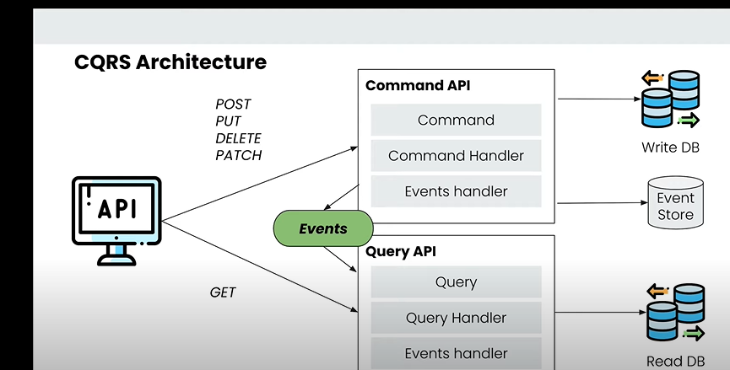
https://developer.axoniq.io/download

Slide 10
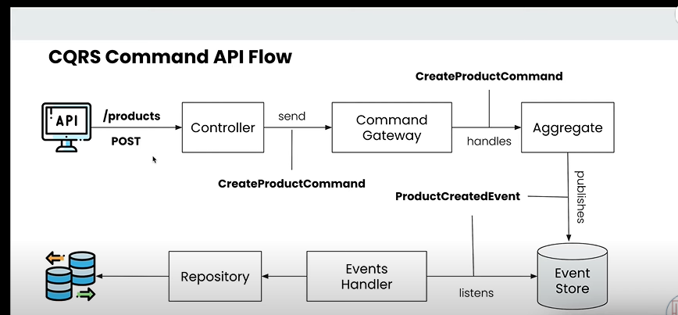

Slide 11
Axon Framework
Axon Framework that adheres to Domain Driven Design (DDD) principles supports microservices patterns with such as Command-Query-Responsibility-Segregation (CQRS) and Event-Driven Architecture in addition to DDD.
For creating DDD, CQRS, and Event Sourcing applications, the open source Axon Framework provides a clear, attractive Java API. It includes basic building blocks for creating aggregates, commands, queries, events, sagas, command handlers, event handlers, query handlers, repositories, and communication buses, among other things.
<dependency>
<groupId>org.axonframework</groupId>
<artifactId>axon-spring-boot-starter</artifactId>
<version>4.5.3</version>
</dependency>

Slide 12
Command Model
@Data
@Builder
public class ProductRestModel {
private String name;
private BigDecimal price;
private Integer quantity;
}
@Data
@Builder
public class CreateProductCommand {
@TargetAggregateIdentifier
private String productId;
private String name;
private BigDecimal price;
private Integer quantity;}

Slide 13
@PostMapping
public String addProduct(@RequestBody ProductRestModel productRestModel) {
CreateProductCommand createProductCommand =
CreateProductCommand.builder()
.productId(UUID.randomUUID().toString()) //320ec6e2-2306-43c7-8037-909fb2116528
.name(productRestModel.getName())
.price(productRestModel.getPrice())
.quantity(productRestModel.getQuantity())
.build();
String result = commandGateway.sendAndWait(createProductCommand);
return result;
}

Slide 14
@Aggregate
public class ProductAggregate {
@AggregateIdentifier
private String productId;
private String name;
private BigDecimal price;
private Integer quantity;
@CommandHandler
public ProductAggregate(CreateProductCommand createProductCommand) {
//You can perform all the validations
ProductCreatedEvent productCreatedEvent =
new ProductCreatedEvent();
BeanUtils.copyProperties(createProductCommand,productCreatedEvent);
AggregateLifecycle.apply(productCreatedEvent);
}
An aggregate is a self-contained tree of objects capable of processing commands. Event Sourcing used to implement aggregates in Axon
annotation signify that the class is Aggregator class.
AggregateLifecycle.apply, invokes event source handler method

Slide 15
@EventSourcingHandler
public void on(ProductCreatedEvent productCreatedEvent) {
this.quantity = productCreatedEvent.getQuantity();
this.productId = productCreatedEvent.getProductId();
this.price = productCreatedEvent.getPrice();
this.name = productCreatedEvent.getName();
}

