Slide 1
JMS
Java Messaging System

Slide 2
What is EMS?
Enterprise Messaging Systems EMS in short is a system that enables data transfer across disparate sytems.
In EMS terminology the word messaging is used to describe asynchronous messages that consists of requests, reports or events that are consumed by enterprise applications and not humans
These messages contain information that is needed to coordinate systems and track progress of the enterprise.
Enterprise messaging systems, which are language and platform-independent solutions, are also called messaging services, or more formally, messaging-oriented middleware (MOM).

Slide 3


What is Synchronous Messaging ?
Synchronous messaging describes communication that takes place between two applications or systems, where the system places a message in a message queue (also called an Event Queue in enterprise messaging systems) and then waits for a message response before it continues processing.
Something that is happening in real time. Synchronous communication examples include: instant messaging, video conferencing, webcams,
Telephonic conversations.

Slide 4

What is ASynchronous Messaging ?
Asynchronous messaging describes communication that takes place between two applications or systems, where the system places a message in a message queue (called an Event Queue in enterprise messaging systems) and does not wait for a reply to continue processing.
Asynchronous groupware includes e-mail, version control systems, or collaborative writing systems.
SMS messaging

Slide 5
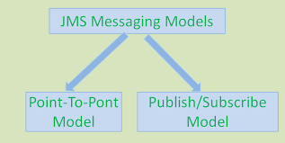
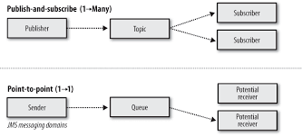

JMS- Java Messaging System
It is a messaging standard that allows application components based on Java EE to create, send, receive, and read messages. It allows the communication between different components of a distributed application to be loosely coupled, reliable, and asynchronous
publisher sends messages into 1 or more topics
subscribers can arrange to receive 1 or more topics, then consume all the messages
producer sends messages into the queue, each message is read by only one consumer
once the message is consumed, it vanishes
multiple consumers can read messages from the queue

Slide 6
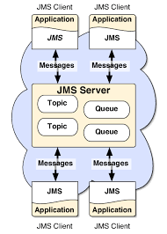

Slide 7
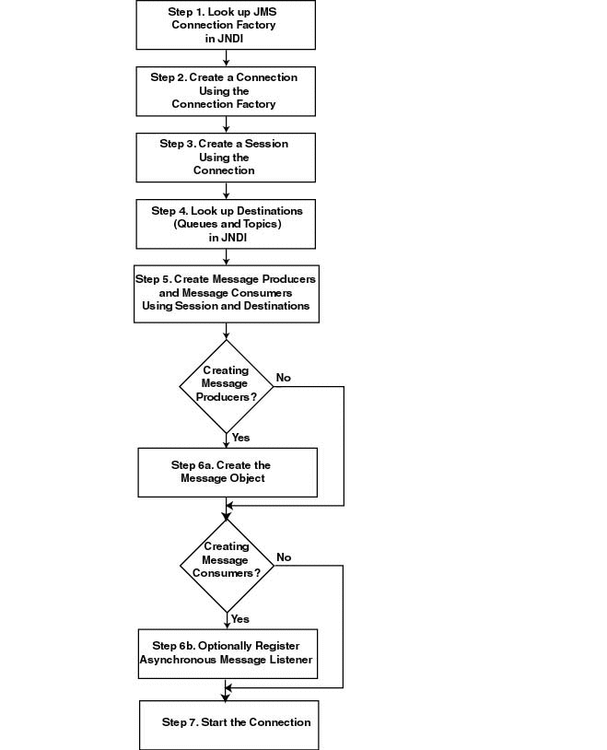
Notes:
Message queuing - a simple use case
Imagine that you have a web service that receives many requests every second, where no request can get lost, and all requests need to be processed by a function that has a high throughput. In other words, the web service always has to be highly available and ready to receive a new request instead of being locked by the processing of previously received requests.
In this case, placing a queue between the web service and the processing service is ideal. The web service can put the "start processing" message on a queue and the other process can take and handle messages in order. The two processes are decoupled from each other and do not need to wait. If you have a lot of requests coming in a short amount of time, the processing system will be able to process them all. The queue will persist with the requests even if their number grows.
Then imagine that the business and workload are growing and the system needs to be scaled up. All that needs to be done is to add more consumers to work off the queues faster.

Slide 8
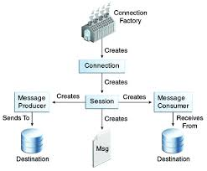

Slide 9
JMS Example
//pom.xml
<dependency>
<groupId>org.springframework.boot</groupId>
<artifactId>spring-boot-starter-activemq</artifactId>
</dependency>
//properties
spring.activemq.in-memory=true
spring.activemq.pool.enabled=false
server.port=8081
spring.activemq.broker-url=tcp://localhost:61616
To start active mq server: activemq start

Slide 10
@EnableJms
@Configuration
public class ActiveMqConfiguration {
@Value("${spring.activemq.broker-url}")
private String brokerUrl;
@Bean
public Queue queue() {
return new ActiveMQQueue("test1");
}
@Bean
public ActiveMQConnectionFactory activeMQConnectionFactory() {
ActiveMQConnectionFactory factory = new ActiveMQConnectionFactory();
factory.setBrokerURL(brokerUrl);
return factory;
}
@Bean
public JmsTemplate jmsTemplate() {
return new JmsTemplate(activeMQConnectionFactory());
}
}

Slide 11
@RestController
public class ActiveMqControllerProducer {
@Autowired
private JmsTemplate jmsTemplate;
@Autowired
private Queue queue;
@GetMapping("/publish/{message}")
public String publish(@PathVariable("message")String message)
{
jmsTemplate.convertAndSend(queue,message);
return message + " Published Sucessfully";
}
}

Slide 12
@Component
public class ActiveMqConsumer {
@JmsListener(destination = "test1") public void listener(String message) {
System.out.println("Received Message: " + message); }
}

