Slide 1
Packages

Slide 2
A package is a collection of related classes and interfaces that provides access protection and namespace management.
Resolves class name clashing by giving a class fully qualified name.
Packages are created using the package keyword.
Example:
package graphics;

Slide 3
Declaring a package
Eg 1: Eg2 :
package p1; package p1.p12.p123;
class A{ class B{
}
}

Slide 4
Classes belonging to one package are stored in the subdirectory whose name is same as the package name.
Package member can be accessed by using import keyword.
Only public members of package are accessible to universe.

Slide 5
Access Specifiers
Java provides four distinct access specifiers for class members.
private
protected
public
default / (package wide scope)

Slide 6
Java Class Path
Both compiler and interpreter search for classes in the specified directory.
The directory specification is provided by CLASSPATH environment variable.
A class path is a list of directories or zip files to search for the class files.
The classpath can also be passed explicitly to javac or java

Slide 7
Access Control
 | Private | Default | Protected | Public
Class |  |  |  | 
Sub class, same package |  |  |  | 
Other class, same package |  |  |  | 
Sub class, diff package |  |  |  | 
Other class, diff package |  |  |  | 

Slide 8
JAR
JAR(java archive) is a file that has a collection of the class files required for the application.
It helps us distribute classes for the application easily and also helps in setting the classpath.
Important thing about the jar file is that it maintains the directory structure.
So if we want a class Student.class to be inside student directory that can be maintained in the jar file.
jar command can be used to create and update a jar file.
It can also be used to extract a jar file.

Slide 9

jar command
Please read Page 21 of Packages.pdf detailing JAR commands .
Notes:
Creation of jar file
jar –cvf filename.jar *.*
Updation:
jar –uvf filename.jar newfilename.ext
Extraction :
jar –xvf filename.jar
Activity to create jars from command line :
Copy student and teacher package folders into D:\test.
Run the following command
D:\packages >jar –cvf college.jar *.class
This jar file can now be copied and placed anywhere. Copy this file to any of your favorite location.
Close the command prompt session.
Set the classpath to
set classpath =%classpath%;yourpath\college.jar
Compile and Execute Tester class.
Activity: Creating jar in eclipse:
Set up:
Make sure that you have a java project called ‘College’ which has 2 packages student and teacher and the associated classes]
Create a new java project called Test and copy the Tester class into it. You should see a lot of errors.
Right click on the College project and select Export.
Expand the Java node and select JAR file. Click Next.
In the JAR File Specification page, select College project.
In the Select the export destination field, either type or click Browse to select a location for the JAR file.
Click Finish to create the JAR file.
Browse on the location that you specified to find the jar file
Activity: Setting classpath in eclipse:
Right click on the Test project and select Build Path→ Add External Libraries.
Browse and Select college.jar file.
All the errors must disappear.
Execute the Tester class

Slide 10
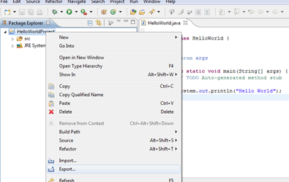
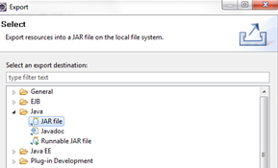
Running project outside Eclipse
To run your Java program outside of Eclipse you need to export it as a jar file. A jar file is the standard distribution format for Java applications.
Step 1: Select your project, right click on it and select Export.
Step 2: Select JAR File from the Export window. Select Next
Select the project and specify the export destination and a name for the jar file. Select Finish.
This jar file can be executed by including it in the classpath.

Slide 11
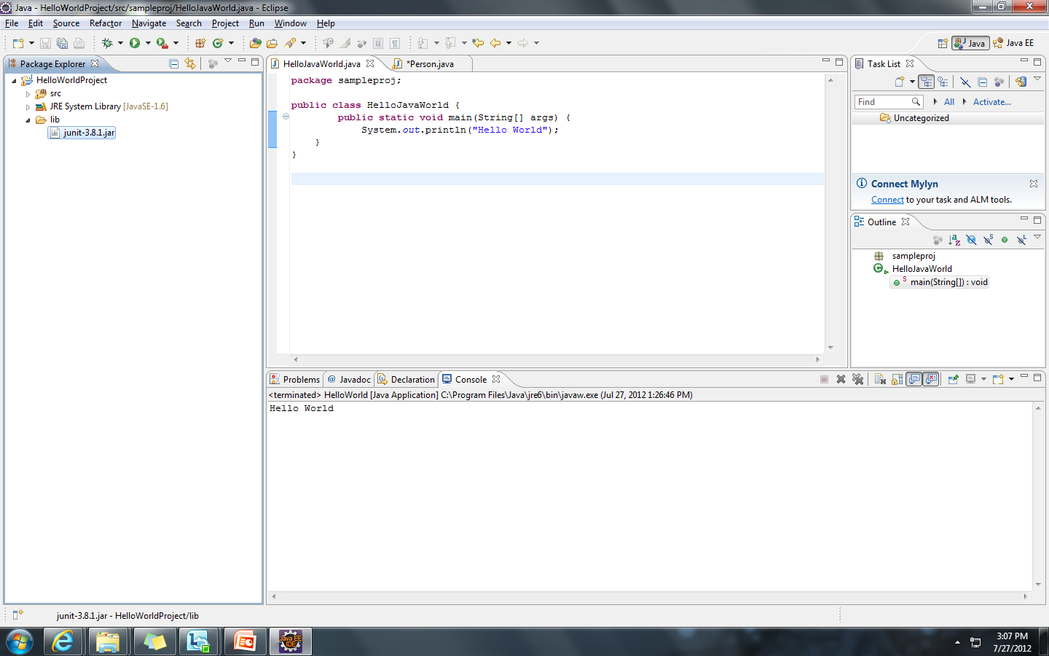
Using Jars (Libraries)
The Steps to add a library (.jar) to the project are as follows.
Step 1: Import the jar to the project by selecting File → Import → General → File System. Select the jar and select the folder lib as target. Alternatively, just copy and paste the jar file into the "lib" folder.

Slide 12
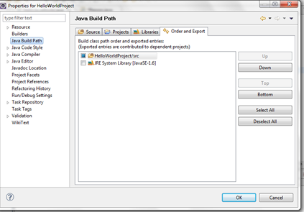
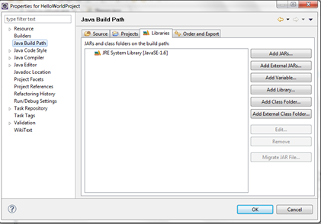
Step 2: Right click on the project and select Properties and select Java Build Path
Step 3: Select “Add JARs” or “Add External JARs”

Slide 13
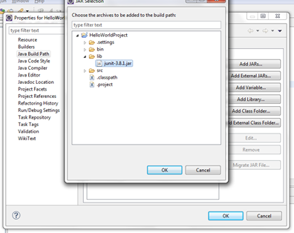
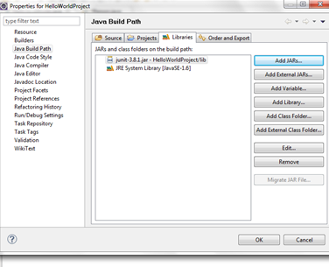
Step 4: Select the Jar to be added and click OK.

Slide 14
Imports
Java provides an easy way to access classes in other packages instead of using long names. This is done by using import statement.
The same is the case with static members of a class too. Static members of a class are accessed using ClassName.staticMemberName. This name also sometimes could be very long. Instead imports could be used such that only static member name can be used.
Two forms of imports:
Class imports
Static imports

Slide 15
Class Imports
Importing only a particular class.
Example:
import student.Student;
public class Tester{
…
Student s= new Student("John","M.C.A.");
}
Importing all the classes in a package.
Example:
import student.*;
public class Tester{
…
Student s= new Student("John","M.C.A.");
}

Slide 16
Static Imports
Makes the static members of a class available to code the directly without explicitly specifying the class name.
Syntax:
import static packageName.ClassName.*;
(imports all the static members)
Or
import static packageName.ClassName.staticMember;
(imports only the particular ‘staticMember’)
Notes:
Added in Java 1.5

Slide 17
Example: Static Imports
Static member of System
import static java.lang.System.out;
import static teacher.Grade.*;
import teacher.*;
class GradeTest{
public static void main(String str[]){
Teacher f=new teacher.Teacher("Tom");
Grade gf= new Grade(f,new student.Student("Malini"),"001",B);
out.println("Grade "+ gf.getGrade());}
}
Instead of System.out.println
Instead of Grade.B

Slide 18
Tell me how?
If importing using * means all classes are imported, is it not better to import the required class to avoid loading of all classes?
Java loads the classes on demand. This is feature called Dynamic Linking.
Only the classes whose members are invoked in some are loaded.
Hence both using * or explicitly specifying class, will not impact class loading.
One advantage of using an explicitly specified class name is for better code comprehension.

Slide 19
Default Access Specifier
Classes or members having default or package access specifier can be accessed only by the classes belonging to the same package.
There is no keyword for default access specifier.
public class Student{
private int regNo;
public int getRegNo(){..}
int getRegNo(){..} // default access
}
Notes:
One of the advantages of using package is also access control of classes. This is done through default access specifier, sometimes also called package access specifier.
If no access specifier is specified for a class or member, by default it is assumed to be package access specifier or default access specifier.

Slide 20
Packages - Not truly nested
To organize the name in meaningful manner packages can be created such that classes can be placed inside multiple folders which are in hierarchy or nested.
Although packages appear to be hierarchical or nested with respect to folder, they are not.
package com;
public class A{}
package com.util;
public class B{}
To use A and B in a class outside the package we must import both the packages separately.
import com.*;
import com.util.*;
public class C{
A a;
B b;}
Notes:
For instance, if all the classes related to college must be inside a college folder, then Student class has to be inside student folder which in turn should be inside college folder and then Teacher class has to be inside teacher folder which in turn should be inside college folder, then the package statement has to be
package college.student;
public class Student{…}
package college.teacher;
public class Teacher{…}
Now
import college.*;
does not import student and teacher package.
It imports only the classes inside college folder/package (if there are any)
To import both student and teacher package, 2 import statements are necessary
import college.student.*;
import college.teacher.*;

Slide 21
Java source file rules
So far, we have been typing all the java classes in a separate file. And of course that is the recommended way. But if you still feel that it will save time if you put some of your related classes together in the same source file then here are the rules that the compiler insists on.
A java source file can contain:
a single package statement which will be the first statement.
any number of import statements. They should be between package and class statement.
any number of classes with default access specifier. In such cases, the file name could be ‘anything’.java.
only one public class. If there is a public class then the file must be named after the public class name.
The package and the import statements apply to all the classes in the source file.

Slide 22
Standard packages in JSE
Some of the important packages :
java.lang : All the classes that are fundamental to the Java programming language. String class is a part of java.lang package. This package is automatically imported by all java classes.
java.util : All the utility classes like Date, LinkedList etc. which are frequently used in applications.
java.io : All the classes related to IO.
java.sql : All the classes related to database.
java.awt : All the classes related to building GUI
The packages in JDK begin with java or javax. So it is recommended that we don’t use java or javax. when we define our package.
Search for rt.jar in your system or in eclipse open rt.jar inside JRE system library and look for the above packages.

Slide 23
Exercise
Create a new project in which create a package named org.animals. In that create various classes like Lion, Monkey, Elephant. In each class create data members like color, weight and age. Create methods like isVegetarian, canClimb, getSound.
Create another project and in that create a package called zoo and create a class called VandalurZoo and create objects for the animals that are existing in zoo and print the characteristic of each animal.
(15 mins)

