Slide 1
JDBC
Java Database Connectivity

Slide 2
JDBC API
JDBC 4.0 (part of JSE 6) is an API that provides standard for connectivity to variety of data sources like SQL databases, spreadsheets and flat.
Therefore before writing JDBC code we must make sure that we have the library with respect to the data source that we intend to use.
JDBC is based on the X/Open SQL Call Level Interface (CLI). JDBC 4.0 complies with the SQL 2003 standard.
JDBC 4.0
java.sql
javax.sql
JDBC core API
JDBC Optional Package API
Notes:
1.

Slide 3
Steps to write database code
Load the driver
Obtain connection
Create and execute statements
[Use result sets to navigate the results]
Close the connection

Slide 4
Load the driver
java.sql.DriverManager class is used to get drivers and get connection to the database.
To register (Load) the driver with the application explicitly:
Class.forName(“<driver class name>");
Or
DriverManager.registerDriver( new <driver class name>());
Both of these registers the given driver with the DriverManager.. Static block of the <Driver class> calls DriverManager.registerDriver() method!
With JDBC 4.0, this class also provides a mechanism to automatically load the database drivers (provided they are packaged in the specified way) → later

Slide 5
Get Connected
Getting Connection:
static Connection getConnection(String url) throws SQLException
static Connection getConnection(String url, Properties info) throws SQLException
static Connection getConnection(String url, String user, String password) throws SQLException

Slide 6
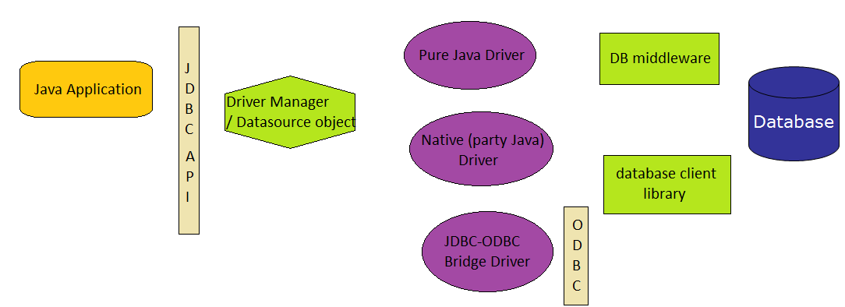
JDBC Architecture
4 Ways to connect to database – through 4 types of driver

Slide 7
Driver Types
JDBC driver are classes used to translate JDBC calls either to vendor-specific database calls or may be directly invoke database commands.
Types of driver
Type 1- JDBC-ODBC Bridge
Type 2- Part Java, Part Native Driver
Type 3- Intermediate Database Access Server
Type 4- Pure Java Drivers

Slide 8
JDBC-ODBC Bridge
Database
Java
application
JDBC
API
ODBC
API
ODBC
Layer
JDBC-ODBC
Bridge
Drivers classes that implement the JDBC API as a mapping to ODBC (Open Database Connectivity) API.
ODBC Microsoft's interface for accessing data in a heterogeneous database management systems.
ODBC binary code and in many cases, database client code -- must be loaded on each client machine that uses a JDBC-ODBC Bridge

Slide 9
Example using JDBC-ODBC Bridge
We will write code to establish connection with JDBC-ODBC Bridge.
Before we write code there are 2 things we need to do
Create a database in MS-Access with any name.
Configure the DSN for ODBC Driver as specified in the next slides

Slide 10
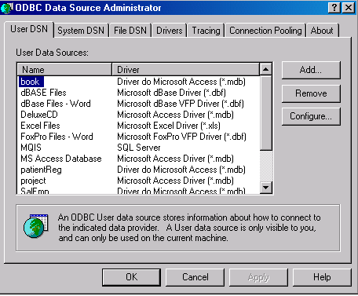
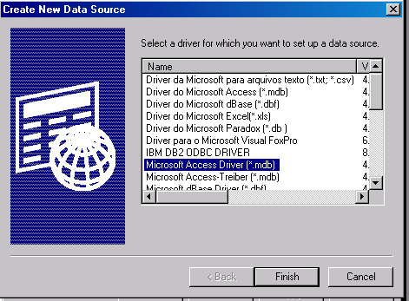
Configure the DSN for ODBC Driver for MS-Access
In control panel locate “Data Sources (ODBC)” icon (inside Administrative Tools)
Double-click the icon and click on “Add” button in the “User DSN” tab.
Select “Microsoft Access Driver” and click “Finish”

Slide 11
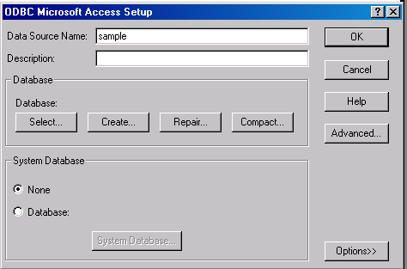
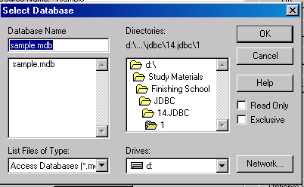
Enter DSN name as “sample” (we will use this name in the code) and click “Select”.
Browse through and get the access file and click “OK”.
Click “OK” on next two screens and come out of the control panel.

Slide 12
Code to get JDBC-ODBC connection
import java.sql.*;
public class ODBCMain{
Connection con;
public ODBCMain() {
try {
//sample is data source name (DSN)
String url = "jdbc:odbc:sample";
//Load the JDBC-ODBC bridge driver
Class.forName("sun.jdbc.odbc.JdbcOdbcDriver");
//Obtain the connection to the database
con = DriverManager.getConnection(url);
System.out.println (“JDBC-ODBC connection established");
con.close();
}
catch(Exception e){
e.printStackTrace();
} }
public static void main(String str[]){new ODBCMain();}}

Slide 13
Disadvantages
ODBC uses a C. Calls from Java to native C code have a number of drawbacks in the security, robustness, and automatic portability of applications.
Multiple layers of indirection leads to inefficiency.

Slide 14
Type2- Part Java, Part Native Driver
Database
Java
application
Vendor
Specific
API
JDBC
API
JDBC Driver
Much like the bridge driver, this style of driver also requires that some binary code be loaded on each client machine. Therefore this also shares the same disadvantages. This driver is very rarely now a days.

Slide 15
Preferred Database Drivers
Type 3 and Type 4 drivers are preferred database drivers for Java.
Each of these drivers are used in different architectural situations.
Type 4 Drivers
Used in 2-tier architecture
Direct to database connection from java application
Pure Java Driver
Type 3
Three-tier
Connection to database happens through a middleware. The middleware provides connectivity to many different databases.
JDBC-Net pure Java Driver
.

Slide 16
Java application
JDBC Driver Manager or Data Source Object
Pure Java Driver
JDBC-Net Pure Java Driver
TYPE 3
TYPE 4
Database middleware
Database

Slide 17
Connecting using type 4 driver
There are two ways in which we can write this code to connect to a database using Type 4 driver
By specifying class explicitly in the code using Class.forName() or DriverManager.registerDriver().
By using JDBC 4.0 way where we can avoid hard coding the class name in the code.
MySQL database using type 4 driver name is com.mysql.jdbc.Driver .
But before we write code to connect to MySQL databse
we must have database. Create a database called test in MySQL.
set the classpath to the jar file with respect to MySQL in the classpath. Download Connector/J driver for mysql-connector-java-5.0.4-bin.jar.

Slide 18
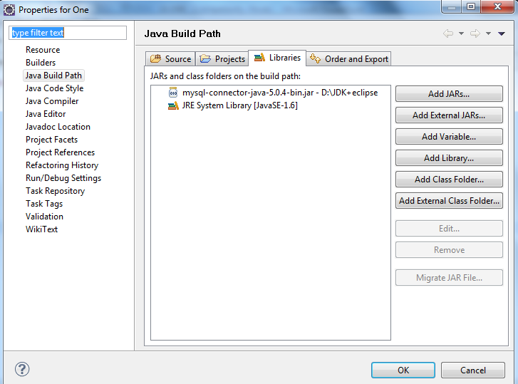
Setting classpath to MySQL driver in eclipse
Select your project, Go to Project menu and select Properties.
Move to “Java Build Path” on the left panel. Click on “Add External JARs”, browse and locate the jar file for MySQL.
Click on Open. This will add the jar file to the Properties Box as shown in the diagram.

Slide 19
Note:
For Web Applications jdbc jar files to be saved in lib directory of the project.

Slide 20
Example: Connecting to MySQL – older way
import java.sql.*;
import java.util.Properties;
public class Connect {
public static void main (String[] args) {
Connection conn = null;
try {
String userName = "root";
String password = "root";
String url = "jdbc:mysql://localhost/test";
Class.forName ("com.mysql.jdbc.Driver");
Properties connectionProps = new Properties();
connectionProps.put("user", userName);
connectionProps.put("password",password);
conn = DriverManager.getConnection(url,connectionProps);
System.out.println ("Database connection successful");}

Slide 21
catch (SQLException e){
System.err.println ("Failed to connect to database" +e);
}
finally{
if (conn != null) {
try { conn.close ();}
catch (SQLException e) { }
}
}
}
}
Result:
Database connection successful

Slide 22
Example: Connecting using JDBC 4.0 way
With JDBC 4.0 the Java service provider mechanism, applications no longer need to explicitly load JDBC drivers using Class.forName().
When the getConnection() is called, the DriverManager will attempt to locate a suitable driver from amongst specified in the classpath. (If there are more than one, the first one is used.)
The code is fundamentally same as the previous example- only line eliminated is Class.forName ("com.mysql.jdbc.Driver");
import java.sql.*;
import java.util.Properties;
public class Connect {
public static void main (String[] args) {
Connection conn = null;
try {
String userName = "root";
String password = "root";
String url = "jdbc:mysql://localhost/test";

Slide 23
Properties connectionProps = new Properties();
connectionProps.put("user", userName);
connectionProps.put("password",password);
conn = DriverManager.getConnection (url,connectionProps);
System.out.println ("Database connection successful");
}
catch (SQLException e) {
System.err.println ("Failed to connect to database" +e);
}
finally
{
if (conn != null) {
try { conn.close ();}
catch (SQLException e) { }
}
}
} }

Slide 24
java.sql.Connection
Connection is an interface.
getConnection()method of DriverManager returns the object that implements this interface.
Connection class can be used to do a variety of tasks
Obtain Statement object
To work with transactions
To get meta-data about the database
For executing a static SQL statement and returning the results it produces, an object that implements Statement interface is used.

Slide 25
Obtaining Statement
Connection class methods to obtain Statement and its subclasses:
Statement createStatement() throws SQLException
PreparedStatement prepareStatement(String sql) throws SQLException
CallableStatement prepareCall(String sql) throws SQLException
Statement
PreparedStatement
CallableStatement

Slide 26
Statement
The object of this type is used for executing a static SQL statement and returning the results it produces.
The result of the query statement is returned in the form of ResultSet object .
Only one ResultSet object per Statement object can be open at the same time.
Therefore, reading data 2 or more ResultSet objects would require obtaining ResultSets from different Statement objects.
On calling execute methods on Statement object, the ResultSet object obtained from this Statement object (if there are any) is automatically closed.

Slide 27
Statement members
ResultSet executeQuery(String sql) throws SQLException
sql is typically a static SQL SELECT statement. a ResultSet object that contains the data produced by the given query; never null
int executeUpdate(String sql) throws SQLException
sql is typically a SQL DML (INSERT, UPDATE, or DELETE statement) or DDL like (CREATE, DROP statements)
Returns the row count as number of rows affected for DML statements or 0 for SQL DDL statement.

Slide 28
boolean execute(String sql) throws SQLException
Used to execute stored procedure
Used to execute sql that many return multiple result set or update counts
To get the results - methods getResultSet or getUpdateCount to retrieve the first result, and getMoreResults to move to any subsequent result(s).
ResultSet getResultSet() throws SQLException
int getUpdateCount() throws SQLException
boolean getMoreResults() throws SQLException

Slide 29
Batch execution methods: Multiple updates can be sent to the database for execution as a batch.
void addBatch(String sql) throws SQLException
used to add the given SQL command to be executed as batch.
int[] executeBatch() throws SQLException
submits a batch of commands to the database for execution and if all commands execute successfully, returns an array of update counts

Slide 30
ResultSet methods (default)
ResultSet is an interface representing table of data that is retrieved from a database
It maintains a cursor initially pointing to the first row. The next method moves the cursor to the next row until returns false when there are no rows to read.
A default ResultSet object is not updatable and has a cursor that moves forward only.
boolean next() throws SQLException
void close() throws SQLException
XXX getXXX(int columnIndex)
throws SQLException
where XXX is any primitive type, String, java.sql.Date (subclass of java.util.Date), Object
columnIndex begins from 1

Slide 31
Example :Code to insert and fetch records
Assuming a table in MYSQL named Student with regNo(int(11)), name(varchar(45)), degree(name(varchar(45)) and semester((int(11))
import java.sql.*;
import java.util.Properties;
public class Connect {
public static void main (String[] args) {
Connection conn = null;
try
{
String userName = "root";
String password = "root";
String url = "jdbc:mysql://localhost/test";
Properties props = new Properties();
props.put("user", userName);
props.put("password",password);
conn = DriverManager.getConnection(url,props);
Statement s= conn.createStatement();

Slide 32
s.executeUpdate("INSERT INTO STUDENT VALUES (1,'Rama','M.C.A.', 1)");
s.executeUpdate("INSERT INTO STUDENT VALUES (2,'Sita','B.Tech', 2)");
ResultSet rs=s.executeQuery("SELECT * FROM STUDENT");
System.out.println("ID Name Degree Semester");
while (rs.next() ) {
System.out.println( rs.getInt(1) +" "+rs.getString(2)+" "+rs.getString(3)+" "+rs.getInt(4)); }
} catch (SQLException e){
System.err.println ("Failed to connect to database" +e);
}
finally {
if (conn != null) {
try { conn.close ();}catch (SQLException e) { }
} } } }

Slide 33
Advanced ResultSet
A default ResultSet object is not updatable and has a cursor that moves forward only.
In order to have ResultSet which are scrollable and updatable a different createStatement() method has to be used.
public Statement createStatement(int resSetType,int resSetConcurrency) throws SQLException
resSetType :
ResultSet.TYPE_FORWARD_ONLY
cursor may move only forward (default)
ResultSet.TYPE_SCROLL_INSENSITIVE
scrollable but not sensitive to changes to the underlying data in the database that happens outside the purview of this object
ResultSet.TYPE_SCROLL_SENSITIVE
scrollable but not sensitive to changes to the underlying data

Slide 34
resSetConcurrency :
ResultSet.CONCUR_READ_ONLY
makes the result set read only
ResultSet.CONCUR_UPDATABLE
makes the result set updateable. Using this object, rows can be inserted, updated and deleted in the object itself which automatically synchronizes with the database.

Slide 35
More ResultSet methods
void afterLast() throws SQLException
void beforeFirst() throws SQLException
boolean first() throws SQLException
boolean last() throws SQLException
boolean isAfterLast()
boolean isBeforeFirst()
boolean isFirst()
boolean isLast()
boolean rowUpdated() throws SQLException
boolean rowInserted() throws SQLException
boolean rowDeleted() throws SQLException

Slide 36
void updateXXX(int columnIndex, byte x) throws SQLException
Where XXX is primitives or String, java.sql.Date, Object
void insertRow() throws SQLException
void updateRow() throws SQLException
void deleteRow() throws SQLException
void refreshRow() throws SQLException
void moveToInsertRow() throws SQLException
How these methods work is better understood by an example ahead.

Slide 37
Example: using advanced ResultSet
import java.sql.*;
import java.util.Properties;
public class AdvRS {
public static void main (String[] args) {
Connection conn = null;
try
{
String userName = "root";
String password = "root";
String url = "jdbc:mysql://localhost/test";
Properties props = new Properties();
props.put("user", userName);
props.put("password",password);
conn = DriverManager.getConnection (url,props);
Statement stmt = conn.createStatement(ResultSet.TYPE_SCROLL_INSENSITIVE, ResultSet.CONCUR_UPDATABLE);

Slide 38
ResultSet rs = stmt.executeQuery("SELECT * FROM STUDENT");
System.out.println("Before...");
System.out.println("ID Name Degree Semester");
while (rs.next() ) {
System.out.println( rs.getInt(1) +" "+rs.getString(2)+" "+rs.getString(3)+" "+rs.getInt(4));
}
//inserting a new row
rs.moveToInsertRow();
rs.updateInt("RegNo", 3);
rs.updateString("name", "Geeta");
rs.updateString("degree", "B.E.");
rs.updateInt("semester", 3);
rs.insertRow();

Slide 39
//updating 2nd row – changing name to Seetha
rs.absolute(2);
rs.updateString(2,"Seetha");
rs.updateRow();
rs.beforeFirst();
System.out.println("After...");
System.out.println("ID Name Degree Semester");
while (rs.next() ) {
System.out.println( rs.getInt(1) +" "+rs.getString(2)+" "+rs.getString(3)+" "+rs.getInt(4)); }}
catch (SQLException e) { System.err.println ("Failed to connect to database" +e);
}
finally {if (conn != null) {
try {conn.close ();} catch (SQLException e) { } } } } }

Slide 40
Result of execution of the code
Before...
ID Name Degree Semester
1 Rama M.C.A. 1
2 Sita B.Tech 2
After...
ID Name Degree Semester
1 Rama M.C.A. 1
2 Seetha B.Tech 2
3 Geeta B.E. 3

Slide 41
PreparedStatement
Interface that inherits from Statement
If the same sql statement is executed many times it is more efficient to use a prepared statement.
It enables a SQL statement to contain parameters like functions. So same statement can be executed for different set of values.

Slide 42
Example: Inserting large objects in the database
Example demonstrating insertion of a picture in a database. Assuming that we have table Photo(id integer(110, name varchar(45), pho blob).
import java.sql.*;
import java.io.*;
public class InsertPhoto{
public static void main(String[] args) {
System.out.println("Insert Image Example!");
String driverName = "com.mysql.jdbc.Driver";
String userName = "root";
String password = "root";
String url = "jdbc:mysql://localhost/test";
Connection con = null;
try{
Class.forName(driverName);
con = DriverManager.getConnection(url,userName,password);

Slide 43
File imgfile = new File("D:\\image.jpg");
FileInputStream fin = new FileInputStream(imgfile);
PreparedStatement pre = con.prepareStatement("insert into Photo values(?,?,?)");
pre.setInt(1,5);
pre.setString(2,"Durga");
pre.setBinaryStream(3,fin,(int)imgfile.length());
pre.executeUpdate();
System.out.println("Inserting Successfully!");
pre.close();
con.close();
}
catch (Exception e){
System.out.println(e.getMessage());}
}
}

Slide 44
Using PreparedStatement for batch updates
Apart from the batch related methods added by the Statement interface, PreparedStatement adds one more
void addBatch() throws SQLException
is used to add batch of commands
But since most of the batch operations are executed using same sql statement, it is usually used with PreparedStatement since it allows parameterized statements and hence they can be cached to give better performance.

Slide 45
Example: Batch updates
import java.sql.*;
public class BatchEx {
public static void main (String[] args) throws SQLException {
Connection conn = null;
String userName = "root";
String password = "root";
String url ="jdbc:mysql://localhost/test";
java.util.Calendar c=java.util.Calendar.getInstance();
conn = DriverManager.getConnection(url,userName,password);
PreparedStatement stmt = conn.prepareStatement("INSERT INTO BookIssue VALUES(?,?,?,?)");
stmt.setInt(1,15);
stmt.setInt(2,1);
c.clear(); c.set(2011,9,25);
stmt.setDate(3, new java.sql.Date((c.getTime()).getTime()));

Slide 46
c.set(2011,9,27);
stmt.setDate(4,new java.sql.Date((c.getTime()).getTime()));
stmt.addBatch();
stmt.setInt(1,16);
stmt.setInt(2,2);
c.clear();
c.set(2011,10,12);
stmt.setDate(3,new java.sql.Date((c.getTime()).getTime()));
c.set(2011,10,27);
stmt.setDate(4,new java.sql.Date((c.getTime()).getTime()));
stmt.addBatch();
stmt.executeBatch();
conn.close();
}}

Slide 47
CallableStatement
Interface that inherits from PreparedStatement that is used to execute stored-procedure.
In Connection.prepareCall(String s)is used to create a CallableStatement.
The string parameter is of the form
{[?=] call <procedure-name>[<arg1>,<arg2>, ...]}
The arguments IN parameter values are set using the set methods inherited from PreparedStatement.
All OUT parameters must be registered before a stored procedure is executed.
void registerOutParameter(int parameterIndex, int sqlType) throws SQLException
java.sql.Types has all the parameters that can be sent as sqlType. (Please refer to <docfolder>\docs\api\java\sql\Types.html)

Slide 48
Java Code to call the stored procedure
PROCEDURE GETSTUD(IN id1 INT,OUT nm VARCHAR(45))
BEGIN
SELECT NAME INTO nm FROM STUDENT WHERE REGNO=id1;
END
import java.sql.*;
public class CallSPMySQL {
public static void main(String[] args) {
String userName = "root";
String password = "root";
String url = "jdbc:mysql://localhost/test";
Connection conn = null;
try{
conn = DriverManager.getConnection(url,userName,password);
CallableStatement c=conn.prepareCall("{call GETSTUD(?,?)}");

Slide 49
String name=null;
c.setInt(1,2);
c.registerOutParameter(2,java.sql.Types.VARCHAR);
c.executeUpdate();
name=c.getString(2);
System.out.println("Name retrieved: "+ name);
}
catch (SQLException e) {
System.err.println ("Failed to connect to database" +e); }
finally {
if (conn != null)
try { conn.close ();} catch (SQLException e) { }
}
}
}

Slide 50
Example: Retrieving ResultSet from stored procedure
PROCEDURE AllStudents()
BEGIN
Select * from Student;
END
import java.sql.*;
public class CallableSQLRS {
public static void main(String[] args) {
String userName = "root";
String password = "root";
String url = "jdbc:mysql://localhost/test";
Connection conn = null;
try{
conn = DriverManager.getConnection(url,userName,password);

Slide 51
CallableStatement c=conn.prepareCall("{call AllStudents()}");
boolean res = c.execute();
while (res) {
ResultSet rs = c.getResultSet();
System.out.println("ID Name Degree Semester");
while (rs.next() ) {
System.out.printf( "%2s %10s %10s %7s\n",rs.getInt(1),rs.getString(2),rs.getString(3),rs.getInt(4));
}
res = c.getMoreResults();
}}
catch (SQLException e) { System.err.println(e);}
finally { if (conn != null)
try {conn.close ();} catch (SQLException e) { } } }}

Slide 52
Transaction support
Methods in Connection class helps to demarcate the set of statements into a transaction.
public void setAutoCommit(boolean autoCommit) throws SQLException
public void rollback() throws SQLException
public void commit() throws SQLException

Slide 53
Example: Transaction support
To understand transactions we will use two tables Login ( id, login, password) and Student (regno, name,degree,semester). Insertion of student data will require us to insert data either into both the tables or in none of them in case there is an error. Login will be same as regno.
import java.sql.*;
class Trans{
public static void insert(String login, String pass,int id, String name){
String userName = "root";
String password = "root";
String url = "jdbc:mysql://localhost/test";
Connection con = null;
try{
con = DriverManager.getConnection(url,userName,password);
Statement st=con.createStatement();
con.setAutoCommit(false);

Slide 54
st.executeUpdate("INSERT INTO Login VALUES("+ id+ ",'"+login+"','"+pass+"')");
st.executeUpdate("INSERT INTO Student VALUES("+login+",'" + name + "','B.E.',1)");
con.commit();
con.close();
} catch(Exception e) {
try{
System.out.println("Rolling back Exception :" + e.toString());
con.rollback();
e.printStackTrace();}
catch(Exception e1){} }
}
public static void main(String[] s){
insert("1111", "danger", 1,"Emily"); } }
Test the application by giving duplicate login values
without transaction statements
with transaction statements

Slide 55
JDBC Transaction Isolation Levels
Connection interface defines a method to set isolation level
void setTransactionIsolation(int level) throws SQLException
Level can have following static constants define in Connection
TRANSACTION_READ_UNCOMMITTED :Allows dirty reads, non-repeatable reads, and phantom reads to occur.
TRANSACTION_READ_COMMITTED :Ensures only committed data can be read.
TRANSACTION_REPEATABLE_READ: Is close to being serializable, however, phantom reads are possible.
TRANSACTION_SERIALIZABLE: Dirty reads, non-repeatable reads, and phantom reads are prevented.
http://docs.oracle.com/javase/tutorial/jdbc/basics/transactions.html
Notes:
Dirty reads (Uncommitted Dependency)[edit]
A dirty read occurs when a transaction is allowed to read data from a row that has been modified by another running transaction and not yet committed.
Non-repeatable reads
A non-repeatable read occurs, when during the course of a transaction, a row is retrieved twice and the values within the row differ between reads.
Phantom reads
A phantom read occurs when, in the course of a transaction, two identical queries are executed, and the collection of rows returned by the second query is different from the first.

Slide 56
DatabaseMetaData to check Isolation Levels support
To check if transaction isolation Levels are supported
DatabaseMetaData md = conn.getMetaData();
if md.supportsTransactionIsolationLevel(Connection.TRANSACTION_REPEATABLE_READ)) {
System.out.println("TRANSACTION_REPEATABLE_READ is supported.");
conn.setTransactionIsolation(Connection.TRANSACTION_READ_COMMITTED);}
MySQL supports this
Notes:
Below is the code snippet for getTransactionIsolationLevel() : Connection conObj = DriverManager.getConnection ("jdbc:odbc:MyDataSource","admin",""); int transLevel = getTransactionIsolationLevel(); Below is the code snippet for setTransactionIsolationLevel() : Connection conObj = DriverManager.getConnection ("jdbc:odbc:MyDataSource","admin",""); int transLevel = getTransactionIsolationLevel(); conObj.setTransactionIsolationLevel(TRANSACTION_SERIALIZABLE);

