Slide 1
Docker

Slide 2
What is a Docker
Docker is a software development platform for virtualization with multiple Operating systems running on the same host. It helps to separate infrastructure and applications in order to deliver software quickly.

Slide 3
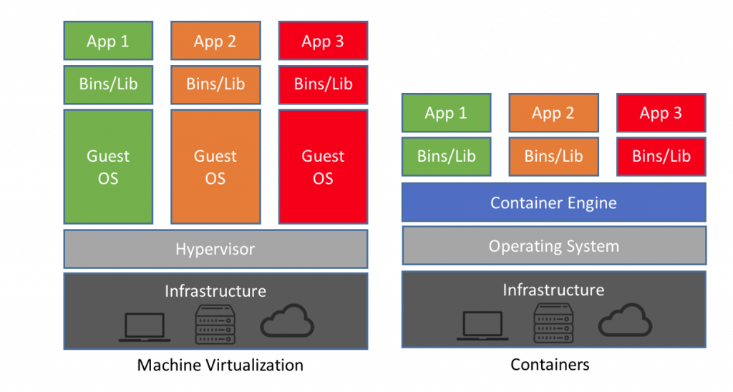
virtualization in Docker is performed on system-level, also called Docker containers.

Slide 4
Docker Engine
Docker is the client-server type of application which means we have clients who relay to the server. So the Docker daemon called: dockerd is the Docker engine which represents the server. The docker daemon and the clients can be run on the same or remote host, and they communicate through command line client binary, as well as a full RESTful API to interact with the daemon: dockerd

Slide 5
Docker Images
Docker images are the "source code" for our containers; we use them to build containers. They can have software pre-installed which speeds up deployment. They are portable, and we can use existing images or build our own.

Slide 6
Docker Registries
Docker stores the images we build in registries. There are public and private registries. Docker company has public registry called Docker hub, where you can also store images privately.

Slide 7
Docker Containers
Containers are the organizational units and one of the Docker basics concept. When we build an image and start running it; we are running in a container. The container analogy is used because of the portability of the software we have running in our container. We can move it, in other words, "ship" the software, modify, manage, create or get rid of it, destroy it, just as cargo ships can do with real containers.

