Slide 1
MicroServices

Slide 2
Monolithic Application
“Monolithic application has single code base with multiple modules. Modules are divided as either for business features or technical features. It has single build system which build entire application and/or dependency. It also has single executable or deployable binary” – Technical Definition
Multi tier architecture
Doesn't require to expose data with API

Slide 3
drawbacks of monolithic architecture
Need to be redeployed on each update.
Extensive Manual testing.
Continuous deployment is difficult.
Dynamic scaling very difficult

Slide 4
SOA – Service Oriented architecture
Service-oriented architecture (SOA) is a style of software design where services are provided to the other components by application components, through a communication protocol over a network. A SOA service is a discrete unit of functionality that can be accessed remotely and acted upon and updated independently, such as retrieving a credit card statement online. SOA is also intended to be independent of vendors, products and technologies.

Slide 5
What is MicroService?
A 'microservice' is a software development technique—a variant of the service-oriented architecture (SOA) architectural style that structures an application as a collection of loosely coupled services. In a microservices architecture, services are fine-grained and the protocols are lightweight. The benefit of decomposing an application into different smaller services is that it improves modularity and makes the application easier to understand, develop, test, and more resilient to architecture erosion. It parallelizes development by enabling small autonomous teams to develop, deploy and scale their respective services independently.^{[2]} It also allows the architecture of an individual service to emerge through continuous refactoring.^{[3]} Microservices-based architectures enable continuous delivery and deployment.

Slide 6
What are microservices?
Also known as the microservice architecture
An architectural style that structures an application as a collection of loosely coupled services, which implement business capabilities. T
The microservice architecture enables the continuous delivery/deployment of large, complex applications

Slide 7
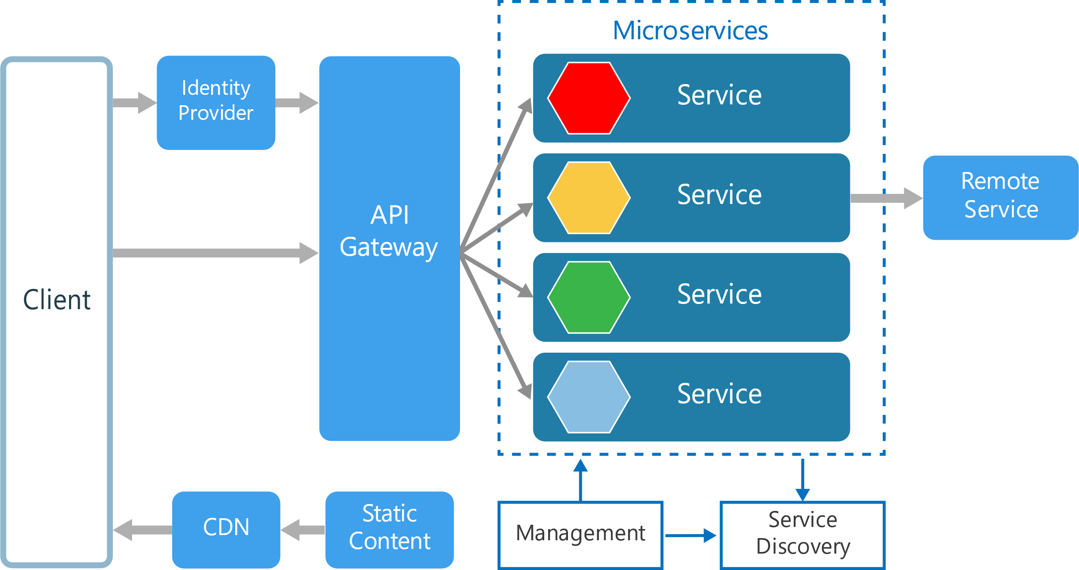
MicroService Architecture

Slide 8
Reasons for Microservices
Easier to understand Small services
When you have small services, and you are responsible for them, it is easier to understand the boundaries of your services, and it will be easier for you to learn what the service does, as oppose to a monolith, where you will never know where your service ends, and where the other service starts
Services are independently deployable
You can deploy services independently. So if you have a feature, that is ready and tested and all, you don’t have to wait for some other components to finish something that is not related to your stuff at all. So you can go live without having to wait for anyone.

Slide 9
Why MS?
Easier to adopt to newer technology (retire vs rewrite)
When you have small little Microservices, and if a new technology comes up that is a very good fit for your service purposes, you can easily ditch the service and rewrite it with the new technology, without the need to rewrite the whole system which could cost you a fortune.
Easier to scale small services
If one or more features in your system are used more than the others, you can just scale up those specific services, and not the whole system or other services that aren’t used as much. This Microservices specification will become more important when you are using Cloud providers like Azure or AWS, where if you scale your whole system up, you are basically wasting money because it is not efficient.

Slide 10
Rules for a good MS architecture
Independent − Each microservice should be independently deployable.
Coupling − All microservices should be loosely coupled with one another such that changes in one will not affect the other.
Business Goal − Each service unit of the entire application should be the smallest and capable of delivering one specific business goal.

Slide 11
Challenges of Microservices Architecture
Bounded Context – Working Dos and Donts
Configuration Management
Dynamic Scale up and Down.
Visibility - Identification of a bug
Fault Identification
Pack of Cards if not architecture properly.- No fault tolerance

Slide 12
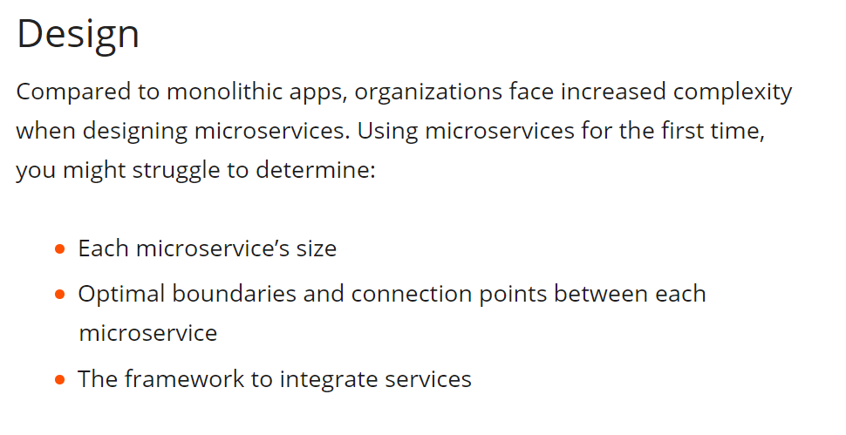

Slide 13
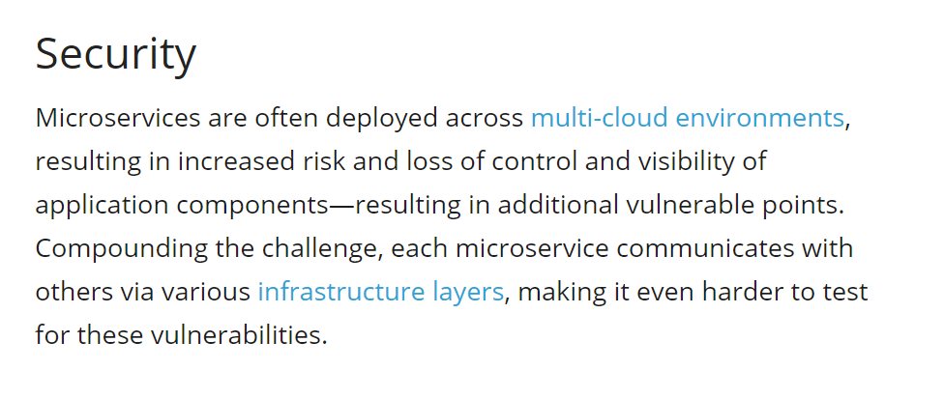

Slide 14
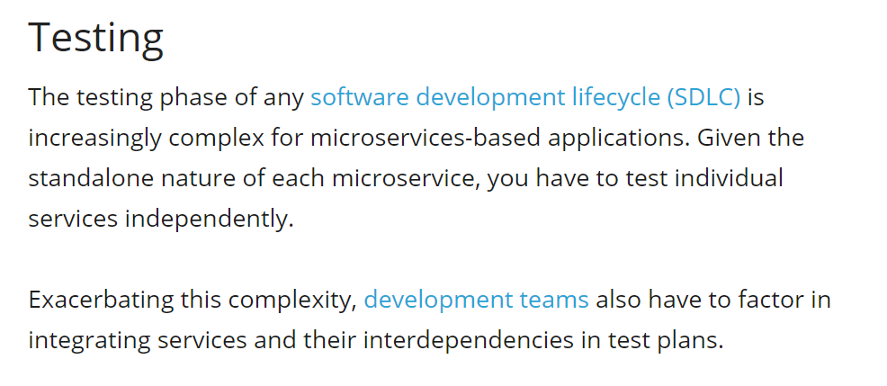

Slide 15
Traditional forms of monitoring may not work for a microservices-based application. Consider a scenario where a request from the user interface traverses multiple services before getting to the one that can fulfill its request. The result of this traversal is a convoluted path of services, and without the appropriate monitoring tools, identifying the underlying cause of an issue is not only tricky—it’s often impossible.
Scalability is another operational challenge associated with microservices architecture. Although the scalability of microservices is often touted as an advantage, successfully scaling your microservice-based applications is challenging.
Optimizing and scaling require more complex coordination. In a typical microservices framework, an application is broken down to smaller-independent services that are hosted and deployed across separate servers. This architecture requires coordinating individual components, which is another challenge particularly when you experience a sudden spike in application usage.
Fault tolerance needed for every service. Businesses need their microservices to be resilient enough to withstand internal and external failures. In a microservices-based application, one component failing can affect the entire system. Therefore, the framework you use should consider fault tolerance for every service to ensure a design that prevents failure of an entire application in the event of an individual service downtime.

Slide 16
Companies using MS architecture
Uber
Netflix
Amazon
Ebay
Karma
Zalando
Coca cola
And many more

Slide 17

Netflix
Netflix is one of the earliest adopters of microservices, and one of the most discussed. The story of Netflix turning towards microservices starts in 2009, when this approach wasn’t known at all.
They set up their microservice architecture on AWS. Their transition process progressed in steps: first they moved movie encoding and other non-customer facing applications. Then they decoupled customer facing elements, like account sign ups, movie selection, device selection and configuration. Netflix needed 2 years to split their monolith into microservices, and in 2011 announced end of redesigning their structure and organizing it using microservice architecture.

Slide 18
How Netflix/other companies address the Challenges of Microservices Architecture?

Slide 19
Spring Cloud
https://projects.spring.io/spring-cloud/
Spring Cloud provides tools for developers to quickly build some of the common patterns in distributed systems (e.g. configuration management, service discovery, circuit breakers, intelligent routing, micro-proxy, control bus, one-time tokens, global locks, leadership election, distributed sessions, cluster state). Coordination of distributed systems leads to boiler plate patterns, and using Spring Cloud developers can quickly stand up services and applications that implement those patterns. They will work well in any distributed environment, including the developer's own laptop, bare metal data centres, and managed platforms such as Cloud Foundry.

Slide 20
Netflix
Provides patterns or OSS patterns to address the challenges of Microservices.
Eureka – Naming and Locating services (Service Discovery)
Histrix -- Fault tolerance /Circuit Breaker
Zuul -- API Gateway (Edge Server)
Ribbon -- Client Load Balancing and dynamic routing
Feign -- proxy
Swagger --
ETC…

Slide 21
Spring Cloud Config
Spring Cloud Config provides server and client-side support for externalized configuration in a distributed system. With the Config Server you have a central place to manage external properties for applications across all environments. The concepts on both client and server map identically to the Spring Environment and PropertySource abstractions, so they fit very well with Spring applications, but can be used with any application running in any language. As an application moves through the deployment pipeline from dev to test and into production you can manage the configuration between those environments and be certain that applications have everything they need to run when they migrate. The default implementation of the server storage backend uses git so it easily supports labelled versions of configuration environments, as well as being accessible to a wide range of tooling for managing the content. It is easy to add alternative implementations and plug them in with Spring configuration.

Slide 22
Spring Cloud Config Server
Configuration for all microservices can be stored in a central repository like git and Spring Config Server manages the configuration.

Slide 23
How to address challenges of MicroServices
Challenge of Dynamic Scale up and Scale Down
Naming Server (Eureka) --
Service registry
Service Discovery
Also gives information of how many instances are running.
Ribbon (Client Side Load Balancing)-
Load is evenly distributed
Dynamic up and down scaling of instances
Feign (Easier REST Clients)
Mechansim for writing simple rest clients

Slide 24
Visibility and Monitoring
Zipkin Distributed Tracing –
Spring cloud Sleuth
Assign an id to request across multiple components
NETFLIX Api Gateway -- Unified interface for multiple MicroServices like logging, security, analytics etc..
Zuul API Gateway
Fault tolerance with hystrix

