Slide 1
Netflix patterns
Addresses the challenges of microservices

Slide 2
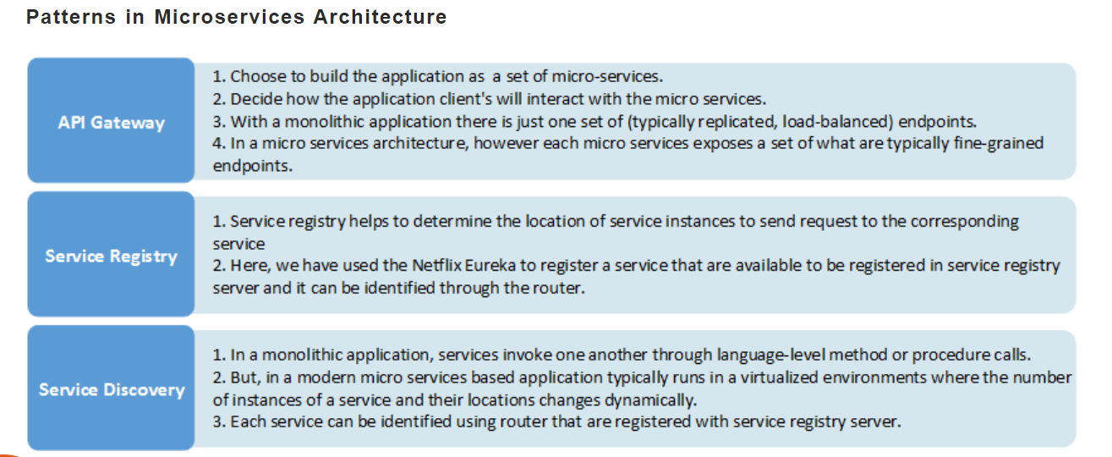

Slide 3
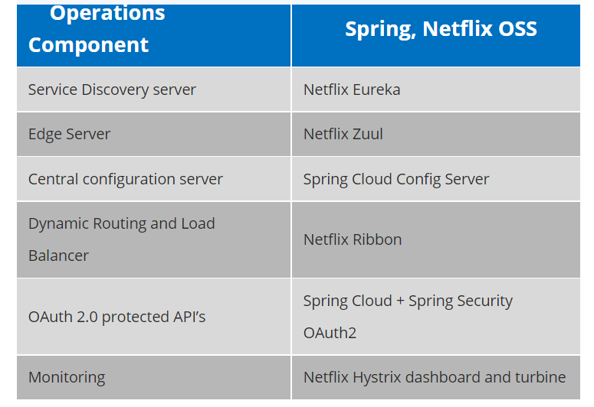

Slide 4
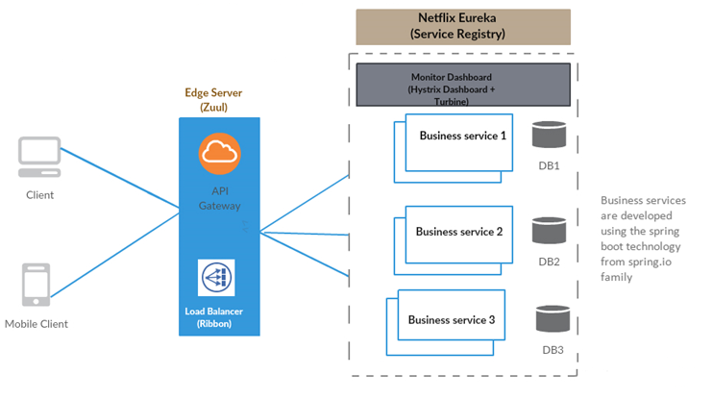

Slide 5
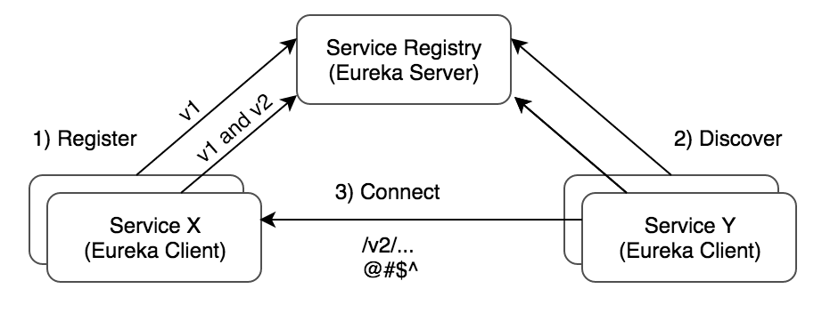

Slide 6
Declarative REST Client: Feign
Feign is a declarative web service client. It makes writing web service clients easier.
Feign aims at simplifying HTTP API clients. Simply put, the developer needs only to declare and annotate an interface while the actual implementation is provisioned at runtime.
Avoids writing boilerplate code.
By just changing the Feign configuration in a Java or using properties you can add encoding/decoding, logging, and change the REST call implementation library. All this is done through configuration only, while the business logic that calls the service remains unchanged. Since Feign uses standard Java interfaces, it's also easy to mock them during unit tests.

Slide 7
Advantages
1.URLs are not hardcoded.
2.you don't have to write unit test cases for feign as there is no code to test however you have to write integration tests.
3.we can use Eureka Client ID instead of the URL.
4.Feign handled the actual code.
5.Feign integrates with Ribbon and Eureka Automatically.
6.Feign provides a very easy way to call RESTful services.

Slide 8
@GetMapping("/getPBook/isbn/{isbn}/qty/{qty}")
public Book getPurchasedBook(@PathVariable("isbn") String isbn,@PathVariable("qty") int qty)
{
String url="http://localhost:8082/book/getbook/isbn/{isbn}";
Map<String,String> uriVariables=new HashMap<>();
uriVariables.put("isbn", isbn);
Book book = restTemplate.getForObject(url, Book.class, uriVariables);
book.setQty(qty);
book.setAmount(book.getQty() * book.getPrice());
return book;
}

Slide 9
@FeignClient(name="bookstore", url="localhost:8082") // ProducerService
public interface BookFeignClient {
@GetMapping("/book/getbook/isbn/{isbn}")
public Book getPurchasedBook(@PathVariable("isbn") String isbn);
}
@Autowired
private BookFeignClient bookFeignClient;
@GetMapping("/getPBook/isbn/{isbn}/qty/{qty}")
public Book getPBook(@PathVariable("isbn") String isbn,@PathVariable("qty") int qty)
{
Book book = bookFeignClient.getPurchasedBook(isbn);
book.setQty(qty);
book.setAmount(book.getQty() * book.getPrice());
return book;
}

Slide 10
EUREKA NAMING AND DISCOVERY SERVER
Eureka Server is an application that holds the information about all client-service applications. Every Micro service will register into the Eureka server and Eureka server knows all the client applications running on each port and IP address. Eureka Server is also known as Discovery Server.
It is a tool that will monitor and maintain the registry of all the microservices in the ecosystem.
Notes:
In simple words, microservice(s) are clusters of small applications that work together in coordination to provide a complete solution.
When we say a lot of small applications running independently together, then they will all have their own URLs and ports. In that scenario, it would be very cumbersome to maintain all these microservices to run in synchronization, and more importantly, with monitoring. This problem will increase manifold when we start implementing load balancers.
To solve this issue, we need a tool that will monitor and maintain the registry of all the microservices in the ecosystem.

Slide 11
HYSTRIX
The Hystrix framework library helps to control the interaction between services by providing fault tolerance and latency tolerance. It improves overall resilience of the system by isolating the failing services and stopping the cascading effect of failures.

Slide 12
ZUUL as a API GATEWAY
Zuul provides a range of different types of filters that allows us to quickly and nimbly apply functionality to our edge service. The filters perform the following functions:
Authentication and Security: It provides authentication requirements for each resource.
Insights and Monitoring: It tracks meaningful data and statistics that give us an accurate view of production.
Dynamic Routing: It dynamically routes the requests to different backed clusters as needed.
Stress Testing: It increases the traffic to a cluster in order to test performance.
Load Shedding: It allocates capacity for each type of request and drops a request that goes over the limit.
Static Response Handling: It builds some responses directly at the edge instead of forwarding them to an internal cluster.
Multi-region Resiliency: It routes requests across AWS regions in order to diversify our ELB usage.

Slide 13
zuul -- filter -- Class -- extends ZuulFilter
pre filters run before the request is routed.
route filters can handle the actual routing of the request.
post filters run after the request has been routed.
error filters run if an error occurs in the course of handling the request.

Slide 14
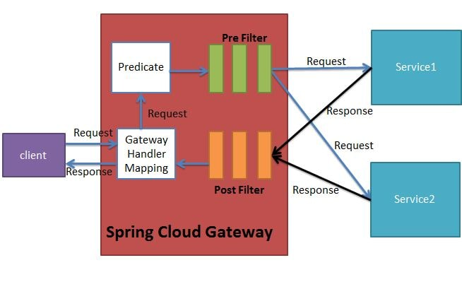
Gateway Cloud Filters

Slide 15
//Java based configuration
@Configuration
public class SpringCloudConfig {
@Bean
public RouteLocator gatewayRoutes(RouteLocatorBuilder builder) {
return builder.routes()
.route(r -> r.path("/service1/**")
//Pre and Post Filters provided by Spring Cloud Gateway
.filters(f -> f.addRequestHeader(“request-header1", "first-request-header")
.addResponseHeader(“response-header1", "first-response-header"))
.uri("http://localhost:8081/")
.id(“Service1"))
.route(r -> r.path("/service2/**")
//Pre and Post Filters provided by Spring Cloud Gateway
.filters(f -> f.addRequestHeader(" request-header2", "second-request-header")
.addResponseHeader(" response-header2", "second-response-header"))
.uri("http://localhost:8082/")
.id(“Service2"))
.build();
}

Slide 16
@RestController
@RequestMapping("/service1”)
public class Controller1 {
@GetMapping("/hello1")
public String test(@RequestHeader(request-header1") String header) {
System.out.println(header);
return "Hello Service 1";
}
}

Slide 17
//application.yml
spring:
cloud:
gateway:
routes:
- id: HelloService1
uri: http://localhost:8088/
predicates:
- Path=/helloservice1/**
- id: HelloService2
uri: http://localhost:8089/
predicates:
- Path=/helloservice2/**

Slide 18
RESILENCE4J CIRCUIT BREAKER
Resilience4j is a lightweight, easy-to-use fault tolerance library inspired by Netflix Hystrix, but designed for Java 8 and functional programming.
Resilience4j provides higher-order functions (decorators) to enhance any functional interface, lambda expression or method reference with a Circuit Breaker, Rate Limiter, Retry or Bulkhead. You can stack more than one decorator on any functional interface, lambda expression or method reference. The advantage is that you have the choice to select the decorators you need and nothing else.

