Slide 1
A Short Distance to
Large Disparities in Health
www.commissiononhealth.org

Slide 2
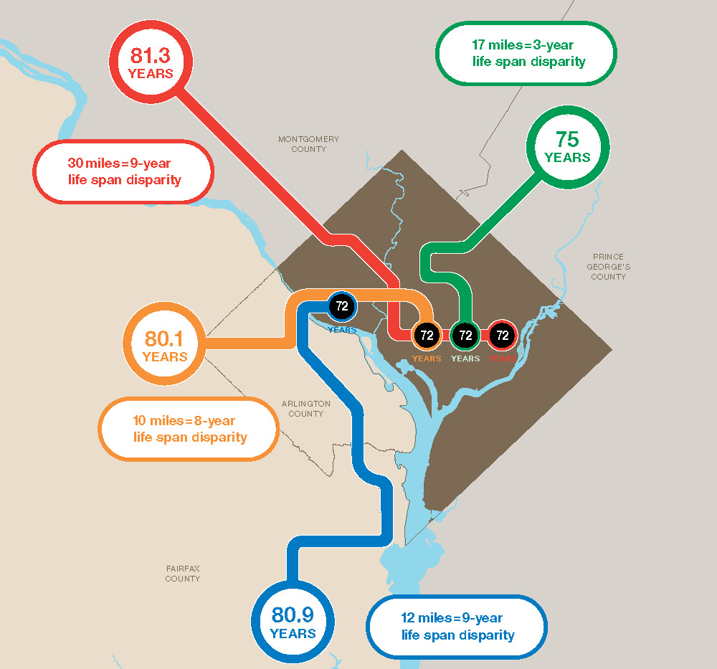
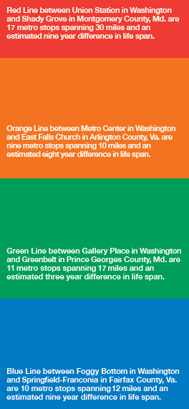
A Short Distance to Large Disparities in Health:
Washington, D.C.

