Slide 1
Learning Day
Database Basics:
1. Isolation Levels
2. Data locking concepts with regular facing issues

Slide 2
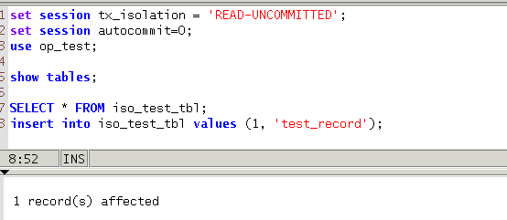
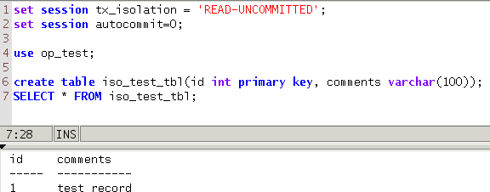
Isolation Levels

Slide 3
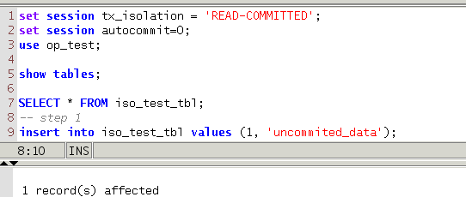
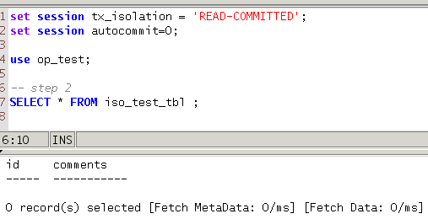
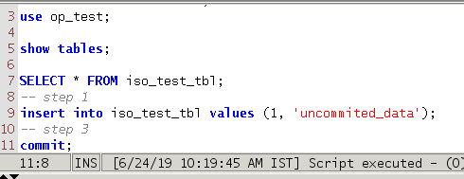
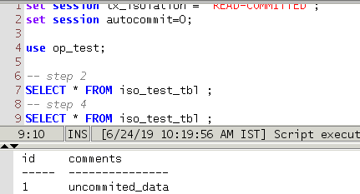
Isolation Levels

Slide 4
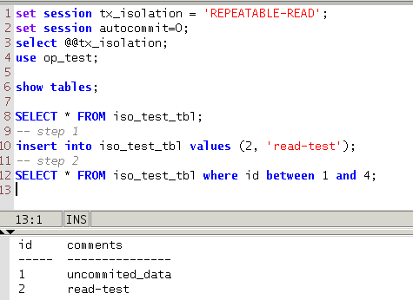
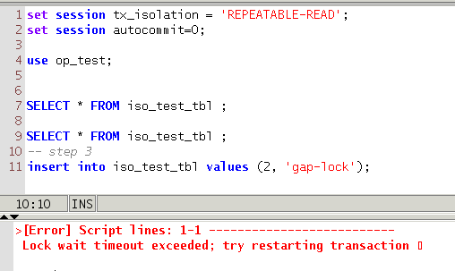
Isolation Levels

Slide 5
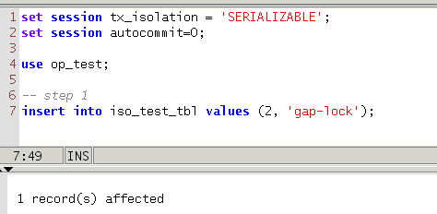
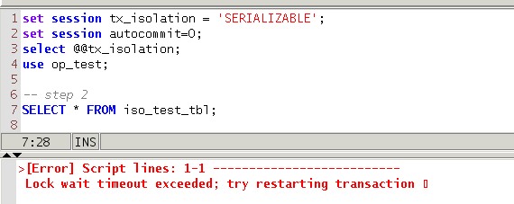
Isolation Levels

Slide 6
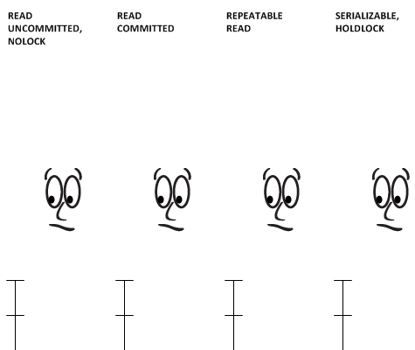
Isolation Levels

Slide 7
Locking Machanism
Shared and Exclusive Locks
Intention Locks
Record Locks
Gap Locks
Next-Key Locks
Insert Intention Locks
AUTO-INC Locks

Slide 8
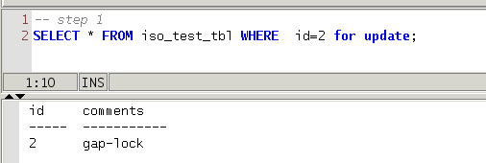
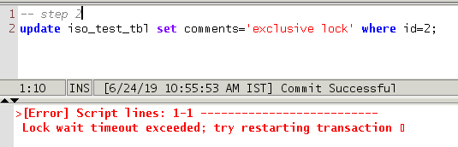
Locking Machanism
Shared ( s ) Locks.
Exclusive ( x ) Locks.
A Shared lock ( s ) permits the transaction that holds the lock to read a row. A request from transaction T2 for an S lock from transaction T1 can be granted immediately. As a result, both T1 and T2 hold an S lock.
An Exclusive lock ( x ) permits the transaction that holds the lock to update or delete a row. A request from transaction T2 for an X lock cannot be generated immediately. At that time it faces an exception called Lock wait Timeout Exceed.

Slide 9
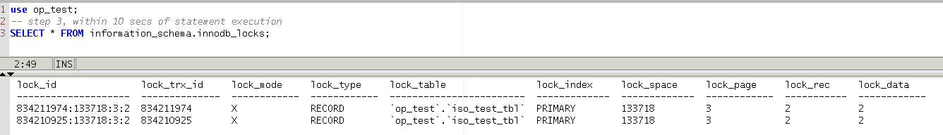
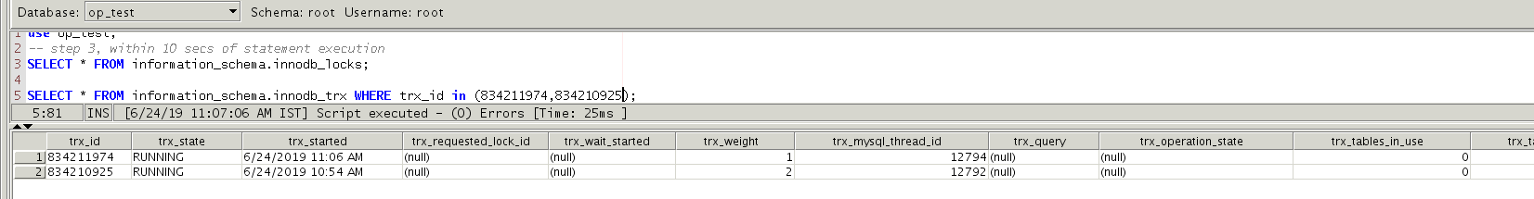
Locking Machanism
Based on trx_started and trx_weight columns values we can get to know which query started first and acquiring the lock.

Slide 10
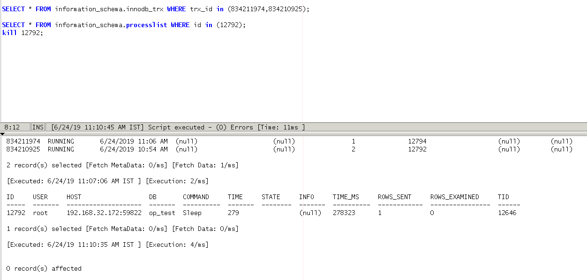
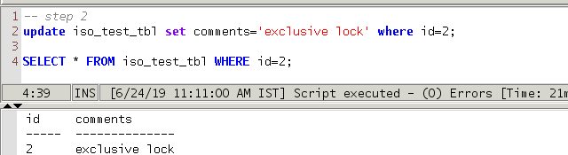
Locking Machanism

Slide 11
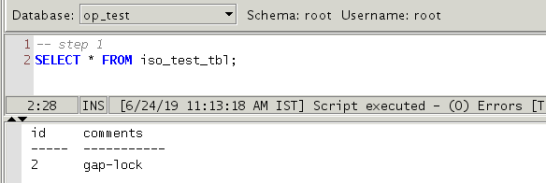
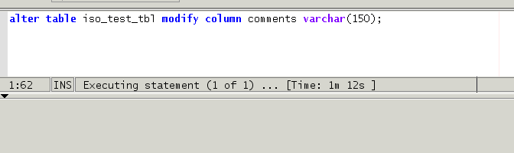
Locking Machanism
Meta Data Lock

