Slide 1
JWT (JSON Web Token)

Slide 2
1. What is JWT?
JWT stands for JSON Web Token. It is an open standard used to securely transfer information between two parties in the form of a JSON object.
In MERN Stack development, JWT is commonly used for Authentication and Authorization.
Example: जब कोई student Ambience Computer Education के LMS Portal में login करता है, तो server successful login के बाद JWT token generate कर सकता है। Student इस token का उपयोग protected pages और APIs को access करने के लिए करता है।

Slide 3
2. Why do we use JWT?
User authentication (login verification)
Authorization (role-based access)
Protecting private API routes
Maintaining user identity across requests
Stateless authentication

Slide 4
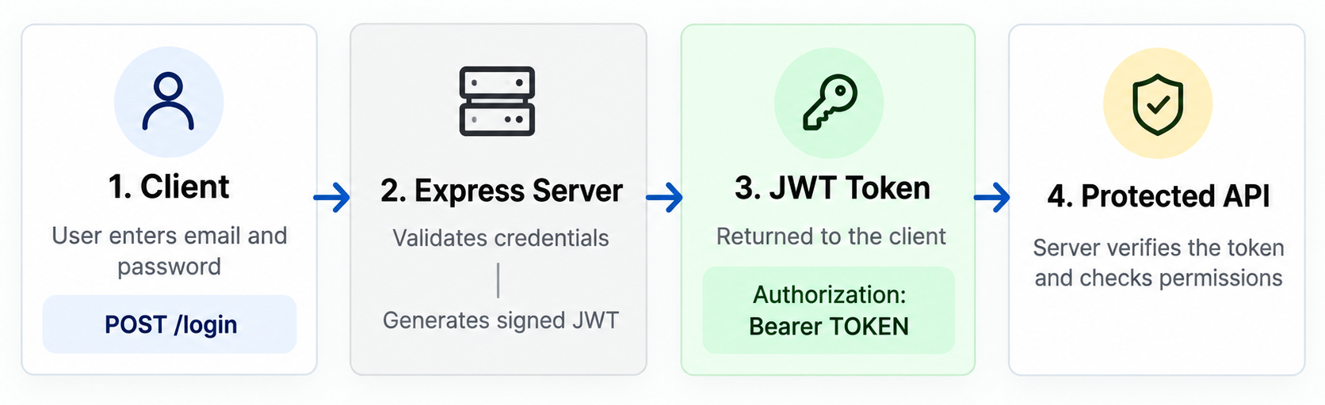
How JWT Works

Slide 5
4. Structure of JWT
A JWT contains three parts separated by dots (.).
xxxxx.yyyyy.zzzzz
1. Header
Contains token type and signing algorithm.
{
"alg": "HS256",
"typ": "JWT"
}
2. Payload
Contains claims such as user ID, role and expiry.
{
"userId": "123",
"role": "student”
}
3. Signature
Verifies that the token has not been altered and was signed using the expected key.
Important: JWT payload is generally encoded, not encrypted. Anyone possessing a normal JWT can decode its payload. Never store passwords or sensitive personal data in it.

Slide 6
5. Authentication vs Authorization
Authentication | Authorization
Who are you? | What can you access?
Verifies user identity | Checks user permissions
Example: Login | Example: Admin-only dashboard
Often performed first | Follows identity verification

Slide 7
6. JWT vs Session Authentication
JWT | Session
Token carries claims | Server stores session state
Often stateless | Usually stateful
Commonly sent as a bearer token | Commonly identified by a session cookie
Revocation requires additional design | Session can often be invalidated server-side
Neither method is automatically more secure. Security depends on implementation, storage,
expiration and revocation.

Slide 8
7. JWT in Node.js and Express.js
Step 1: Install packages
npm install express jsonwebtoken dotenv
For a real login system, also install a password-hashing library such as bcrypt.
Step 2: Create a .env file
JWT_SECRET=replace_with_a_long_random_secret
Generate a strong random secret and never commit .env to GitHub.

