Slide 1
Project Update 2
Assignment 14
Team 7- Victoria Lara-Aguilar, Isabelle Goode, David Rak, Radhey Patel

Slide 2
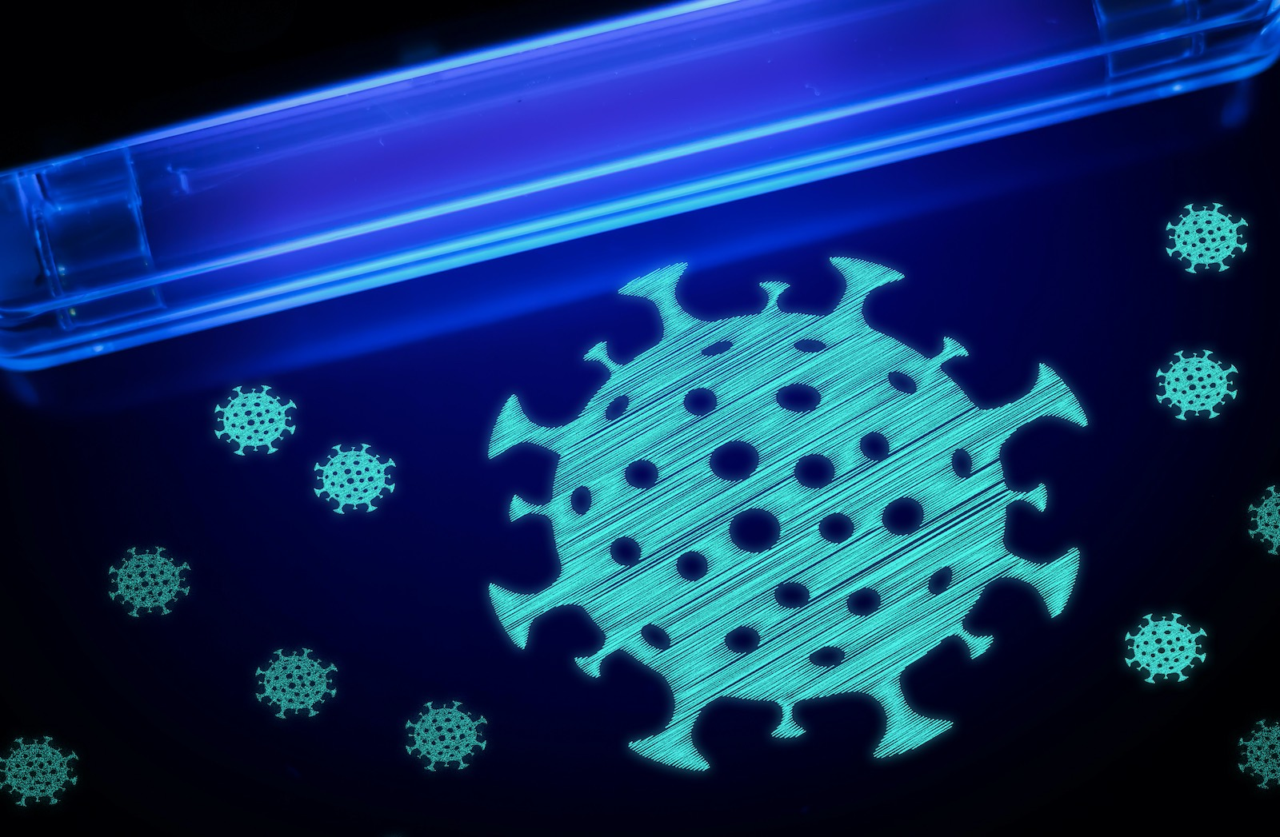
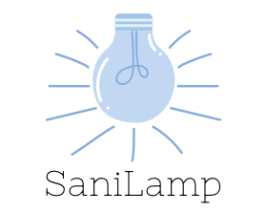
Company Name: SaniLamp
https://memoori.com/can-uv-light-kill-coronavirus-in-our-contaminated-buildings/

Slide 3
Problem
Facilitating cleaning of shared spaces in vehicles
UV light sanitizes the frequently touched surfaces
Timer controlled, hands-free cleaning
Easy to install and use
Reusable
Reduces waste of disposable cleaning wipes
Not subject to cleaning supply shortages
Notes:
Victoria

Slide 4
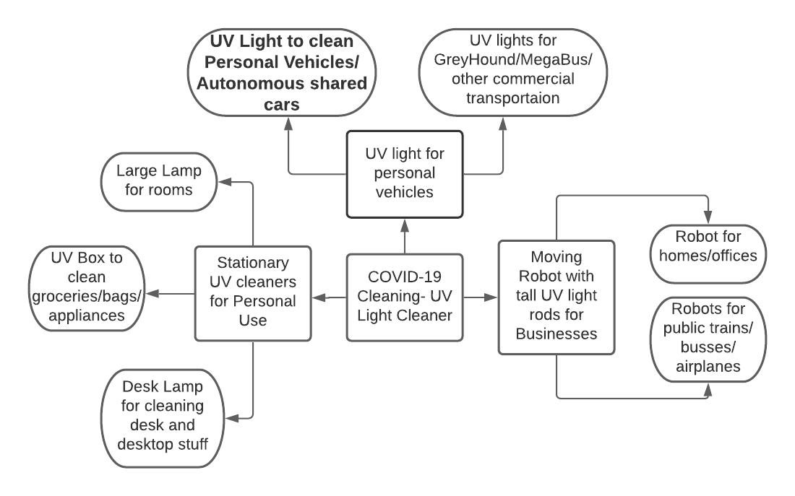
Extrapolation Map
Notes:
David

Slide 5
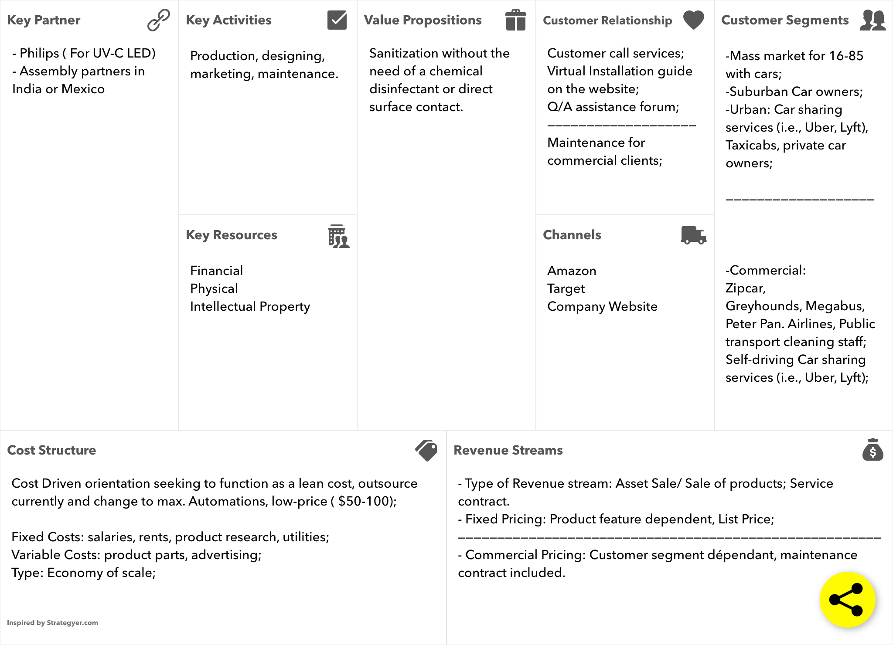
Business Canvas
Notes:
Radhey

Slide 6
5 Competing Forces
Competitive rivalry
Current UV light wands for household cleaning
Larger/more developed UV technology
Bargaining power of suppliers
Could drive up costs due to UVC LED specificity
Could use the business’s desire for high quality to leverage higher costs.
Bargaining power of customers
Powerful sized client base.
Could drive down the cost of this product by opting for cheaper alternative cleaners.
Threat of new entrants
New businesses could adopt similar UV light sanitizing products.
Threat of substitute products
Regular cleaning supplies (Lysol disinfecting wipes, etc.) are cheaper, in short term.
Notes:
Isabelle

