Slide 1



Raktsetu
Real-Time Blood Availability Finder
A Medallion Lakehouse + Progressive Web App
. Radhey Gajera (25MCA057)
· Shruti Gajipara (25MCA058)
Guide: Ms. Konica Soni
MCA Project · CMPICA, CHARUSAT
Notes:
[Radhey] Good morning, respected faculty. I am Radhey Gajera, and with me is Shruti Gajipara. Our project is Raktsetu, which means 'bridge of blood'. It is a real-time blood availability finder for all of India. It collects blood stock data from the government's eRaktKosh portal every few hours, checks its quality, and shows it on a fast website that works on any phone, even offline. Our guide is Ms. Konica Soni. In the next ten minutes we will show the problem, our solution, how it is built, how we tested it, and a short live demo.

Slide 2



In an emergency, families still phone bank after bank
Search one district at a time
4,716
eRaktKosh has the data, but it is slow to search on a phone
blood banks on eRaktKosh
No compatible-group search
An O- patient can only take O-; the portal does not show this
701
No sign of how fresh data is
districts in 35 states / UTs
Some banks have not updated for weeks
…and every minute counts
Notes:
[Radhey] Imagine a patient needs O-negative blood at night. The family opens eRaktKosh, picks one district, checks it, then the next district, and keeps phoning banks. The data exists: our database has 4,716 blood banks in 701 districts across 35 states and union territories. But the portal makes you search district by district, it does not tell you which groups are compatible, and it does not warn you when a bank has not updated its stock for weeks. In an emergency, these minutes matter. That is the gap we wanted to close.

Slide 3
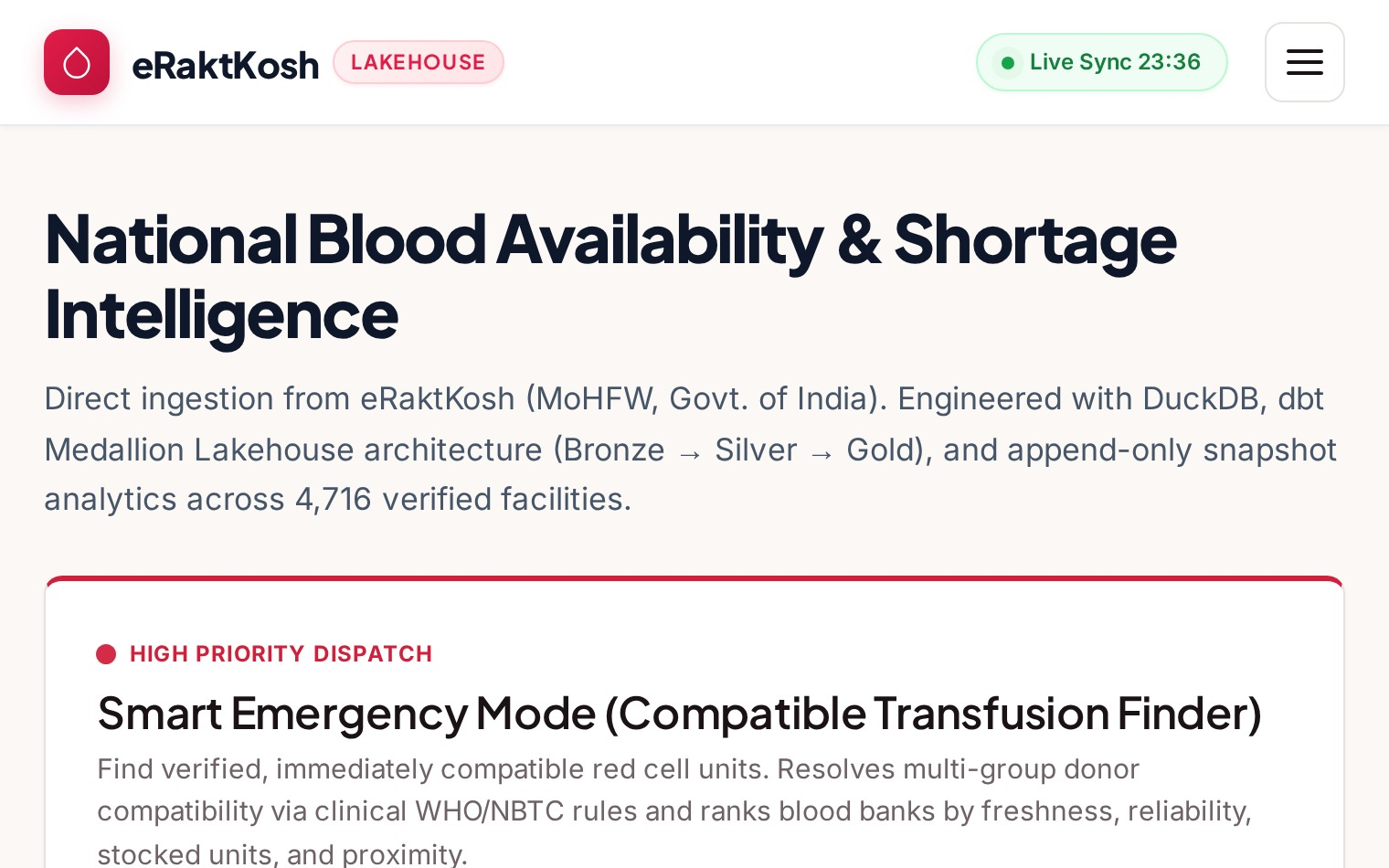



One pipeline collects, checks and serves India's blood stock
Collect automatically
Polite crawler fetches every district every 6 hours
Check the quality
37 data tests and a safety gate block bad data
Search instantly on any phone
Fast, installable web app that also works offline
Home page: live counts of fresh and stale blood banks
Notes:
[Radhey] Our solution does three things. First, it collects data automatically: a polite crawler visits every district on eRaktKosh every six hours. Second, it checks the quality: 37 automatic data tests and a safety gate make sure broken data never reaches users. Third, it lets anyone search instantly from any phone. On the right is the home page. It shows how many banks updated in the last 24 hours and how many are stale, so users know how much to trust the numbers.

Slide 4
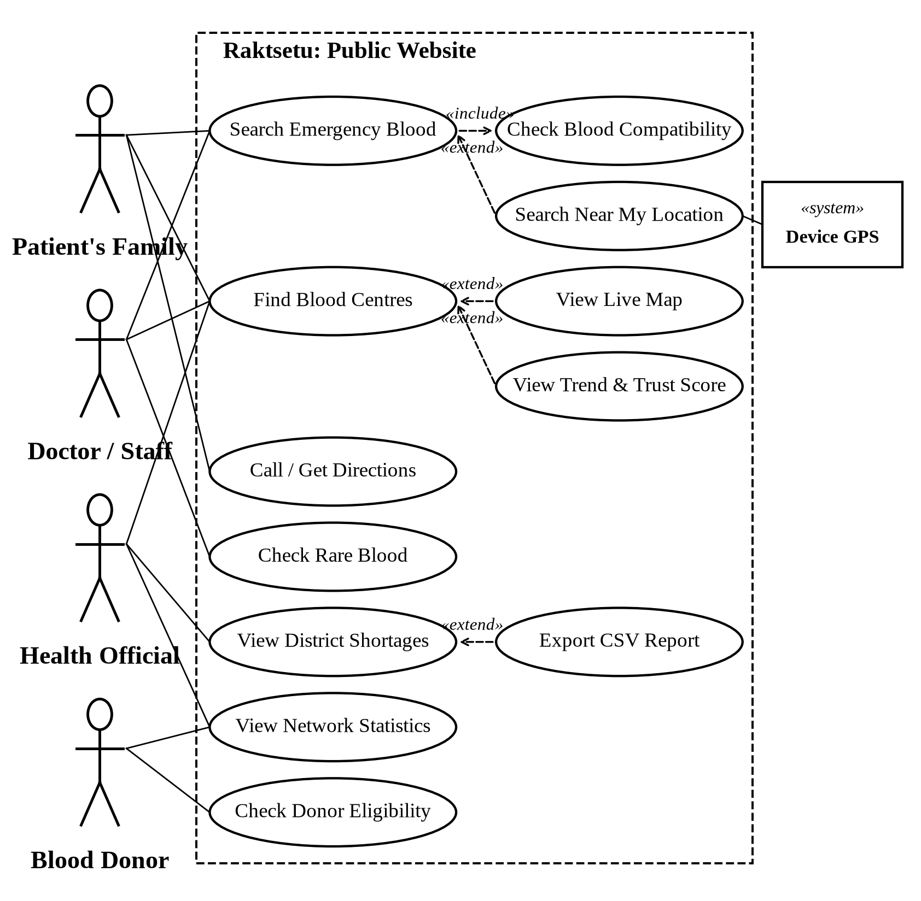





Five kinds of people use Raktsetu for different needs
Patient's family
Find nearby stock and call the bank
Doctor / hospital staff
Emergency Mode: compatible, ranked banks
Health official
District shortages, rare blood, CSV export
Blood donor
Check eligibility, see where stock is low
Operator
Runs the pipeline and watches data health
System actors: eRaktKosh portal, Device GPS, OpenStreetMap
Notes:
[Radhey] Who uses Raktsetu? We identified five human roles. The patient's family searches nearby stock and calls the bank. Doctors and hospital staff use Emergency Mode to get compatible, ranked blood banks. Health officials look at district shortages and rare blood, and export CSV files. Blood donors check if they are eligible and see where stock is low. Finally, the operator runs the data pipeline. There are also three system actors: the eRaktKosh portal as our data source, the device GPS for 'near me', and OpenStreetMap for district locations.

Slide 5






Six features turn raw stock data into fast decisions
Blood Finder
Emergency Mode
Map + Near Me
State, district, group and component filters with sorting
Compatible groups, ranked by freshness, trust and distance
Banks on a map; GPS search widens 50 → 150 → 400 km
Trust Score
Shortages + Rare Radar
Export, Donor Check, Offline
0–100 score from freshness, phone and coverage
Districts running out; where Rh-negative and Bombay are
Excel-safe CSV, eligibility checker, works without internet
Notes:
[Shruti] Thank you, Radhey. I am Shruti, and I will cover the features. The Blood Finder filters by state, district, blood group and component. Emergency Mode is the heart of the project: it knows which groups are compatible and ranks banks by freshness, trust and distance. The map shows every bank, and 'Near me' widens the search from 50 to 150 to 400 kilometres until it finds stock. Every bank gets a trust score. Officials see district shortages and a rare blood radar. We also have Excel-safe CSV export, a donor eligibility checker, and offline support.

Slide 6
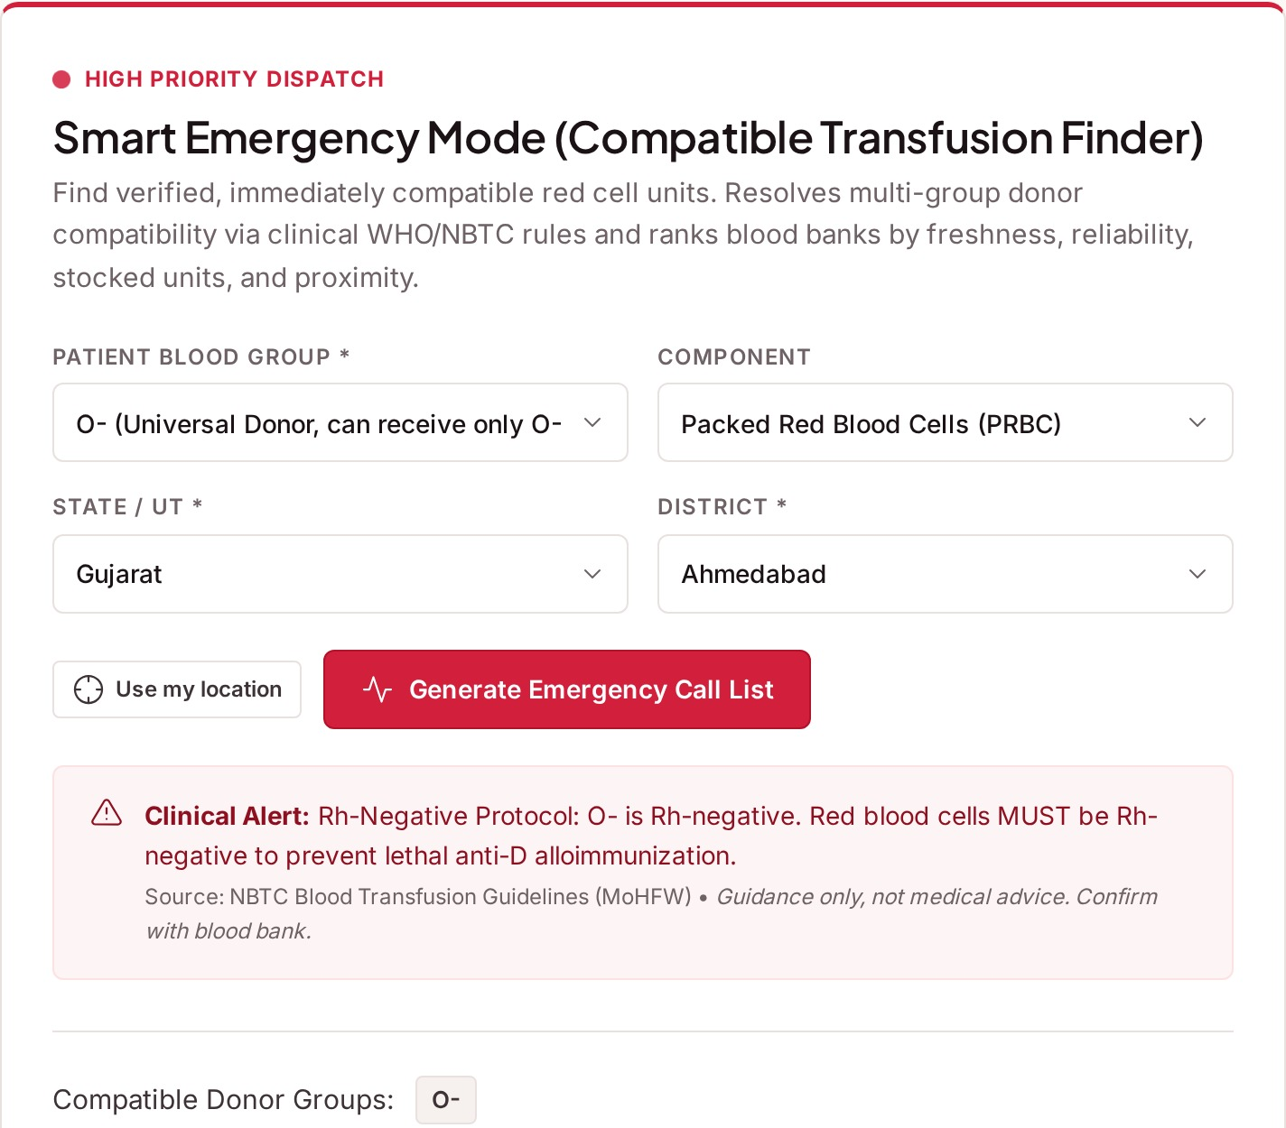
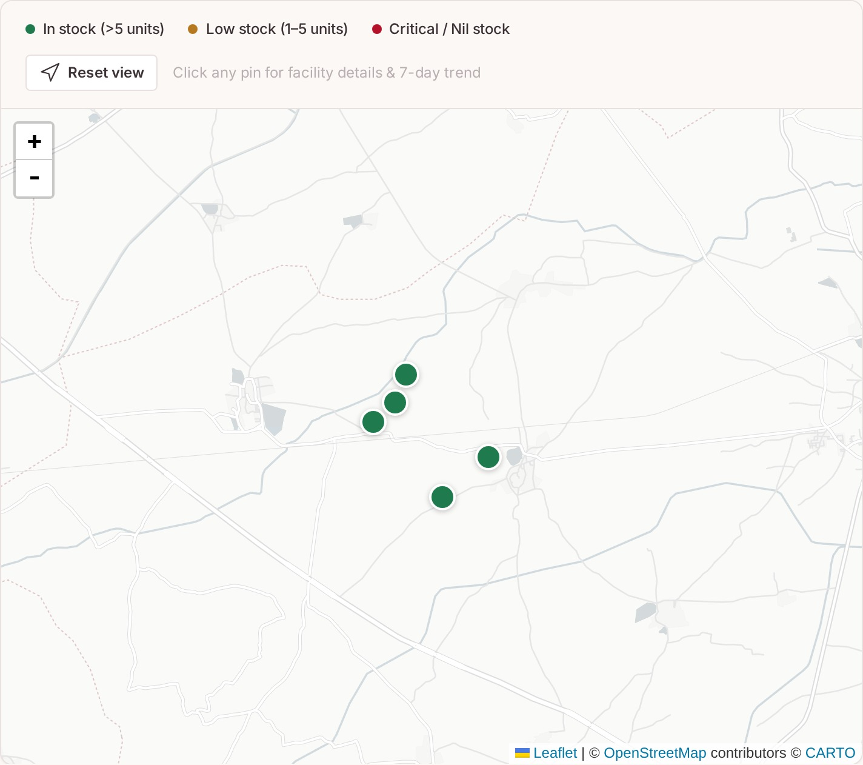
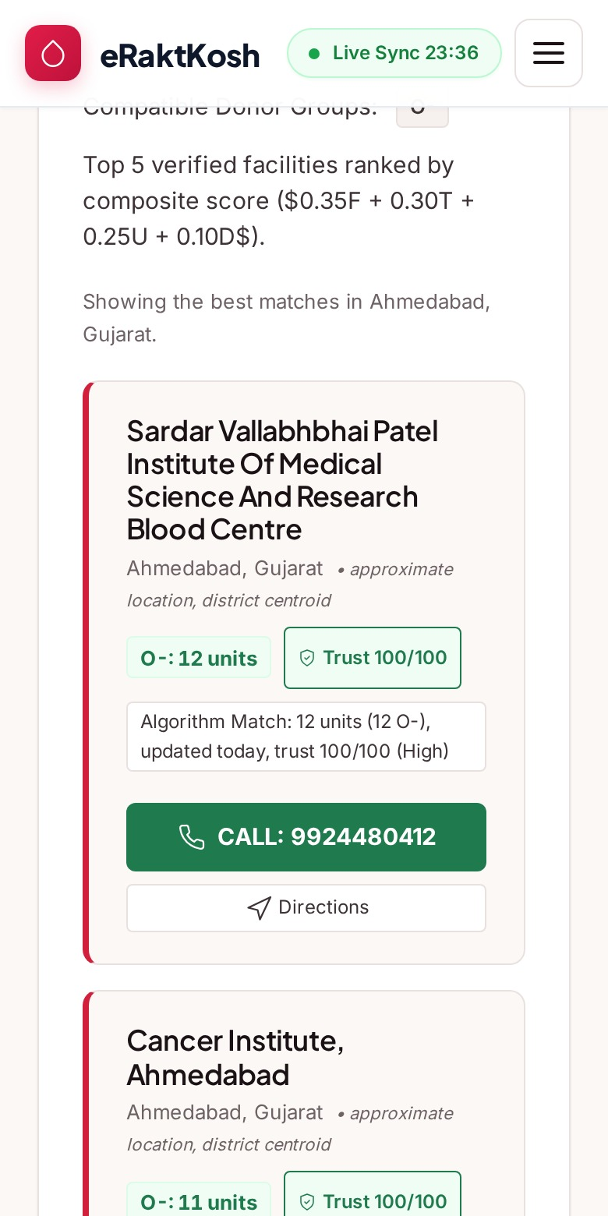
The same app works on a desktop and a phone
Emergency Mode: ranked banks, each with a reason
Map view: click a pin to see and call
Phone view
Notes:
[Shruti] Here are three real screens. On the left, Emergency Mode for an O-negative patient. Each card shows compatible units, how fresh the data is, the trust score, and one line explaining why it is ranked there, with a call button. In the middle is the map view; clicking a pin shows the bank and its phone number. On the right is the same emergency search on a phone. Switch to live demo here (2 min): search Gujarat, Anand; run Emergency Mode for O-; open the map; open a trend chart.

Slide 7
Data is kept raw, checked, then published safely
Scraper
(aiohttp)
Parquet
landing
DuckDB
bronze
dbt silver
+ gold
Web app
(PWA)
FastAPI
serving
.duckdb
Quality
gate
Why layers? Raw files are never changed, so any table can be rebuilt. If a scrape is bad (banks drop below 80% of the last run), publishing stops and users keep yesterday's good data.
Notes:
[Shruti] This is the architecture. The scraper fetches every district and saves the raw answer as a Parquet file that is never changed. We load it into DuckDB as the bronze layer. dbt then cleans it into silver tables and builds gold tables, such as current stock, trust score and shortages. A quality gate checks the result. If the number of banks falls below 80 percent of the last run, we stop. Only good data is copied, in one atomic step, into the serving database. FastAPI reads that and the web app shows it. Layers mean we can always rebuild from raw data and never show half-broken data.

Slide 8
A free, open-source stack that runs on one small server
Data
Backend
Frontend
DevOps & testing
Python 3.12
aiohttp (async)
Parquet
DuckDB
dbt
FastAPI
Pydantic
Uvicorn
Typer CLI
HTML, CSS, JavaScript
Leaflet + CARTO
Chart.js
PWA (service worker)
GitHub Actions
Docker
pytest
Playwright
ruff
DuckDB: fast analytics in a single file, no database server. dbt: readable SQL with built-in tests. FastAPI: validation and API docs for free.
Notes:
[Shruti] Everything we used is free and open source. For data: Python with aiohttp for fast asynchronous scraping, Parquet files, DuckDB and dbt. The backend is FastAPI with Pydantic validation. The frontend is plain HTML, CSS and JavaScript, with Leaflet maps and Chart.js, and it is a progressive web app. For quality we use pytest, Playwright, ruff and GitHub Actions, and Docker to deploy. We chose DuckDB because it is very fast for analytics and is just a file, with no server to manage. dbt gives us readable SQL with tests built in.

Slide 9

Every number is checked; every bank gets a trust score
Circuit breaker
Trust score, worked example
Scrape stops if more than 20% of requests fail
Part | Rule | Points
Freshness | Updated 2 days ago | 35 / 50
Valid phone | 8 or more digits | 25 / 25
Components | 4 types reported | 25 / 25
Total | High (75 or more) | 85 / 100
37 dbt data tests
No missing keys, no duplicates, valid blood groups
Anomaly gate
Publish blocked if banks fall below 80% of last run
Freshness shown
Same bank, 10 days with no update: 8 + 25 + 25 = 58 → Medium
Every card says when the bank last updated
Notes:
[Radhey] Data quality is the most important part of a medical tool. The scraper has a circuit breaker: if more than 20 percent of requests fail, it stops. dbt runs 37 data tests: no missing keys, no duplicate banks, and only valid blood groups. The anomaly gate blocks publishing if the bank count drops below 80 percent. And every bank gets a trust score out of 100. In this example, a bank updated two days ago gets 35 for freshness, 25 for a valid phone, and 25 for reporting four components: 85, which is High. If it stops updating for ten days, it drops to 58, Medium.

Slide 10
Tested at every layer, on desktop and mobile
98
37
146
7
pytest unit and API tests
dbt data tests
Playwright browser checks
screen widths, phone to desktop
All tests pass; zero console errors on desktop and mobile
28 documented test cases with expected and actual results
CSV exports open correctly in Excel, Google Sheets and pandas
Offline mode verified: app shell loads with no internet
Notes:
[Radhey] We tested every layer. 98 pytest tests cover the scraper, scoring, compatibility rules, CSV export and every API endpoint. 37 dbt tests check the data itself. Our Playwright script clicks through the real website like a user: 146 checks on desktop and mobile, failing on any console error. We also checked the layout at seven screen widths, from 360 to 1920 pixels. We documented 28 test cases in the report, verified CSV files in Excel, Google Sheets and pandas, and confirmed the app loads offline.

Slide 11


Honest limits today, and a clear path forward
Limitations
Future scope
Snapshot every 6 hours, not live: call first
Depends on banks updating eRaktKosh
Map shows district centres, not exact address
'Near me' needs HTTPS; English only
SMS / WhatsApp alerts for rare groups
Donor registration and blood-drive matching
Hospital login for direct stock updates
Demand forecasting and regional languages
Notes:
[Shruti] We want to be honest about the limits. The data is a snapshot every six hours, not live, so users should always call before travelling. Accuracy depends on banks updating eRaktKosh. The map shows district centres, not exact hospital addresses. 'Near me' needs HTTPS, and the interface is English only. For the future: SMS or WhatsApp alerts when a rare group becomes available, donor registration, a hospital login so banks can update stock directly, demand forecasting once we have enough history, and regional languages.

Slide 12
Raktsetu turns scattered public data into a life-saving search
Impact
Learning
Working product
4,716 banks searchable in seconds, with compatible groups
Real data engineering: lakehouse, dbt, testing, PWA
Tested, documented and ready to deploy
Questions?
Thank you
Notes:
[Shruti] To conclude: Raktsetu turns scattered public data into a search that can save lives. 4,716 blood banks are now searchable in seconds, with compatible groups and a trust score. For us, it was real data engineering: a lakehouse, dbt, automated testing and a progressive web app. And it is a working product: tested, documented and ready to deploy. Thank you. We are happy to take your questions.

Slide 13
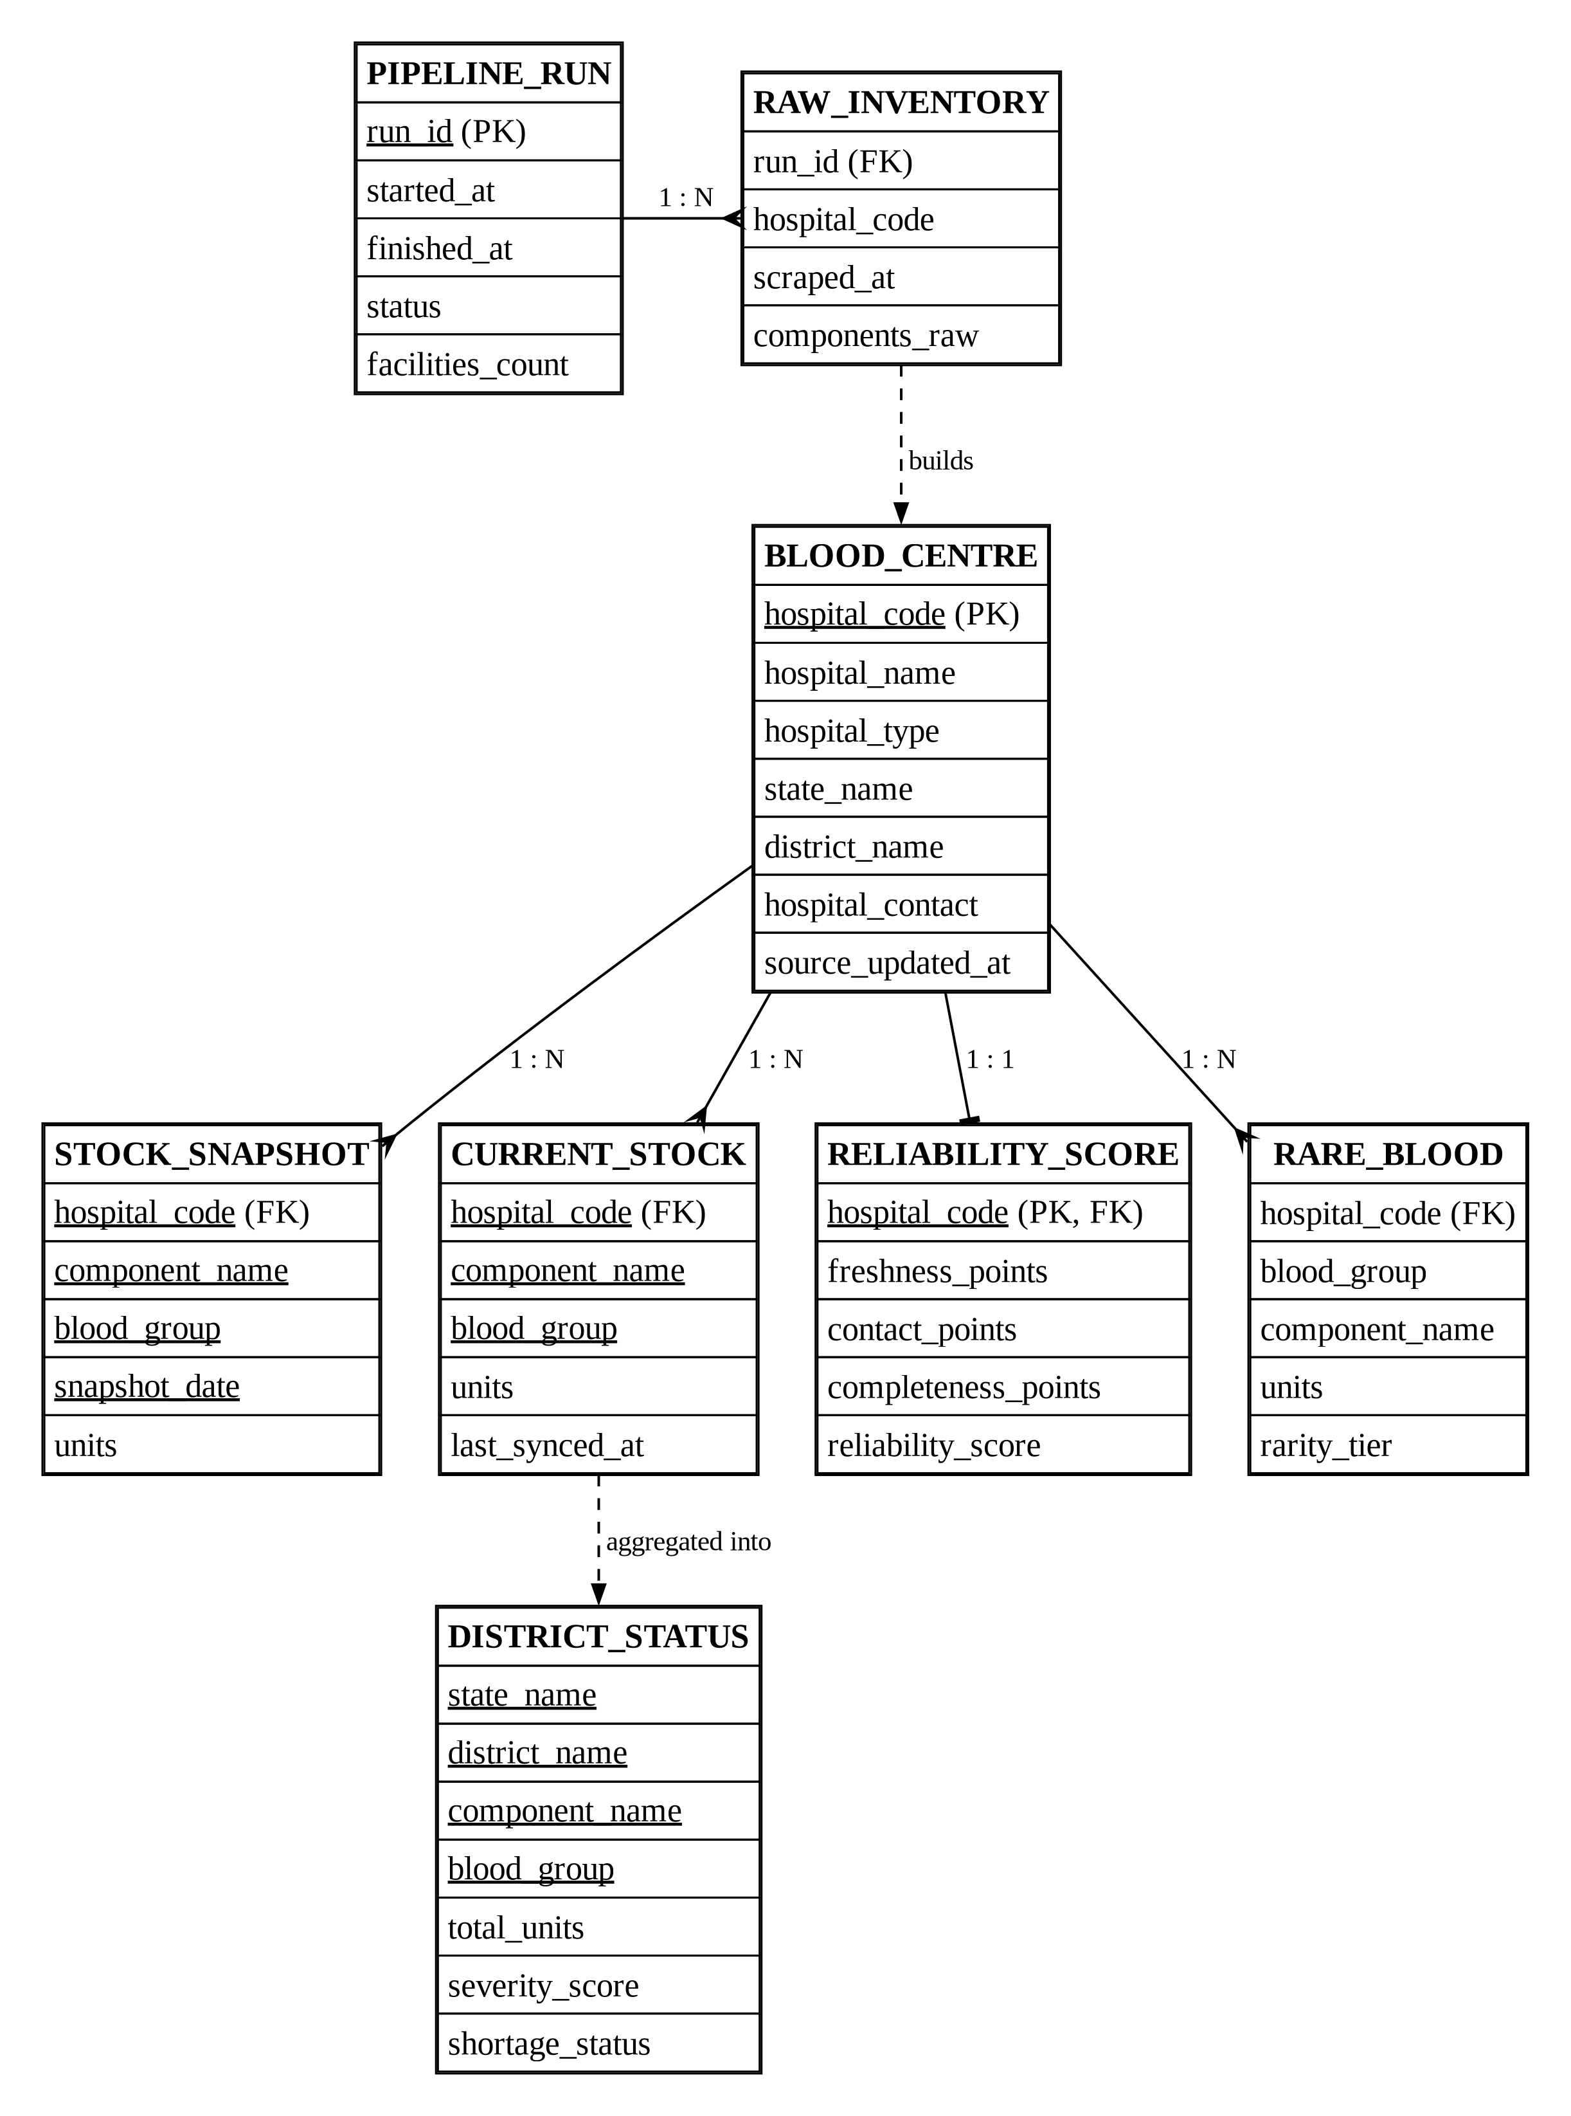
Backup: ER diagram of the gold tables
Notes:
Backup. hospital_code links every gold table to dim_blood_banks.

Slide 14
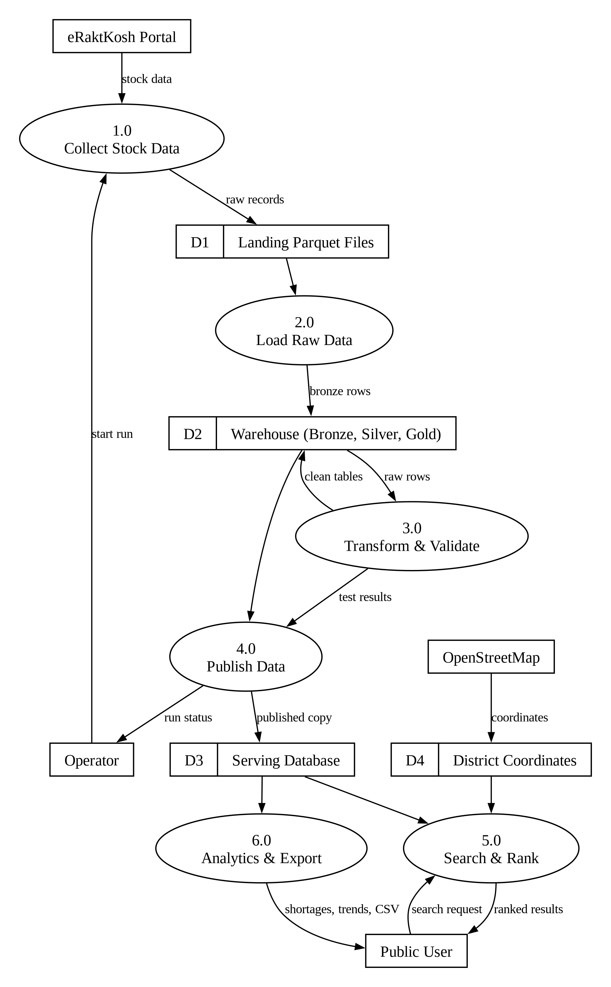
Backup: DFD Level 1
Notes:
Backup. Six processes and four data stores.

Slide 15
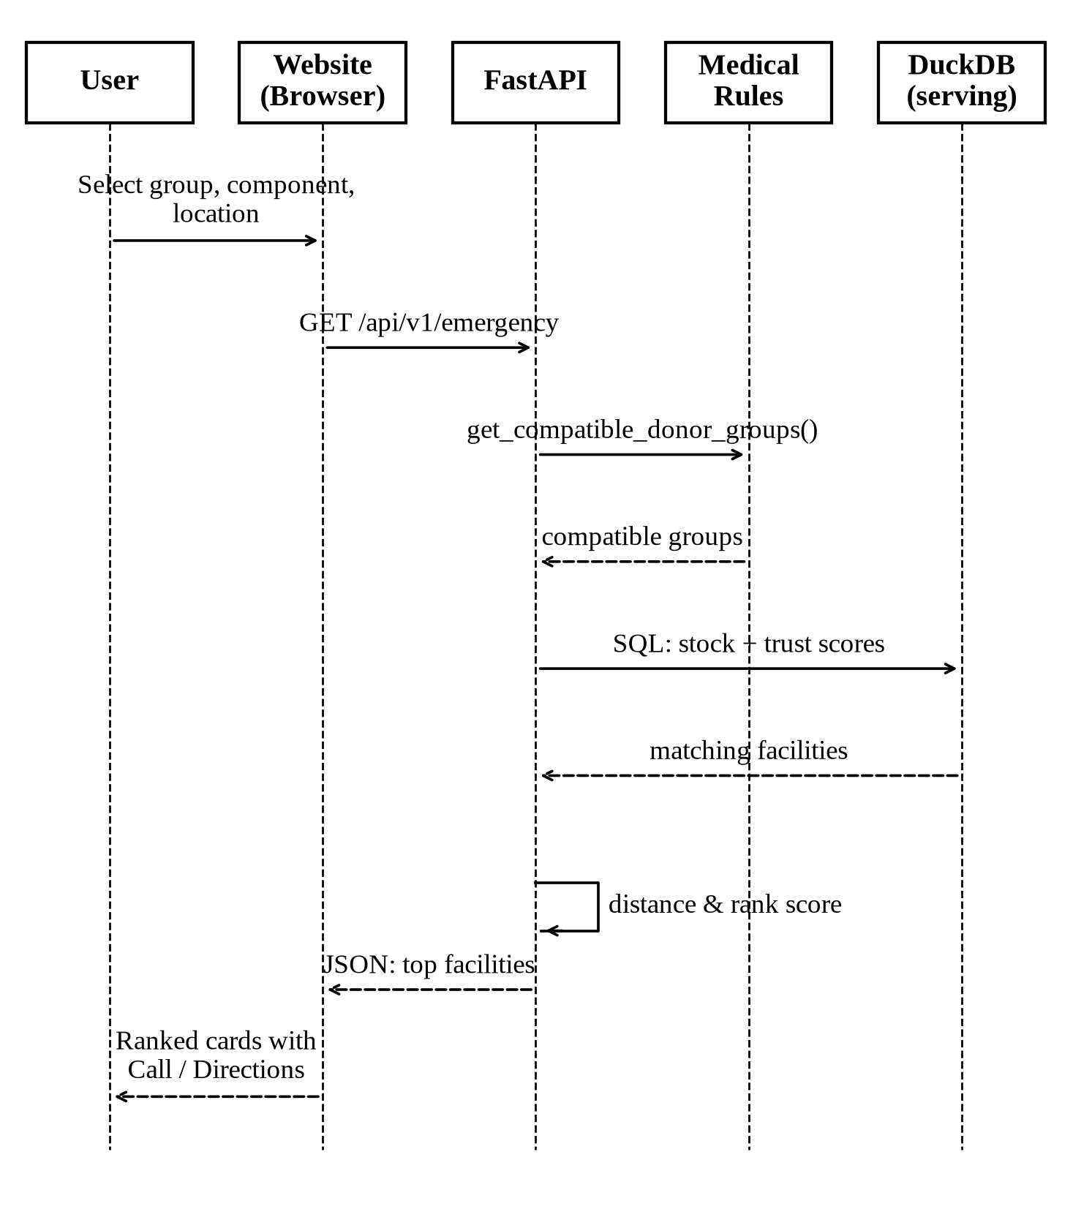
Backup: Emergency search sequence
Notes:
Backup. Browser → FastAPI → medical rules → DuckDB → ranked JSON.

Slide 16
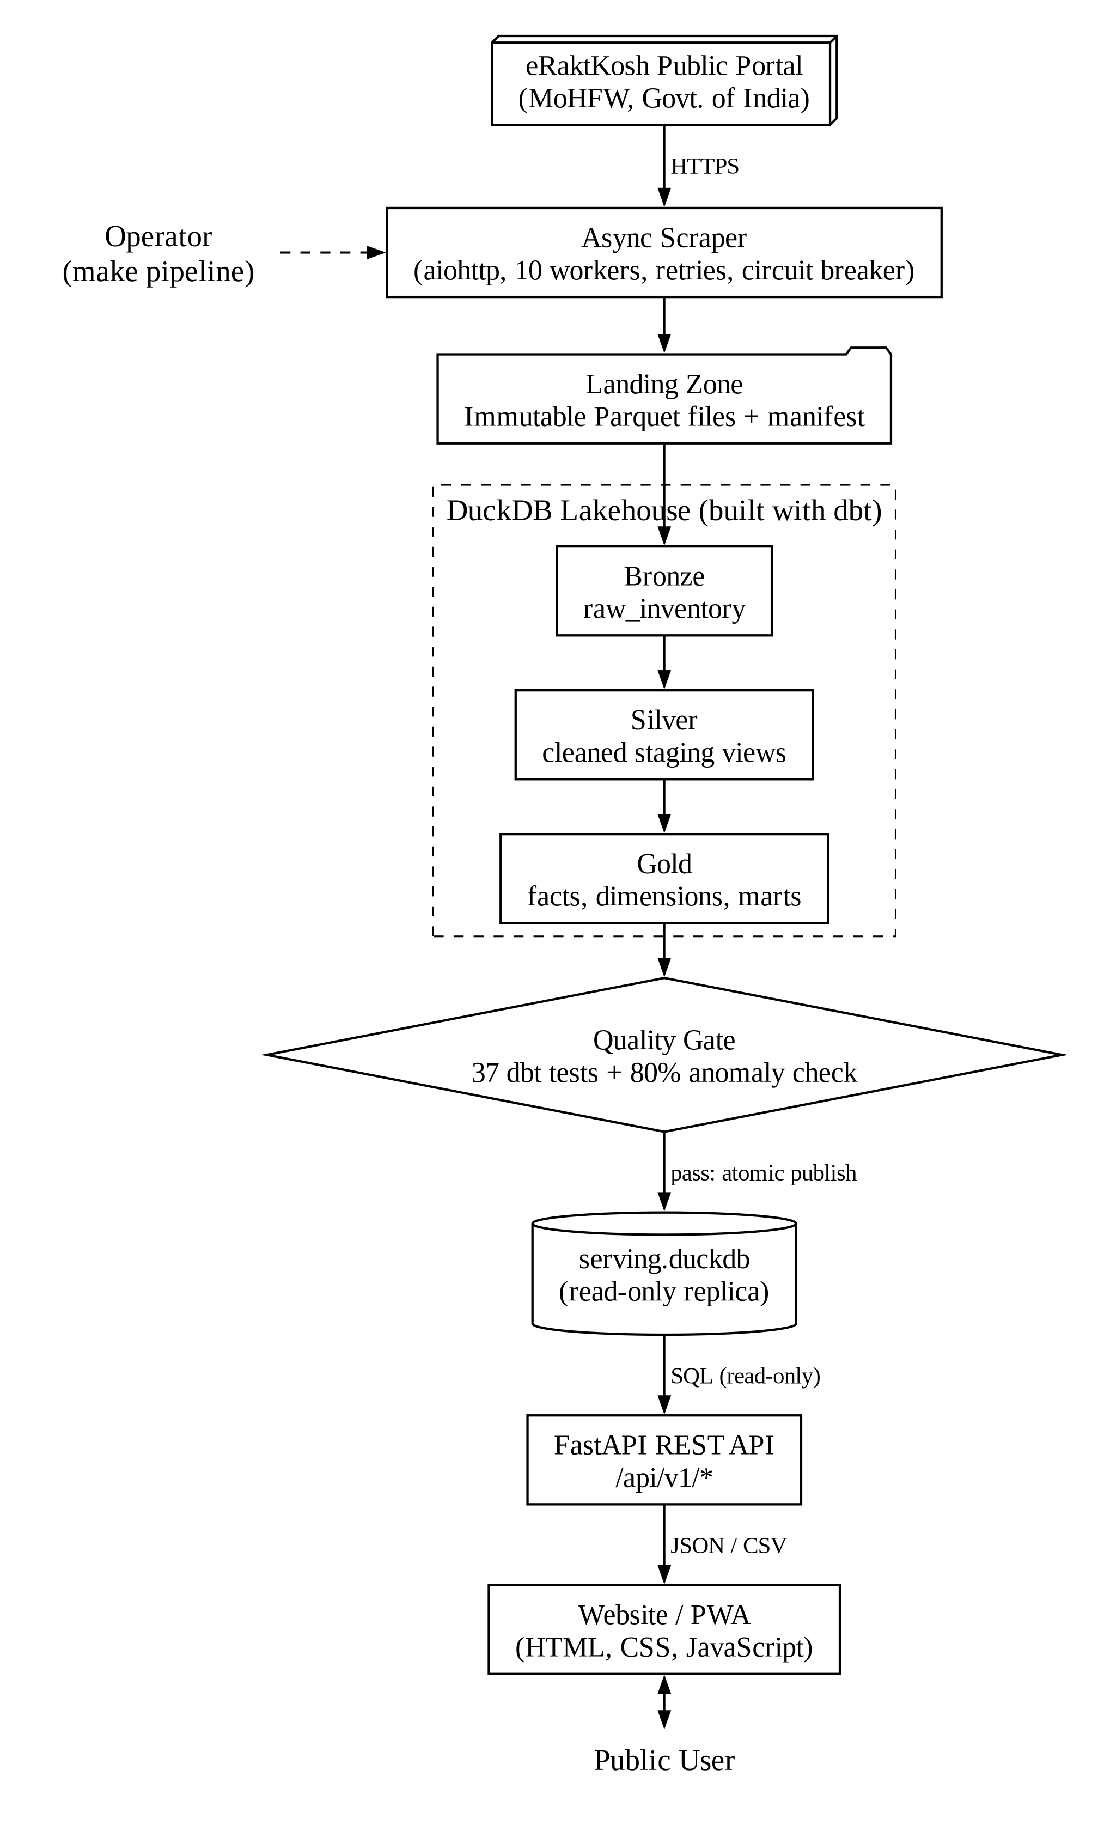
Backup: Detailed architecture
Notes:
Backup. Full architecture diagram from the report.

Slide 17
Backup: Main API endpoints
Endpoint | Used for
GET /api/search | Blood Finder and map
GET /api/v1/emergency | Emergency Mode ranking
GET /api/v1/shortages | District shortages
GET /api/v1/rare | Rare Blood Radar
GET /api/history | Trend chart
GET /api/v1/health/dashboard | Data Health panel
GET /api/v1/export/*.csv | CSV downloads
Notes:
Backup. Full list with parameters at /docs (Swagger UI).

Slide 18
Backup: Likely viva questions
Why DuckDB, not MySQL?
Is the data real?
Analytics workload, no server, reads Parquet.
Yes, eRaktKosh (MoHFW); no fake data.
What if eRaktKosh is down?
How is Emergency rank made?
Circuit breaker + gate; old data stays live.
0.35 fresh + 0.30 trust + 0.25 units + 0.10 distance.
Why is plasma different?
How do you stop SQL injection?
Reverse rule: AB is the universal plasma donor.
All values passed as ? parameters.
Notes:
Backup. More answers in docs/guide/16_GLOSSARY_AND_FAQ.md.

