Slide 1
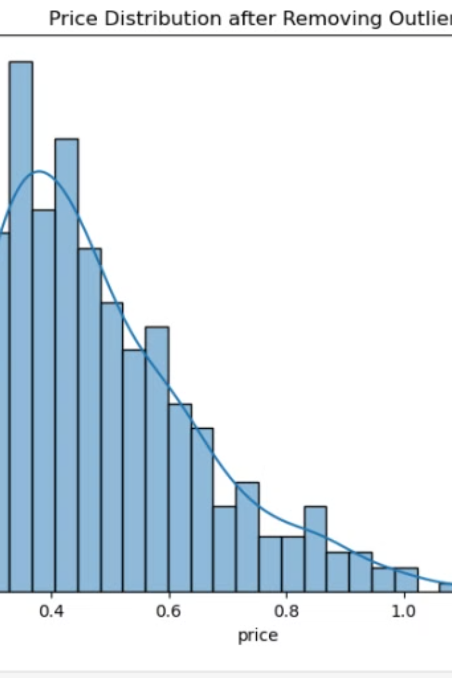

House Price Prediction Project
This housing dataset contains 545 records and the following attributes: Price, Area, Bedrooms, Bathrooms, Stories, Mainroad, Guestroom, Basement, Hotwaterheating, Airconditioning, Parking, Prefarea, and Furnishingstatus.
by Radhika Ambulkar

Slide 2
Dataset Attributes
Price
Area
Bedrooms & Bathrooms
The house price, ranging from ₹1,750,000 to ₹13,300,000, with an average of ₹4,766,729.
The area of the house, ranging from 1,650 to 16,200 sq. ft, with an average of 5,150 sq. ft.
The number of bedrooms ranges from 1 to 6, with an average of 3. The number of bathrooms ranges from 1 to 4, with most homes having 1 to 2.

Slide 3
Dataset Attributes (Continued)
Stories
Amenities
Furnishing Status
The number of floors in the house, ranging from 1 to 4, with most homes having 1 or 2 floors.
The dataset includes information on whether the house has a main road, guest room, basement, hot water heating, air conditioning, parking, and preferred area.
The house's furnishing status is categorized as semi-furnished, unfurnished, or furnished.

Slide 4
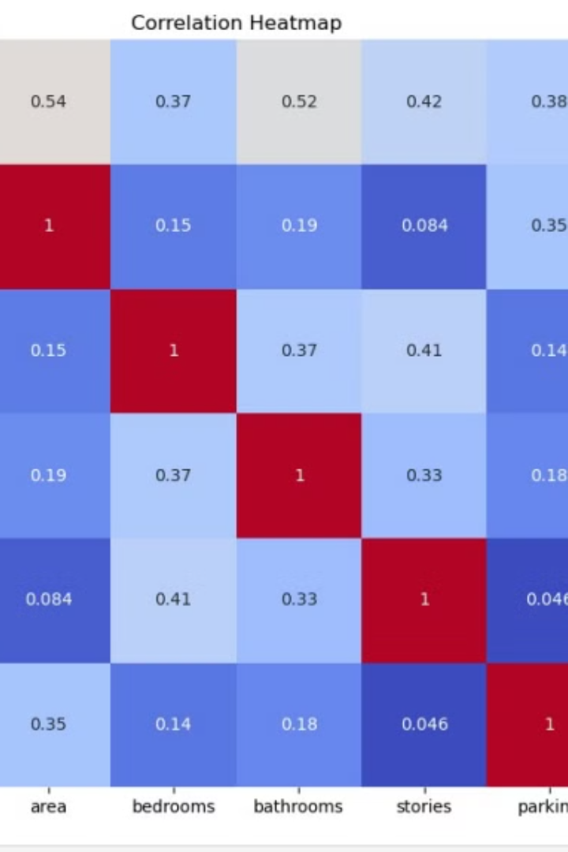
Data Exploration
Price
Area
Bedrooms
Bathrooms
Stories
Parking
1.000000
0.535997
0.366494
0.517545
0.420712
0.384394
0.535997
1.000000
0.151858
0.193820
0.083996
0.352980
0.366494
0.151858
1.000000
0.373930
0.408564
0.139270
0.517545
0.193820
0.373930
1.000000
0.326165
0.177496
0.420712
0.083996
0.408564
0.326165
1.000000
0.045547
0.384394
0.352980
0.139270
0.177496
0.045547
1.000000

Slide 5
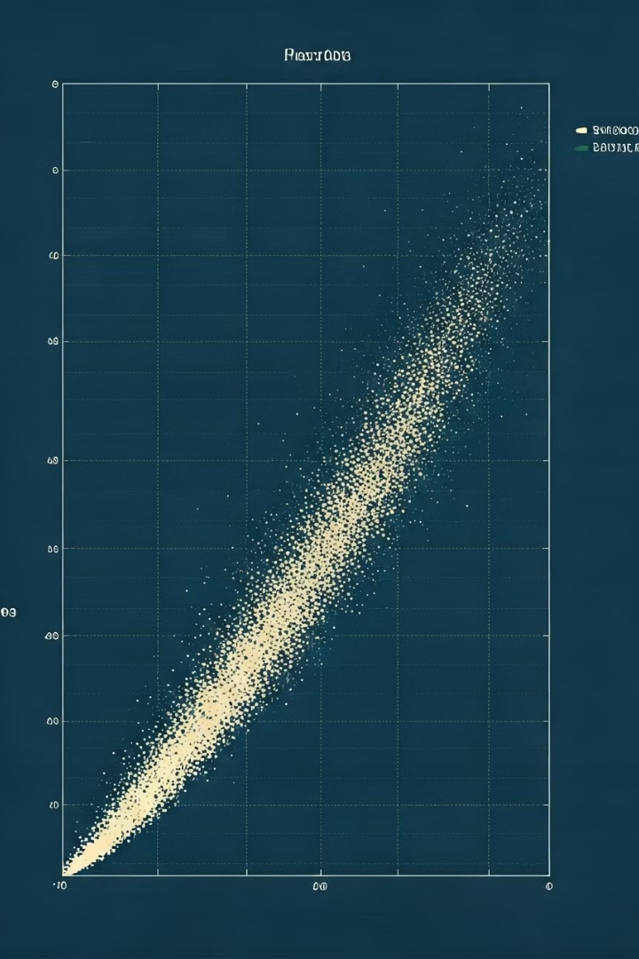
Data Visualization
1
Price Distribution
The distribution of house prices is skewed to the right, indicating a higher concentration of houses at lower prices.
2
Area Distribution
The distribution of house areas is also skewed to the right, with a higher concentration of houses with smaller areas.
3
Price vs. Area
There is a positive correlation between house price and area, suggesting that larger houses tend to have higher prices.
4
Correlation Heatmap
The correlation heatmap shows the relationships between all numerical variables in the dataset.

Slide 6
Data Preprocessing
1
Encoding Categorical Variables
Categorical variables like 'mainroad', 'guestroom', and 'furnishingstatus' are converted into numerical values using label encoding.
2
Scaling Numerical Features
Numerical features like 'area', 'bedrooms', and 'parking' are scaled using StandardScaler to ensure they are on a similar scale.
3
Splitting Data
The dataset is split into training and testing sets to evaluate the performance of the model.

Slide 7
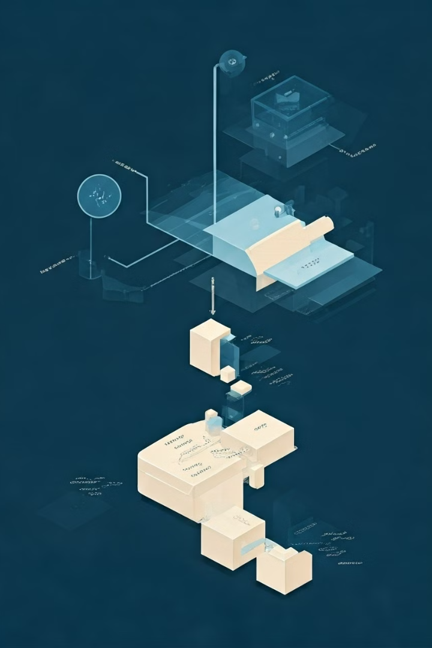
Model Training
1
Linear Regression
A linear regression model is trained on the training data to predict house prices based on the input features.
2
Random Forest Regression
A random forest regression model is trained on the training data to predict house prices based on the input features.
3
Hyperparameter Tuning
GridSearchCV is used to find the optimal hyperparameters for the random forest model.
4
Model Evaluation
The performance of both models is evaluated using metrics like RMSE and R² score.

Slide 8
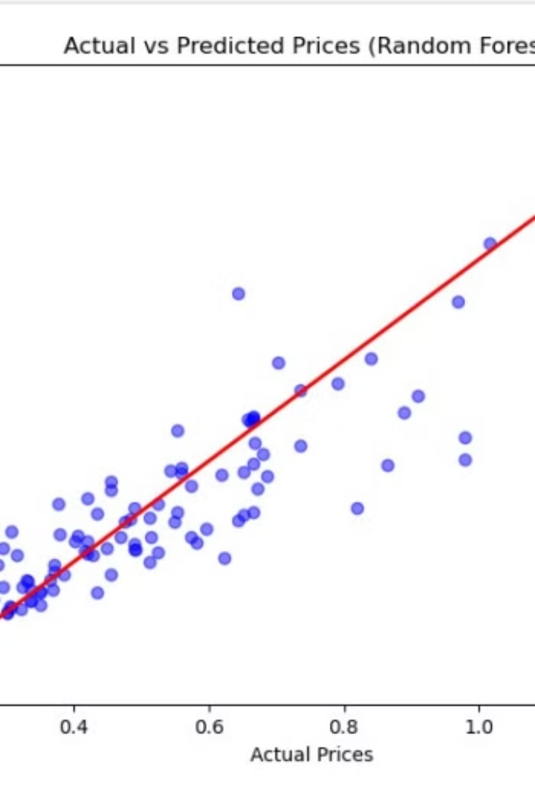
Model Evaluation
1
Random Forest Performance
The random forest model achieved a higher R² score and lower RMSE compared to the linear regression model, indicating better performance.
2
Actual vs. Predicted Prices
The scatter plot shows the actual prices against the predicted prices from the random forest model, with a trend line indicating a strong correlation.

Slide 9
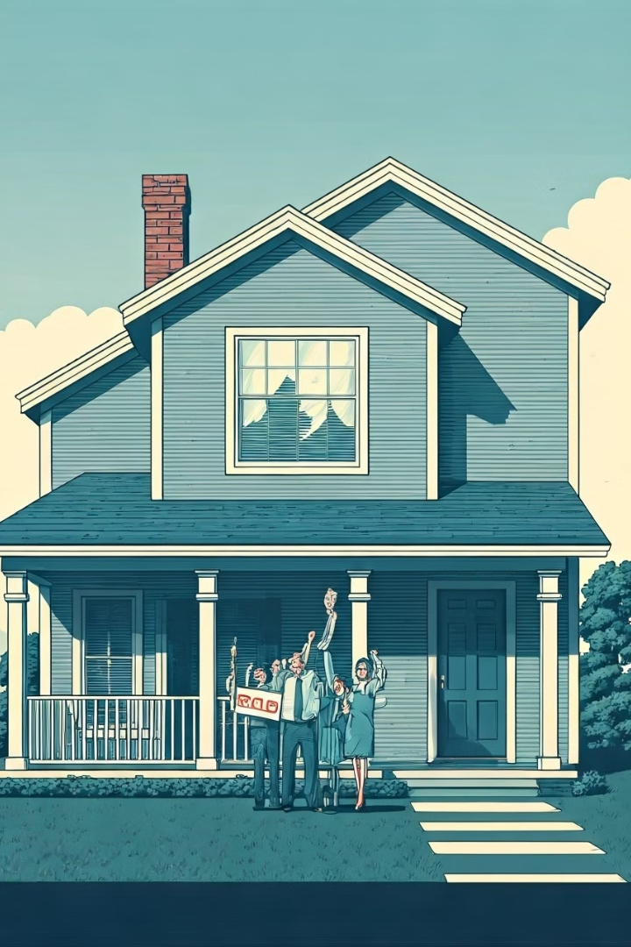
Predicting House Prices
The trained random forest model can be used to predict the price of a new house based on its features. The model takes the input features, scales them using the fitted StandardScaler, and outputs a predicted price.

Slide 10
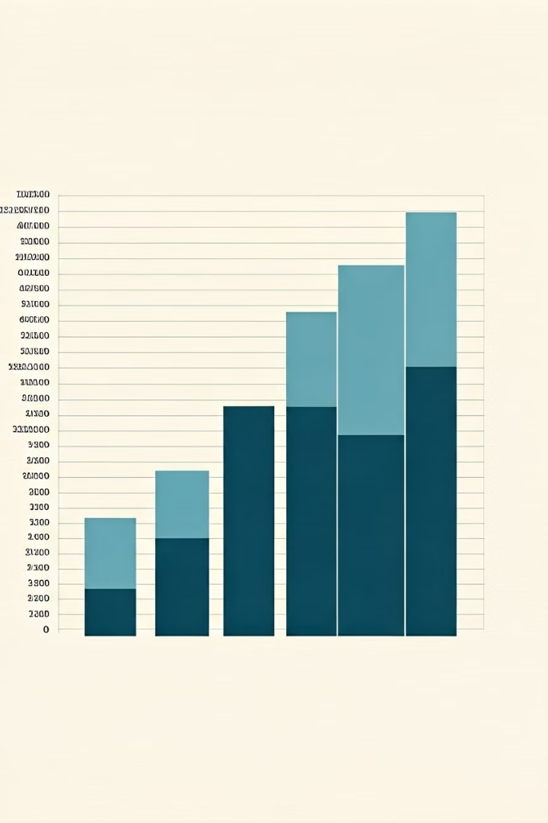
Conclusion
The house price prediction project successfully developed a random forest model that can accurately predict house prices based on various features. The model can be used to assist in real estate decision-making and provide insights into the housing market.

