Slide 1
RFID BASED SUPERMARKET AUTOMATION SYSTEM
PRESENTED BY-
RADHIKA KULKARNI

Slide 2
CONCEPT
Electronic hardware system fitted in the trolley is used to make purchase comfortable
RFID tag is attached to all the products in the supermarket.
When any product is scanned, details of product are displayed on LCD and total bill amount is calculated.
Feature of deleting a scanned product.
Set the price limit so that if total bill amount exceeds the price limit then the user will be notified.
Send billing data wirelessly to the billing desk.

Slide 3
REQUIREMENTS
PIC 18F4550 Microcontroller
RFID Cards with RFID Reader
4 x 4 Keypad
LCD Display
Wireless TX unit (RF 2483.92 MHZ)
Wireless RX unit (in PC side)
Buzzer
RS 232
Hyper terminal

Slide 4
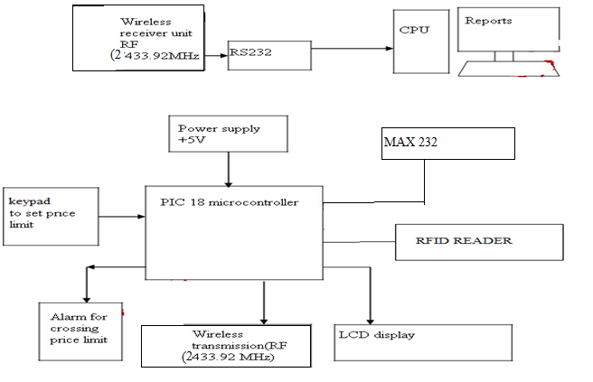
BLOCK DIAGRAM

Slide 5
COMPONENTS USED AND WORKING

Slide 6
Step 1: When system is turned on:
LCD
Components: LCD : 16 x 4
PIC 18F4550: The various functions performed by the microcontroller PIC 18F4550 [7] are:
Storing data scanned by RFID system.
Sending this data to LCD for displaying output.
Providing the signals to the respective output devices.
WELCOME
PIC
18F4550

Slide 7
STEP 2: The system asks the customer to enter the price limit. If the amount exceeds the set limit then the buzzer notifies the user.
Components: 4 x 4 matrix keypad – The 16-button keypad provides a useful human interface component for microcontroller
Buzzer - PS12 Type buzzer which consumes low power.
16 x 4 LCD
4 x 4 matrix keypad
PLZ ENTER AMT: 1000
PIC
18F4550
Buzzer

Slide 8
If total bill amount exceeds the previously set price limit
Buzzer is used just for the purpose of notifying the user. The user can still continue shopping.
16 x 4 LCD
4 x 4 matrix keypad
EXCEEDS
PIC
18F4550
Buzzer

Slide 9
Step 3: Scan products
Components: RFID Reader: RFID readers are high performance proximity readers with operating frequency of 125 kHz.
RFID Tag: is used for the purpose of identifying and tracking the object
Product
16 x 4 LCD
RFID Tag
KURKURE RS.20
58212 TB:0020
PIC
18F4550
RFID Reader

Slide 10
Step 4: Delete scanned product
Long press the delete button (here key no. 2 on matrix keypad) and scan the product simultaneously which is to be removed
The details of the product will be displayed on LCD
The price of the product will be deleted from the total bill amount and will be displayed on LCD.

Slide 11
Step 5: Shopping completed
Press done button (here key no 1 on matrix keypad)
Components: CC2500 is RF transceiver developed by Texas instruments which is used in 2400-2483.5 MHz ISM/SRD band systems.
16 x 4 LCD
4 x 4 matrix keypad
DATA SENT TO PC
1
PIC
18F4550
RF Transceiver

Slide 12
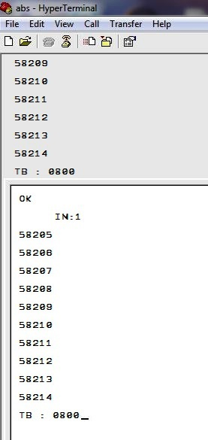
Step 6 : Data received at billing desk
Bill displayed on hyper terminal
Wireless receiver unit
C
P
U
Bill
RS 232

Slide 13
ADVANTAGES & DISADVANTAGES
ADVANTAGES
Time required for shopping reduces drastically
One time investment
Reduces the number of employees required at the billing desk
Less hassles as everything is in user’s hand
It helps to keep the users informed of the total bill amount at the time of purchase.
Alert users when exceeding the estimated budget.
Automatic data transfer to billing section.
DISADVANTAGES
Cost of the system is more
Security threat , if customer opts for extreme ways
The system requires constant battery backup.

Slide 14
APPLICATIONS
Worldwide supermarkets
Military Canteens
Malls
Clothing showrooms
Grocery stores

Slide 15
FUTURE SCOPE
Data at the PC displays the ID number of the shopped items on the hyper terminal. Further the entire data of the items shopped could be sent and displayed using a software application.
If the LCD provides a layout of the shopping mall then the customer would be able to find products easily in different shelves.
Thefts can be avoided by use of robotic ARM for picking and dropping products.
If ATM card swiping system is incorporated in the system, then the customer will not be required to pay the bill at the billing counter. This will further reduce the shopping time.
The system can also include voice assistance.

Slide 16
THANK YOU!

