Slide 1

FUTURE BEGINS HERE
Mental Health Disorder
Classification.
Presented by:- Under the Guidance of:-
Sonika Thakur(2022d1r007) Ms. Arti Kotru
Radhika(2022d1r017) (Associate Professor)

Slide 2
FUTURE BEGINS HERE
INDEX
Technology and Libraries Used
Project Introduction
Advantages and disadvantge of the Current System
Project Descriptions
Working
Flowchart
Dataset Used
After Cleaning Dataset
Exploratory Data Analysis
Result and comparison
Proposed methodology and performance
Deployed model
Future scope
Bibliography

Slide 3

FUTURE BEGINS HERE
TECHNOLOGY USED
The Mental Health disorder classify machine learning project is a project that aims to classify the mental health disease based on their symptoms.
Machine learning: This field of study focuses on enabling machines to interpret and analyze visual data. In the project,machine learning is utilized to analyze vast datasets of patient information, including demographics, symptoms, and treatment outcomes.
One-Hot encoder: This is a technique used in machine learning and data preprocessing to represent categorical variables as binary vectors.
Python programming language: Python is a popular programming language in the field of machine learning, and is used extensively in the project for tasks such as data preprocessing, model training, and evaluation.
Tensorflow: TensorFlow can be used to develop models for various tasks, including
natural language processing , image recognition , handwriting recognition , and
different computational-based simulations such as partial differential equations.

Slide 4



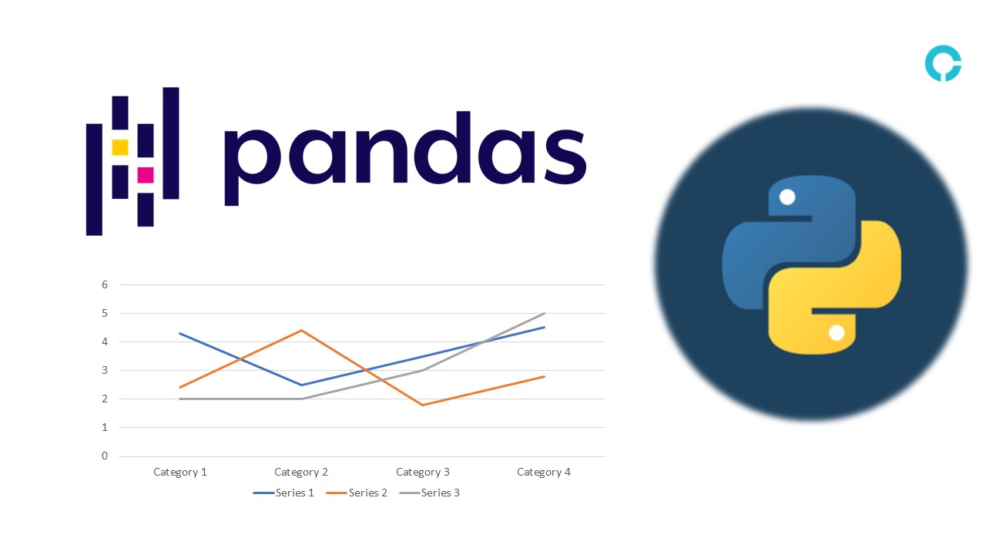

FUTURE BEGINS HERE
LIBRARIES USED
Numpy: Numpy is a Python library used for numerical computing and scientific computing. It provides support for large, multi-dimensional arrays and matrices, along with a large collection of mathematical functions to operate on them.
Pandas: Pandas is a Python library used for data manipulation and analysis. It provides data structures and functions to handle and manipulate data in a structured way, making it easier to work with data.
Matplotlib: Matplotlib is a Python library used for data visualization and plotting. It provides functions and tools to create a wide variety of static, animated, and interactive visualizations of data.
Scikit-learn: Scikit-learn is a Python library used for machine learning tasks such as classification, regression, and clustering. It provides a wide range of tools and algorithms to perform these tasks, along with functions to evaluate the performance of machine learning models.
Seaborn: Seaborn is a Python library for statistical graphics plotting. It provides beautiful default styles and color palettes to make statistical plots more attractive.

Slide 5

FUTURE BEGINS HERE
PROJECT INTRODUCTION
To predict mental disorders based on symptoms using machine learning with 17 features and 120 samples, follow these steps:
Data Collection: Assemble a diverse dataset with symptom information and diagnosed mental disorders.
Data Preprocessing: Clean, handle missing values, and encode categorical variables. Split data into symptom features and diagnosed disorder targets.
Feature Engineering: Analyze feature relevance and perform dimensionality reduction if necessary.
Model Selection: Choose appropriate classification algorithms (e.g., Random Forest, SVM,LR) and ensemble methods.
Training and Evaluation: Split data, train models on training set, and evaluate using metrics like accuracy, precision, recall, and F1-score.
Validation: Validate models with techniques such as cross-validation to ensure robustness.
Prediction: Deploy the best-performing model for predicting mental disorders based on symptoms.
Monitoring and Updating: Continuously monitor model performance and update as new data or
understanding of mental disorders emerges.

Slide 6
FUTURE BEGINS HERE
DISADVANTAGES OF THE EXISTING SYSTEM
Limited access to care: Despite the existence of effective prevention and treatment options, many individuals face barriers in accessing mental health services. Factors such as financial constraints, lack of healthcare infrastructure, and geographic remoteness can restrict access to care, exacerbating mental health issues.
Stigma and discrimination: Stigmatization surrounding mental health conditions can lead to social exclusion, discrimination in employment and education, and reluctance to seek help. This stigma can prevent individuals from disclosing their struggles, seeking treatment, or accessing supportive resources, thereby perpetuating the cycle of distress and impairment.
Human rights violations: Individuals with mental health disorders may experience human rights violations, including involuntary treatment, confinement, and neglect. These violations can further exacerbate distress and impair functioning, leading to long-term consequences for individuals' well-being and autonomy.

Slide 7
FUTURE BEGINS HERE
ADVANTAGES OF THE CURRENT SYSTEM
Early Detection and Intervention: Machine learning algorithms can analyze vast amounts of data to identify patterns indicative of mental health conditions, enabling early detection and intervention before symptoms escalate.
Improved Access to Care: Telemedicine and digital mental health platforms powered by machine learning can extend mental health services to underserved populations, including those in remote or resource-limited areas, enhancing access to care.
Predictive Analytics: Machine learning models can predict treatment outcomes, relapse risk, and response to different interventions, assisting clinicians in making informed decisions about patient care and resource allocation.

Slide 8
FUTURE BEGINS HERE
PROJECT DESCRIPTION
Mental Health Disorder Classification Using Machine Learning Techniques.
Data Preprocessing: We will clean and preprocess the dataset to handle missing values, normalize numerical features, and encode categorical variables.
Model Selection: We will explore various machine learning algorithms such as Logistic Regression (LR), Random Forest (RF), Support Vector Machine (SVM), and ensemble models, proposed model to classify mental health disorders.
Model Training: We will split the dataset into training and testing sets and train the selected models using the training data.
Model Evaluation: We will evaluate the performance of each model using metrics such as accuracy, precision, recall, F1 score, and confusion matrix.
Testing and Prediction: Finally, we will deploy the trained model to predict mental health disorders for new, unseen data and assess its generalization ability.

Slide 9
FUTURE BEGINS HERE
PROJECT DESCRIPTION
Outcome of this project:
The developed machine learning system will enable early detection and classification of mental health disorders, thereby facilitating timely intervention and personalized treatment planning. By leveraging various features related to individuals' mental health status, the system aims to improve access to effective mental health care and reduce stigma and discrimination associated with these disorders.We propose a neural network model for mental disorder classification, featuring two hidden layers with dropout regularization to prevent overfitting. Trained with the Adam optimizer and sparse categorical cross-entropy loss, the model evaluates performance using metrics.Based on these predictions, the app provides suggestions, such as seeking professional help and maintaining a routine to manage mood swings. There is also an option to generate a PDF report of the predictions and suggestions.

Slide 10
FUTURE BEGINS HERE
WORKING
The overview you provided offers a comprehensive understanding of Linear Regression (LR), Random Forest (RF), Support Vector Machine (SVM), ensemble models,Prosposed model dataset details, and the steps involved in training data, preprocessing, building an ensemble model, training & evaluation, and testing & prediction in machine learning.
The dataset comprises 120 samples for analysis. The dataset contains four types of mental health disorder datasets: normal, depression, bipolar-type 1, and bipolar type 2. It consists of 17 features related to mental health, including Sadness, Euphoric, Exhausted, Sleep Disorder, and others.
Logistic Regression (LR), Random Forest (RF), and Support Vector Machine (SVM) are powerful supervised machine learning algorithms used for various classification and regression tasks. Ensemble models combine multiple individual models to improve predictive performance and robustness.

Slide 11
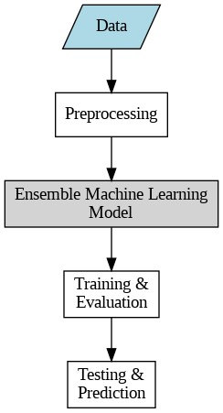
FUTURE BEGINS HERE
FLOWCHART
Proposed Model

Slide 12
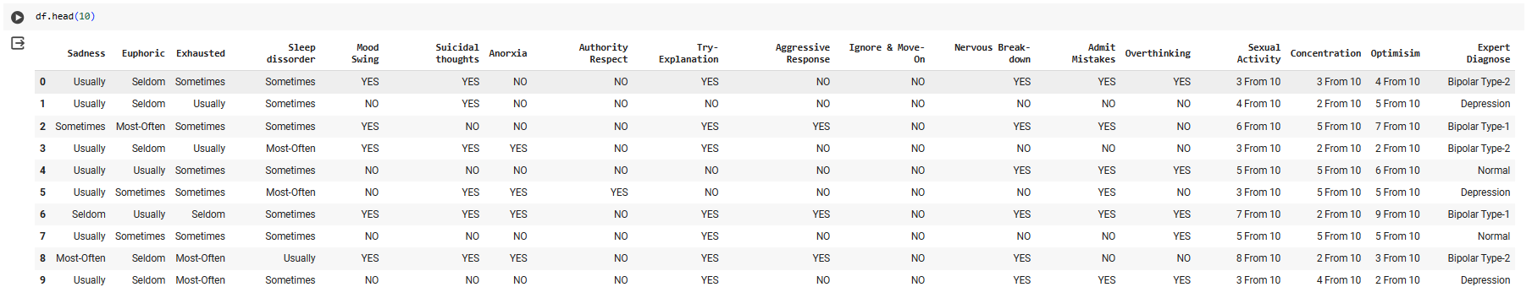
FUTURE BEGINS HERE
DATASET USED

Slide 13

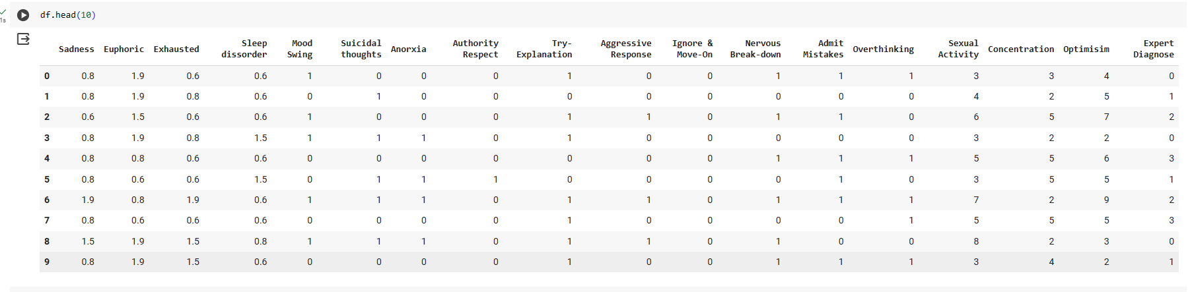
AFTER CLEANING DATASET

Slide 14
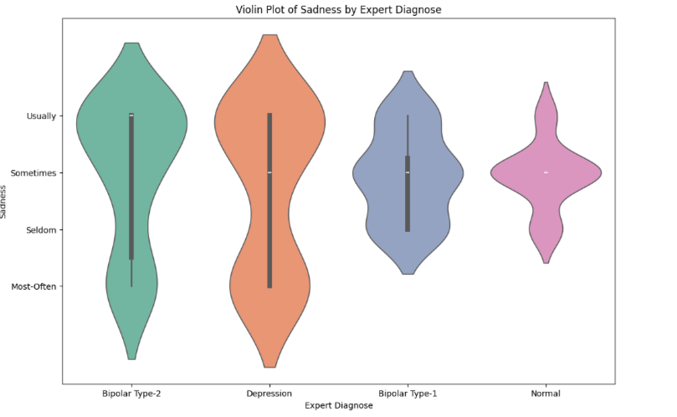
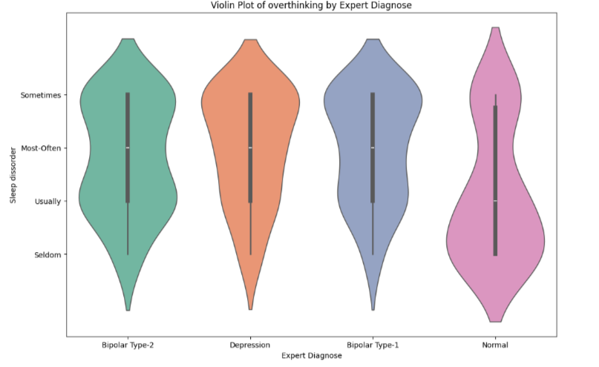
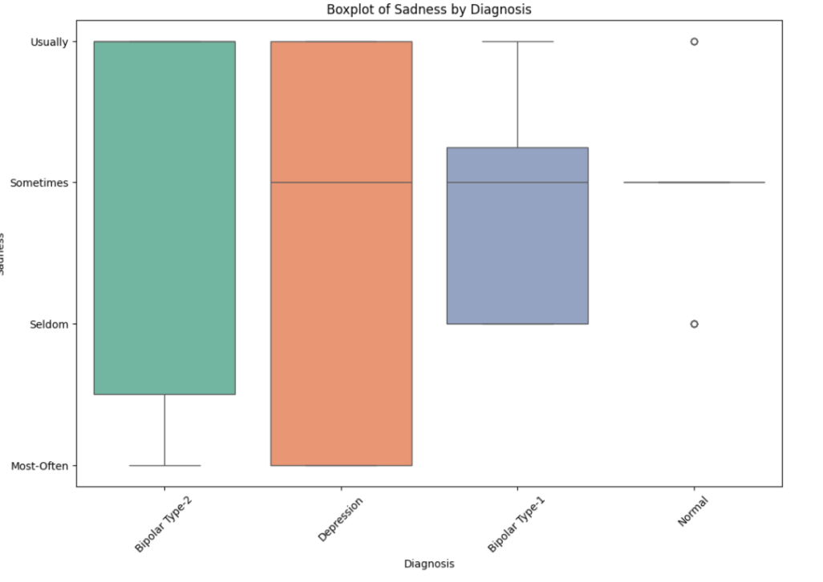
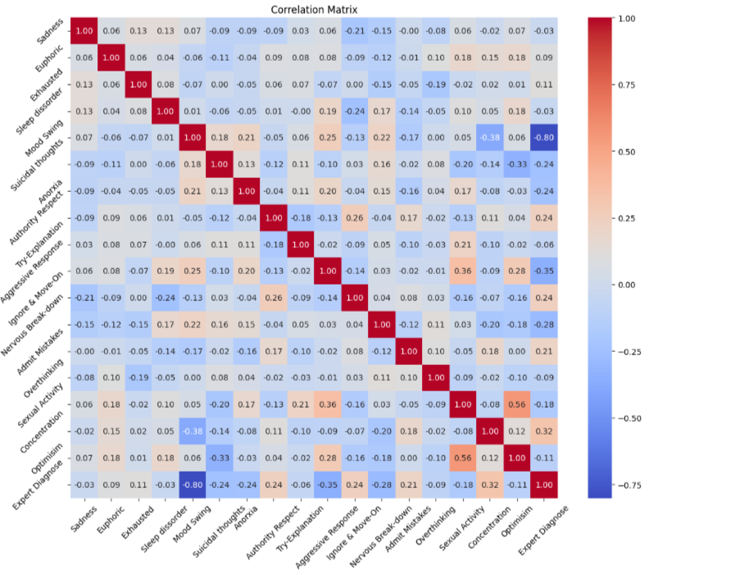
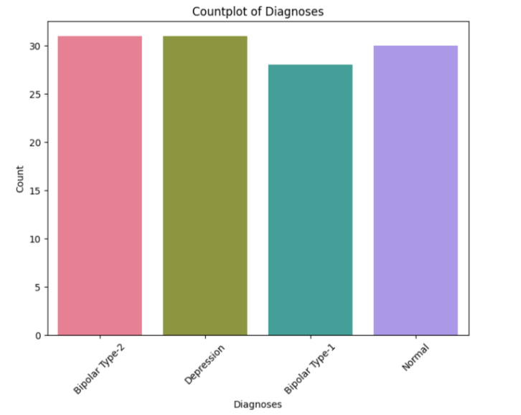
Exploratory Data Analysis(EDA)

Slide 15
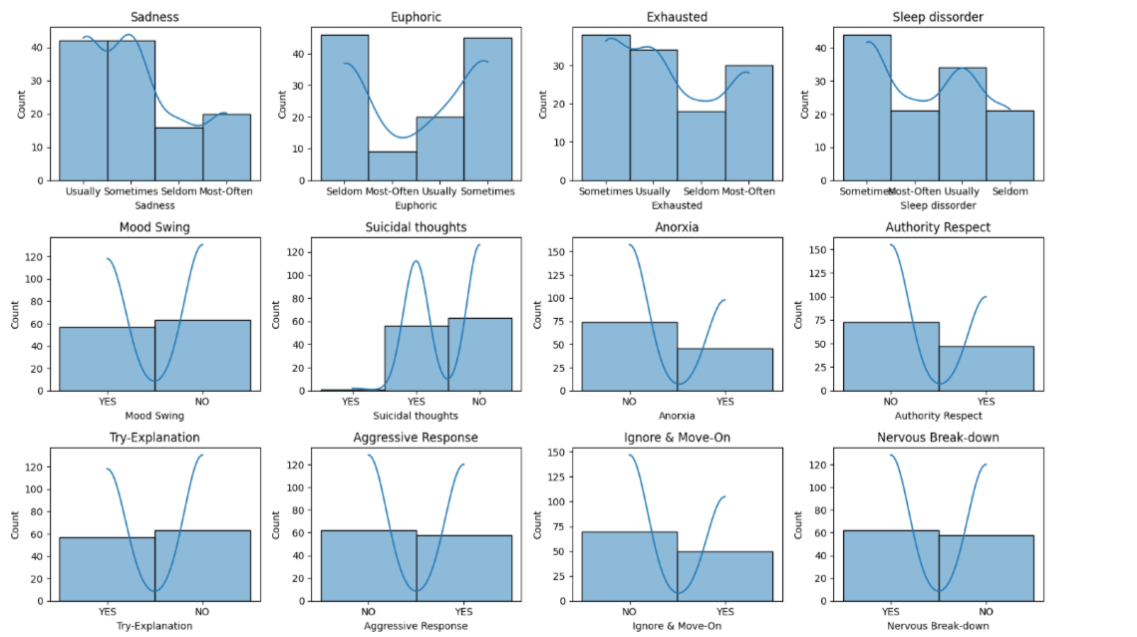
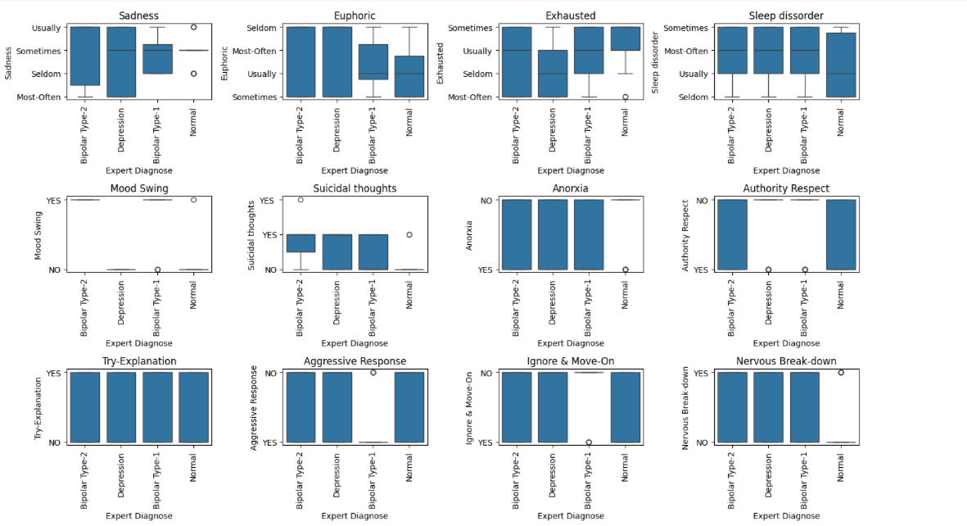
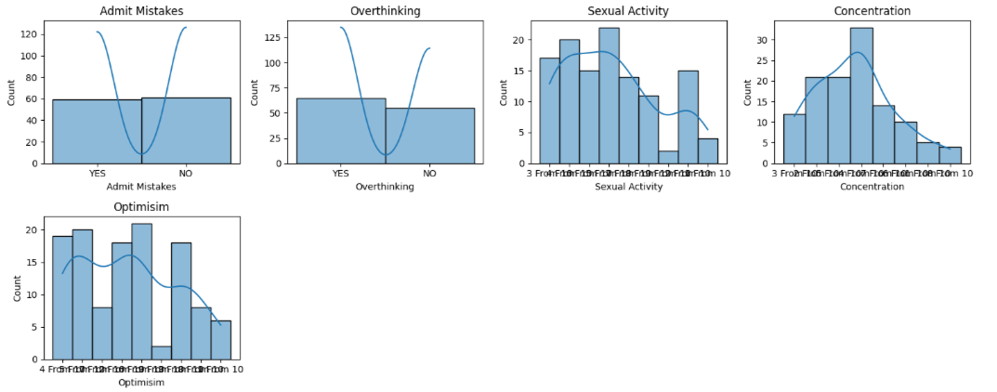
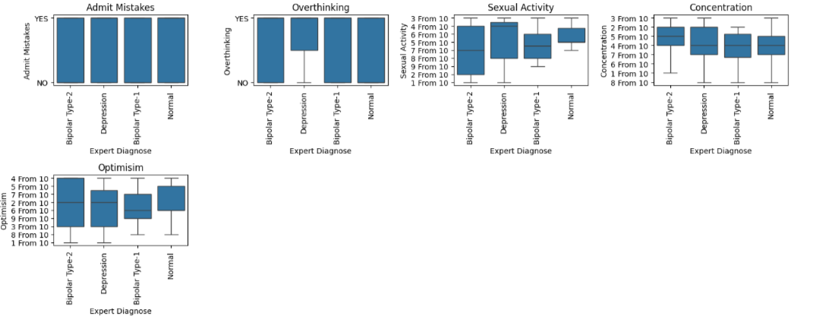
Exploratory Data Analysis(EDA)
Univariate Analysis
Bivariate Analysis

Slide 16
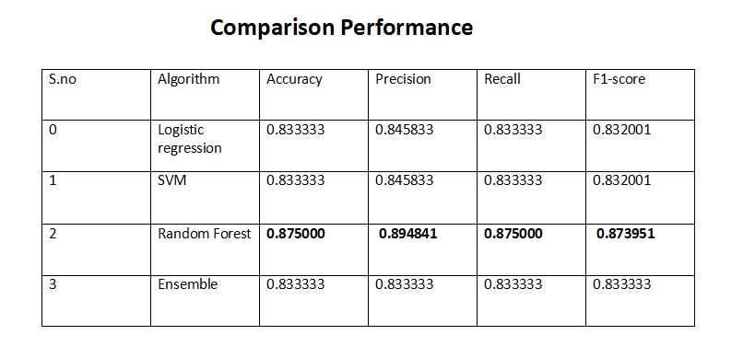
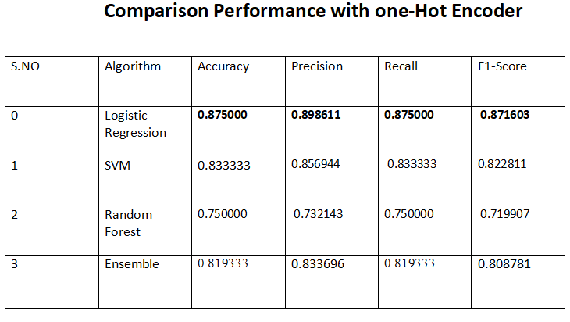
Results and comparison

Slide 17
Proposed Methodology
Our model is a neural network for mental disorder classification, featuring two hidden layers with dropout regularization to prevent overfitting. Trained with the Adam optimizer and sparse categorical cross-entropy loss, the model evaluates performance using metrics like accuracy, precision, recall, and F1-score, complemented by a confusion matrix.
The model architecture:
Input Layer: Accepts the feature vector representing patients' emotional states and behaviors.
Hidden Layers: Two layers with ReLU activation functions (64 and 32 neurons, respectively) for learning complex relationships.
Output Layer: Four neurons representing the mental disorder classes, using softmax activation.
Regularization: Dropout applied after each hidden layer.
Loss Function and Optimizer: Sparse categorical cross-entropy loss with Adam optimizer.
Training Procedure: Trained on split training data for 100 epochs with early stopping (patience = 10).
Evaluation: Assessed using split test data with metrics and confusion matrix.

Slide 18
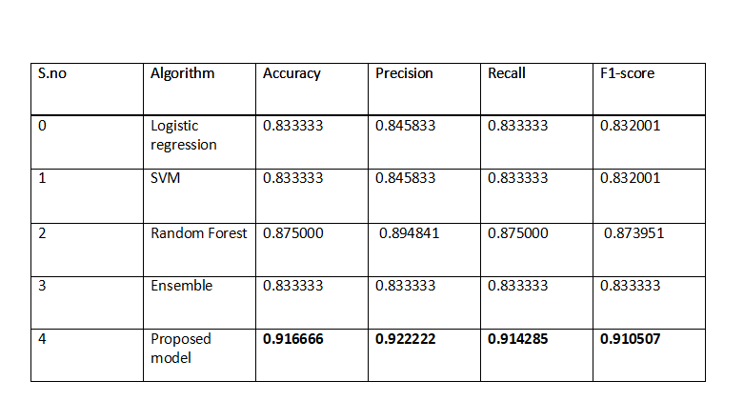
Proposed Model Performance

Slide 19
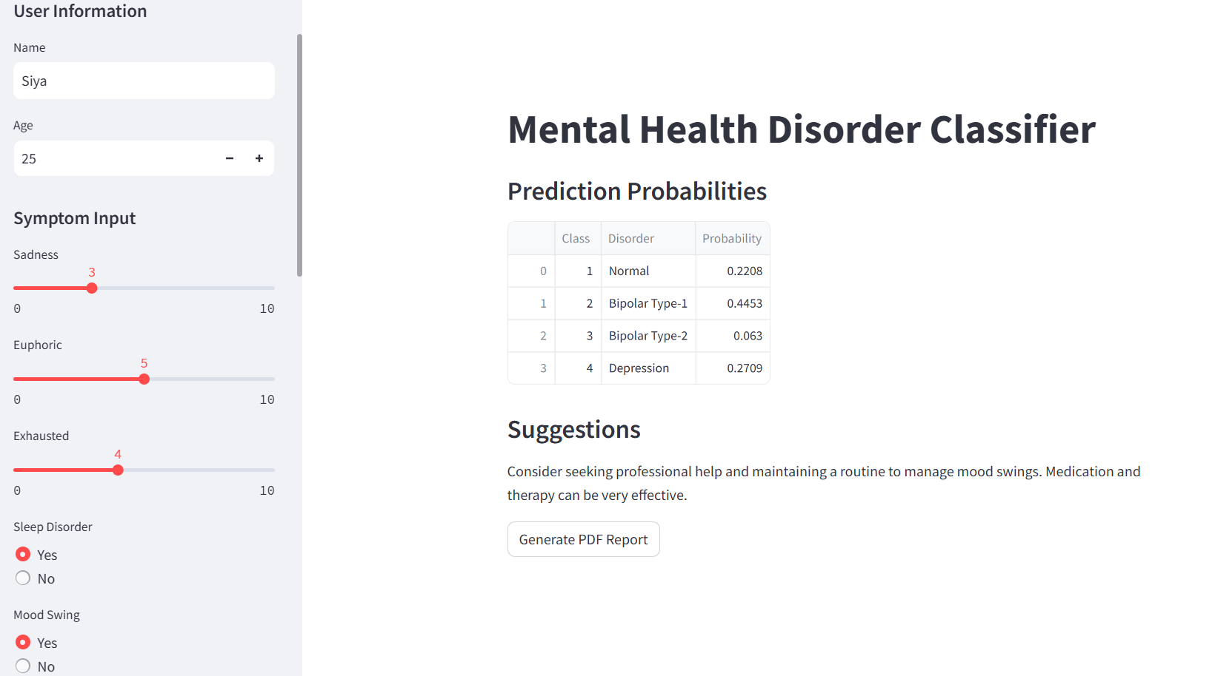
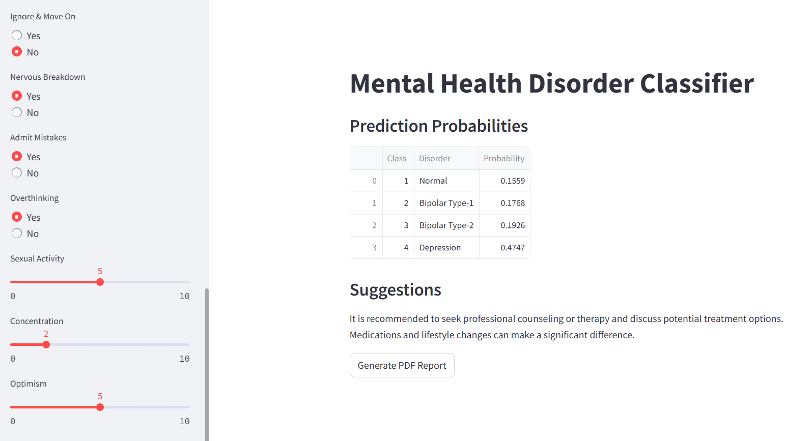
Deployed Model

Slide 20
Deployed Model
Streamlit is used to create an interactive web application where the model is trained in Google Colab and then integrated into the Streamlit app for real-time inference by taking user inputs. The process begins with model training in Google Colab, involving data preparation where data related to mental health symptoms and disorders is gathered and preprocessed. Machine learning algorithms are then used to train the model on this data, and the model's performance is evaluated to ensure high accuracy. Once the model achieves satisfactory performance, it is saved using a method such as joblib or pickle.
In the Streamlit app, the saved model is loaded to perform real-time inference. Streamlit provides a user-friendly interface where users can input their symptoms. For instance, users enter their name (e.g., Siya) and age (e.g., 25). They then rate their level of sadness, euphoria, and exhaustion on scales from 0 to 10 (e.g., sadness: 3, euphoric: 5, exhausted: 4). Additionally, users indicate whether they have a sleep disorder and experience mood swings (Yes or No).
The right section of the app displays the model output, specifically the Mental Health Disorder Classifier, which predicts the probabilities of different mental health disorders based on the user's input. For example, the model might predict the following probabilities. Based on these predictions, the app provides suggestions, such as seeking professional help and maintaining a routine to manage mood swings. There is also an option to generate a PDF report of the predictions and suggestions.

Slide 21
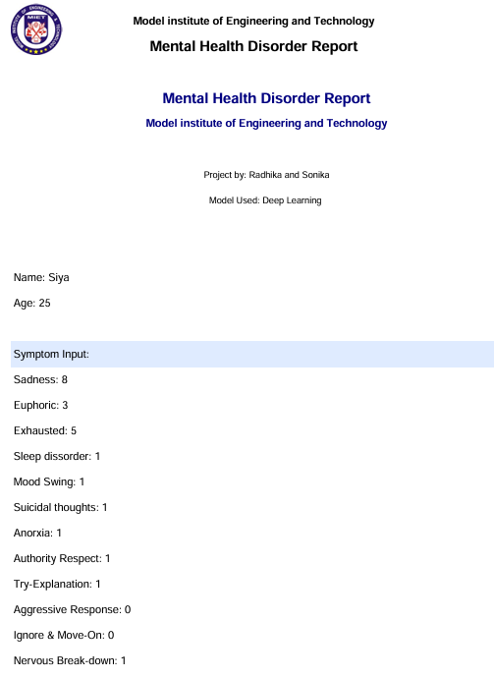
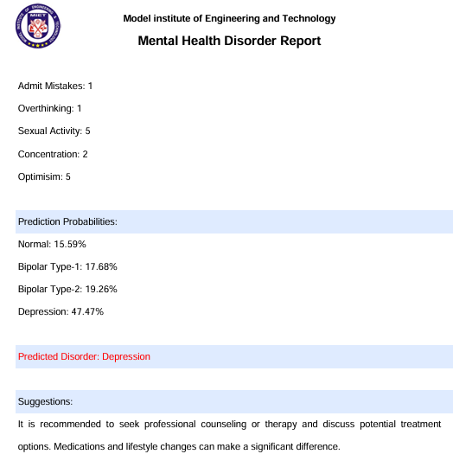
Deployed Model

Slide 22
Future Scope
MRI Scans and Other Medical Imaging: Integrate MRI scans, CT scans, and other medical imaging data to improve diagnosis accuracy.
Wearable Device Data: Utilize data from wearable devices (e.g., heart rate, sleep patterns) for continuous monitoring and early detection of mental health issues.
Deep Learning Models: Employ advanced deep learning models like Convolutional Neural Networks (CNNs) for image data and Recurrent Neural Networks (RNNs) or Transformers for sequential data.
Personalized Dashboard: Develop a personalized dashboard that tracks the user’s history, symptoms, and progress over time.

Slide 23
FUTURE BEGINS HERE
BIBLIOGRAPHY
Data Sets
Mental Health disease Dataset with 120 patients
https://www.kaggle.com/code/ibrahimelgmmal/mental-disorder-predictor/input
References:
Clark, Lee Anna et al. “Three Approaches to Understanding and Classifying Mental Disorder: ICD-11, DSM-5, and the National Institute of Mental Health’s Research Domain Criteria (RDoC).” Psychological Science in the Public Interest 18 (2017): 145 - 72.
Wolman, Benjamin B.. “Classification and Diagnosis of Mental Disorders.” (1978).
Essen-Möller, E. “ON CLASSIFICATION OF MENTAL DISORDERS.” Acta Psychiatrica Scandinavica 37 (1961): n. pag.
Clark, Lee Anna et al. “Three Approaches to Understanding and Classifying Mental Disorder: ICD-11, DSM-5, and the National Institute of Mental Health’s Research Domain Criteria (RDoC).” Psychological Science in the Public Interest 18 (2017): 145 - 72.
Andrews, Gavin et al. “Classification of Anxiety and Depressive disorders: problems and solutions.” Depression and Anxiety 25 (2008): n. pag.
Lecrubier, Yves. “Refinement of diagnosis and disease classification in psychiatry.” European Archives of Psychiatry and Clinical Neuroscience 258 (2008): 6-11.

Slide 24
FUTURE BEGINS HERE
THANK YOU

