Slide 1
Beyond the Textbook:
Smart Protection for Quantum Computers That Make Mistakes
Quantum computers make mistakes. We found out when fixing them helps, and built a smart program that picks the best fix.
Notes:
Hello, judges. Our project is about protecting quantum computers from mistakes. Quantum computers are very sensitive and make errors easily. We tested when fixing those errors actually helps, using a quantum simulator called Qiskit and a smart program.

Slide 2
The Problem & Our Approach
What we set out to do
Real Data
Realistic Test Setup
Smart Choice
Real machines are messy. We used a real Kaggle dataset about quantum circuit stability to set how noisy our test computer is.
We built a full test in Qiskit that copies real problems: gates that make mistakes, qubits that fade over time (T1/T2), and reading errors.
Why guess the best fix? Our smart program (machine learning) picks between no protection, Dynamical Decoupling (regular nudges), or 3-qubit error correction.
Notes:
Most projects stop at textbook maths. We did three things: used real data, built a realistic test, and added a smart program that picks the best fix. We found out when error correction works, and when its extra steps make things worse.

Slide 3



How We Built It & Used Real Data
Turning Data into Noise
We take numbers from the Kaggle data (gate error rate, how fast qubits fade) and turn them into noise in Qiskit.
How We Check Results
We put a qubit in a known state, add noise, then undo everything. If all is perfect, the answer is exactly 0. This keeps checking quick and simple.
The 3 Options We Test
No protection, Dynamical Decoupling (regular nudges), and 3-qubit codes for bit-flip and phase-flip errors.
Notes:
The Kaggle data tells us how noisy real quantum circuits are. We turn that data into noise inside our simulator. To check results, we start a qubit in a known state, add noise, then undo everything. We try six different starting states, so our method cannot cheat by working for only one.

Slide 4
The Gates We Use
CNOT Gate
Flips one qubit only if another qubit is 1. It copies and checks information. It is also our biggest source of extra mistakes.
X and H Gates
X flips a qubit (0 becomes 1). H puts a qubit in a "both at once" state. We use them to set up test states and to catch phase errors.
Measurement
Reads the final answer from the qubit. Reading can also go wrong, so we add that mistake to our tests too.

Slide 5
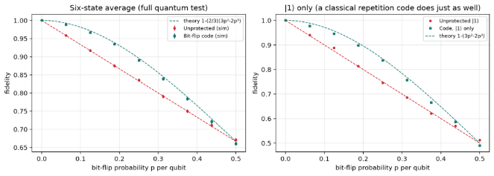
First, Checking Our Tool
Maths vs. our simulation
Does It Match the Maths?
With perfect gates, our simulation gives exactly the answer the textbook formula predicts. So we can trust it.
Wrong Tool, Worse Result
A code made for bit-flip errors does worse than doing nothing when the noise is phase errors.
Our simulation matches the textbook maths.
Notes:
First we checked our tool against textbook maths. With perfect gates, our results match the formula exactly, so we can trust our simulator. We also learned that using the wrong kind of protection can be worse than using none.

Slide 6
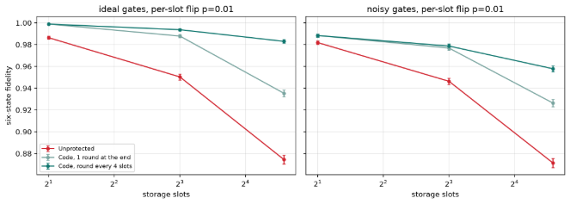
Longer Waiting = More Errors
The longer a qubit waits, the more it is damaged. Checking regularly keeps it safer.
Notes:
The longer a qubit waits, the more it is damaged. Checking it regularly helps most. Left side: perfect gates. Right side: gates that also make mistakes, where the benefit gets smaller.

Slide 7
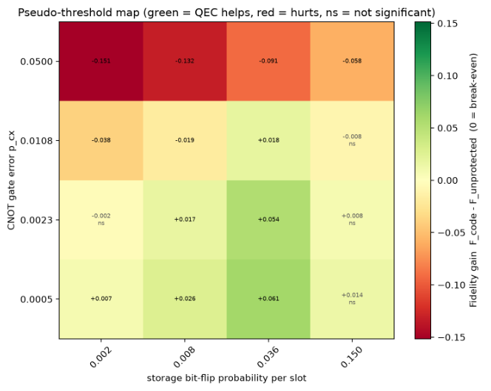
Map: When Does Protection Help?
Up-Down Axis
How faulty the CNOT gate is.
Left-Right Axis
Chance of a mistake while the qubit sits idle.
Green = Helps
Protection fixes more mistakes than it causes.
Red = Hurts
The extra CNOT gates add more mistakes than the code fixes.
Notes:
This colour map is our main finding. Green means error correction helps. Red means the extra gates it needs add more mistakes than they fix. This shows why we need a smart choice on today's noisy machines.

Slide 8
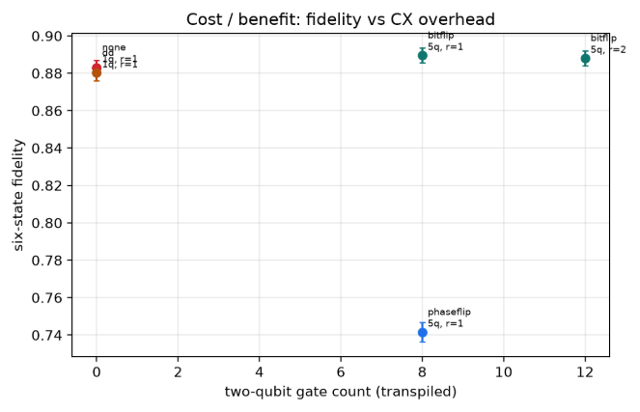
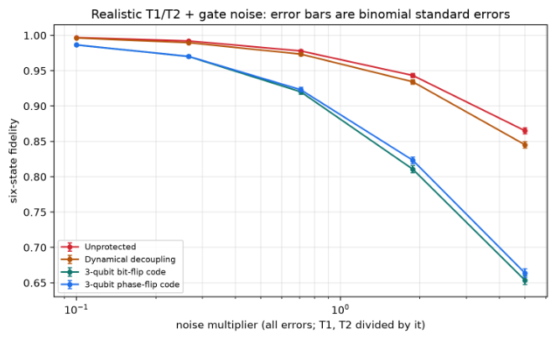
What Protection Costs
Cost vs. benefit
Extra Cost
3x
qubits needed
~2.7x
circuit length
Extra gates needed vs. accuracy gained: about 7% better for 3.3x the gates.
Tested with different gate mistake levels and with qubits fading over time (T1/T2).
~3.3x
number of gates
Fading (T1/T2): With realistic fading over time, the benefit of protection disappears.
Notes:
Error correction is not free. It needs about 3 times the qubits and about 3.3 times the gates, and gave only about 7 percent better accuracy. With realistic fading over time, even that small gain shrinks. This leads to our solution.

Slide 9
What Is New in Our Work
01
02
03
04
Help-or-Hurt Map
Smart Choice
Maths + AI
Real Data
A colour map showing exactly when error correction helps and when its extra work makes things worse.
A program that picks the best protection for each case, instead of always using one fixed method.
We give the AI known physics formulas as hints. We score it by "regret": how much worse its pick is than the best pick.
Kaggle data sets the noise in our tests. Results use six different starting states, with error bars.
Notes:
Here is what is new. One: a map showing when error correction helps and when it hurts. Two: a smart program that picks the best protection for each case. Three: AI that is given physics formulas as hints and scored by regret. Four: real Kaggle data used to set the noise, with six starting states and error bars.

Slide 10




The Smart Program That Picks the Fix
How It Learns
Maths as Hints
It learned from thousands of simulated noise situations (using a common ML method called Gradient Boosting).
We give it known physics formulas as hints, so it learns faster and picks better.
Score: "Regret"
Backup Plan
We measure how much accuracy we lose compared to a perfect decision-maker.
If a computer does not allow scikit-learn, our program still works using plain NumPy.
Notes:
Noise changes from machine to machine, so we built a smart program that picks the best protection each time. We gave it known physics formulas as hints, not just raw data. We score it by regret, meaning how much worse it is than a perfect choice, and we tested it on noise levels it had never seen.

Slide 11
The Result
What We Did
We combined textbook maths with realistic quantum simulations.
What We Found
On today's quantum computers, protection is limited by the many extra CNOT gates and by qubits fading over time.
What Is New
A reliable smart program that picks the best protection when noise changes.
Notes:
In short: we found out when quantum error correction pays off. We used real data, a realistic simulation, and a smart program. So we do not just simulate quantum circuits, we decide how to protect them.

