Slide 1
Student Expenses Analytics
Where the money goes: 300 transactions, January–December 2025
Notes:
Opening: this deck summarises the Student_Expenses dataset (300 transactions, 2025) and the Power BI style dashboard built from it.

Slide 2
₹4.46 lakh spent across 300 transactions
₹445,815
300
₹1,486
62.4%
Food
Total spend
Transactions
Average transaction
Share spent on needs
Top category (27.6%)
Spending averages about ₹37,000 a month. Individual transactions range from ₹51 to ₹2,991, so a few large payments move the totals more than the many small ones.
Notes:
Total ₹445,815; mean ₹1,486; monthly average ₹37,151. Needs ₹278,062 = 62.4%.

Slide 3
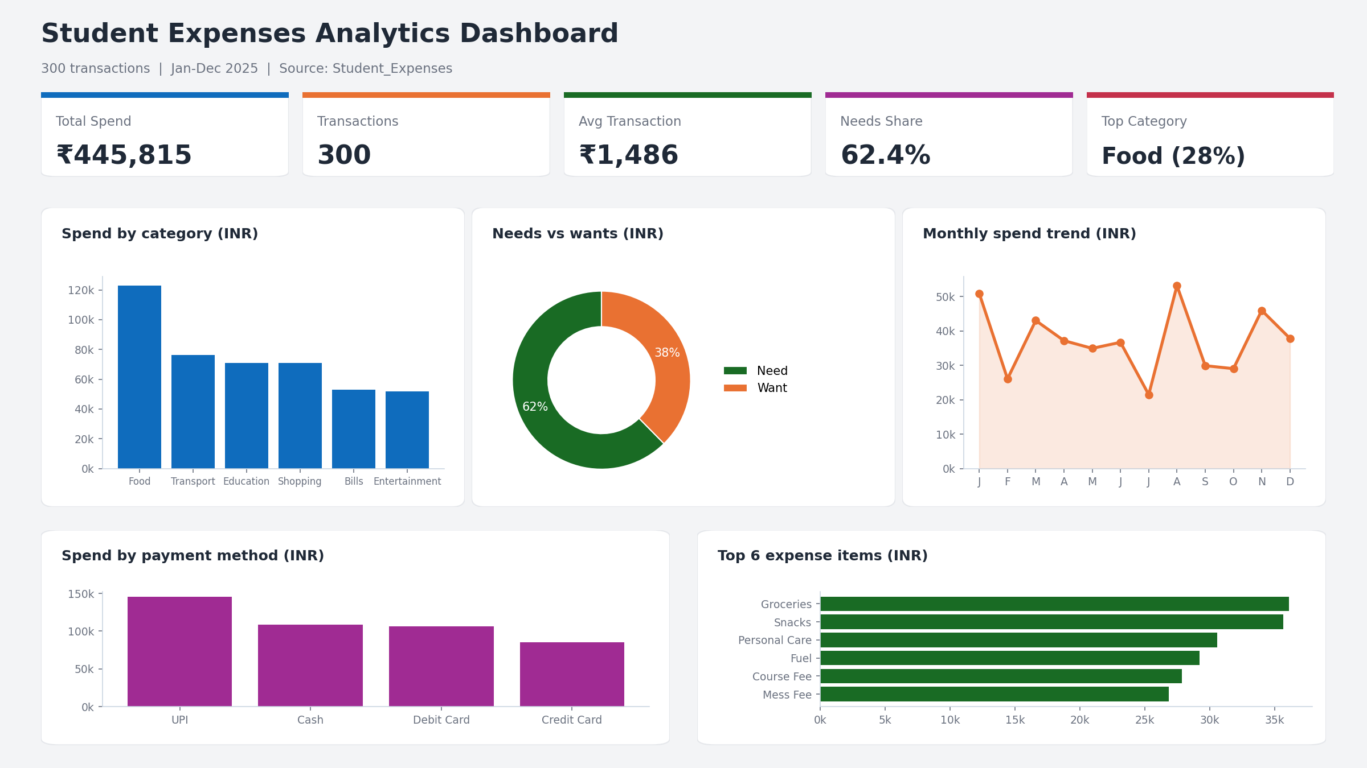
The dashboard at a glance
Notes:
Five KPIs and five charts: category, needs vs wants, monthly trend, payment method, top 6 items.

Slide 4
Food leads; three categories drive 61%
27.6%
of all spend goes to Food (₹122,911)
60.6%
comes from the top three: Food, Transport and Education
Notes:
Food 122,911; Transport 76,301; Education 71,092 = 270,304 = 60.6% of 445,815.

Slide 5
Needs make up 62% of spending
₹278,062
needs (62.4%), against ₹167,753 on wants (37.6%)
72%
48%
of Food spend is a need
of Education spend is a want
Wants are highest in Education, Shopping and Entertainment, where roughly half the spend is discretionary.
Notes:
Food need share 88,827/122,911=72.3%; Education want share 34,446/71,092=48.5%; Bills need share 79.6%.

Slide 6
Spending peaks in August, dips in July
₹53,133
August, the highest month
₹21,459
July, the lowest, about 2.5× lower
Notes:
Peak Aug 53,133; Jan 50,862; low Jul 21,459. Ratio 2.48x.

Slide 7
UPI is the most-used payment method
UPI carries 32.6% of spend, while credit cards account for only 19.0%. Spending is spread fairly evenly across places, with the hostel (27.4%) and outside (26.8%) slightly ahead.
Notes:
UPI 145,422 =32.6%; Cash 24.4%; Debit 23.9%; Credit 19.0%. Hostel 27.4%, Outside 26.8%, Home 23.8%, College 21.9%.

Slide 8
What this means for students
1
Watch Food first
It is the largest line at 27.6% of spend; groceries and snacks alone top ₹35,000 each.
2
Trim the wants
₹167,753 (37.6%) is discretionary, with the most room in Shopping and Entertainment.
3
Plan for peak months
August and January run more than twice the lowest month, so set aside a buffer for them.
Notes:
Recommendations follow from the category, need/want and monthly findings.

