Slide 1

SRI CHANDRASEKHARENDRA SARASWATHI VISWA MAHAVIDHYALAYA (Deemed to be university u/s 3 of UGC act 1956) (Accredited with “A” by NAAC) Enathur, Kanchipuram – 631561. Tamilnadu www.kanchiuniv.ac.in
STOCK VALUE - PRICE PREDICTION
11179A005
RADHIKA ADDANKI

Slide 2
Contents
Abstract of the project
Index terms
Problem statement
Literature survey
Existing system
Proposed system
Implementation
Sample dataset
Conclusion
Future work
References
Publication proof
‹#›
*

Slide 3
Abstract
Using historical stock data, we developed two models to make short-term predictions for a stock price. The models were refined by including the influence of NASDAQ index. Advanced mathematical techniques were used to formulate these models. Investors can use these models to obtain suggestions and pointers. We use Random Forest and SVM algorithms for the prediction of the stock market.
Index terms : Support Vector Machine , Random Forest, Machine Learning , Stock Analysis ,Price Prediction
‹#›
*

Slide 4
Problem statement
Predicting the stock value using sentimental analysis or any other tool is a time consuming process. It is also an inefficient method for analysis. Hence Machine learning algorithms are used to increase the accuracy and efficiency of the predicted value . Since there are no online tools available for the value-prediction of a stock , this project will be a very useful tool and the most demanding topic in future ML.

Slide 5
Literature Survey
TITLE : Stock closing price prediction using Machine learning SVM model | AUTHORS : U.G. Student , Department of Information Technology , B.K. Birla college of Arts, Science and Commerce (Autonomous), Kalyan 421 306 , Maharashtra , India. | In this paper , we proposed how accurately a SVM model can check the stock closing price of Tesla Inc. Which is a Tech company and Reliance Industries Limited which is a public company. A SVM kernel models were trained and tested by using past 1 year (i.e. from Nov 2019 to Nov 2020) stock data of both the companies .
TITLE : Predicting Stock Market Trends Using Machine Learning and Deep Learning Algorithms Via Continuous and Binary Data; a Comparative Analysis | AUTHORS : Mojtaba Nabipour,Pooyan Nayyeri,Hamed Jabani,Shahab S.,Amir Mosavi | Firstly, calculating the indicators by stock trading values as continuous data, and secondly converting indicators to binary data before using. Each prediction model is evaluated by three metrics based on the input ways. The evaluation results indicate that for the continuous data, RNN and LSTM outperform other prediction models with a considerable difference.

Slide 6
TITLE : Stock market prediction using machine learning methods. | AUTHORS : Subhadra Kompella Department of Computer Science and Engineering, GITAM (Deemed to be University), Visakhapatnam, India. Kalyana Chakravarthy Chilukuri Department of Computer Science and Engineering, MVGR College of Engineering (A), Vizianagaram, India | With the help of sentiment analysis, we found the polarity score of the new article and that helped in forecasting accurate results. Although the share market can never be predicted with hundred per-cent accuracy due to its vague domain, this paper aims at proving the efficiency of Random forest for forecasting the stock prices..
TITLE : Integrated Long-Term Stock Selection Models Based on Feature Selection and Machine Learning Algorithms for China Stock Market | AUTHORS : Xianghui Yuan ( Northwest Polytechnic University, ) , Tianzhao Jiang ( Northwest University, Qurat Ul Ain ( University of central Punjab) | In this paper, the features are selected by various feature selection algorithms, and the parameters of the machine learning-based stock price trend prediction models are set through time-sliding window cross-validation based on 8-year data of Chinese A-share market.
TITLE : Machine learning Algorithms - A Review | AUTHORS : Ayon Dey Department of CSE, Gautam Buddha University, Greater Noida, Uttar Pradesh, India | – In this paper, various machine learning algorithms have been discussed. These algorithms are used for various purposes like data mining, image processing, predictive analytics, etc. to name a few. The main advantage of using machine learning is that, once an algorithm learns what to do with data, it can do its work automatically.

Slide 7
Existing System
The techniques which were used in the existing system for the stock market prediction are on the basis of sentiments of Twitter feeds which are experimented on S&P 100 index . A continuous Dirichlet process mixture model was used to learn the daily topic set . Stock index and twitter sentiment time-series were then regressed to make a prediction.
‹#›
*

Slide 8
Proposed System
For making it more dynamic , we use a dataset for project implementation . The dataset is then trained to the machine . Then the Algorithms Random forest and SVM are applied for Stock prediction and ML technology is used to implement the same .
‹#›

Slide 9
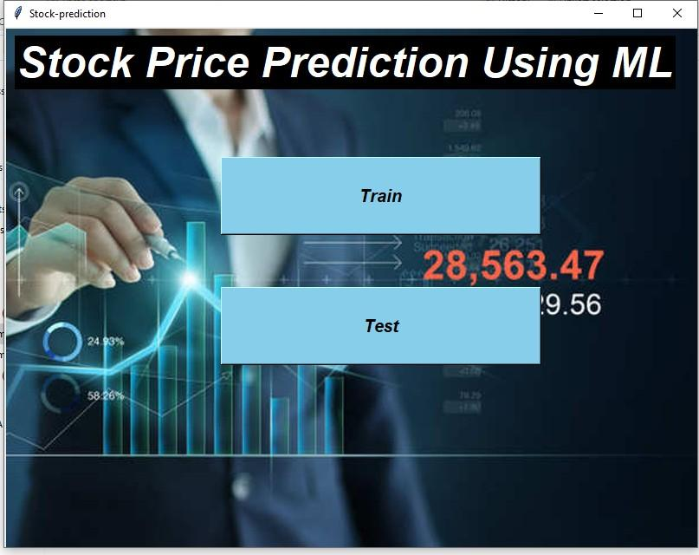
Implementation
‹#›
*

Slide 10
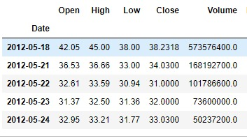
Sample Data set

Slide 11
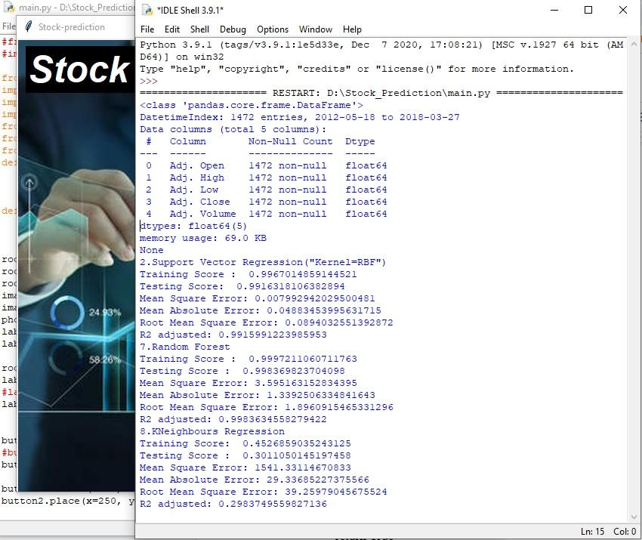

Slide 12
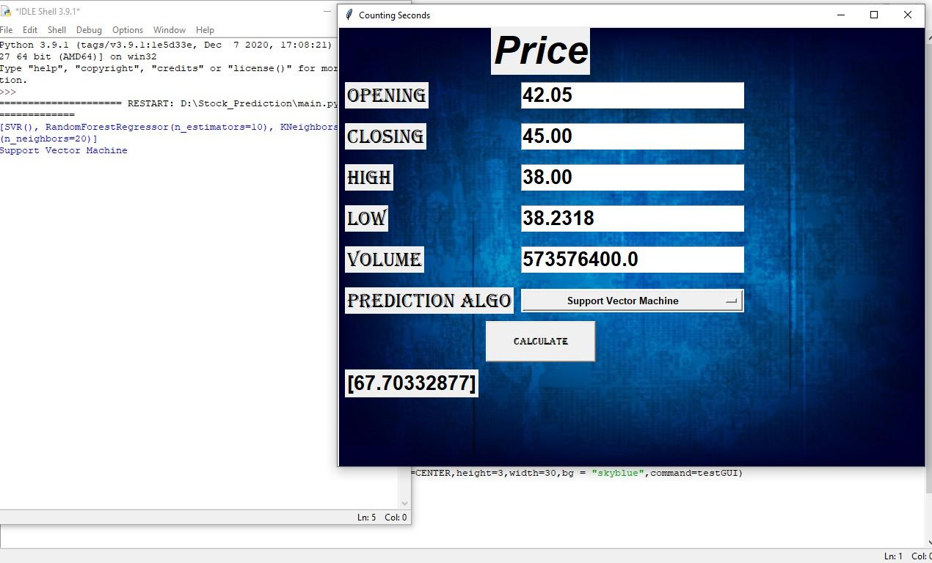

Slide 13
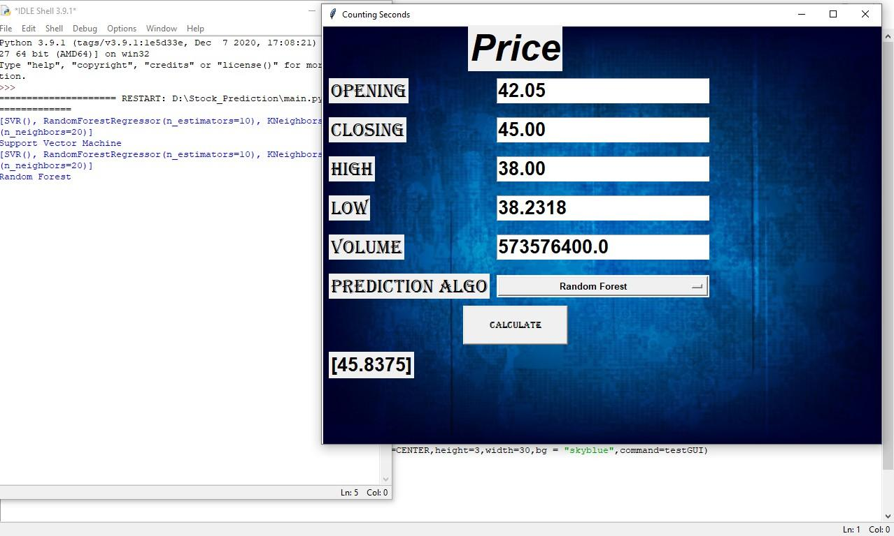

Slide 14


Slide 15
Conclusion
To wrap it all up , In this project we have used Random Forest , Support Vector machine and K-NN algorithms for the stock market prediction. The dataset is preprocessed successfully and gives the future predicted value of the stock with a slight variation of value between the algorithms . We made the project with an aim to make it easier for the stock investors to clear their hesitations and learn stock fluctuations practically . Our aim is to put an end to the myths fabricated on the stock market , untie the intricate knots of confusions and make it stocker friendly . Three different algorithms are designed in such a way that helps the stocker in making accurate decisions and make it sure that they don't end up in loss.
‹#›
*

Slide 16
Future Work
Stock prediction will help a stocker to predict the fluctuations in stock at any stage of their investment and suggest them if they need to terminate or continue with their investment . This project is completely focused on one agenda i.e; to prevent the stocker from getting loss and save them from going bankrupt . There are no online tools available for analysing a stock , hence with this application , an investor can ensure that the stock he is investing is worthy and growing.

Slide 17
References
[1] Liao, Jing chi and Peng, Cameron and Zhu, Ning, Price and Volume Dynamics in Bubbles (January 10, 2020). Available at SSRN: https://ssrn.com/abstract=3188960 or http://dx.doi.org/10.2139/ssrn.3188960
[2] Stock Price Prediction Using CNN and LSTM-Based Deep Learning Models https://paperswithcode.com/paper/stock-price-prediction-using-cnn-and-lstm
[3] Z.Wang, S. Ho and Z. Lin, "Stock Market Prediction Analysis by Incorporating Social and News Opinion and Sentiment," 2018 IEEE International Conference on DataMining Workshops (ICDMW) https://ieeexplore.ieee.org/document/8637365
‹#›
*

