Slide 1

Veriqo
Know what to check before you buy.
Team name: Obscura
Team leader: Radhika Audichya
Team member: Somya Kedia
Problem Statement
Used-car buyers can't quickly tell what a car's photos actually show, what its registration record says, or what still needs checking — so they overpay or buy hidden problems. Veriqo gives a fast, evidence-based pre-purchase report that is honest about what it could not verify.

Slide 2
Brief about the idea
Veriqo turns a used-car buyer's photos, the registration number and the seller's listing into one evidence-tagged report — measured median 9.8 seconds from upload to report on the live deployment.
• Gemini 2.5 Flash reads every photo: visible damage, rust, tyre wear and interior damage — each finding linked to the photo it came from.
• A registration lookup adds record facts (insurance, loan, challans, blacklist). In this prototype it is SIMULATED with synthetic test plates; any other plate is shown as “not verified”.
• Deterministic rules build a transparent score, flag a listing that doesn't match the record, and flag missing photo angles.
• Every finding is labelled Observed · Record · Inferred · Not checked — and every report ends with a prioritised “what to check before paying” list.
Veriqo is a red-flag triage. It never certifies a car as safe — accident history and hidden mechanical condition are always listed as Not checked, so a clean-looking car never gets an “all clear”.

Slide 3
Opportunities
• How different is it? Marketplaces inspect only the cars they sell; independent inspections are paid, physical and take a day. Veriqo is an instant, self-serve first check for any car — including a private listing.
• How does it solve the problem? Before any money or travel, the buyer sees what the photos show, what the record says, what doesn't match, and exactly what to inspect.
• USP — evidence you can trace. Every finding says where it came from and what it's based on; the score is the sum of published rules; anything simulated or unverified is labelled as such.
The four provenance labels used in every report:
Observed
Record
Inferred
Not checked

Slide 4
List of features offered by the solution
• Photo analysis with evidence. Each finding shows the photo it came from, with Gemini's confidence.
• Registration check. Insurance, loan, challans, blacklist — simulated in this prototype and labelled so.
• Listing vs record check. Flags when the seller's make/model differs from the record.
• Missing-angle detection. Says which views (rear, sides, tyres, interior) were never shown.
• Transparent score. Sum of published rules; photos alone can't max it out (capped at 60).
• Prioritised checklist. “What to check before paying”, highest-impact first.
• Saved, shareable report. Stored in Firestore; the link reopens it after a refresh.
• Safe failure handling. Rejects non-images and >12 MB files; clear messages if the model or network fails.
Honesty built in: simulated registration data is labelled “SIMULATED — NOT GOVERNMENT VERIFIED”; an unknown plate is shown as “not verified” — never filled with invented data.

Slide 5
Process flow diagram
1. Buyer input
Photos + registration no. + listing make/model
2. Validate & store
Real-image check · private Cloud Storage
3. Gemini vision
Structured findings per photo (Observed)
4. Registration lookup
Record facts — simulated in this prototype
5. Rules engine
Cross-checks · coverage · score (deterministic)
6. Report
4 labels + checklist → Firestore + audit trail
One buyer action in, one traceable report out. If Gemini fails, nothing is saved and the buyer sees a clear retry message.

Slide 6
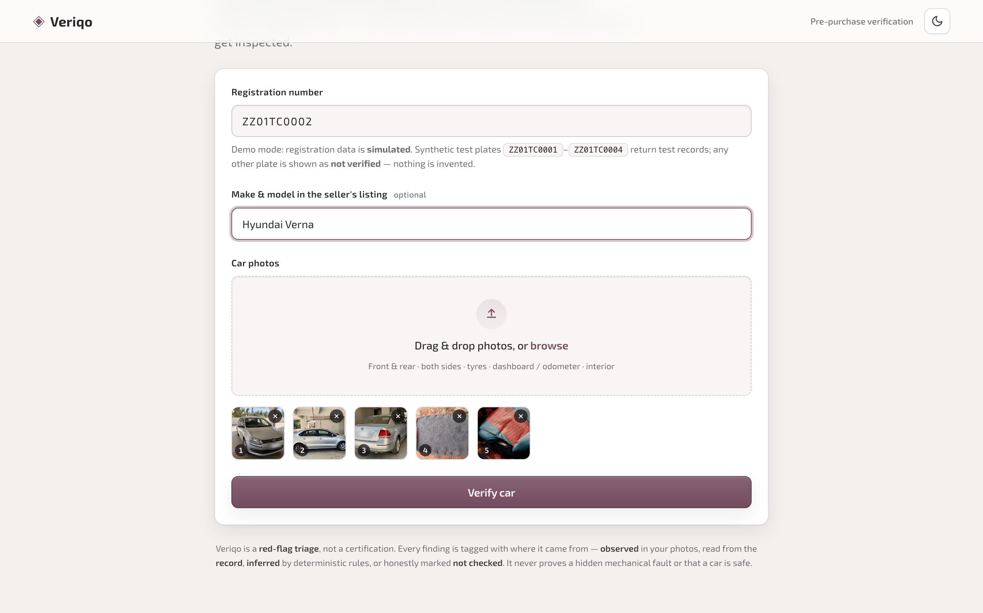
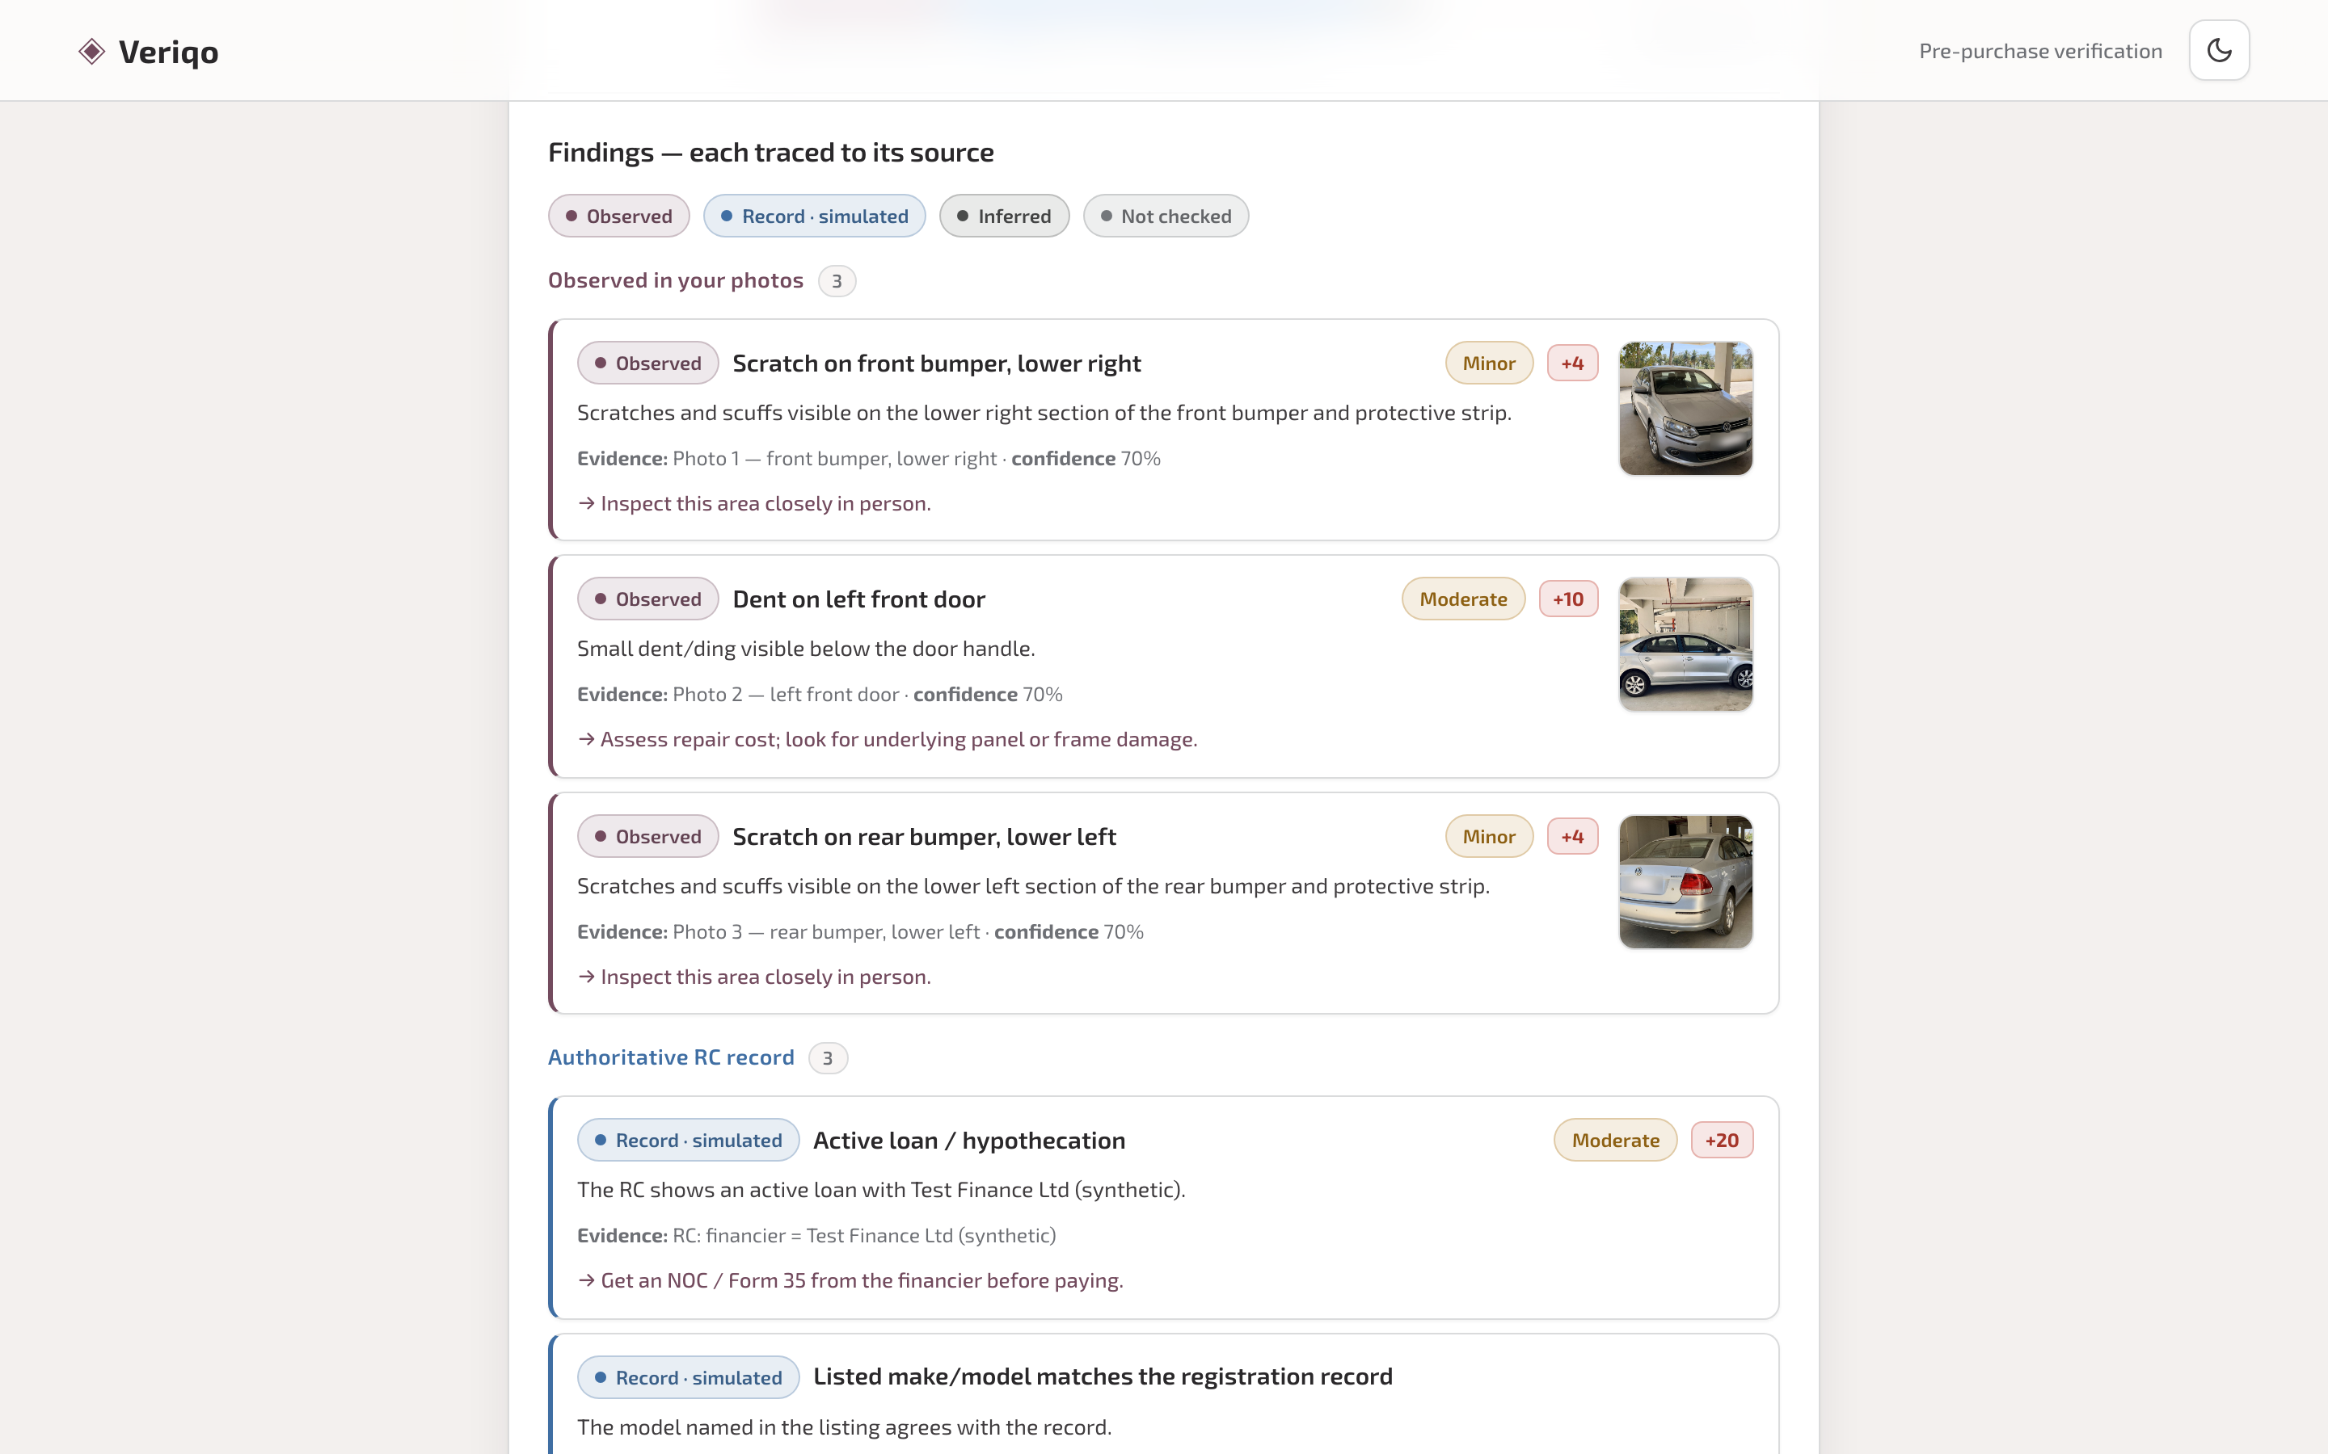
Wireframes / Mock diagrams of the proposed solution
Upload: plate, listing, numbered photos
Report: findings labelled by source, with photo evidence
Actual screens captured from the deployed app (veriqo-api-920194228751.us-central1.run.app) — not mockups.

Slide 7
Architecture diagram of the proposed solution
Buyer's browser
React web app
Cloud Run · veriqo-api (us-central1)
Serves the web app + FastAPI · image validation · deterministic rules
Gemini 2.5 Flash
Vertex AI · structured findings
Registration lookup
SIMULATED — synthetic test fixtures
Cloud Firestore
Reports + append-only audit trail
Cloud Storage
Private bucket · 30-day expiry
Gemini perceives; Cloud Run decides with fixed rules; Firestore keeps the auditable record. Not used in this prototype: Firebase Hosting and Firebase Authentication (Cloud Run serves the app; there is no sign-in).

Slide 8
Technologies to be used in the solution
• Gemini 2.5 Flash on Vertex AI — multimodal photo analysis with a typed JSON response schema (temperature 0).
• Cloud Run — one service serving the React app and the FastAPI backend; 1 warm instance.
• Cloud Firestore (Firebase) — saved reports and an append-only audit trail.
• Cloud Storage — uploaded photos in a private bucket, deleted automatically after 30 days.
• Cloud Build + Artifact Registry — builds and stores the container on every deploy.
• React + Vite + TypeScript · FastAPI + Pydantic (Python) — app and API.
• pytest + Playwright — API tests and browser tests run against the live deployment.
• Registration data — synthetic fixtures today; built to plug in a licensed provider (Surepass / Signzy class).

Slide 9
Estimated implementation cost (optional)
Indicative, prototype scale. These are estimates, not measured bills.
Component | Driver | Indicative cost
Gemini 2.5 Flash | ≈5 photos per report | Fractions of ₹ per report
Cloud Run | 1 always-warm instance (avoids cold starts) | Small fixed monthly cost
Firestore + Cloud Storage | Prototype volumes; photos auto-deleted at 30 days | Within free tier
Registration provider (when live) | Per-lookup fee | Likely the largest per-report cost

Slide 10
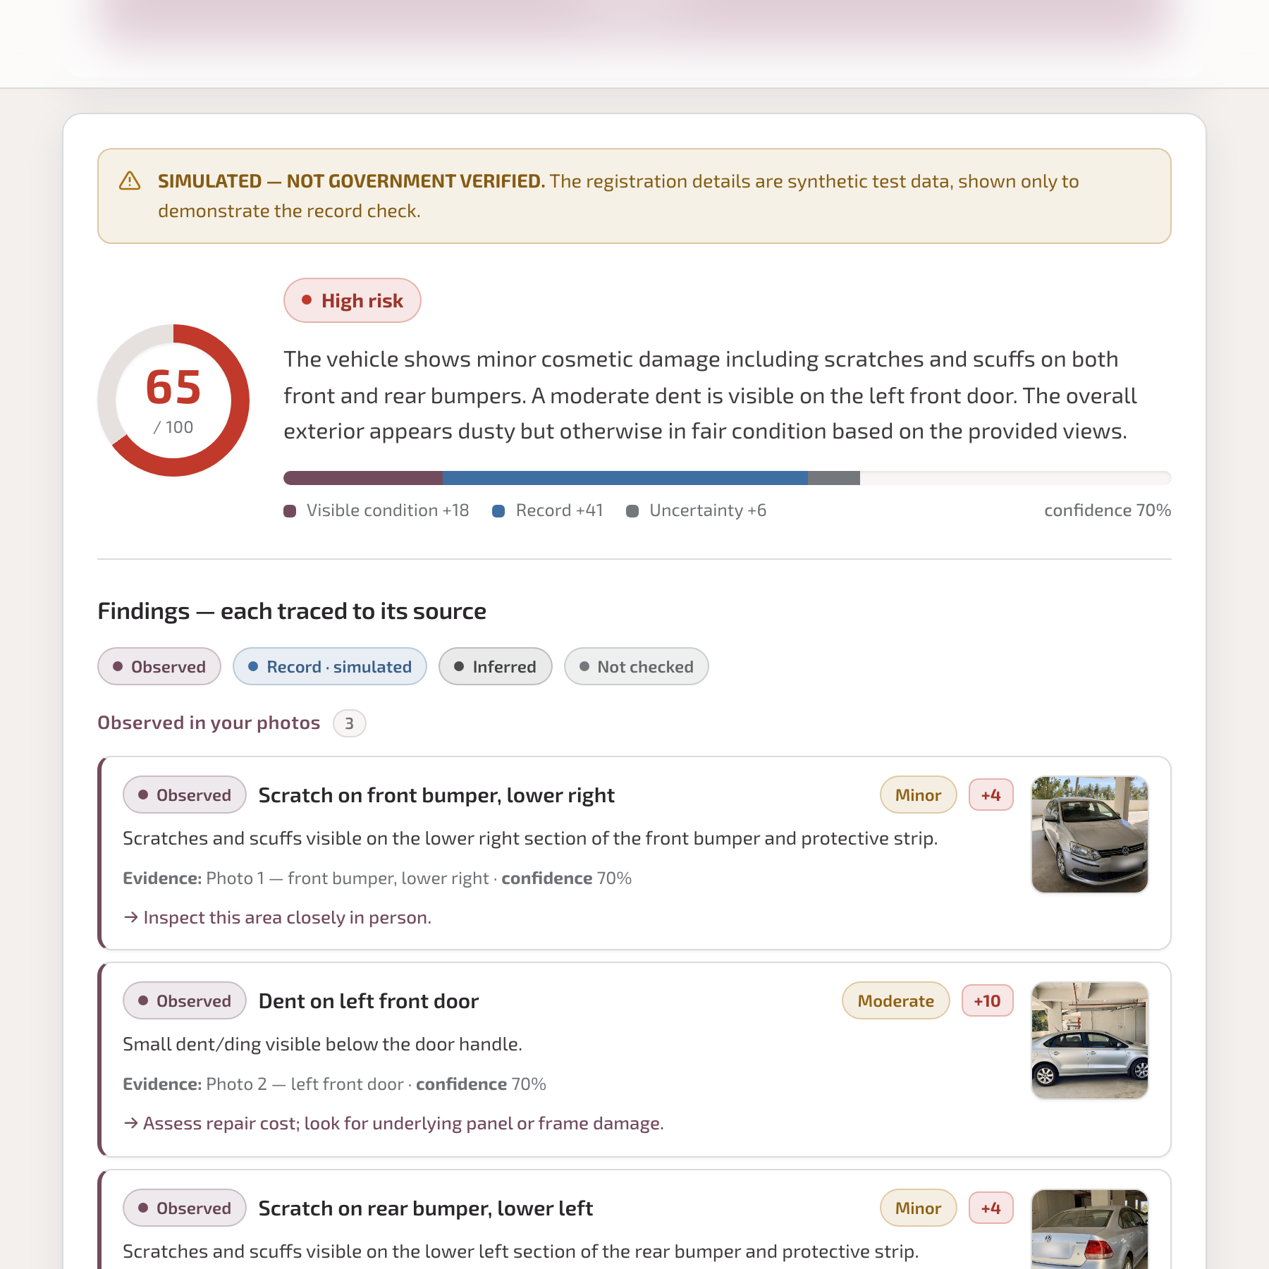
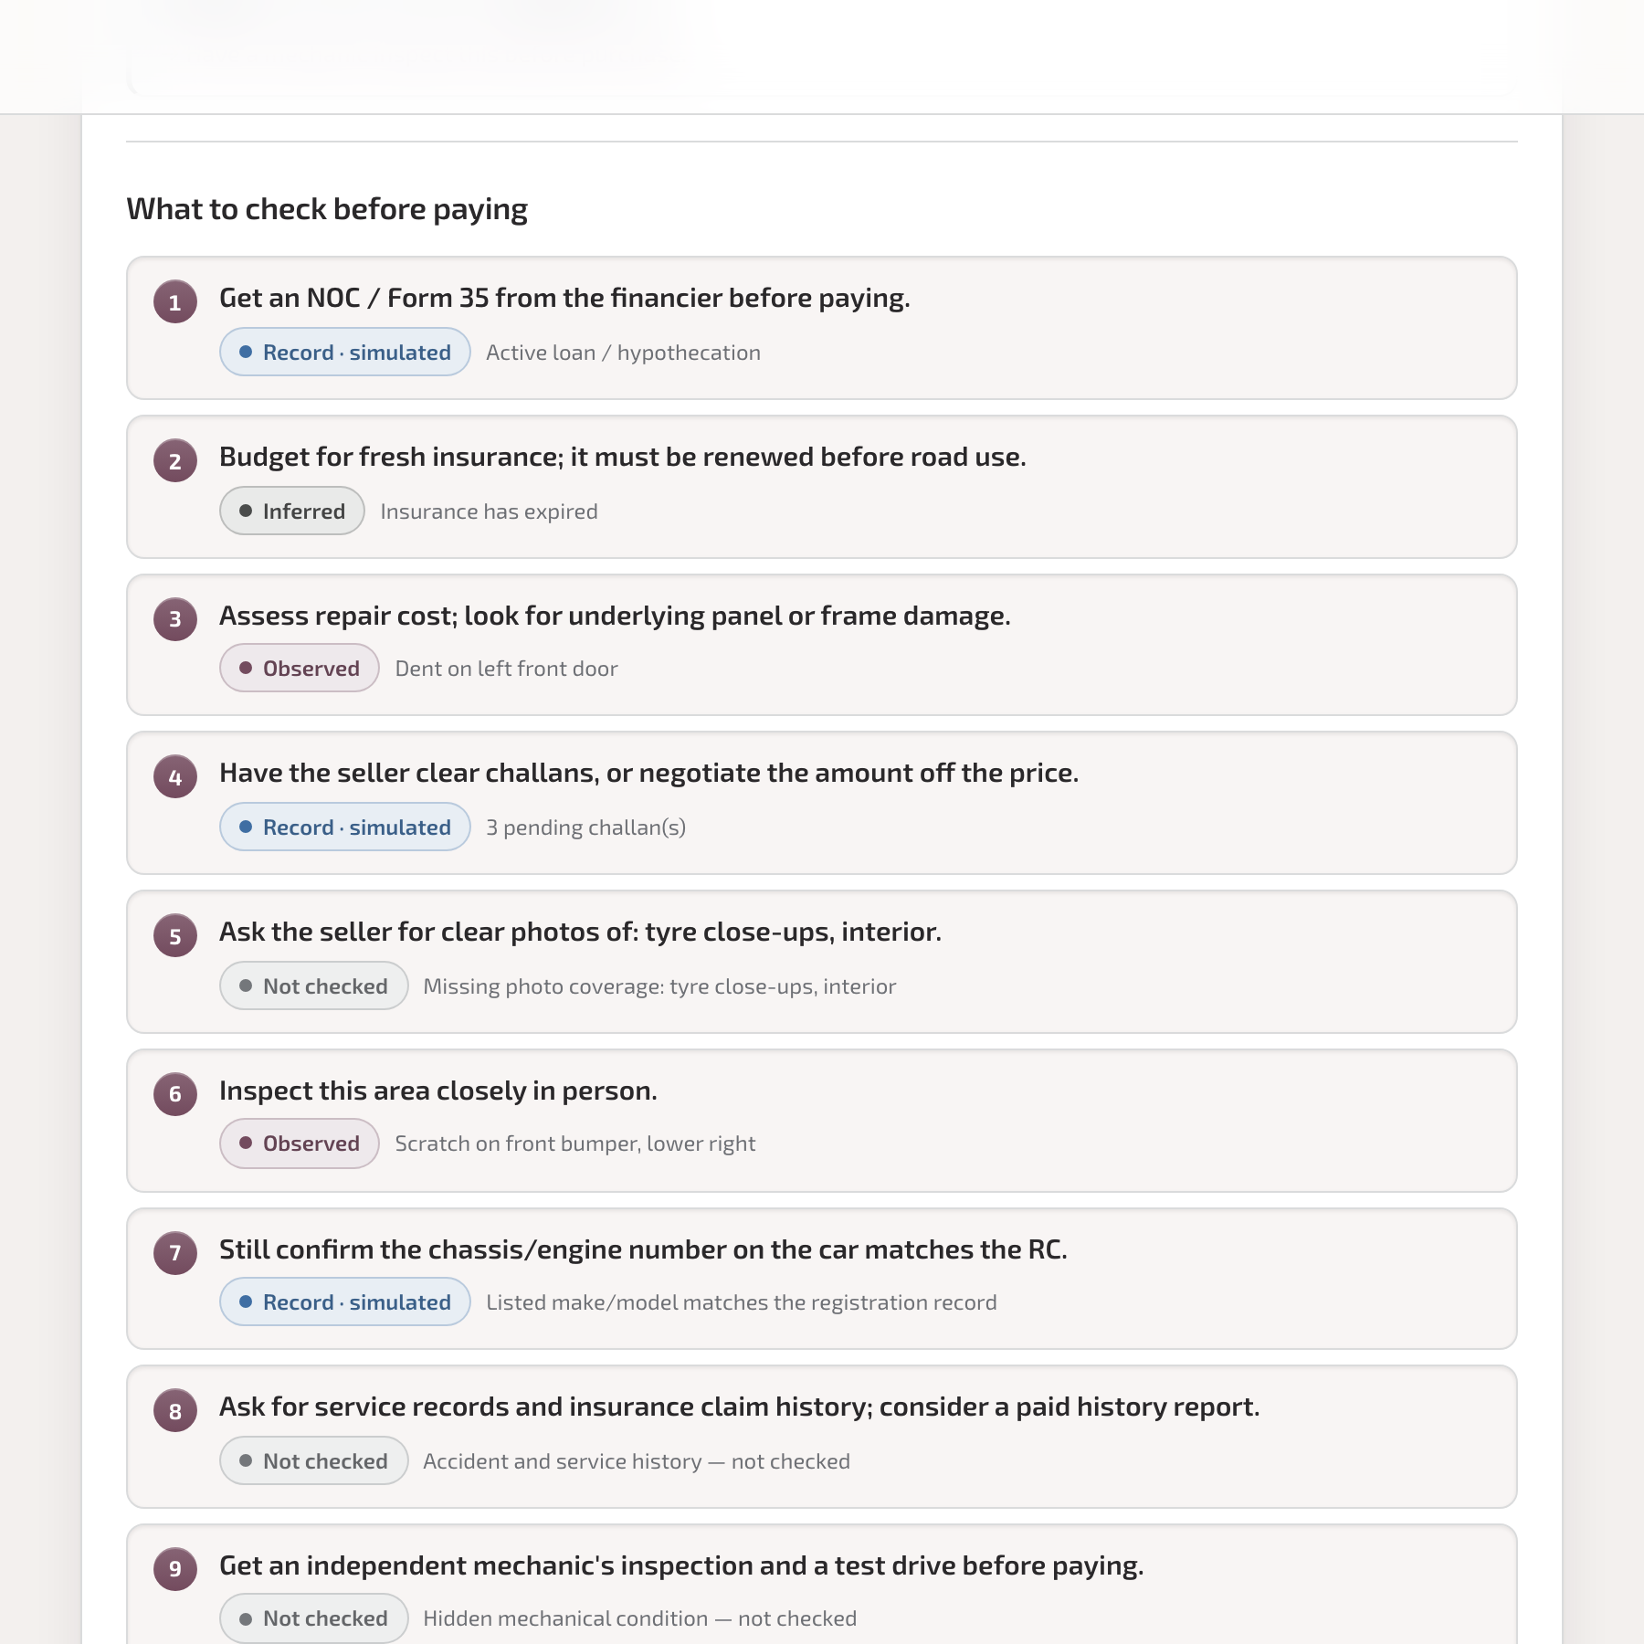
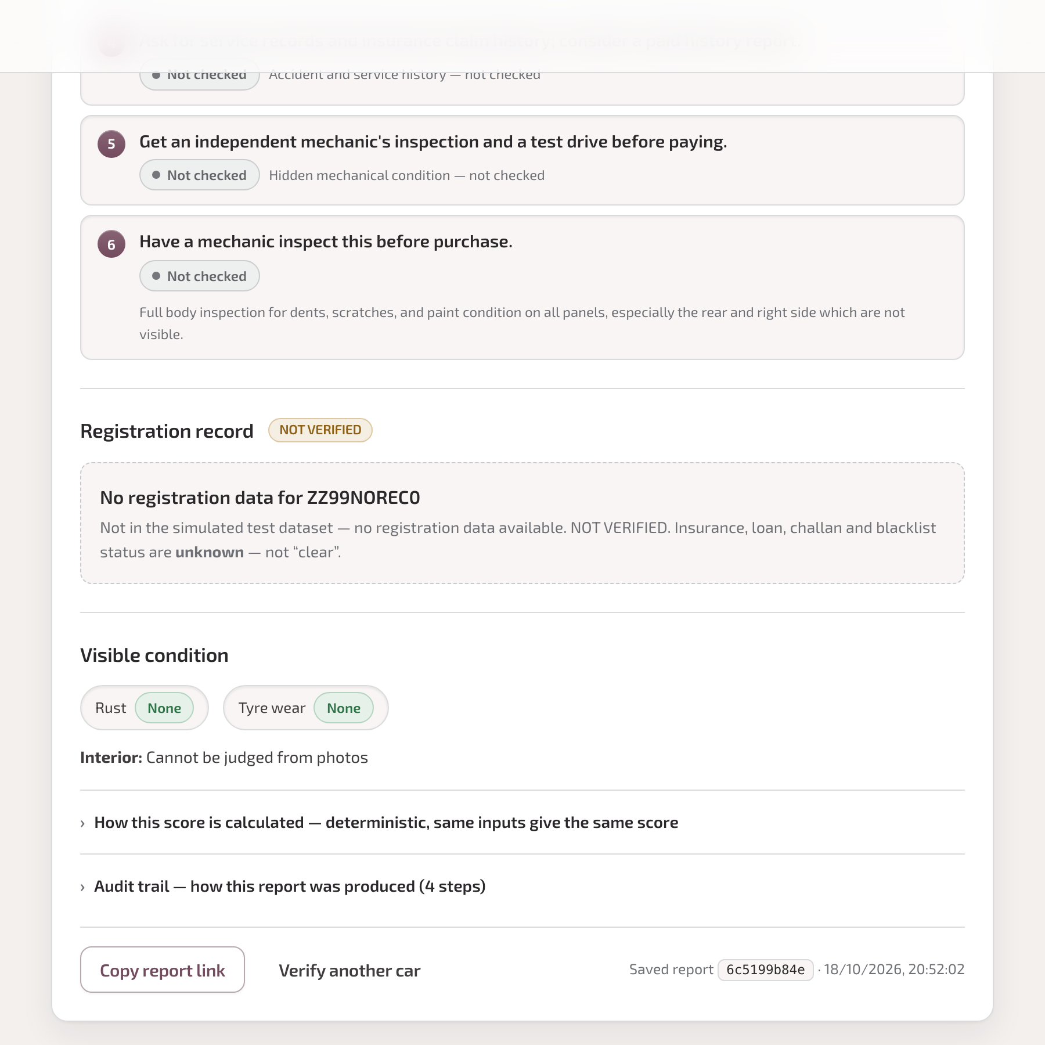
Snapshots of the prototype
Score, breakdown, simulated label
Prioritised buyer checklist
Unknown plate → not verified
Captured from the live deployment with real Gemini output. Test photos: openly licensed Wikimedia Commons images (credits in the repo). Registration data is synthetic and labelled as simulated.

Slide 11
Prototype Performance report/Benchmarking
What we measured | Result
API tests (pytest, 21 cases incl. invalid files, model failures, persistence) | 21 / 21 pass
Scoring-rule evaluation (11 labelled cases) | 67 / 67 checks pass
Browser tests on the live deployment (15 scenarios) | 15 / 15 pass (first run: 14 / 15)
Upload → report time, 13 live runs | median 9.8 s · range 6.8–17.2 s
Model review (checked by hand, before → after prompt and rule fixes)
• Fixed: one key scratch scored 100/100 → now 26 (one moderate item); sharp close-ups were marked low-confidence → now 0.7–1.0; a blurry photo claimed views → now claims none; repeat runs disagreed → now identical.
• Still open: headlight severity varies between photo sets; a dent photo still yields 6 items. No precision/recall is claimed — 11 photos are not a labelled benchmark.
Sources: docs/05-TEST-RESULTS.md · docs/05b-MODEL-REVIEW.md

Slide 12
Additional Details/Future Development
• Live registration data. Connect a licensed provider so records become “Record verified”, not simulated.
• A real accuracy benchmark. ~100 labelled photo sets checked by mechanics → per-defect precision/recall.
• Accounts. Firebase Authentication so buyers can keep and share their reports.
• History signals. Partner data for accident, service and odometer history.
• Local languages. Reports in Hindi and regional languages with Gemini.
• Same engine, new listings. Verify rental-flat listings with the same evidence-tagged approach.

Slide 13
Provide links to your
● GitHub Public Repository
https://github.com/radhikaaudi/Veriqo
● Demo Video Link (3 Minutes)
[ paste the video link after upload ]
● Final Product Link
https://veriqo-api-920194228751.us-central1.run.app
The live app is kept warm (1 always-on Cloud Run instance) for the evaluation period.

Slide 14


